Slide 1
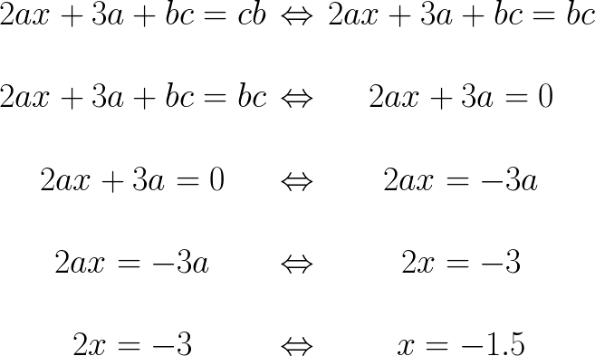
Let’s start with the magic of algebra
Seems legit, doesn’t it?
But what did I do wrong though?

Slide 2
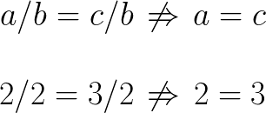
I didn’t specify what are a, b, c and x
If these are all integers, then obviously this wouldn’t work
Even worse for natural
And for quaternion multiplication is not even commutative

Slide 3
Three things to put together
Different types of numbers have different algebras
Not only numbers, but tensors, vectors, functions, transformations, symmetries, - basically every type of mathematical object you can think out an operation or few for may have its own algebra.
Some of these objects share algebraic properties. All or partially.
Why is this awesome?

Slide 4
This is Bob.
Bob spent years proving theorems for square matrices
This is Bob when he learned that square matrices don’t attract funding anymore.
This is Bob when he learned that square matrices and integers modulo X share the same algebra.
Bob spent a night doing
“Ctrl-c + Ctrl-v” and he is now world class specialist in uint32_t.

Slide 5
That’s why abstract algebra is awesome!
Knowing that the basic properties of algebraic systems are similar,
you may presume that the derived properties are held as well.
You can prove one theorem (or propose an algorithm) for one
algebraic system, and it will automagically work for another!
Sounds familiar?

Slide 6
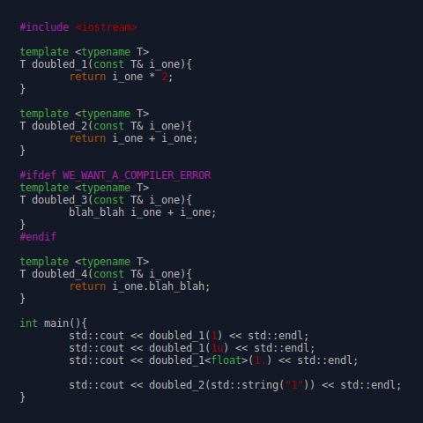
C++ templates
Compiler checks
for syntax errors – always;
for type consistency – on instantiation;
for algebraic properties – never.
It turns 1 to 11 for strings.
Let’s not do that.

Slide 7
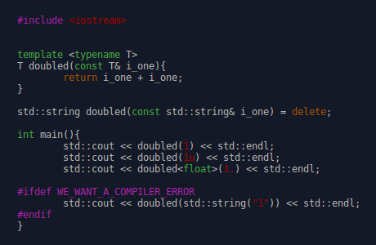
Specialize and delete
Technically we can specialize a function per every type but...
what is the point of templates then?

Slide 8
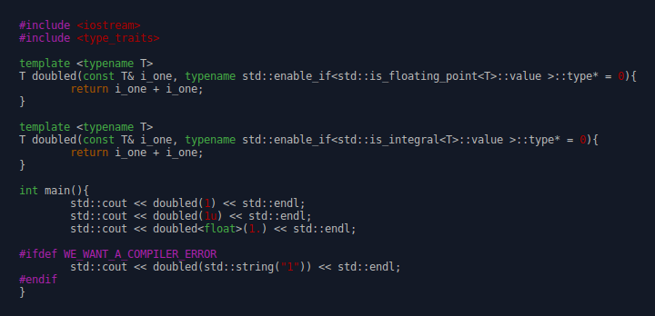
Type traits
Better, but still it’s either code duplication,
or very elaborate type traits system

Slide 9
Concepts

