Slide 1
Discrete cosine transform
Phạm Tuấn Anh – 20182903
Đinh Sỹ Dũng – 20182912
Giang Vũ Tuấn Hải - 20182912

Slide 2
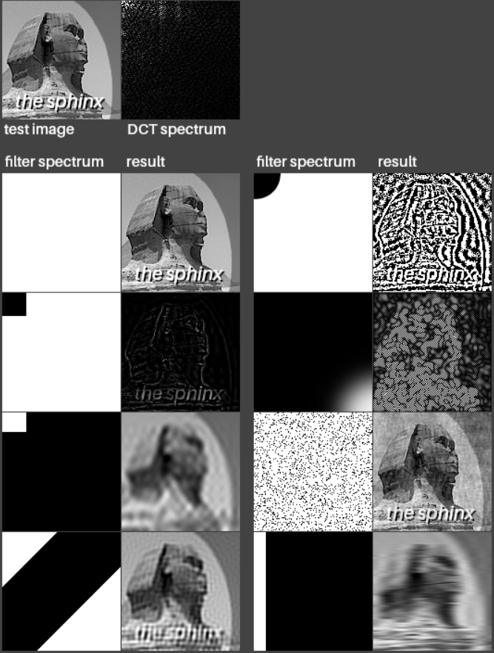
Introduction
Discrete cosine transform (DCT) is widely used in image processing, especially for compression.
Some of the application of DCT
DCT involve still image compression and compression of individual video frames
compression of video streams and volume spaces
compression of video streams and volume spaces

Slide 3
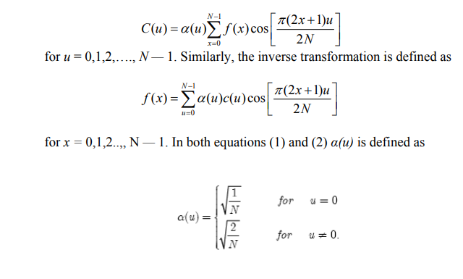
The One-Dimensional DCT
The most common DCT definition of a 1-D sequence of length N is

Slide 4
The Two-Dimensional DCT
The objective of this project is to study the efficacy of DCT on images. This necessitates the extension of ideas presented in the last section to a two-dimensional space.

Slide 5

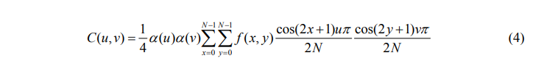

The Two-Dimensional DCT
The 2-D DCT is a direct extension of the 1-D case and is given by
for u,v = 0,1,2,….,N — 1 and α(u) and α(v) are defined in (3). The inverse transform is defined as

Slide 6

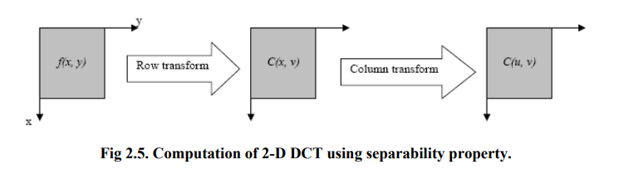
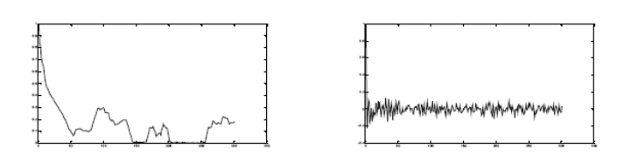

Properties of DCT
Decorrelation
Energy Compaction
Separability
Symmetry
Orthogonality
Saturn and its DCT

Slide 7
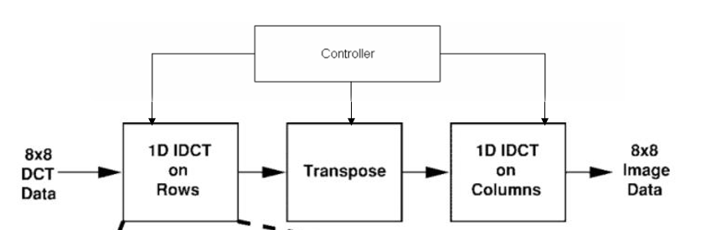
Algorithm
2-D DCT implementation

Slide 8
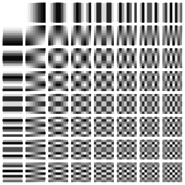
Specification
Input
Positive Integer number
Range [0 : 255]
Represent : 8 bits

Slide 9
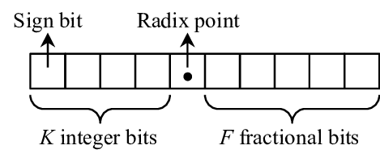
Specification
Output
Real number
Range [-2047 : 2047]
Represent : 32 bits fixed point
12 integer bits
20 fractional bits

Slide 10
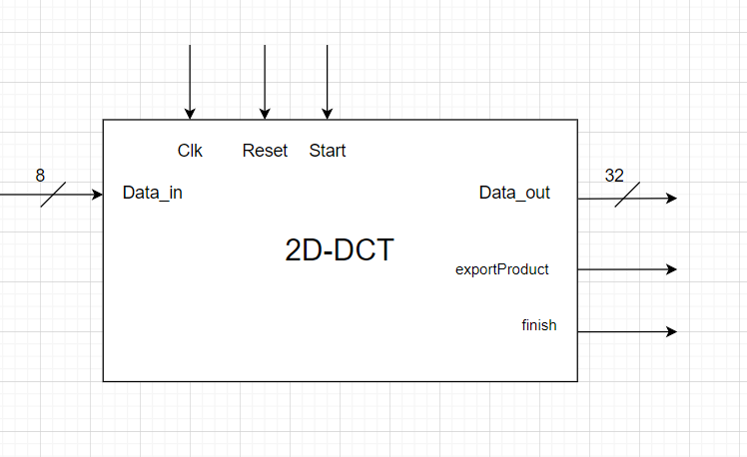
Architecture
Clk : clock signal
Reset: reset signal
Start: start signal
Data_in: 1 point of input data – 64 point input data will be put in one by one
Data_out: 1 point of ouput data – 64 point output data will be export one by one
exportProduct: signal to start outputting data
finish: finish signal
2-D DCT module architecture

Slide 11
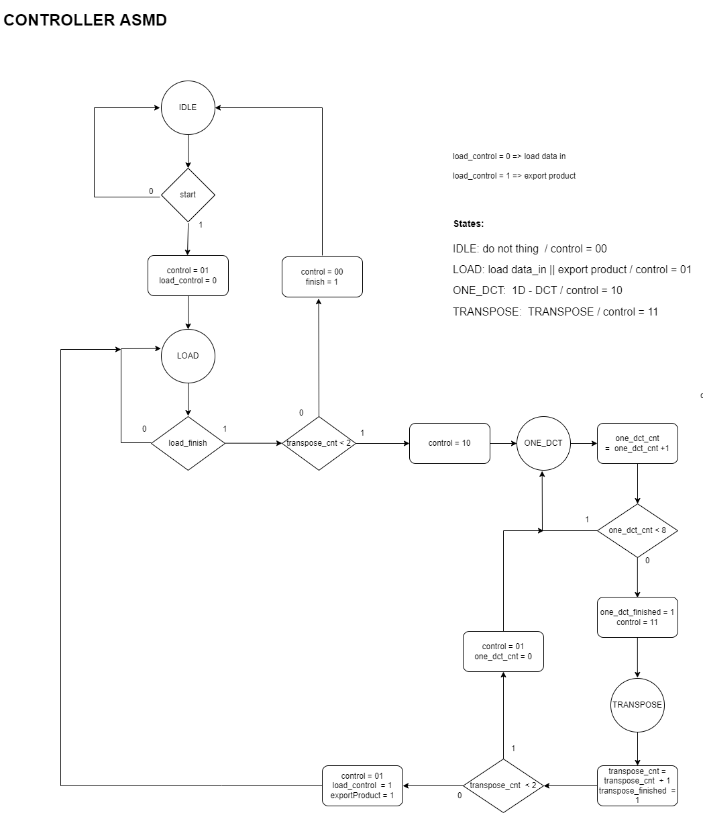
ASMD

Slide 12
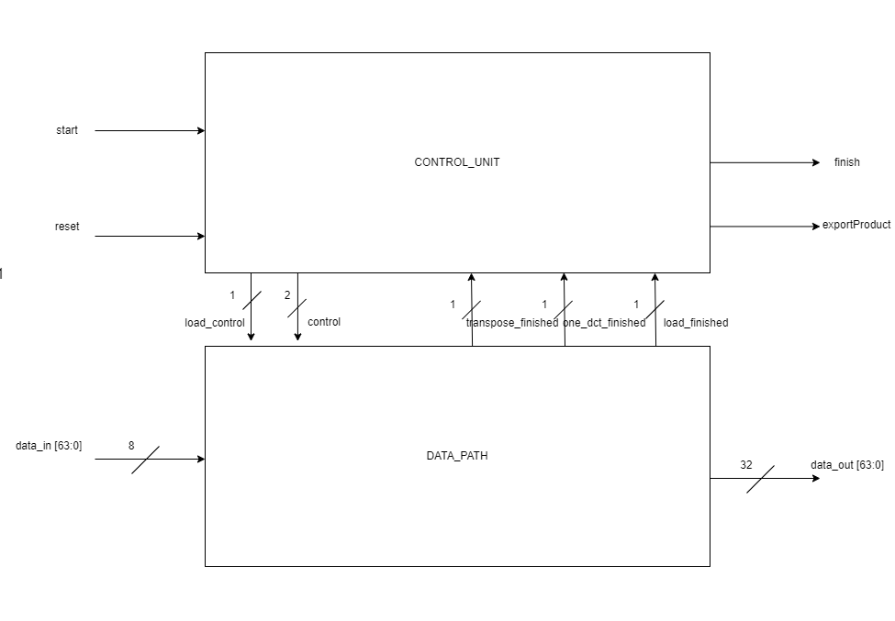
ASMD

Slide 13
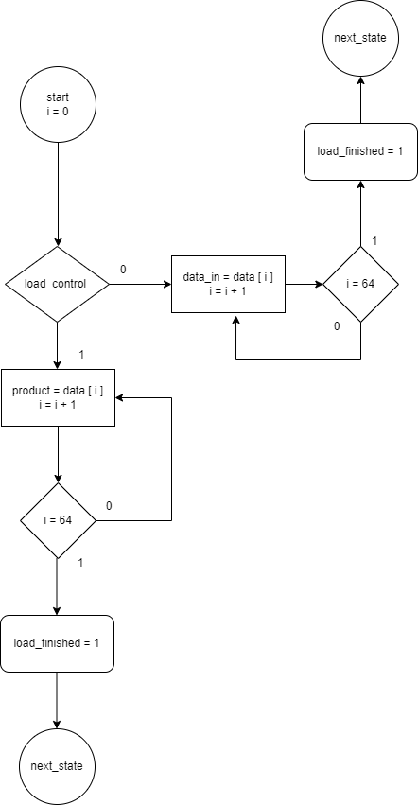
ASMD
LOAD STATE

Slide 14
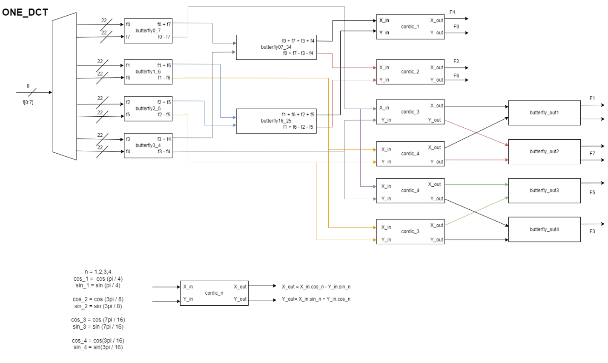
ASMD
LOAD STATE
ONE_DCT STATE

Slide 15
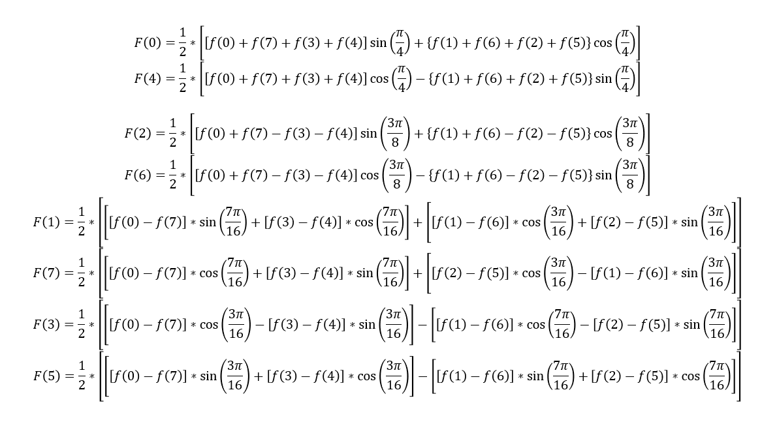
ASMD
LOAD STATE
ONE_DCT STATE

Slide 16
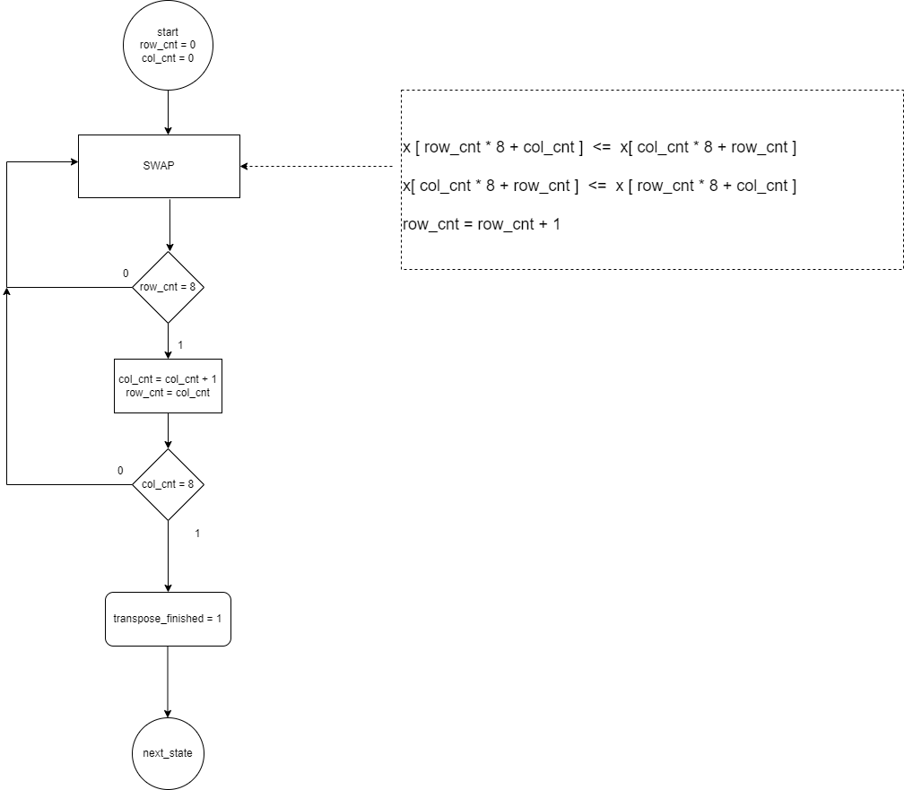
ASMD
LOAD STATE
ONE_DCT STATE
TRANSPOSE STATE

Slide 17
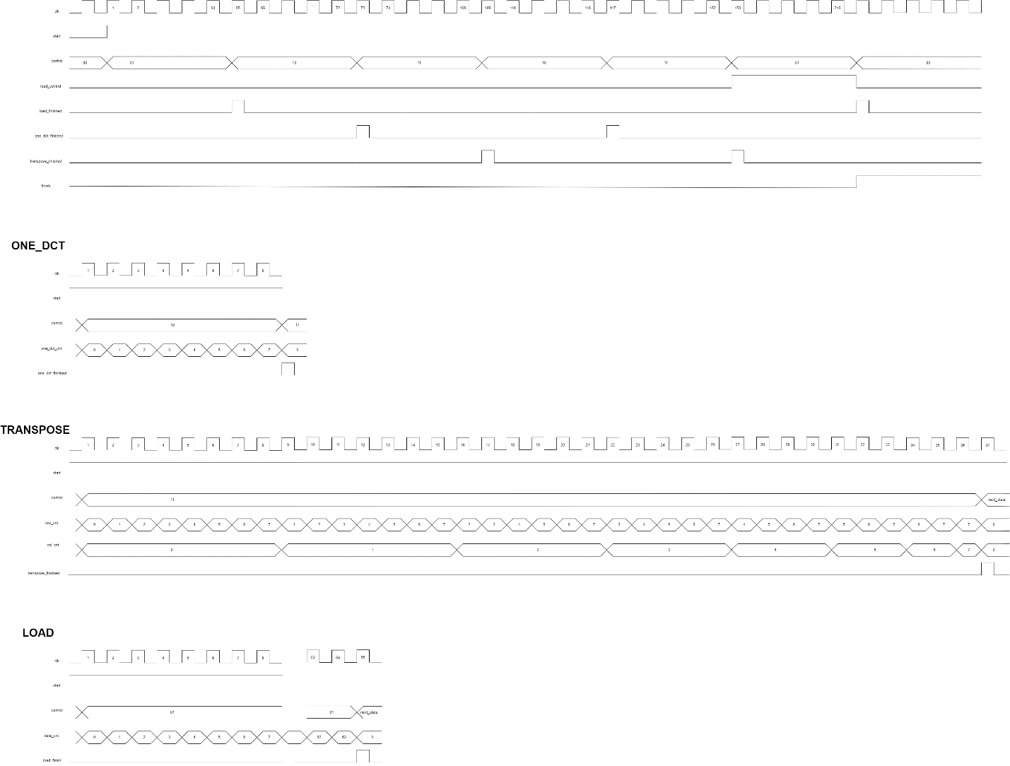
Timming

Slide 18
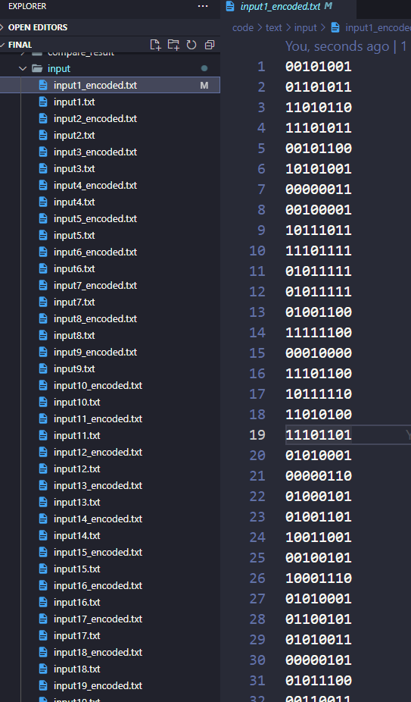
Simulation and Test script
Step 1: Generate input data
Input data

Slide 19
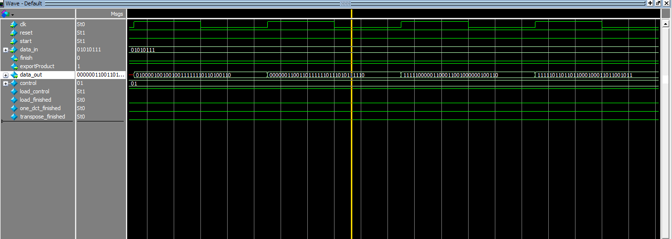
Simulation and Test script
Step 1: Generate input data
Step 2: Simulate with each file data & export output data
Model Sim wave

Slide 20
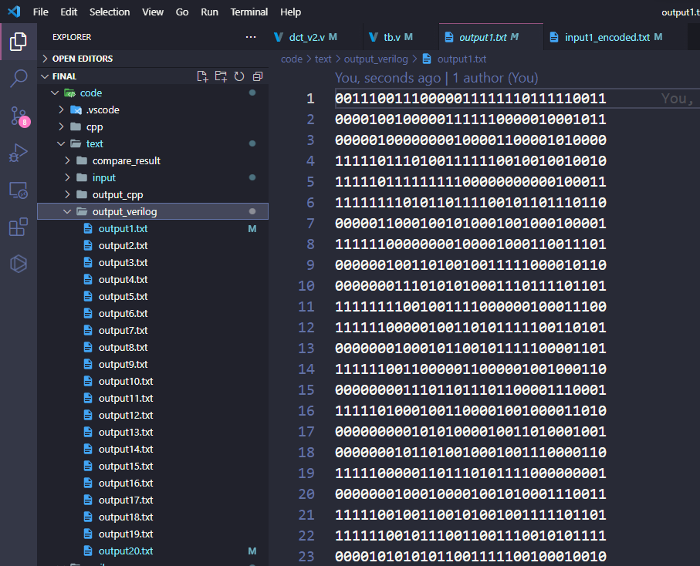
Simulation and Test script
Step 1: Generate input data
Step 2: Simulate with each file data & export output data
Output data

Slide 21
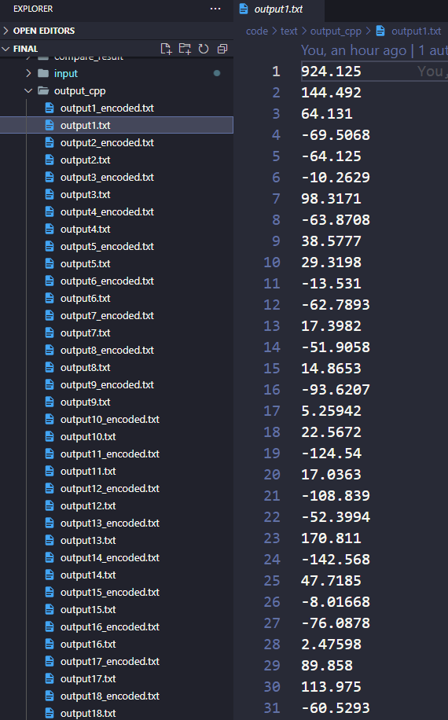
Simulation and Test script
Step 1: Generate input data
Step 2: Simulate with each file data & export output data
Step 3: do 2D-DCT with C++ code of the same input files
Output data of C++

Slide 22
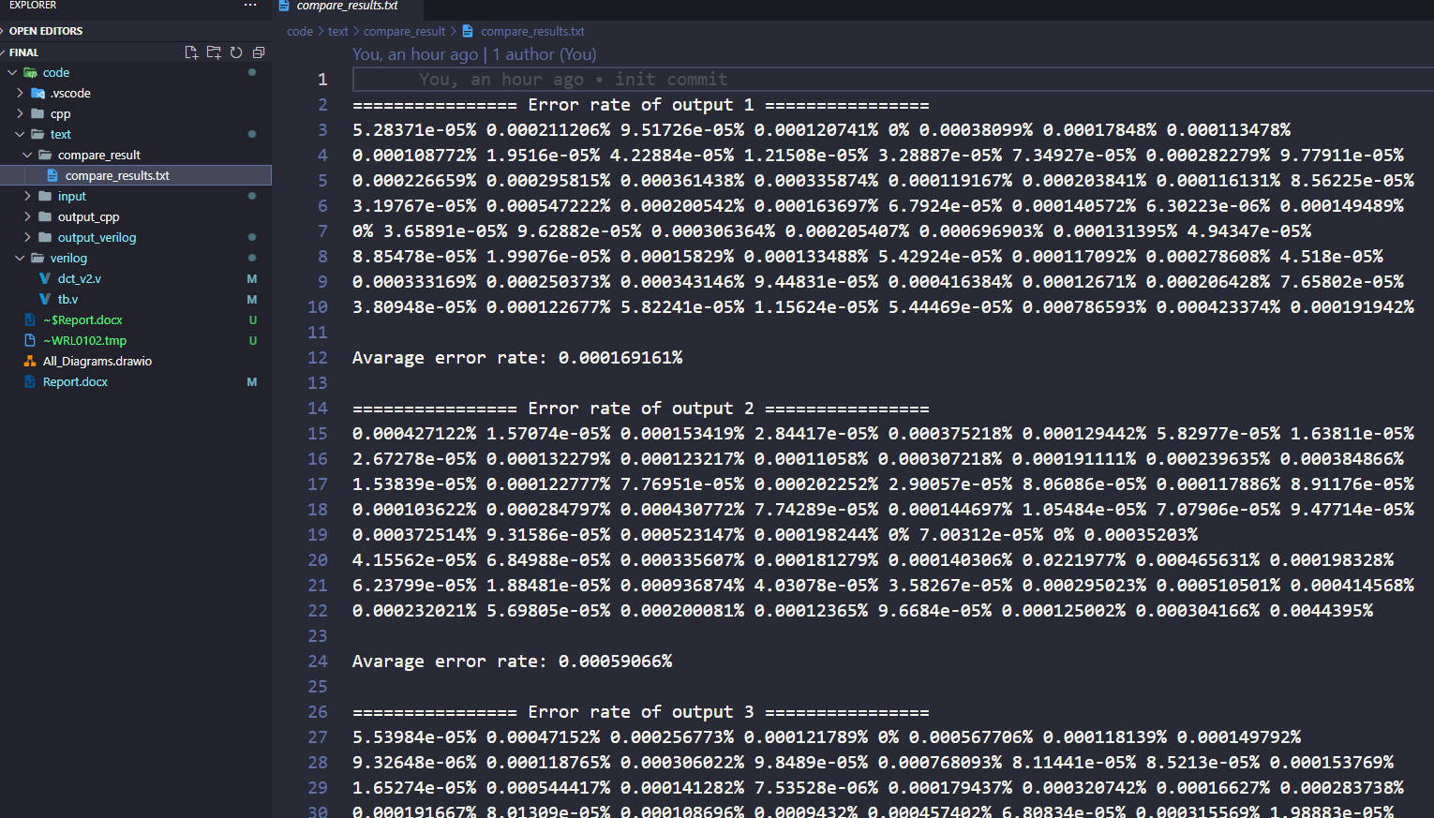
Simulation and Test script
Step 1: Generate input data
Step 2: Simulate with each file data & export output data
Step 3: do 2D-DCT with C++ code of the same input files
Step 4: Compare 2 output data
Step 5: Comment and conclusion
Compare result

Slide 23

Thanks for listening

