Slide 1
P2 Micromegas — final R&D phase
Gain recovery tests, simulation campaign, new bulks
Alexandra Kallitsopoulou · CEA Saclay · 7 October 2026

Slide 2
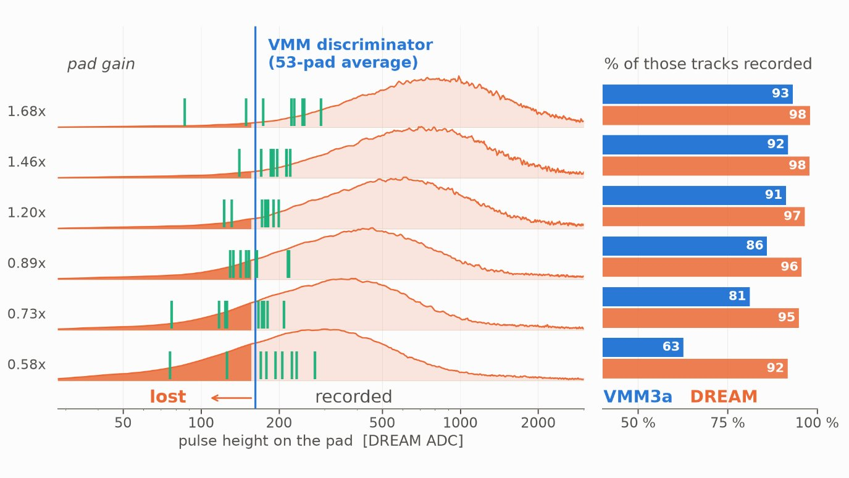
Why: VMM loses the low-gain part of the chamber
• SPS July 2026, same pads, same beam:
  – DREAM 95.6 %, VMM 85.3 %
• The chamber gain varies by ×3.9 across the surface (non-planarity: drift gap and PCB bending)
• Low-gain pads fall under the VMM threshold → lost
Plan: raise the gain and make it less sensitive to the gap
• Larger isobutane fraction (Ar/iso 95/5 → 90/10)
• Larger drift gap (4 → 5 mm)
• Possibly other mixtures (Ne/iso 95/5, 85/15)
• Measure the effect with the VMM electronics

Slide 3
Simulation campaign: goals
For each gas (Ar/iso 95/5, 90/10 · Ne/iso 95/5, 85/15) and drift gap (4, 5 mm):
1. Gain and signal
• Gain vs mesh voltage, and how much it changes with the local gap
• Primary electrons per muon → charge on the pad → VMM efficiency (gain 3.0 / 4.5 mV/fC, 100 / 200 ns)
• Check against the SPS data (DREAM and VMM)
2. Background
• Photons 40–100 keV: probability of ≥ 1 primary, Ne vs Ar
• Event-by-event deposits: photons vs 100 MeV electrons → upper ADC cut
• Weighted with Matthieu's background spectra (P2Sim) → rates per layer

Slide 4
What Geant4 + Garfield need
Geant4 (energy deposits)
• Detector geometry from the design files ✓
• Pillar map ✓
• Gases with correct composition ✓
• Particles: 150 GeV μ (SPS), 100 MeV e⁻, photons 10–150 keV ✓
• Background spectra and directions (Matthieu) ✓
Garfield++ (charges and signals)
• Gas tables (Magboltz) per mixture: drift velocity, diffusion, attachment, Townsend coefficient
• Penning transfer rate per mixture (from measured gain curves)
• Fields: drift and 150 µm amplification gap, mesh / drift voltages
• Signal: pad weighting field → induced current
• VMM shaper transfer function ✓ (Iakovidis et al.)
• Measured gain curves (SPS HV scans) to calibrate

Slide 5
Basic steps
1. Geant4: μ / e⁻ / γ through the P2 wedge → ionization clusters in the gas ✓
2. Magboltz: gas tables for each mixture → next
3. Drift to the mesh: diffusion, attachment, transparency
4. Avalanche: gain vs mesh voltage, calibrated on the SPS HV scans
5. Signal on the pad → VMM shaper → amplitude, time, threshold
6. Compare with SPS data, then predict 90/10, 5 mm, Ne
7. Background: photon runs × P2Sim spectra → e/γ separation, ADC cut
Stage A · Geant4
particle through the wedge → ionization clusters (position, time, primaries) [step 1]
Garfield++
gas tables (Magboltz) · avalanche gain · pad signal [steps 2, 4, 5]
Stage B · Digitizer
drift → diffusion → attachment → transparency → gain → pad [steps 3–4]
Stage C · VMM3a
shaper (Iakovidis) → threshold → amplitude, time [step 5]

Slide 6
Background estimation (Matthieu, P2Sim)
• Full P2 setup: photon rates and spectra at each Micromegas layer
• ~65 % of the photons at 40–100 keV, mostly within 30° of the normal
• Soft photons (< 20 keV) from the chamber wall: small flux, but half the detected rate in the first layer; stopped by its readout plane
• Our campaign uses these spectra as input: response per photon from our detailed detector simulation × his rates
• Geometries compared layer by layer; differences to align: mesh pitch, amplification gap, readout copper thickness

Slide 7
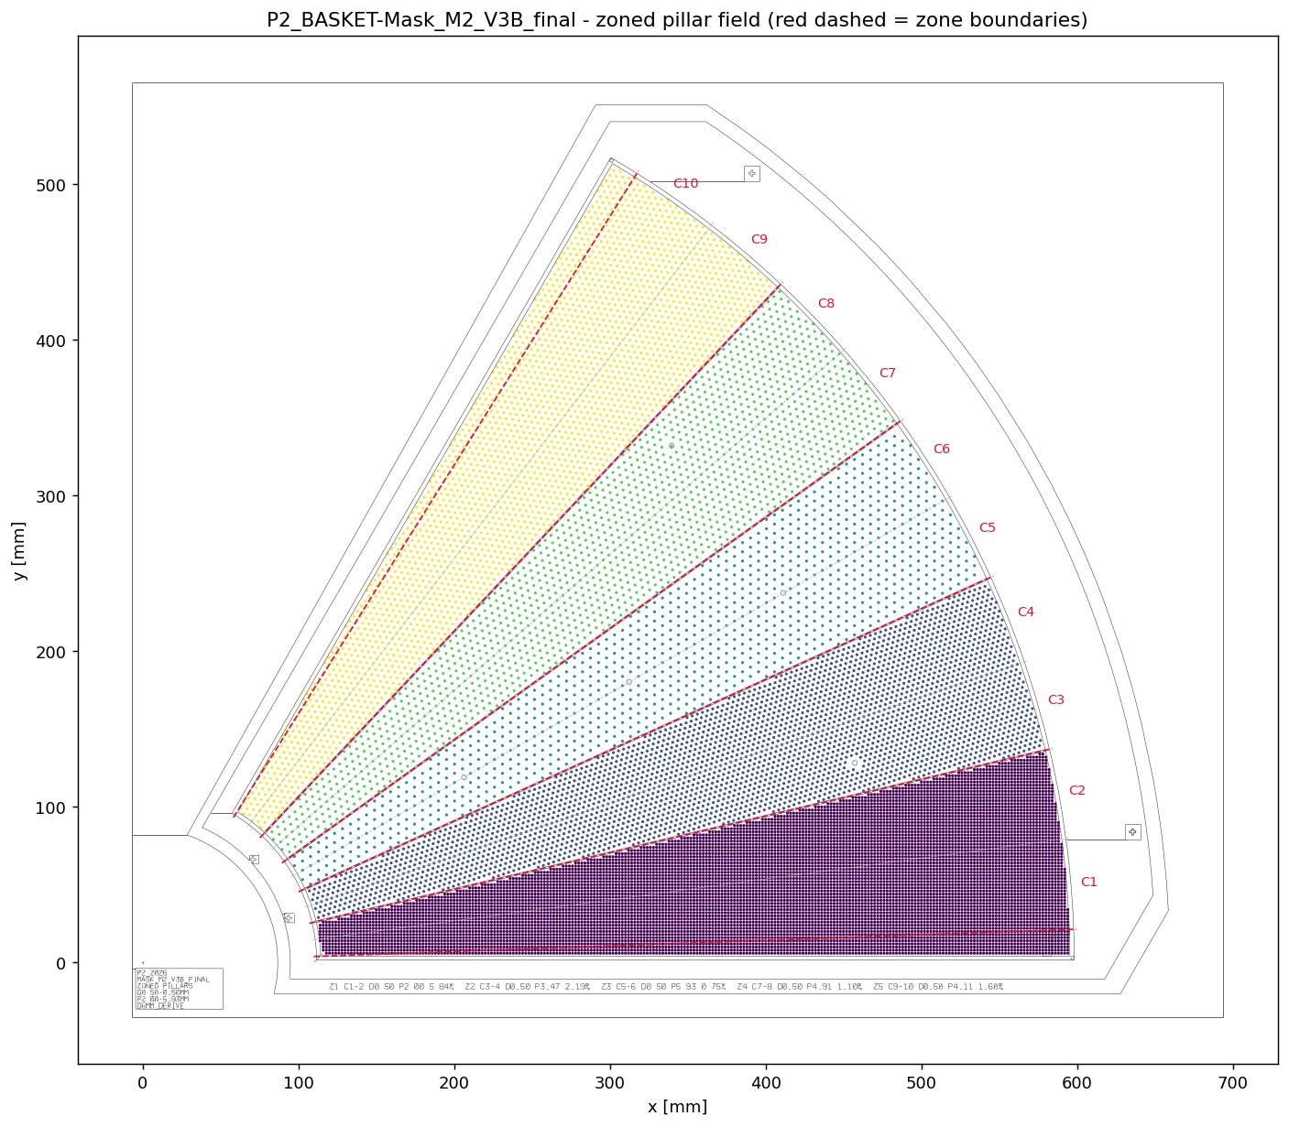
In parallel: new bulks in the lab
New insulation masks (V3B_final)
• Pillars Ø 0.5 mm everywhere
• 5 zones, pitch 2.0 mm (CERN reference) to 5.9 mm
• Dead area 2.3–6.5 % per zone, 3.5 % overall
• Test the efficiency per zone → choose the production pitch
PCBs with pillars
• Mesh glued, no lamination: needs gluing tooling
• Compare pre-stressed mesh (CERN supplier) vs standard

