Slide 1

Exploratory Data
Analysis
Presented by:
Ankita Kallurwar
Batch: CDF Feb2019

Slide 2

Breast Cancer survival
Data Set Information
The dataset contains cases from a study that was conducted between 1958 and 1970 at the University of Chicago's Billings Hospital on the survival of patients who had undergone surgery for breast cancer. This dataset contains the information of 306 patients.
Attribute Information
Age of patient at time of operation (numerical)
Patient's year of operation (year - 1900, numerical)
Number of positive axillary nodes detected (numerical)
Survival status (class attribute) -- 1 = the patient survived 5 years or longer -- 2 = the patient died within 5 year
Objective
The objective is to get insights from the data whether the patient will survive after 5 years or not based upon the patient’s age, year of operation and the number of positive axillary nodes.

Slide 3
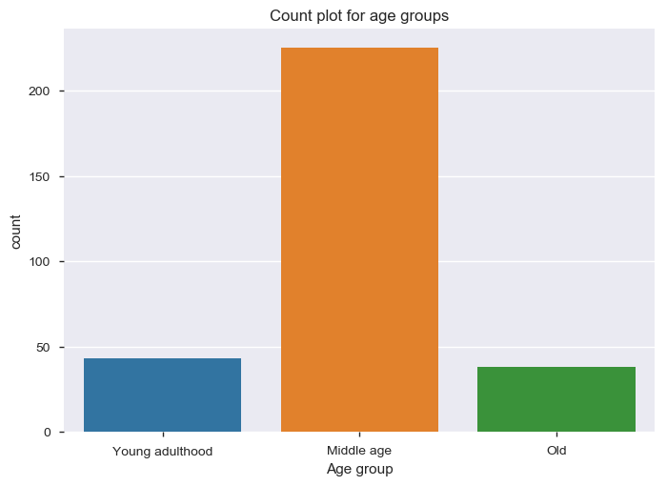
What are the different age group of patients?
Observation:
From this data, we observe that mostly the patients are in the range of 40 to 65 years.
73% patients are in the age group 40-65
14% patients are of young age i.e. below 40.
12% patients are of old age i.e. above 65.

Slide 4
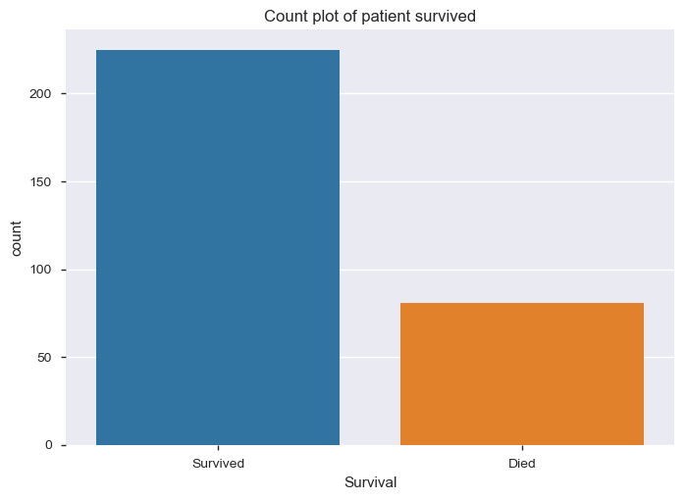
Of all the patients, how many survived?
Observation:
- From the graph, 225 patients survived for more than 5 years and 81 died within 5 years.
- 73% patients survived after 5years of operation.

Slide 5
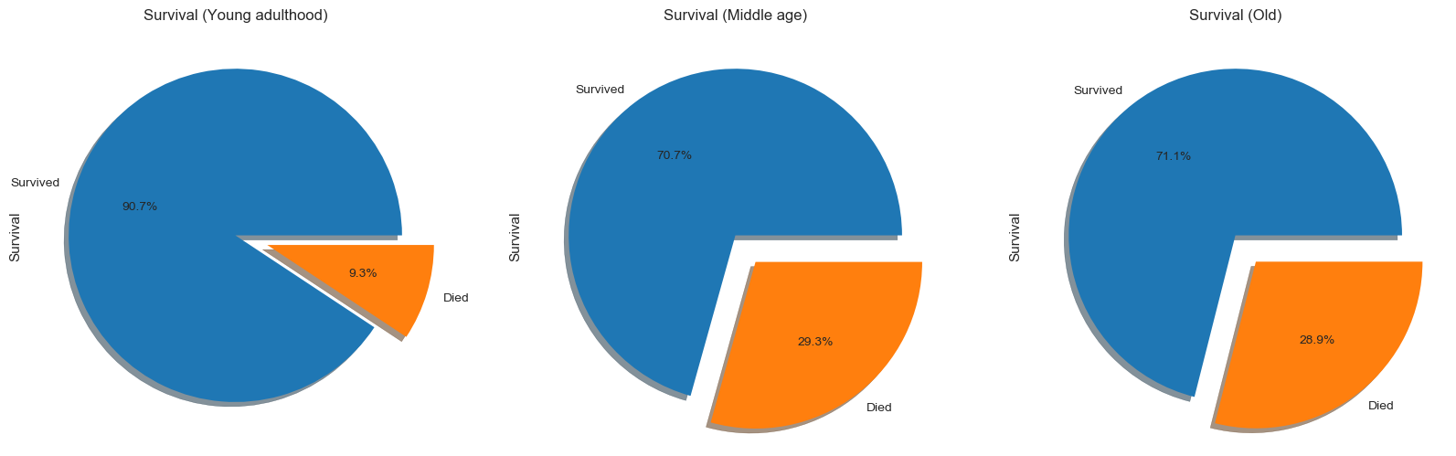
Which age group patients survived?
From above graph
- In young adulthood (Age below 40), 90% patients survived hence the chances of survival are high.
- In middle age(age between 40-65), 70% patients survived.
- In old age(Age above 65), 71% patients survived.

Slide 6
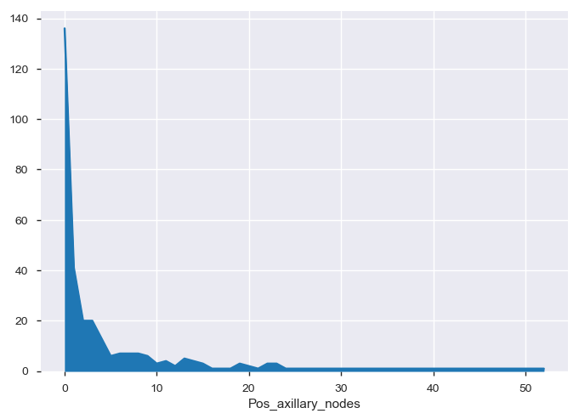
What is the number of positive axillary nodes found in patients?
From this graph,
Almost 87% patients has 0-10 numbers of positive axillary nodes.
Very few patients have more than 10 positive axillary nodes.

Slide 7
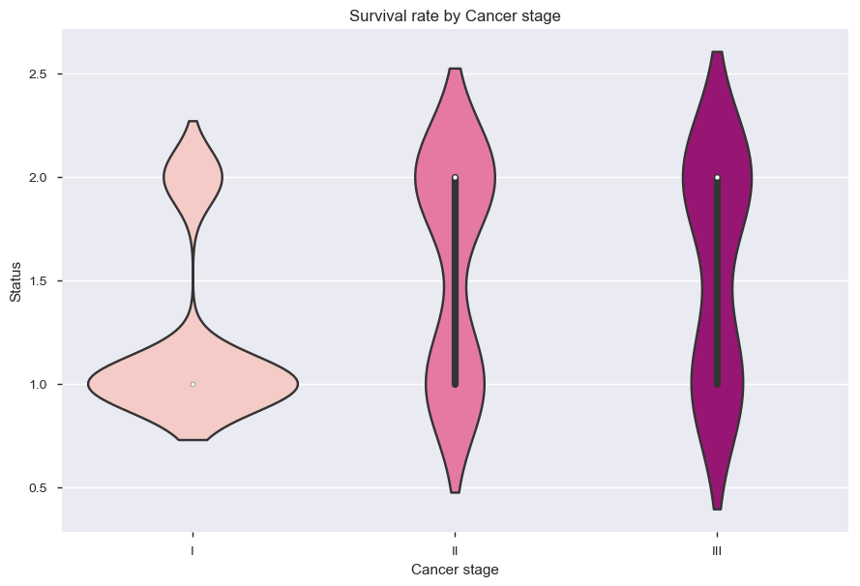
Rate of survival with respect to Cancer stage(Positive axillary nodes)
Observation
From graph,
Survival rate of Ist stage (less than 10 nodes)cancer is high as compare to others.
In IInd & IIIrd stage(more than 10 nodes), patients died are slightly higher than the survived.

Slide 8
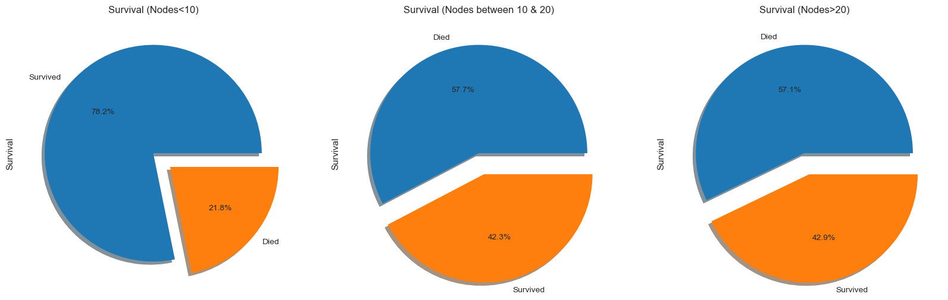
Analyzing survival rate with Cancer stage(Positive axillary nodes).
Observation:
From above graph,
- 78% patients survived with less than 10 positive axillary nodes.
- With positive axillary nodes greater than 20, more patients died than survived.
- Maximum nodes found in patients is 52.

Slide 9
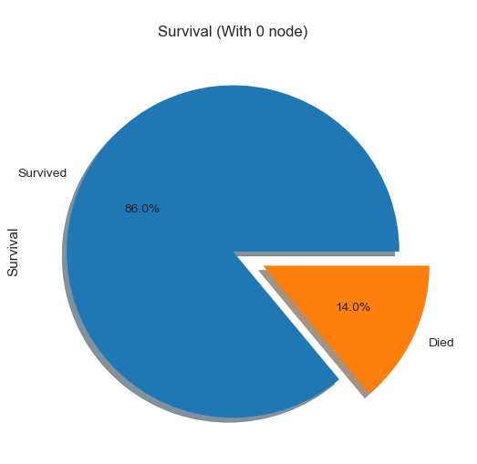
Analyzing survival rate with 0 positive axillary nodes
Observation
From the graph
- 44% patients have 0 positive axillary nodes and their survival rate 86%.

Slide 10
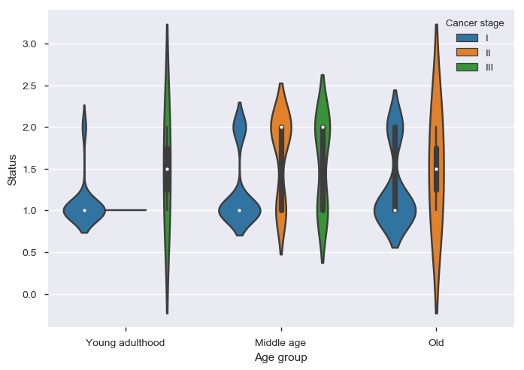
What is the survival rate with respect to Age group and Positive axillary nodes?
Observation:
- In Young Adulthood(Age<40):
- 92% patients survived of nodes less than 10.
- In Middle age(Age between 40-65):
- 76% patients survived with less than 10 positive axillary nodes.
- In Old(Age greater than 65):
- 72% patients survived with less than 10 positive axillary nodes.
- No patient found with more than 20 nodes in old age.

Slide 11
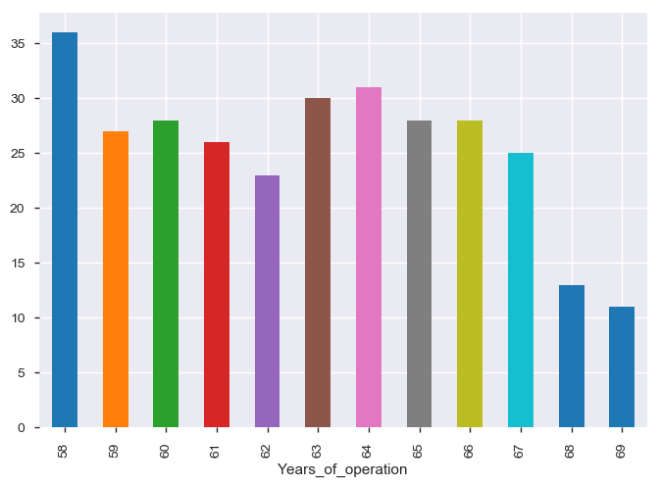
What is the count of operations per year?
Count of number of operations per year
Year 1958 has highest number of operation.
As the years pass by, the number patients who undergone surgery are decreasing.

Slide 12
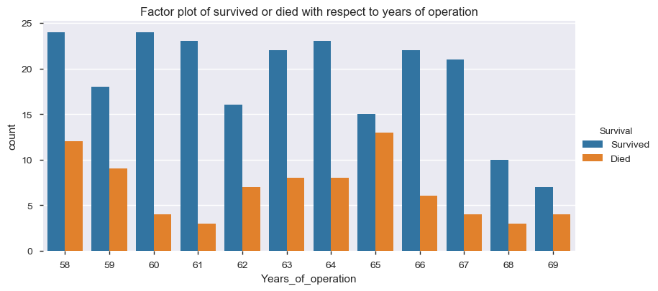
Observing the survival rate with respect to years of operation
Observation
- From year 1958 to 1961,rate of patients died is getting lesser and lesser.
- From year 1962 to 64,survival rate is getting higher.
- Then, year 1966 onwards again the rate of patients died is getting lesser.

Slide 13
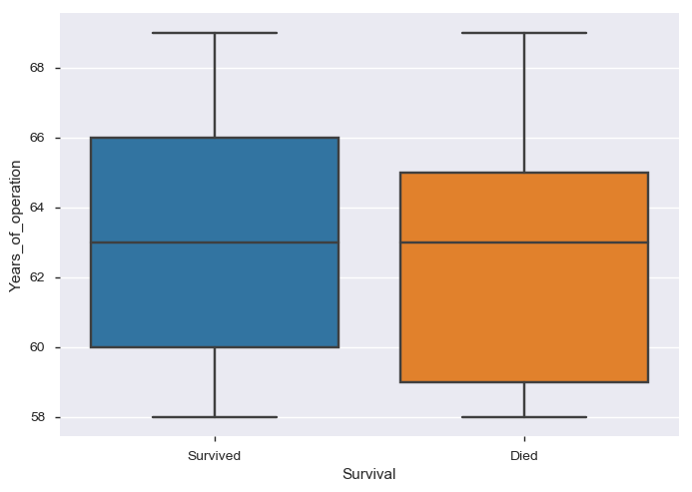
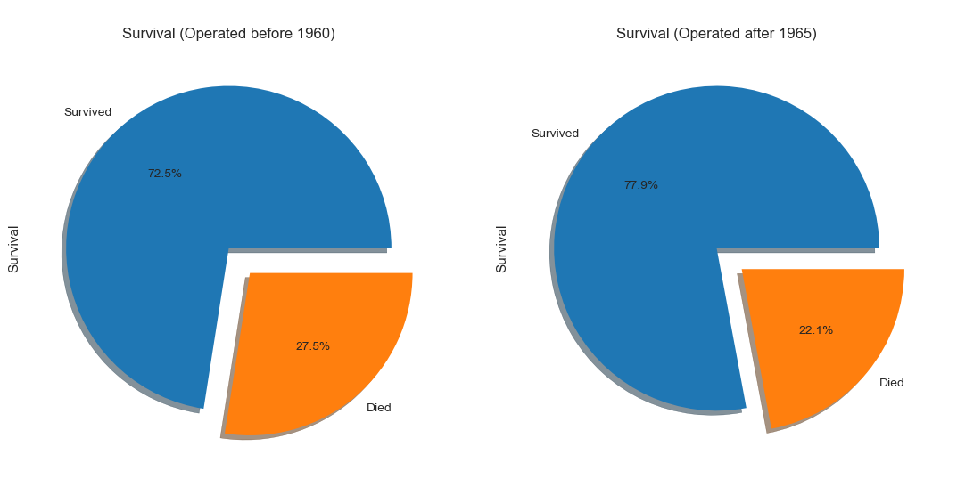
Calculating the survival rate with respect to year of operation.
Observation
The patients operated after 1965 have the slightly higher chance to survive than the rest. The patients operated before 1960 have the slightly lower chance to survive than the rest.
- The patients operated before 1965 have 72% survival rate wherein patients operated after 1965 have 78% survival rate so the difference is 6%.

Slide 14
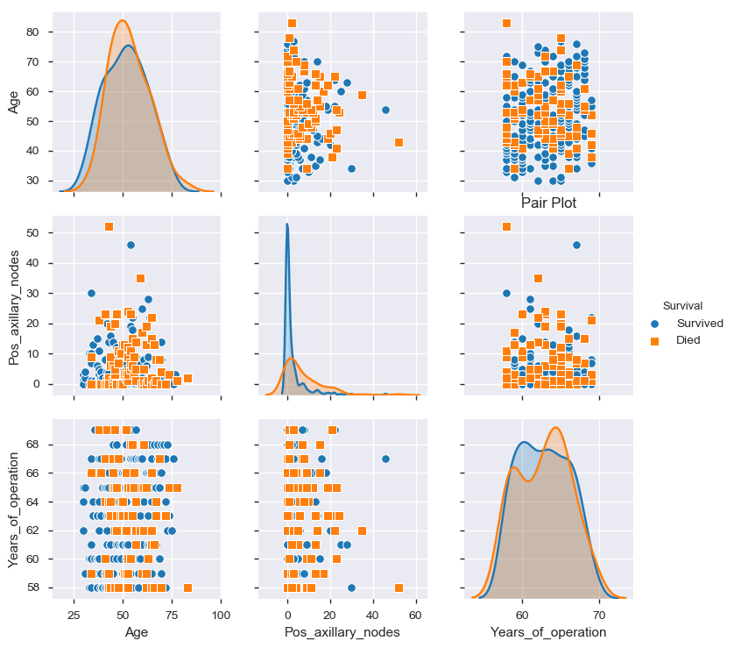
Observing the joint relationship between 'Age', 'Pos_axillary_nodes‘, 'Years_of_operation' and 'Survival'
Observing diagonal elements:
Most patients of age group 70-90 died than survived.
Patients with 0-10 positive axillary nodes survived than died & more than 10 nodes died than survived.
Patients who operated in year 1965, the ratio of died & survived is almost same.

Slide 15
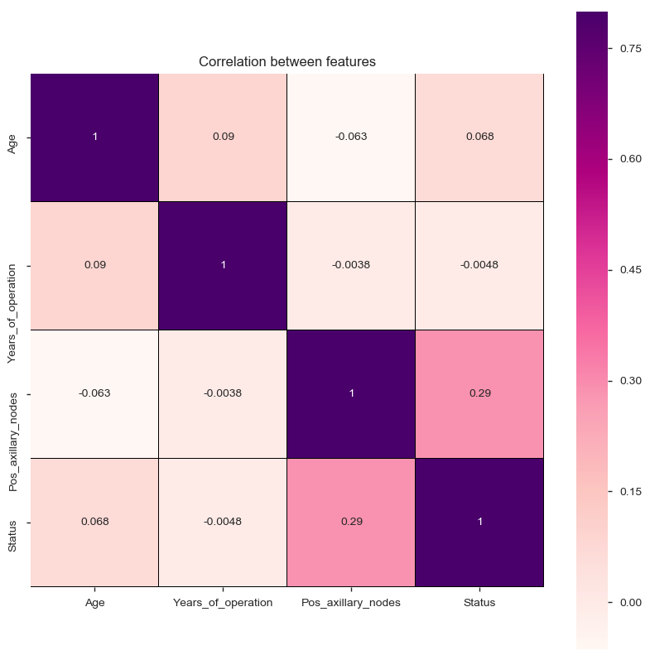
Establish correlation between all the features using heat map
Observation
Darker the shade then the variables are positively correlated to each other.
Variables like Status & Pos_axillary_nodes are correlated.
Variables like Age & Years of operation. are positively correlated.
Variables like Years_of_operation and Pos_axillary_nodes are negatively correlated.
Variables Age & Pos_axillary_nodes are also negatively correlated.

Slide 16
Hypothesis
- Of total,73% patients survived.
- If we consider the age of patients then middle age group with age 40-65 years are more prone to this disease.
- Broadly, young age group(age less than 40) has better survival rate ie. 90% and young age with less tan 10 positive axillary nodes has survival rate of 92%.
- Almost 87% patients have less than 10 positive axillary nodes.
- With axillary nodes less than 10,the survival rate is 78% but for nodes greater than 10 the survival rate is 42%.
- Maximum nodes found in patient is 52.
- 44% patients have 0 axillary nodes and survival rate with 0 axillary nodes is 86%.
- Years 1958 reported the maximum number of operations.
- The patients operated after 1965 have slightly higher rate of survival than patinets operated before 1960 (Difference in rate of survival is 6%).

Slide 17
Thank You

