Slide 1
Logical reasoning

Slide 2
SERIES AND PATTERNS

Slide 3
A – 1 H - 8 O – 15 V - 22
B – 2 I – 9 P – 16 W - 23
C – 3 J – 10 Q - 17 X - 24
D – 4 K – 11 R – 18 Y - 25
E – 5 L – 12 S – 19 Z – 26
F – 6 M – 13 T - 20
G – 7 N – 14 U - 21

Slide 4
Complete the sequence
2, 3, 6, 11, 18, ____
What comes next in the series
3, 12, 48, 192, _____
Find the missing letter ?
Z, W, S, N, _____
4. Fill in the blanks – Series : C, F, J, O, _____

Slide 5
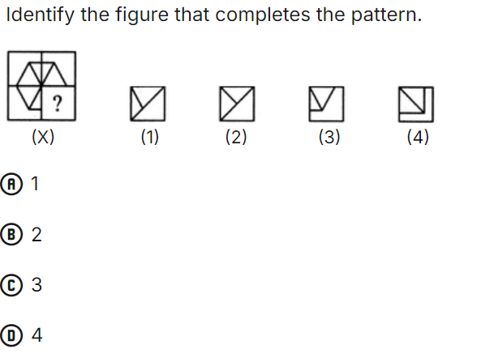
PATTERN BASED QUESTIONS

Slide 6
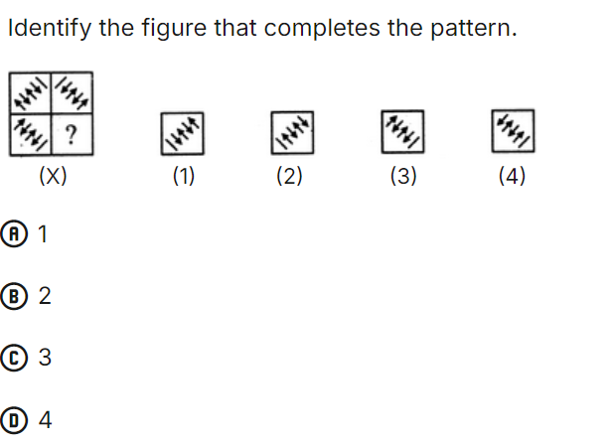

Slide 7
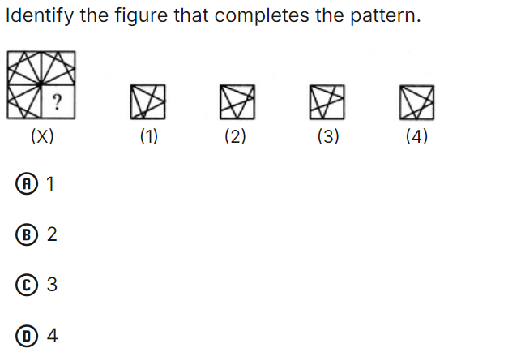

Slide 8
NUMBER GRID PATTERN
Which number replaces the question mark?
5 | 9 | 13
6 | 12 | ?
7 | 15 | 23

Slide 9
VISUAL PATTERN
Which shape comes next in the sequence?
(Triangle, Square, Pentagon, Hexagon, ___)

Slide 10
CODING AND DECODING

Slide 11
Alphabetic Coding
If in a certain code, "CATER" is written as "FDOHW," how is "APPLE" written in that code?
Numerical Coding
In a certain code, BIRD is written as 25. How will CAT be written in the same code?
3. Letter shifting
If MIND is coded as OQPF, how will WORK be coded?

Slide 12
4. Mixed Coding
If in a code language, BOY is written as ZPC, and GIRL is written as TJQM, how would MAN be coded?
5. Symbol – Based Coding
If A = +, B = @, C = #, what is the code for the word CAB?
6. Word Pattern Coding
In a certain code, WORD is coded as 23-15-18-4. How would you write CODE in that code?

Slide 13
‘for profit order now’ is written as ‘ho ja ye ga’,
‘right now for him’ is written as ‘ga ve ja se’,
‘place order for profit’ is written as ‘ga bi ho ye’,
‘only in right order’ is written as ‘ve du ye zo’.
1. What is the code for him ?
2. What does bi stands for ?
3. What is the code for order ?
4. ‘fo ve du’ could be the code for which of the following ?
a) in right spirits b) only in profit c) order only him
d) place in right e) order only now
5. Which of the following may represent “only for now” ?

Slide 14
BLOOD RELATIONS

Slide 15
Family Tree/ Symbol
A is father of B
A is brother of B
A is wife of B
A is son of B
A is grandfather of B
SYMBOLS

Slide 16
A is the father of B. B is the mother of C. C is the son of D. What is the relation of A to C?
X is the sister of Y. Y is the brother of Z. If Z is the father of W, then how is X related to W?

Slide 17
3. A is the sister of B. B is the brother of C. D is the mother of A. How is D related to C?
4. If R is the son of T, and T is the brother of U. How is R related to U?

Slide 18
In a family of six person A, B, C, D, E and F there are two married couples
D is grandmother of A and mother of B
C is wife of B and mother of F
F is granddaughter of E
Questions:
1. How is A related to F ?
2. How is C related to D ?
3. A is E’s ?

Slide 19
DIRECTION SENSE

Slide 20
N
W
E
S
Crossing or fixed Point
A man walking 20km towards North or Straight
In which direction
A with respect to B
B with respect to A
4. A is 20m to the west of C

Slide 21
Sam walks 15 meters towards the south and then turns right to walk 10 meters. After that, he turns right again and walks 15 meters. How far is he from his starting position?
2. Anuja goes 5km towards East from a fixed point N, and then 35km after turning to her left, Again she goes 10km after turning to her right. After this she goes 35km after turning to her right, how far is she from N ?

Slide 22
3. John starts from his house and walks 20 meters north. Then he turns left and walks 30 meters. After that, he turns left again and walks 20 meters. Finally, he turns right and walks 30 meters. Where is he now in relation to his starting point?
4. Viki walks 4m towards East then turns to his right and walks 4m and turn to his left and walks 5m. Again turning to her left he walks 4m and stopped, What is the shortest distance between starting point and Ending Point ?

Slide 23
5. John goes 30 meters towards the west, then turns left and walks 10 meters. After that, he turns left again and walks 30 meters. In which direction is he from his starting point?
6. If a person walks 7 km south and then 24 km east, what is the distance from the starting point?

Slide 24
syllogism

Slide 25
Some A are B
All A are B
No A is B

Slide 26
Statement 1 :Some fruits are sweet. Statement 2: All apples are fruits. Conclusion: Therefore, some apples are sweet.
Premise 1: All students study. Premise 2: Some students play sports. Conclusion: Therefore, some students who study also play sports.

Slide 27
3. Statement :
1. Some trees are papers
2. All papers are inks
3. Some ink are blue
Conclusion:
1. Some inks are trees
2. Some papers are tress
3. Some blue are paper
4. Some blue are ink

Slide 28
4. Statements:
1. All chairs are table
2. No table is Sofa
3. Some sofa are wood
4. No wood is Brown
Conclusion:
1. Some Table are chair
2. Some wood are sofa
3. Some brown are chair
4. Some brown are sofa
5. All sofa are wood

Slide 29
Thank you

