Slide 1
syllogism

Slide 2
Some A are B
All A are B
No A is B

Slide 3
Statement 1 :Some fruits are sweet. Statement 2: All apples are fruits. Conclusion: Therefore, some apples are sweet.
Premise 1: All students study. Premise 2: Some students play sports. Conclusion: Therefore, some students who study also play sports.

Slide 4
3. Statement :
1. Some trees are papers
2. All papers are inks
3. Some ink are blue
Conclusion:
1. Some inks are trees
2. Some papers are tress
3. Some blue are paper
4. Some blue are ink

Slide 5
4. Statements:
1. All chairs are table
2. No table is Sofa
3. Some sofa are wood
4. No wood is Brown
Conclusion:
1. Some Table are chair
2. Some wood are sofa
3. Some brown are chair
4. Some brown are sofa
5. All sofa are wood

Slide 6
VERBAL ABILITY

Slide 7
SYNONYMS - MEANINGS
1.She made a perfect presentation.
What is the synonym of “Perfect” ?
a) aweful b) bad c) excellent d) fault
excellent
2. My sister gets jumpy when no one is at home with her
What is the synonym of “jumpy” ?
a) Happy b) joyful c) nervous d) blissful
nervous
3. I didn’t eat anything this morning, and I m ravenous.
What is the synonym of “ravenous”?
a) Full b) dirty c) starving d) sleepy
starving

Slide 8
4. Choose the word closest in meaning to the given word.
Select the synonym of the word "Benevolent". a) Cruel b) Generous c) Harsh d) Unkind
Generous
5. Identify the word with a similar meaning based on how it is used in a sentence.
She had a _______ sense of fashion that everyone admired. a) Awful b) Exquisite c) Plain d) Dull
Exquisite

Slide 9
6. Matching Synonyms
Match the given words with their synonyms from a list of options.
Column A | Column B Rigid | Begin Commence | Inflexible Abundant | Hopeless Despair | Plentiful
Rigid – Inflexible
Commence – Begin
Abundant – Plentiful
Despair - Hopeless

Slide 10
ANTONYMS - OPPOSITE
Fill in the blank with the appropriate antonym.
The climate in the desert is _____ compared to the rainforest.
Answer : Humid
2. What is the antonym of "friend"? A) Companion B) Ally C) Foe D) Partner
Foe

Slide 11
3. What is the antonym of "happy"? A) Joyful B) Sad C) Excited
D) Angry
Sad
4. Antonym - Frequent
A) Regular B) Occasional C) Common D) Repeated
OCCASIONAL

Slide 12

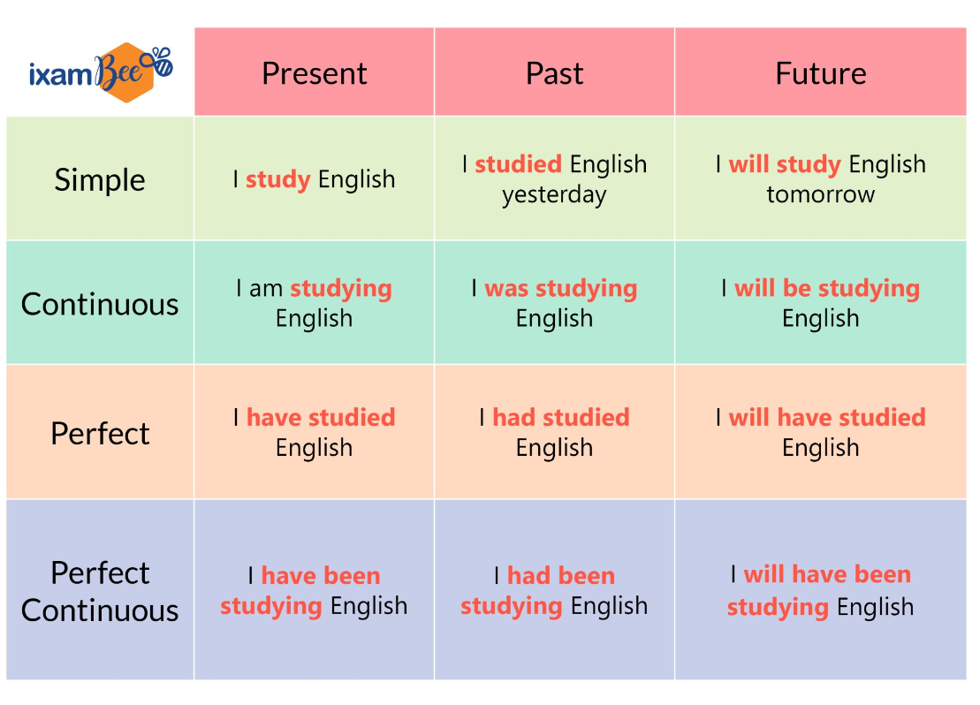
TENSES

Slide 13
1. Identify the tense: "She has been working here for five years."
Answer: Present Perfect Continuous
2. Fill in the blank with the correct tense: "By next year, I (complete) my degree."
Answer: will have completed
3. Which sentence is in the simple past tense? A) He walks to school every day. B) He walked to school yesterday. C) He is walking to school. D) He has walked to school.
B) He walked to school yesterday.

Slide 14
4. They ______ (to visit) their grandparents last weekend.
Options: A) visit B) visits C) visited
visited
5. He ______ (to walk) to school every day. Options: A) walking B) walks C) walked
walks

Slide 15
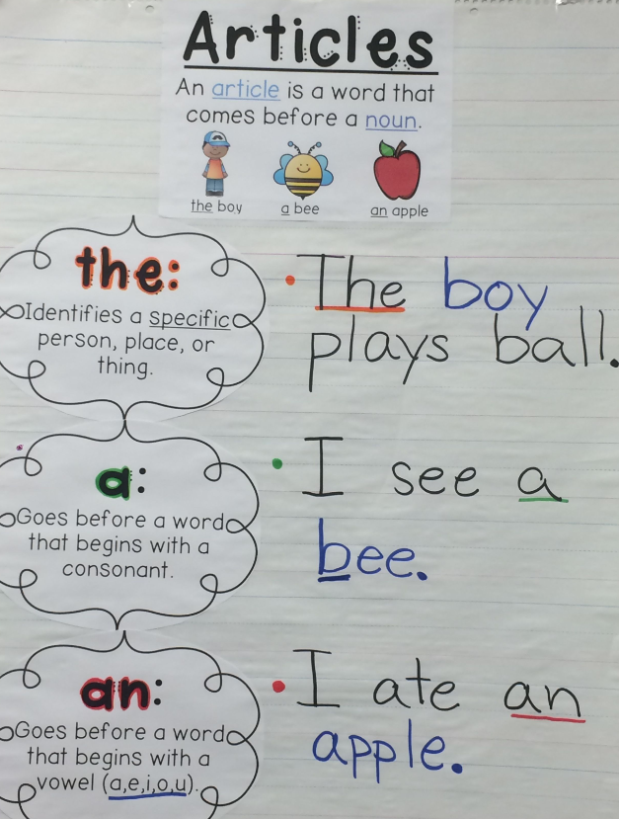

Slide 16
Fill in the Blanks with Articles
Question 1: I saw ______ elephant at the zoo.
Question 2: She wants to be ______ engineer when she grows up.
Question 3: ______ sun rises in the east.
Question 4: Can you pass me ______ salt, please?
Question 5: I would like to have ______ apple for lunch.
Question 6: He is reading ______ interesting book.
Question 7: They traveled to ______ United States last year.
Question 8: My brother is ______ artist.
Question 9: I need ______ hour to finish this task.
Question 10: I saw ______ bird sitting on the fence.
an
an
The
The
an
an
the
an
an
a

Slide 17
preposition

Slide 18
Definition: Prepositions are words that show the relationship between a noun (or pronoun) and other words in a sentence. They often indicate direction, location, time, or manner.
Common Types of Prepositions
Prepositions of Place: indicate location.
Examples: in, on, at, under, over, between, among
Example Sentence: The cat is on the table.
Prepositions of Time: indicate when something happens.
Examples: at, in, on, during, before, after
Example Sentence: We will meet at 5 PM.

Slide 19
3. Prepositions of Direction: indicate movement.
Examples: to, towards, through, into, across
Example Sentence: She walked to the store.
4. Prepositions of Manner: indicate how something is done.
Examples: with, by, like
Example Sentence: He solved the problem with ease.

Slide 20
The book is ______ the table.
She will arrive ______ Monday.
They walked ______ the park to get to the restaurant.
He was sitting ______ his friend during the movie.
We will finish the project ______ Friday.
on
on
through
beside
by

Slide 21
READING COMPREHENSION
The Mysteries of the Ocean
The ocean covers over 70% of the Earth's surface and is home to a vast array of life forms, many of which remain undiscovered. Scientists estimate that more than 80% of the ocean is still unexplored, making it one of the last frontiers on our planet. The deep sea is particularly intriguing, with its dark, cold waters and bizarre creatures adapted to extreme conditions. One of the most fascinating aspects of the ocean is its biodiversity. From colorful coral reefs teeming with fish to the mysterious depths where bioluminescent organisms glow, the ocean is a treasure trove of life. Many species have developed unique adaptations that allow them to thrive in their specific environments. For example, the anglerfish uses a bioluminescent lure to attract prey, while the octopus can change its color and texture to blend in with its surroundings. In addition to its rich biodiversity, the ocean plays a critical role in regulating the Earth's climate. It absorbs carbon dioxide from the atmosphere and produces a significant portion of the oxygen we breathe. However, human activities, such as pollution and overfishing, threaten the health of marine ecosystems. Protecting the ocean is essential for maintaining the balance of life on Earth. Exploring the ocean is not just about discovering new species; it is also about understanding the intricate connections within our planet's systems. As we learn more about the ocean, we gain insights that can help us address pressing environmental issues and ensure a sustainable future for all living beings.

Slide 22
Question 1: What percentage of the Earth's surface is covered by the ocean?
Question 2: Why is the deep sea considered intriguing?
Question 3: Name two adaptations mentioned in the passage that help marine creatures survive.
Question 4: What role does the ocean play in regulating the Earth's climate?
Question 5: Why is protecting the ocean important, according to the passage?

Slide 23
Thank you

