Slide 1
CropDisease Forecast Predicting Crop Disease Outbreaks Using Climate Data
Team Members: Akalya Tamilvel Senbakam,
Sachitha Ravichandran Class: AIML-A

Slide 2
Problem Statement
The dataset used in this project consists of climate data and crop disease data collected from different sources. Climate data was collected from the Open-Meteo API, and disease data was collected from agricultural datasets such as ICRISAT.
The dataset contains four years of data from 2020 to 2023 for the Thanjavur region in Tamil Nadu. The features used in this project include temperature, humidity, rainfall, and wind speed.
These features were used to analyze climate patterns and their relationship with crop disease outbreaks.

Slide 3
Dataset
The dataset used in this project consists of climate data and crop disease data collected from different sources. Climate data was collected from the Open-Meteo API, and disease data was collected from agricultural datasets such as ICRISAT.
The dataset contains four years of data from 2020 to 2023 for the Thanjavur region in Tamil Nadu. The features used in this project include temperature, humidity, rainfall, and wind speed.
These features were used to analyze climate patterns and their relationship with crop disease outbreaks.

Slide 4
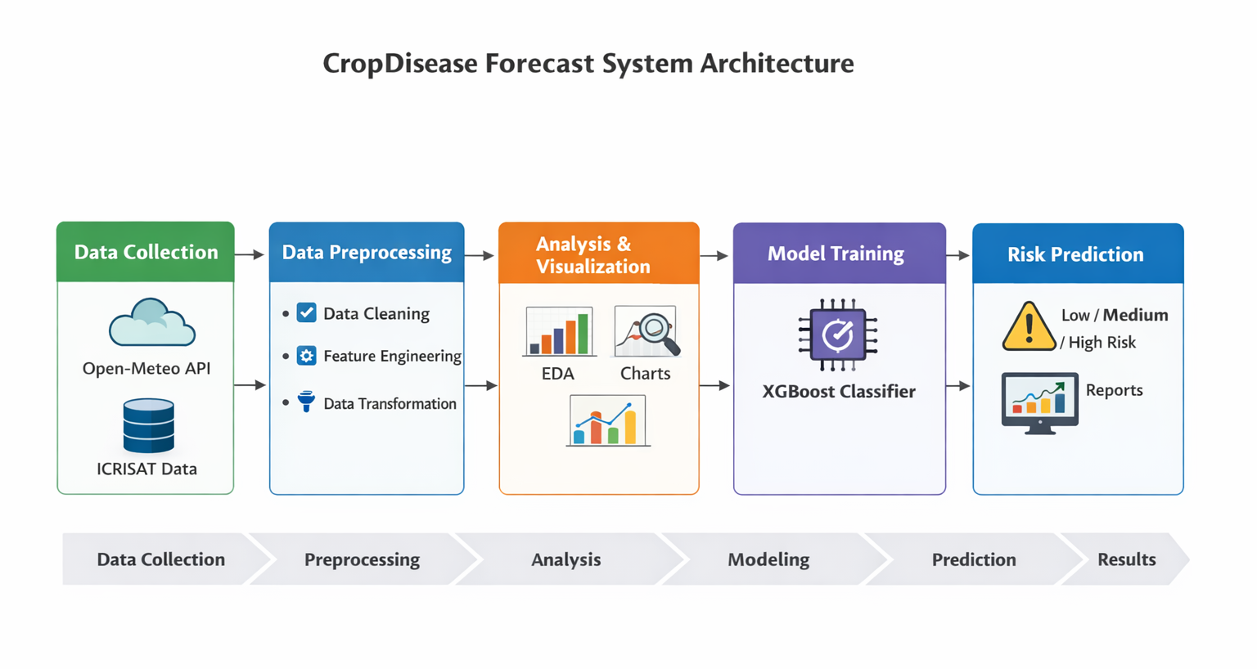
Methodology
The methodology of this project consists of several stages. First, data was collected from different sources. Then, data preprocessing was performed to clean the dataset and handle missing values.
Next, Exploratory Data Analysis (EDA) and data visualization were performed to understand patterns and relationships between climate conditions and crop diseases.
Feature engineering was performed to create new features such as high humidity days and heavy rainfall days. Finally, a machine learning model (XGBoost) was trained to predict crop disease risk.

Slide 5
Exploratory Data Analysis
Exploratory Data Analysis was performed to understand the relationship between climate variables and crop disease outbreaks. From the analysis, it was observed that most disease outbreaks occur during the monsoon season.
High humidity and heavy rainfall were found to be the most important factors influencing crop diseases. Temperature also plays a role in disease development.
Correlation analysis showed that humidity and rainfall have a strong positive relationship with crop disease outbreaks.

Slide 6
Visualizations
Various visualizations were created to understand the data clearly. Temperature trend graphs were used to analyze temperature changes over time. Rainfall graphs were used to identify monsoon patterns.
A correlation heatmap was created to show the relationship between climate variables and crop diseases. Disease distribution charts were created to show the percentage of low, medium, and high-risk cases.
These visualizations helped in identifying patterns and understanding the dataset better.

Slide 7
Model Development
In this project, the XGBoost machine learning algorithm was used to predict crop disease risk. The dataset was divided into training data and testing data using an 80:20 ratio.
The model was trained using climate features such as temperature, humidity, rainfall, and wind speed. The target variable was disease risk level, which was classified into Low, Medium, and High categories.
After training, the model was evaluated using accuracy and feature importance.

Slide 8
Results
The machine learning model achieved an accuracy of approximately 85% in predicting crop disease risk. Feature importance analysis showed that humidity is the most important factor affecting crop diseases, followed by rainfall.
The results also showed that the monsoon season has the highest disease risk due to high humidity and heavy rainfall.
This system can be used as an early warning system to help farmers take preventive measures and reduce crop loss.

Slide 9
Conclusion and Future Work
In this project, a crop disease prediction system was developed using climate data and machine learning techniques. The model successfully predicted disease risk with good accuracy.
This project shows how data science can be used in agriculture to solve real-world problems.
In the future, this system can be improved by using real-time weather data, developing a mobile application for farmers, and expanding the system to support multiple crops and regions.
Project GitHub Repository: https://github.com/akalyatamilvel/MiniProject_DS_AIML-A_2026_CropDiseaseForecast

