Slide 1

Sitespeed User Guide
January 2024

Slide 2
Access and Administration
Management of all tests is performed from the Jump server
There are no passwords used for communication with any server
For existing Sitespeed installations, contact the Sitespeed administrator to have an account created
Obtain an SSH private key for the Jump server from the Sitespeed administrator
The SSH key will allow access to the Jump server only
A second SSH key pair was installed during the initial system installation, which is used for communication between the Jump server and the other servers
Notes:
Single Domain and Competitive Analysis are stored in Graphite in two different namespaces
Complete flexibility in how tests are set up
Nothing set in stone about the number of single domain vs competitive analysis tests

Slide 3
Jump Server Access for New Installations
During initial installation of the Jump server, an SSH public key is installed on the Jump server
The SSH private key for the Jump server can be downloaded from https://as.akamai.com/user/sitespeed/jump
Copy the displayed contents to a file called jump and change the file permission to 600 (i.e., chmod 600 jump)
The SSH passphrase for the SSH private key is !!sitespeed!!
When using SSH to access the jump server, use the origin address
ssh user@sitespeed.akamai.com will FAIL since port 22 will not be transported across Akamai Edge
ssh user@sitespeed.akadns.net will work since the origin is being used directly
To create a new SSH key pair use the following steps:
Use ssh-keygen -t rsa -b 2048 -C "jump" -f jump to generate a new key pair
The name jump can be changed to anything
Copy the public key to ~/.shh/authorized_keys on the Jump server
Notes:
Single Domain and Competitive Analysis are stored in Graphite in two different namespaces
Complete flexibility in how tests are set up
Nothing set in stone about the number of single domain vs competitive analysis tests

Slide 4
Test Workflow
The following are the high-level tasks required to start collecting data:
Create a seed file
Deploy the seed file
Create a test schedule
Deploy the test schedule
When a test is no longer required, it is recommended you remove the test schedule entry and associated seed file and then either stop all testing or re-deploy the revised schedule if there are other tests running
All test and server management is performed using a single script called admin.sh
All commands described in this document are performed on the Jump server with one exception. The graphite.sh is used on the Graphite server.
Notes:
Single Domain and Competitive Analysis are stored in Graphite in two different namespaces
Complete flexibility in how tests are set up
Nothing set in stone about the number of single domain vs competitive analysis tests

Slide 5
Admin Script
All tasks are performed using the admin.sh script
The script has been designed to avoid and prevent as many errors as possible
When the script encounters an error, it will print a descriptive reason why the task failed before exiting
The script contains a help menu that can be displayed using the following methods:
./admin.sh
./admin.sh –help ← double dash before the word help
./admin.sh –h
./admin.sh /?
The following slide contains a complete summary of all commands and arguments
This guide will cover will explain what each command does and why and when it should be used
Notes:
Single Domain and Competitive Analysis are stored in Graphite in two different namespaces
Complete flexibility in how tests are set up
Nothing set in stone about the number of single domain vs competitive analysis tests

Slide 6
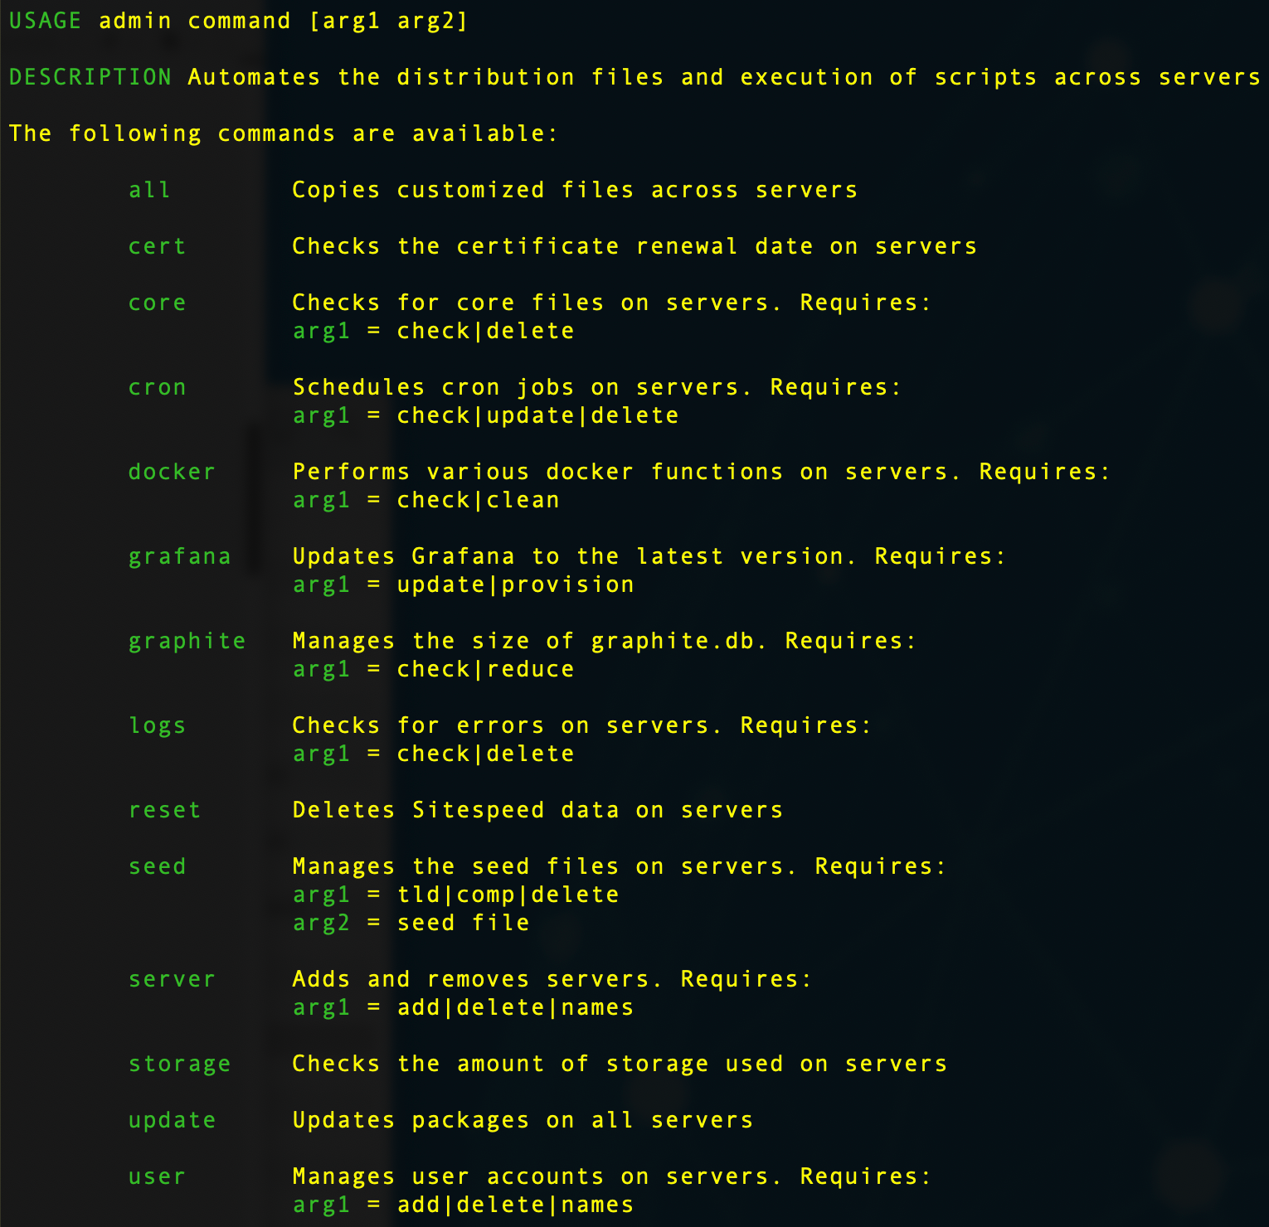
Admin Script
User access to admin functions is restricted based on account permission
User accounts are created with either Admin level or User level permission
All users are permitted to create seed files and schedule tests
Notes:
Single Domain and Competitive Analysis are stored in Graphite in two different namespaces
Complete flexibility in how tests are set up
Nothing set in stone about the number of single domain vs competitive analysis tests

Slide 7
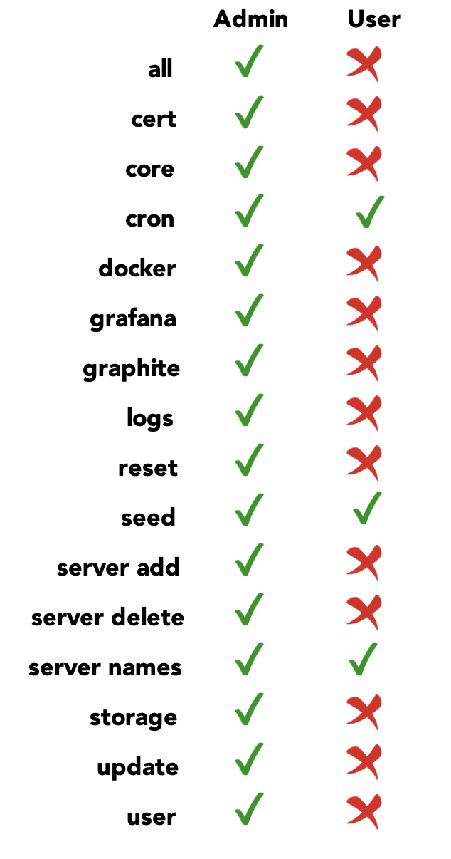
Admin Permission Matrix
Notes:
Single Domain and Competitive Analysis are stored in Graphite in two different namespaces
Complete flexibility in how tests are set up
Nothing set in stone about the number of single domain vs competitive analysis tests

Slide 8
Seed File Information
A seed file serves two purposes – it represents the name of the test, and it contains the URLs that are associated with a test
All tests require their own seed file, which contain one or more URL entries, including query parameters
All URLs should be tested using a browser to ensure they are valid
A seed file entry consists of three fields, separated by spaces:
URL (including the scheme)
Page name
Domain name
The Page and Domain names are used in Grafana dashboards, so it is recommended to use friendly, meaningful names
A seed file name must include a ”txt” extension
Seed file names are case-insensitive and can contain special characters, such as “–” and “_”
The name of the seed file is used in Grafana dashboards, so it is recommended to use friendly, meaningful names
Notes:
Single Domain and Competitive Analysis are stored in Graphite in two different namespaces
Complete flexibility in how tests are set up
Nothing set in stone about the number of single domain vs competitive analysis tests

Slide 9
Seed File Deployment
All servers use the same seed file
Only one seed file can be deployed at a time
Use admin.sh to deploy a seed file across servers using the following three arguments:
seed
tld | comp | delete
name
tld (top-level domain) and comp (competitive analysis) tells the system where to store the results in the Graphite database
delete removes a previously deployed seed file
name is the seed file that resides in the seeds folder
Do not include the “txt” extension when running the admin script
The admin script checks to ensure the correct number of arguments are used
If the script does not find a seed file with a “txt” extension the script will print an error message before exiting
Notes:
Single Domain and Competitive Analysis are stored in Graphite in two different namespaces
Complete flexibility in how tests are set up
Nothing set in stone about the number of single domain vs competitive analysis tests

Slide 10
Scheduling Tests
All tests are controlled using a cron job on each server
The cron folder on the Jump server contains two files:
psicron
sitecron
psicron controls the collection of Google Chrome User Experience and Lighthouse data
Data is collected once per day since Google only updates their database daily
The following is an example of a psicron entry
5 1 * * * /usr/local/sitespeed/google.sh tld ATT &>> /usr/local/sitespeed/logs/YYY.ZZZ.msg.log
tld can either be tld (top-level domain) or comp (competitive analysis)
ATT (example) is the name of the seed file that was previously created and deployed
No other portions of the file should be modified
Notes:
Single Domain and Competitive Analysis are stored in Graphite in two different namespaces
Complete flexibility in how tests are set up
Nothing set in stone about the number of single domain vs competitive analysis tests

Slide 11
Scheduling Tests
sitecron controls the synthetic testing schedule
The following is an example of an entry
5 * * * * /usr/local/sitespeed/sitespeed.sh tld ATT XXX 3 &>> /usr/local/sitespeed/logs/YYY.ZZZ.msg.log
tld can either be tld (top-level domain) or comp (competitive analysis)
ATT (example) is the name of the seed file that was previously created and deployed
3 represents the number of test iterations
If the number if missing, it will default to 3
The number must be odd
No other portions of the file should be modified
The first five fields of a cron entry represent Minute Hour Day of Month Month Day of Week
Multiple test entries should be spaced out using the first two fields. The duration of a test will determine the best amount of time to wait before scheduling the next test
Normal testing is done once per hour
Notes:
Single Domain and Competitive Analysis are stored in Graphite in two different namespaces
Complete flexibility in how tests are set up
Nothing set in stone about the number of single domain vs competitive analysis tests

Slide 12
Scheduling Tests
The admin cron command requires a single argument:
check Displays the jobs currently running on all servers
update Deploys all test entries contained in psicron and sitecron
delete Deletes all tests on all servers
The following is an example deploying a new test
./admin.sh cron update
When testing is complete, remove your entries from the psicron and sitecron files and run either one of the following commands:
./admin.sh cron update
./admin.sh cron delete
Since the system is designed for multiple users, it is a good idea to run ./admin.sh cron check before deleting all tests as a courtesy to other users
Test duration is subjective and depends on what is trying to be accomplished
Notes:
Single Domain and Competitive Analysis are stored in Graphite in two different namespaces
Complete flexibility in how tests are set up
Nothing set in stone about the number of single domain vs competitive analysis tests

Slide 13
Admin Commands
./admin.sh all
The all command distributes customized scripts and configuration files across servers. This is helpful if a lot of changes have been made and you want to ensure that all servers have a consistent configuration.
./admin.sh cert
During installation, the certbot capability was installed, enabling the installation of an SSL certificate using Let’s Encrypt. If an SSL certificate was installed after the initial installation, the cert command displays the current status of the SSL certificate.
./admin.sh core check|delete
The core command checks for the existence of core dump files on each server and provides the ability to delete the core dump files. The check argument counts the number of core dump files on each server. The delete argument deletes the core dump files on all servers. Core dump files are an indication that the testing process is having trouble and should be investigated. A common cause of core dumps is when a URL is being blocked by a WAF rule. Although the test will proceed, the internal node.js application will generate a core dump file. The solution is to examine the logs files, identify the offending URL, remove the URL from the seed file, and then re-deploy the revised seed file.
Notes:
Single Domain and Competitive Analysis are stored in Graphite in two different namespaces
Complete flexibility in how tests are set up
Nothing set in stone about the number of single domain vs competitive analysis tests

Slide 14
Admin Commands
./admin.sh cron check|update|delete
The cron command manages all aspects of scheduling across servers. The check argument displays the current cron schedules on each server. The update argument deploys the jobs that have been defined in psicron and sitecron to all servers. psicron gets deployed to Google and sitecron gets deployed to all the Sitespeed machines. The delete argument removes the test schedule on all servers. The delete argument does not cancel any tests that are currently in progress.
./admin.sh docker check|clean
The docker command checks the installed Docker images and running containers on each server. The check argument displays the current Docker images on the server and the current status of any running containers. This is useful to identify any long running, run-a-way Docker containers. If you suspect that containers are not getting shutdown “gracefully” use the clean argument to forcibly delete all Docker images and containers. A new Docker image will automatically be installed during the next test cycle.
./admin.sh grafana update|provision
The grafana command remotely updates Grafana from the Jump server. The update argument updates Grafana to the latest Grafana Enterprise version. The provision argument serves two purposes. The first is to re-install the default dashboards that were installed during the initial installation. The second is to install either revised or new dashboards that have been created and published.
Notes:
Single Domain and Competitive Analysis are stored in Graphite in two different namespaces
Complete flexibility in how tests are set up
Nothing set in stone about the number of single domain vs competitive analysis tests

Slide 15
Admin Commands
./admin.sh graphite check|reduce
The graphite command checks the current storage usage of the Graphite annotations database and provides the ability to reduce its size if necessary. The check argument displays the current size of the Graphite annotations database. Although this process runs on a nightly basis, check should be used if it is suspected that the nightly maintenance job is not running. The nightly maintenance job runs on the Jump server and is called maintenance.sh. All running jobs can be checked using ./admin.sh cron check. The reduce argument will delete all annotations from the database older than seven days.
./admin.sh logs check|delete
The logs command displays the number of errors on all the servers and provides the ability to delete the log files on all servers. The check argument displays the number of errors that have been logged for tld and comp test on each server. This information is also displayed with the Grafana Sitespeed Monitor dashboard. The delete argument deletes log files on all servers.
./admin.sh reset
The reset command deletes all logs, test result images and videos, tld and comp seed files, and the Sitespeed HTML-based results on each server. This function is a good way to clean each server to get it back to its initial state. This function does not delete any data from the Graphite database.
Notes:
Single Domain and Competitive Analysis are stored in Graphite in two different namespaces
Complete flexibility in how tests are set up
Nothing set in stone about the number of single domain vs competitive analysis tests

Slide 16
Admin Commands
./admin.sh seed tld|comp|delete name
The seed command manages the distribution and deletion of seed files on all servers. The tld and comp arguments specify where the seed files gets stored on the Sitespeed machines. The tld argument refers to a top-level domain test and the comp argument refers to a competitive analysis test. The delete argument deletes the named seed file on all servers. The name argument is the name of the seed file that either gets deployed or deleted on all servers. All seed files reside in the seeds folder on the Jump server. When a seed file is created it must use a “txt” extension. However, when the name of the seed file is used with the seed command, the “txt” extension should not be included; the admin script will check for the correct format.
./admin.sh server add|delete|names
The server command manages the adding and deleting of servers from the testing. The add argument adds a server and the delete argument removes a server. A prerequisite for using the add argument is that the server must be online, and its name must be resolvable. The delete argument only deletes a server if it already exists; delete does not delete the actual server. The name argument displays the name of the current servers. If you delete a server, be sure to run ./admin.sh cron delete first since there may be jobs already running on the server that is to be deleted.
Notes:
Single Domain and Competitive Analysis are stored in Graphite in two different namespaces
Complete flexibility in how tests are set up
Nothing set in stone about the number of single domain vs competitive analysis tests

Slide 17
Admin Commands
./admin.sh storage
The storage command displays how much disk space is used by the tld and comp tests on each server, and the associated images stored on each server. This information is also displayed with the Grafana Sitespeed Monitor dashboard.
./admin.sh update
The update command updates all the installed O/S packages on all servers.
./admin.sh user add|delete|names
The user command manages the adding and deleting of users that can create and schedule tests. All new users are assigned the same permissions as the user that installed the system, which is the Administrator. The Administrator is different than the root user of the O/S. The add argument adds a new user to all servers only if the user does not exist. The delete argument deletes a user from all server only if the user does exist. Some caveats when using the delete argument are you cannot delete your own account or the Administrator’s account.
Notes:
Single Domain and Competitive Analysis are stored in Graphite in two different namespaces
Complete flexibility in how tests are set up
Nothing set in stone about the number of single domain vs competitive analysis tests

Slide 18
Miscellaneous Commands
jump name
The jump command is a custom Bash function that enables easy access to other servers from the Jump server. The name argument is the name of the server that you “jump” over to via SSH. To display the names of all servers run ./admin.sh server names
./graphite.sh start|stop|status
The graphite.sh is used to start or stop the Docker container that runs the Graphite database. The status argument displays the status of the Graphite Docker container. This script does not need to be used unless there is an issue with the Docker container or if any of the underlying Graphite configuration files have been modified (i.e., changing the frequency of testing, which is initially set to 60 minutes). This script should be run directly on the Graphite server.
Notes:
Single Domain and Competitive Analysis are stored in Graphite in two different namespaces
Complete flexibility in how tests are set up
Nothing set in stone about the number of single domain vs competitive analysis tests

Slide 19
Akamai CDN
Sitespeed uses TCP ports 22, 2003, and 8888 for intra-system communication, which will cause the system to fail across Akamai
During installation, the origin domain name should be used
Akamai could be used to deliver HTML-based results, which are on the Sitespeed portal
The following files on the Jump server should be changed to deliver HTML-based results across Akamai
/usr/local/sitespeed/admin.sh → set the CDN variable to the FQDN that traverses Akamai
/usr/local/sitespeed/portal/index.html → change the domain for Grafana to the FQDN that traverses Akamai
/usr/local/sitespeed/portal/error.html → change the domain for Sitespeed and Grafana to the FQDN that traverses Akamai
Once the changes are done distribute the changes using ./admin.sh all
Modify the following file on the Graphite/Grafana server
/var/lib/grafana/dashboards/sitespeed/Page Metrics.json → change the domain to the FQDN that traverses Akamai
Notes:
Single Domain and Competitive Analysis are stored in Graphite in two different namespaces
Complete flexibility in how tests are set up
Nothing set in stone about the number of single domain vs competitive analysis tests

Slide 20
Converting to HTTPS
Sitespeed is installed using HTTP
During installation certbot was installed on every server that uses a web server
Use the following steps from to convert Sitespeed to HTTPS
Run certbot –nginx on each server to install a Let's Encrypt SSL certificate
Change HTTP to HTTPS on the following files on the Jump server
/usr/local/sitespeed/admin.sh
/usr/local/sitespeed/sitespeed.sh
/usr/local/sitespeed/portal/index.html
/usr/local/sitespeed/portal/error.html
Run ./admin.sh all to distribute all changes
Change HTTP to HTTPS in /var/lib/grafana/dashboards/sitespeed/Page Metrics.json, on the Graphite/Grafana server
Notes:
Single Domain and Competitive Analysis are stored in Graphite in two different namespaces
Complete flexibility in how tests are set up
Nothing set in stone about the number of single domain vs competitive analysis tests

Slide 21
Converting to HTTPS
The following steps should be done on the Graphite/Grafana server
systemctl stop grafana-server
certbot certonly → use option #1
chown –R grafana /etc/letsencrypt/live
chown –R grafana /etc/letsencrypt/archive
chmod –R 755 /etc/letsencrypt/live
chmod –R 755 /etc/letsencrypt/archive
systemctl start grafana-server
Make the following changes to /etc/grafana/grafana.ini in the Server section
protocol = https
http_port = 443
cert_file = abc
cert_key = xyz
where abc and xyz are the names of the files that were installed during the certbot process
Notes:
Single Domain and Competitive Analysis are stored in Graphite in two different namespaces
Complete flexibility in how tests are set up
Nothing set in stone about the number of single domain vs competitive analysis tests

Slide 22
Implementing an External Storage Volume
The default location of the Graphite database on the Graphite/Grafana server is /usr/local/graphite
Depending on the required data retention period, it may be necessary to create an external Linode volume that is large enough to store large amounts of data
Use the Linode Console Manager to add an external storage volume
The minimum recommended size is 2TB
Once the volume exists, it can be resized
Use the following steps to move the existing Graphite database to the newly created Linode volume
For illustration purposes, the new volume will be mounted at /mnt/data
The following commands must be executed from the Graphite/Grafana server
Create a File System
sudo mkfs.ext4 /dev/disk/by-id/scsi-0Linode_Volume_data
Create a Mount Point
sudo mkdir –p /mnt/data
Notes:
Single Domain and Competitive Analysis are stored in Graphite in two different namespaces
Complete flexibility in how tests are set up
Nothing set in stone about the number of single domain vs competitive analysis tests

Slide 23
Implementing an External Storage Volume
Mount the Volume
sudo mount /dev/disk/by-id/scsi-0Linode_Volume_data /mnt/data
Add the following line to /etc/fstab to mount the volume when the Linode server starts
/dev/disk/by-id/scsi-0Linode_Volume_data /mnt/data ext4 defaults,noatime,nofail 0 2
The following steps should be performed on the Graphite/Grafana server when no tests are running
Shutdown the Graphite database
sudo /usr/local/graphite/graphite.sh stop
Move the Graphite database to the new volume
sudo mv /usr/local/graphite/graphite-conf /mnt/data
sudo mv /usr/local/graphite/graphite-storage /mnt/data
sudo mv /usr/local/graphite/graphite-log /mnt/data
Notes:
Single Domain and Competitive Analysis are stored in Graphite in two different namespaces
Complete flexibility in how tests are set up
Nothing set in stone about the number of single domain vs competitive analysis tests

Slide 24
Implementing an External Storage Volume
Edit /usr/local/graphite/graphite.sh and change the highlighted text to /mnt/data
-v /usr/local/graphite/graphite-conf:/opt/graphite/conf \
-v /usr/local/graphite/graphite-storage:/opt/graphite/storage \
-v /usr/local/graphite/log:/var/log \
Edit /usr/local/graphite/sqlite.sh and change the highlighted text to /mnt/data
sqlite3 /usr/local/graphite/graphite-storage/graphite.db < /usr/local/graphite/deleteoldevents.sql && sqlite3 /usr/local/graphite/graphite-storage/graphite.db 'VACUUM;’
Notes:
Single Domain and Competitive Analysis are stored in Graphite in two different namespaces
Complete flexibility in how tests are set up
Nothing set in stone about the number of single domain vs competitive analysis tests

Slide 25
Implementing an External Storage Volume
The following files must be modified on the Jump server
Edit /usr/local/sitespeed/admin.sh and change the highlighted text to /mnt/data
ssh -i $Key $(whoami)@graphite.$Domain du -sh /usr/local/graphite/graphite-storage/graphite.db
Edit /usr/local/sitespeed/maintenance.sh and change the highlighted text to /mnt/data
echo "sitespeed_log.disk `ssh -i $Key $(whoami)@graphite.$Domain du -s /usr/local/graphite/graphite-storage/whisper/sitespeed_io | awk '{print $1}'` `date +%s`" | nc graphite.$Domain 2003 &> /dev/null
echo "sitespeed_log.TLD.disk `ssh -i $Key $(whoami)@graphite.$Domain du -s /usr/local/graphite/graphite-storage/whisper/sitespeed_io/TLD | awk '{print $1}'` `date +%s`" | nc graphite.$Domain 2003 &> /dev/null
echo "sitespeed_log.Competitors.disk `ssh -i $Key $(whoami)@graphite.$Domain du -s /usr/local/graphite/graphite-storage/whisper/sitespeed_io/Competitors | awk '{print $1}'` `date +%s`" | nc graphite.$Domain 2003 &> /dev/null
SSH back into the Graphite/Grafana server to restart the Graphite database
sudo /usr/local/graphite/graphite.sh start
Notes:
Single Domain and Competitive Analysis are stored in Graphite in two different namespaces
Complete flexibility in how tests are set up
Nothing set in stone about the number of single domain vs competitive analysis tests

