Slide 1

Advanced Solutions
Site Analysis Portal
April 2023

Slide 2
Sitespeed.io
Created in 2012 as an open-source project
Easy to configure and run
Capabilities continue to evolve/improve with 700+ developers
Full integration with tools such as WPT, CrUX, PSI, Lighthouse, S3, GCS, Graphite, InfluxDB
Well documented and great support (Github, Slack, Facebook, Twitter)
All test results saved in a time-series database
Extensive scripting support for multi-page journeys
SPA support
The list goes on …

Slide 3
Use Cases
Single source of data for TBAs, web site analysis, general research, etc.
Collect data for competitive benchmark studies
Single pane of glass for all vital metrics
Domain and Page Metrics
Site Construction
1st & 3rd Party Information
Largest JS, CSS, and Images
Slowest First and Third-Party Resources
Prescriptive Guidance
Core Web Vitals
Waterfall
Filmstrip
Video
Google Lighthouse
Chrome User Experience (CrUX)
Notes:
Siteseed.io was chosen for its rich analysis capabilities and ability to store results in a TSDB

Slide 4




Site Analysis Portal
Single Domain
Competitive Analysis

Slide 5
Continuous Testing
Single Domain and Competitive Analysis testing is driven by Sitespeed.io
Tests are performed on a LAN and an emulated mobile connection
The number of unique tests and the number of URLs tested in parallel depends on the number of other tests running on the system
Test 1
Test 2
Test 3
Test 4
Test 5
Test 6
Competitive Analysis
Single Domain
Notes:
Single Domain and Competitive Analysis are stored in Graphite in two different namespaces
Complete flexibility in how tests are set up
Nothing set in stone about the number of single domain vs competitive analysis tests

Slide 6
Data Flow
Latest Result
Latest Result
Test 1
Test 2
Test 3
Test 4
Test 5
Test 6
Competitive Analysis
Single Domain
All Results
All Results

Slide 7
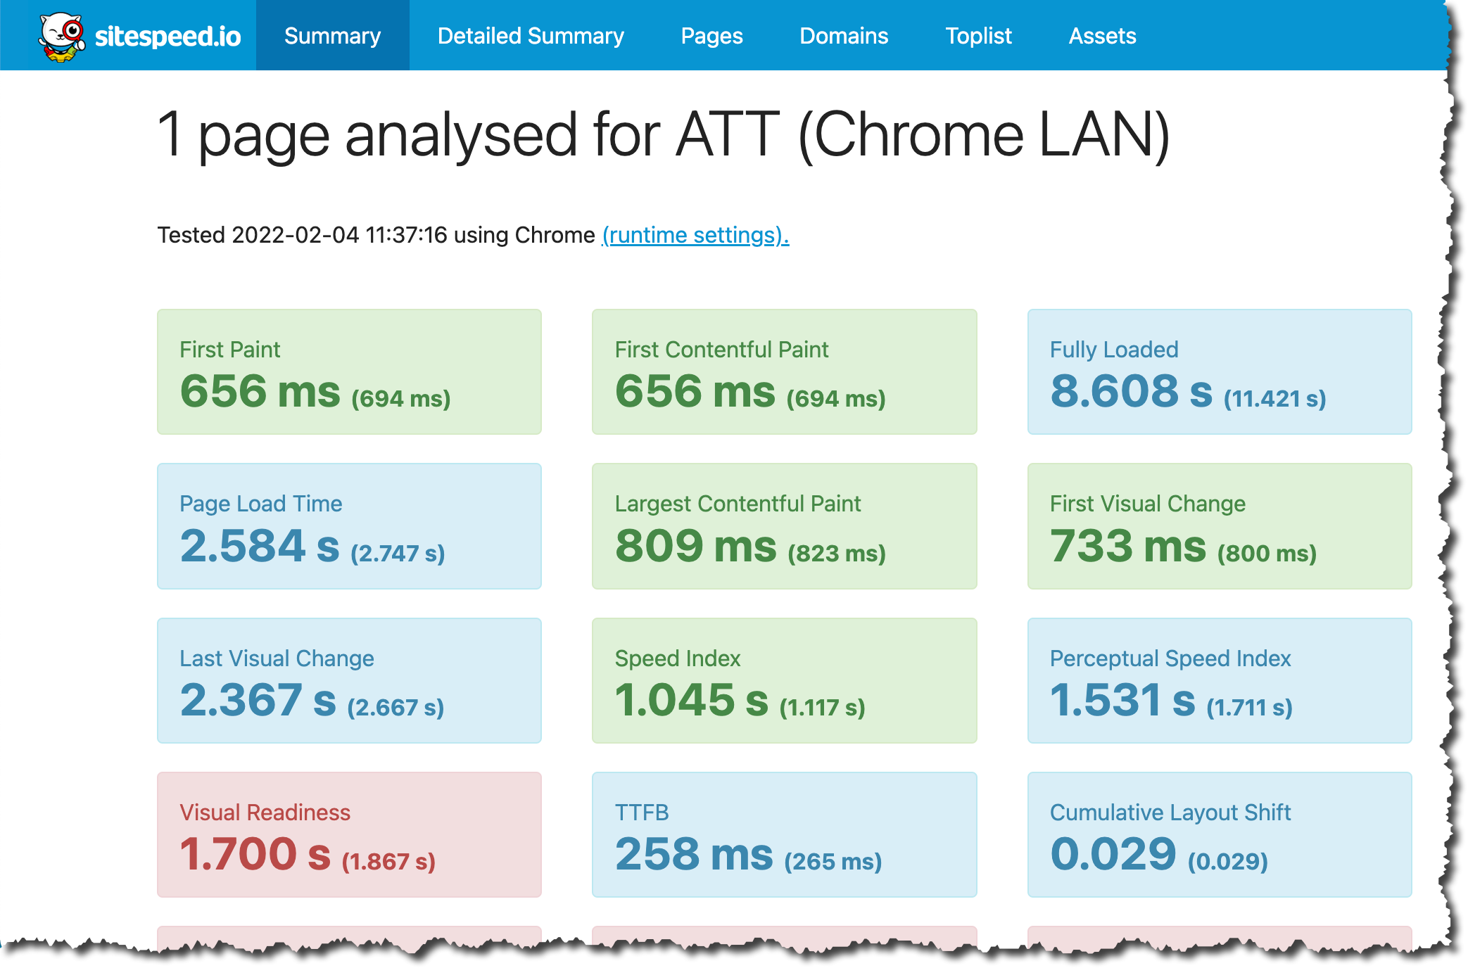
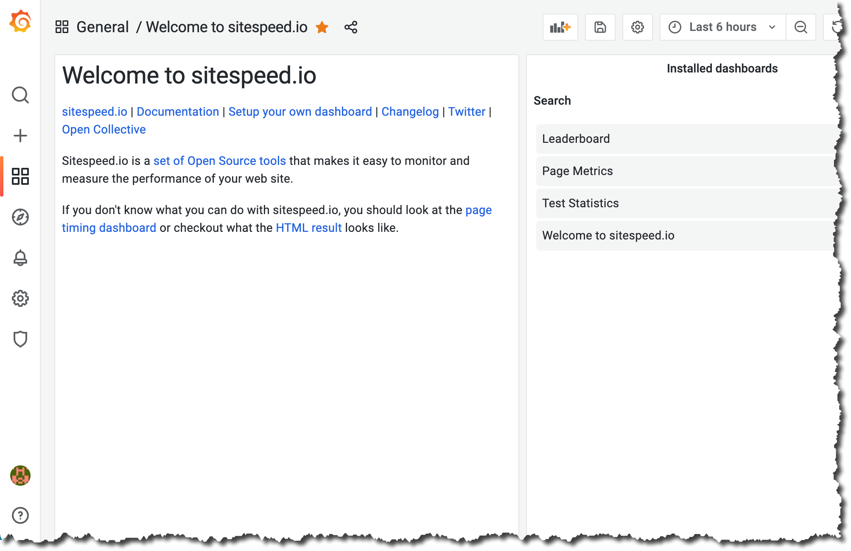
Interfaces
Sitespeed.io
Open access
Dynamically updated
Grafana
Restricted access
Rich dashboard capabilities

Slide 8

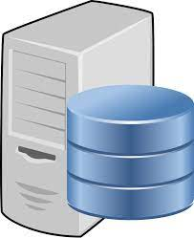
Servers
Jump
Sitespeed *
Google
Administration
Data flow
* One machine in each testing location
Graphite/Grafana

Slide 9

SSH Security
Google
Key Pair 2 (Public)
Jump
Graphite/Grafana
Key Pair 2 (Public)
Key Pair 1 (Private)
Key Pair 1 (Public)
Sitespeed
Key Pair 2 (Private)
Key Pair 2 (Public)
Notes:
Web access to Graphite is restricted via F/W rule only from home network
All Docker related data is mapped outside container for persistence
Grafana installed natively for more control of configuration and frequency of updates

Slide 10
Firewall Security
Jump
Sitespeed
Google
Graphite/Grafana
OPEN
TCP 22* (unrestricted)
TCP 80/443 (unrestricted)
ICMP (unrestricted)
OPEN
TCP 22* (Admin Portal)
TCP 80/443 (unrestricted)
ICMP (unrestricted)
OPEN
TCP 22* (Admin Portal)
ICMP (unrestricted)
OPEN
TCP 22* (Admin Portal)
TCP 80/443 (unrestricted)
TCP 8888*, 2003* (Sitespeed/Google)
ICMP (unrestricted)
* Refer to Sitespeed Admin Guide if you plan to use Akamai CDN
Default Rule – Drop all unmatched traffic

Slide 11



Software Components
Jump, Sitespeed, Google
Graphite/Grafana
Sitespeed.io running in Docker
nginx web server
HTTPS 443
Graphite running in Docker
HTTP 8888
Carbon TCP 2003
Grafana runs natively
Embedded Apache server
HTTPS 443
Notes:
Web access to Graphite is restricted via F/W rule only from home network
All Docker related data is mapped outside container for persistence
Grafana installed natively for more control of configuration and frequency of updates

