Slide 1
Site Analysis Portal
February 2022

Slide 2

Continuous Testing
Test 1
Test 2
Test 3
Test 4
Test 5
Test 6
Competitive Analysis
Single Domain
Single Domain
Up to 5 URLs
Every 3 hours
3 iterations
LAN and LTE
Competitive Analysis
Up to 7 URLs
Every 4 hours
1 iteration
LAN and LTE
Notes:
Single Domain and Competitive Analysis are stored in Graphite in two different namespaces
Complete flexibility in how tests are set up
Nothing set in stone about the number of single domain vs competitive analysis tests

Slide 3


Data Flow
Latest Result
Latest Result
Test 1
Test 2
Test 3
Test 4
Test 5
Test 6
Competitive Analysis
Single Domain
All Results
All Results

Slide 4


Site Analysis Portal
www.hilltoptech.net
Single Domain
Competitive Analysis
Notes:
hilltoptech.net is my personal domain running on GoDaddy

Slide 5
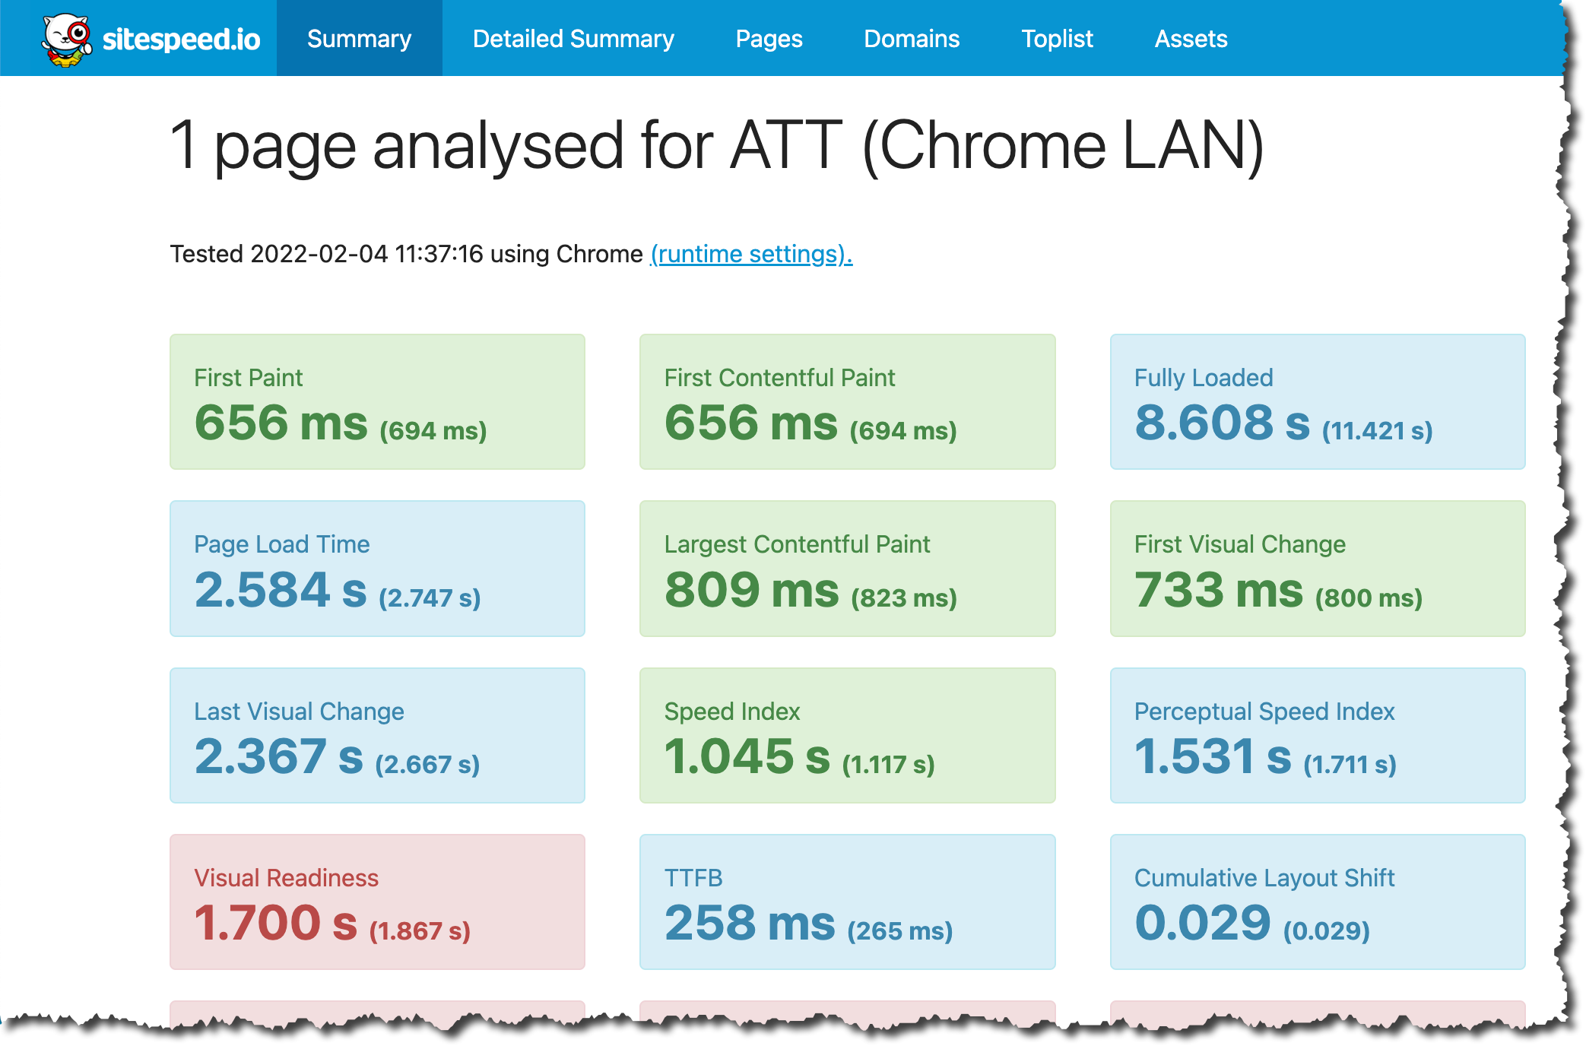
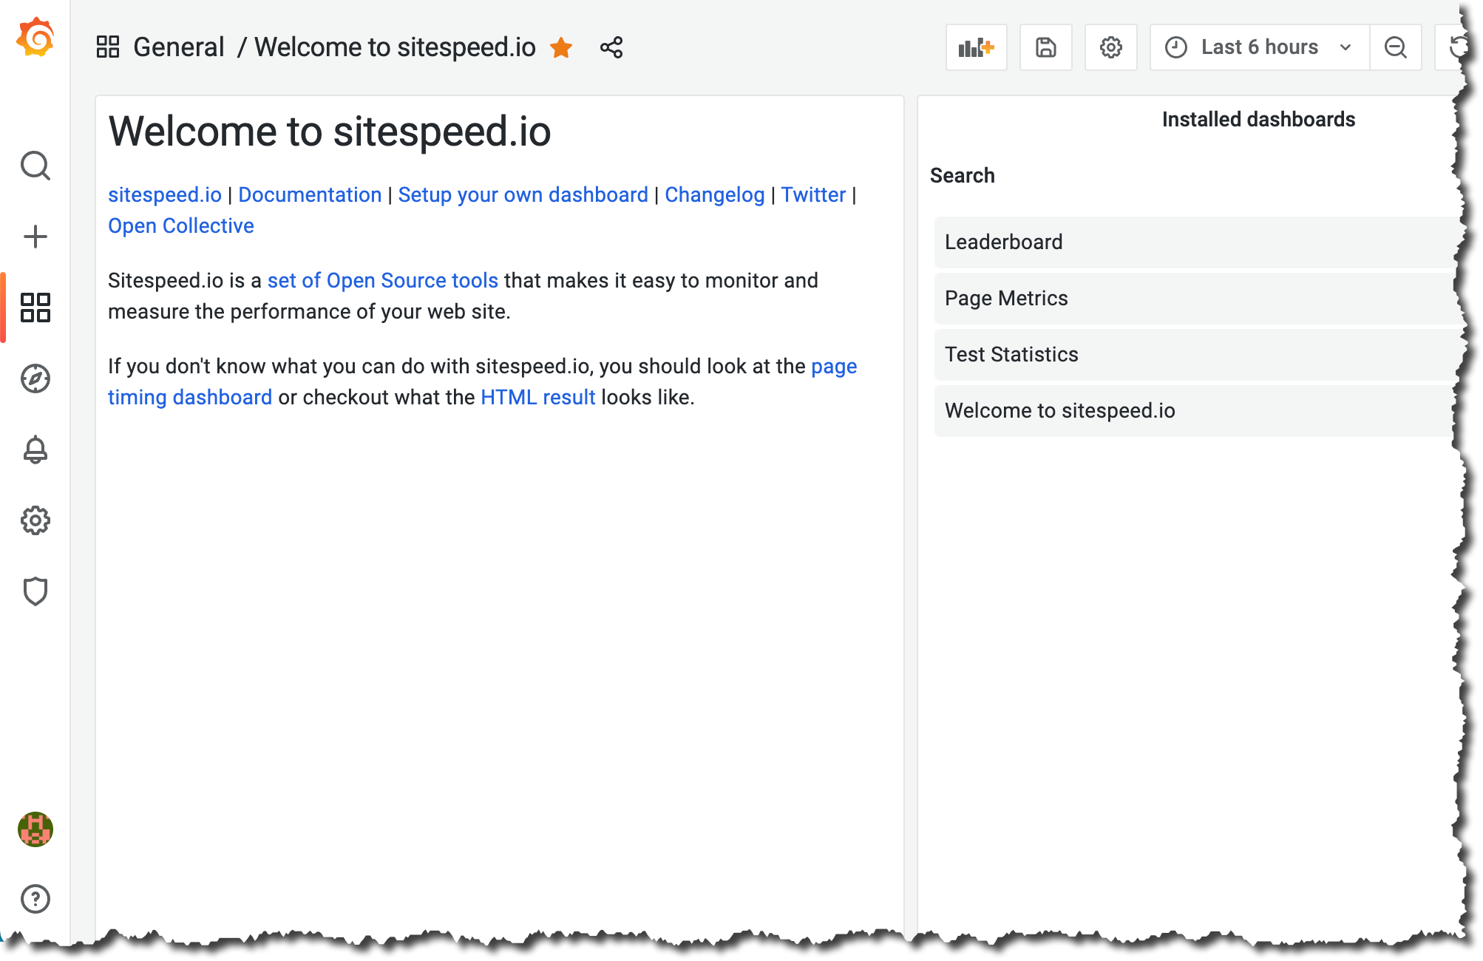
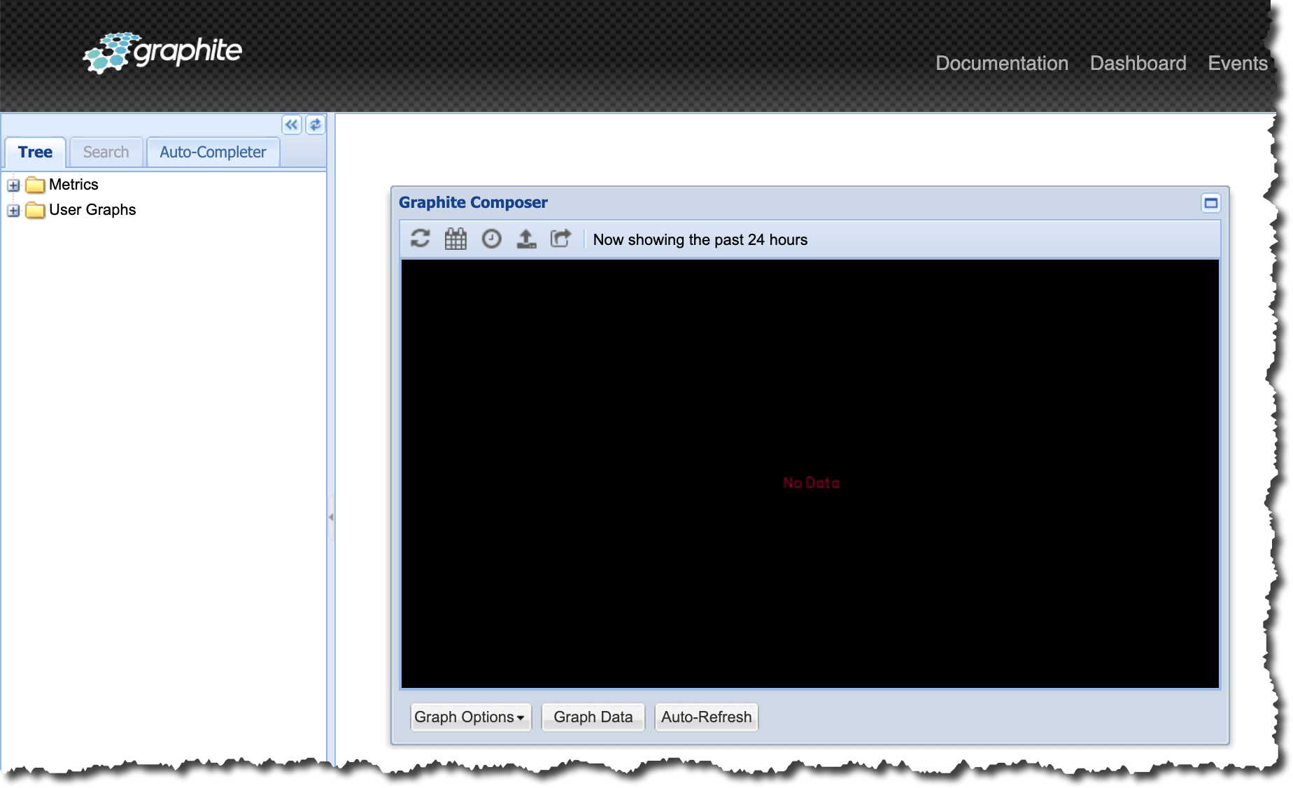
Interfaces
Sitespeed.io
Open access
Dynamically updated
Grafana
Restricted access
Rich dashboard capabilities
No data segmentation in place
Graphite
Restricted access
Used only for health check

Slide 6

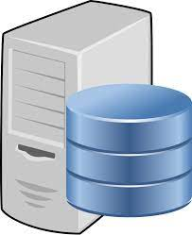
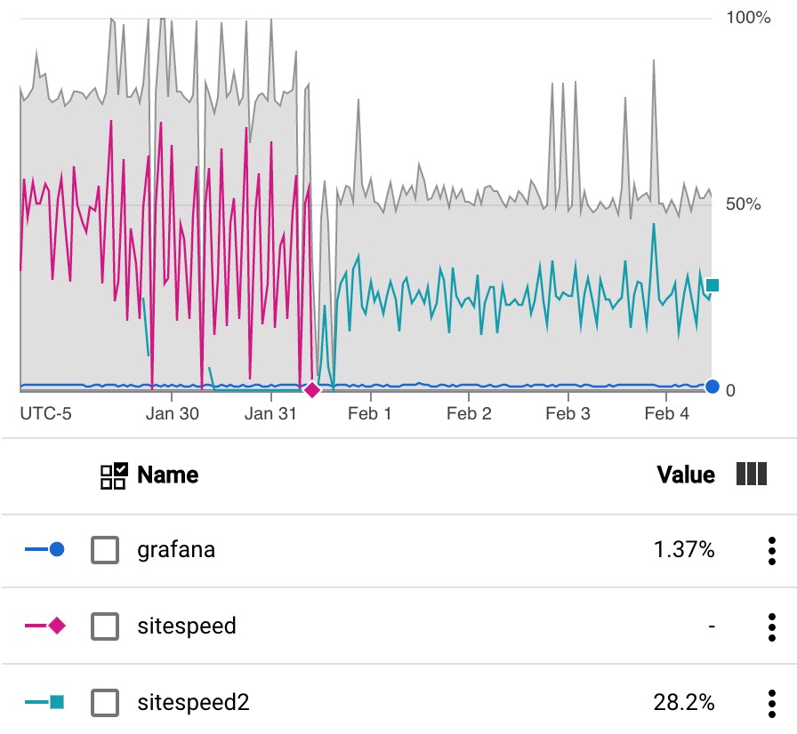
Hardware Architecture
Google
Sitespeed.io
Graphite/Grafana
US Region, Central Zone
Single VPC
GCE running CentOS 8
4 vCPU, 8GB RAM, 40GB HDD
Static public facing IP
GCE running CentOS 8
2 vCPU, 8GB RAM, 100GB HDD
Static public facing IP
2 vCPUs
4 vCPUs

Slide 7



Software Components
Sitespeed.io
Graphite/Grafana
Sitespeed.io running in Docker
nginx web server
HTTP 80 HTTPS 443
Graphite running in Docker
HTTP 8888*
Carbon listens on TCP 2003
Grafana runs natively
Embedded Apache server
HTTP 80
Notes:
Web access to Graphite is restricted via F/W rule only from home network
All Docker related data is mapped outside container for persistence
Grafana installed natively for more control of configuration and frequency of updates

Slide 8
Use Cases
Single source of data for TBAs, web site analysis, general research, etc.
One stop for all vital metrics
Domain and Page Metrics
Site Construction
1st & 3rd Party Information
Largest JS, CSS, and Images
Slowest First and Third-Party Resources
Prescriptive Guidance
Core Web Vitals
Waterfall
Filmstrip
Video
Rigor replacement…
Synthetic testing is a perfect complement to mPulse RUM data
Data can be used for reports and/or used to drive live customer discussions
Notes:
Siteseed.io was chosen for its rich analysis capabilities and ability to store results in a TSDB

Slide 9
Why Sitespeed.io?
Created in 2012 as an open-source project
Easy to configure and run!
Capabilities continue to evolve/improve with 700+ developers
Full integration with tools such as WPT, CrUX, PSI, Lighthouse, S3, GCS, Graphite, InfluxDB
Well documented and great support (Github, Slack, Facebook, Twitter)
All test results saved in a database
Extensive scripting support for multi-page journeys
SPA support
The list goes on …
Sitespeed.io

Slide 10
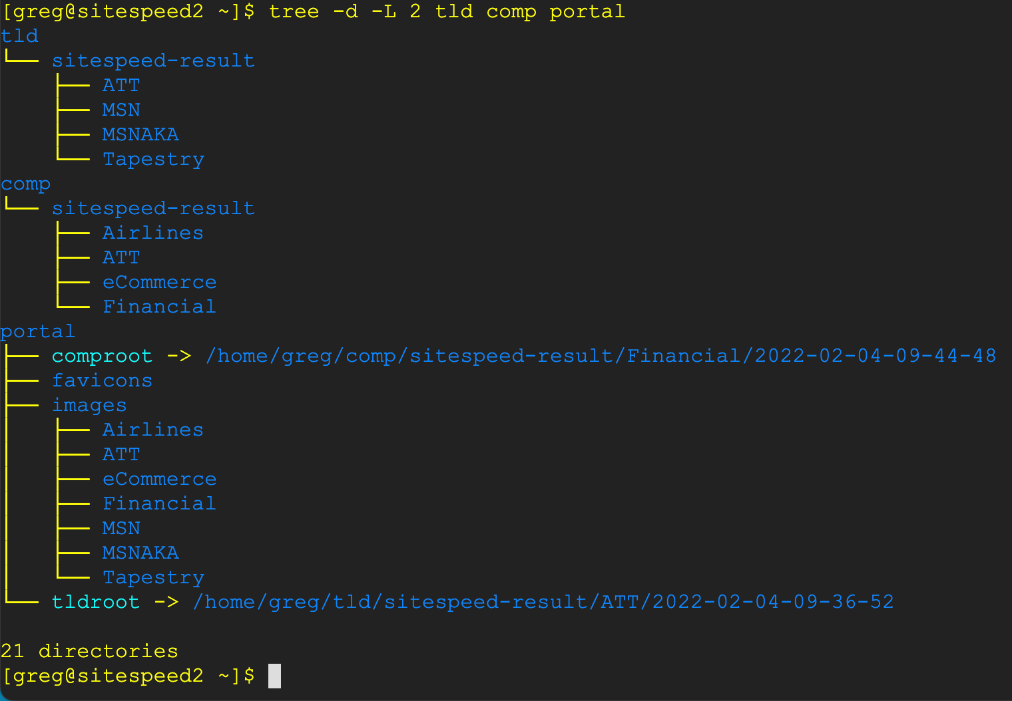
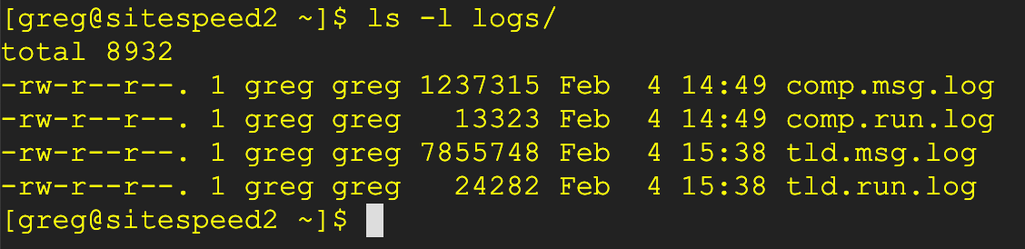
Folder Structure
Single Domain
Competitors
www.hilltoptech.net
Dynamically changing symbolic links
Logs

Slide 11
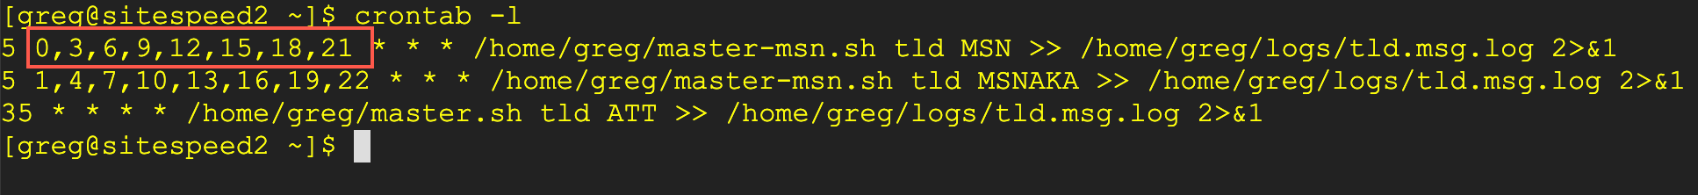
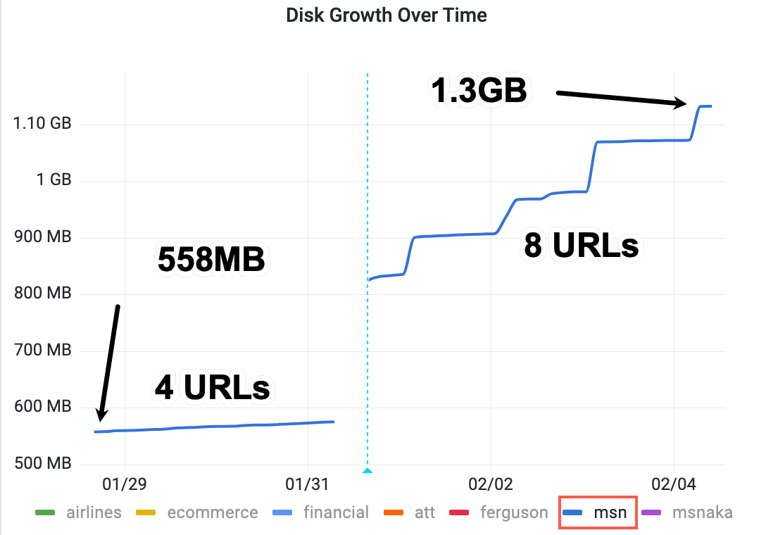
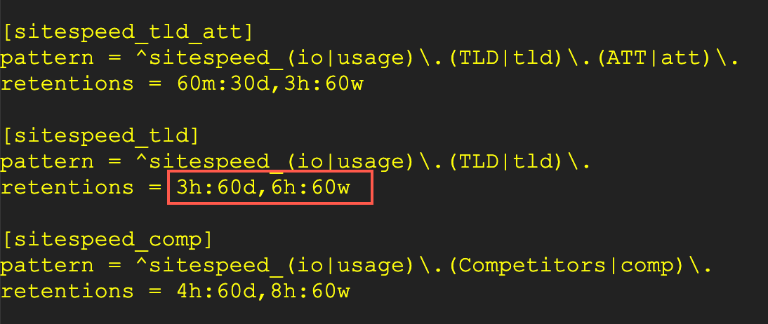
Database Sizing
Database sizing is driven by the frequency of data collection and the amount of time the data will remain in the database without being rolled off

Slide 12
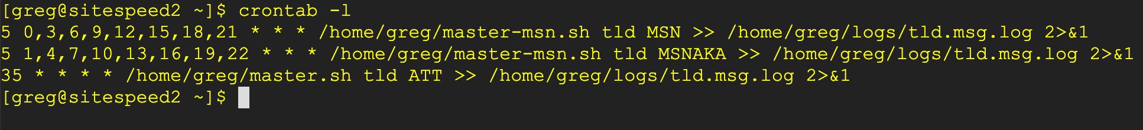
Setup and Configuration
Step 1 – Create URL seed file in either ~/tld or ~/comp depending on the test type
https://www.delta.com/ Delta
https://www.united.com/ United
https://www.southwest.com/ Southwest
https://www.aa.com/ American
https://www.jetblue.com/ jetBlue
https://www.alaskaair.com/ Alaska
https://www.flyfrontier.com/ Frontier
Airlines.txt
Namespace
Step 2 – Create a crontab entry
Test name = Seed file

Slide 13
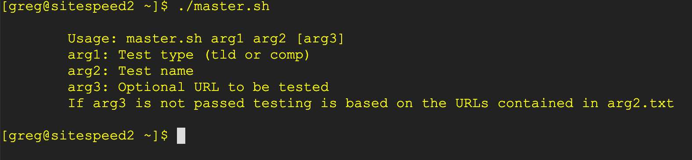
Operation
The entire process is driven by ONE script called master.sh
Requires two arguments
The third argument is optional and can be used to test a single URL on the fly
The execution of master.sh performs consistency checks and will not proceed until all prerequisites have been satisfied

Slide 14

Utilities
System check → syschk.sh
Log check → logchk.sh
Web permissions → nginx.sh
Reset EVERYTHING → reset.sh
Docker installation → install-docker.sh
Graphite → start-graphite.sh

Slide 15
Future Direction/Features
Co-exist with CuRe on ECP
Implement using Kubernetes
Ability to configure tests using Web interface
Ability to run “one off” tests and access the output on the portal indefinitely until overwritten

