Slide 1
Site Analysis Portal
June 2022

Slide 2

Continuous Testing
Single Domain and Competitive Analysis is driven by Sitespeed.io
Testing occurs hourly, each URL is tested three times, and all testing occurs over a LAN and LTE connection
The number of unique tests and the number of URLs that can be tested in parallel depends on the number of other tests currently running
Test 1
Test 2
Test 3
Test 4
Test 5
Test 6
Competitive Analysis
Single Domain
Notes:
Single Domain and Competitive Analysis are stored in Graphite in two different namespaces
Complete flexibility in how tests are set up
Nothing set in stone about the number of single domain vs competitive analysis tests

Slide 3


Data Flow
Latest Result
Latest Result
Test 1
Test 2
Test 3
Test 4
Test 5
Test 6
Competitive Analysis
Single Domain
All Results
All Results

Slide 4


Site Analysis Portal
Sitespeed Portal
Single Domain
Competitive Analysis

Slide 5
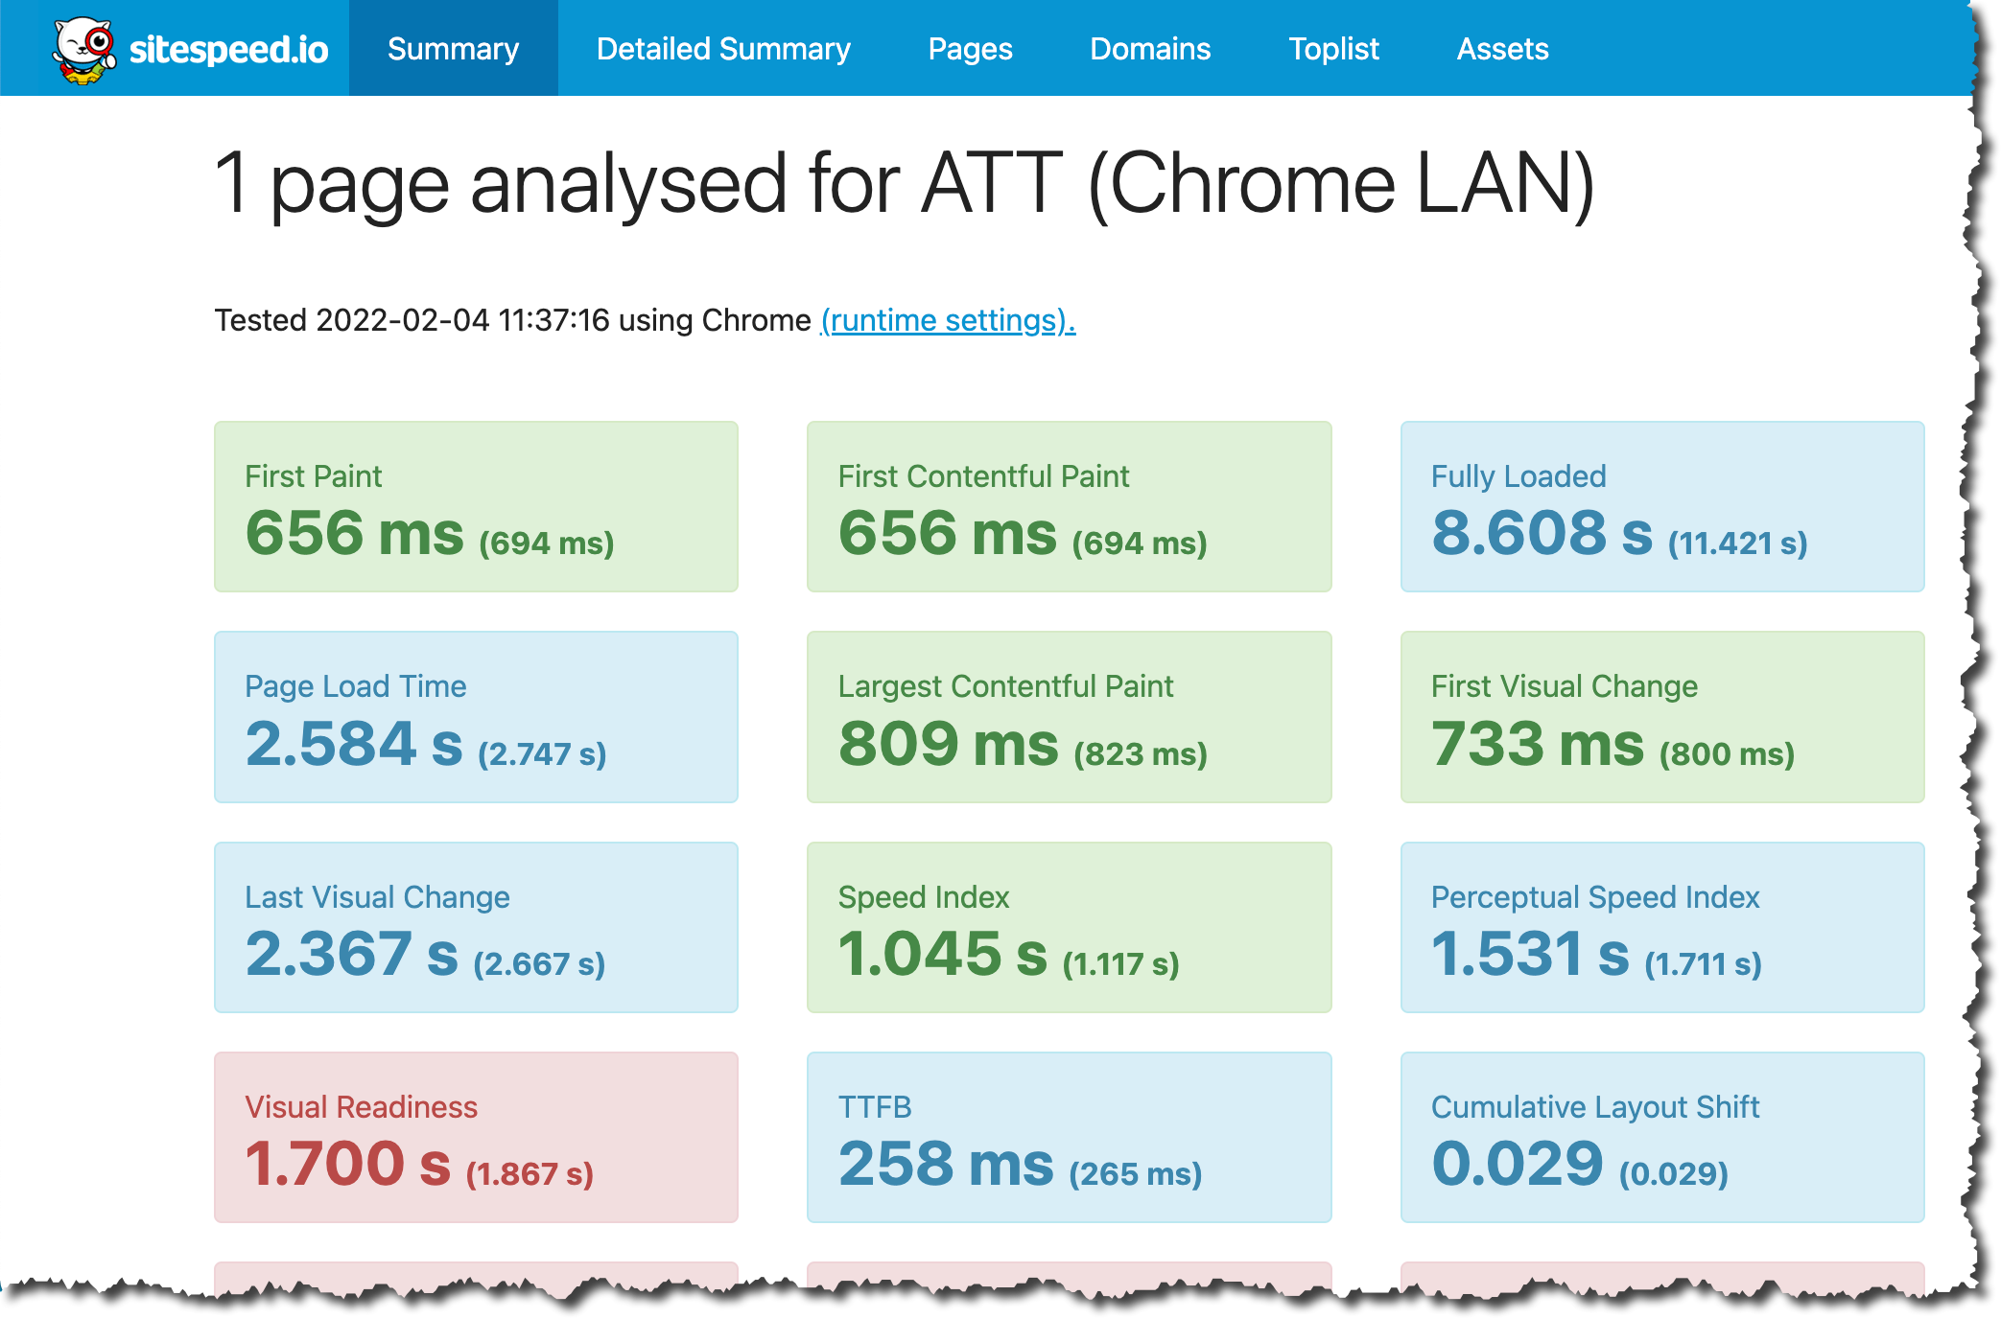
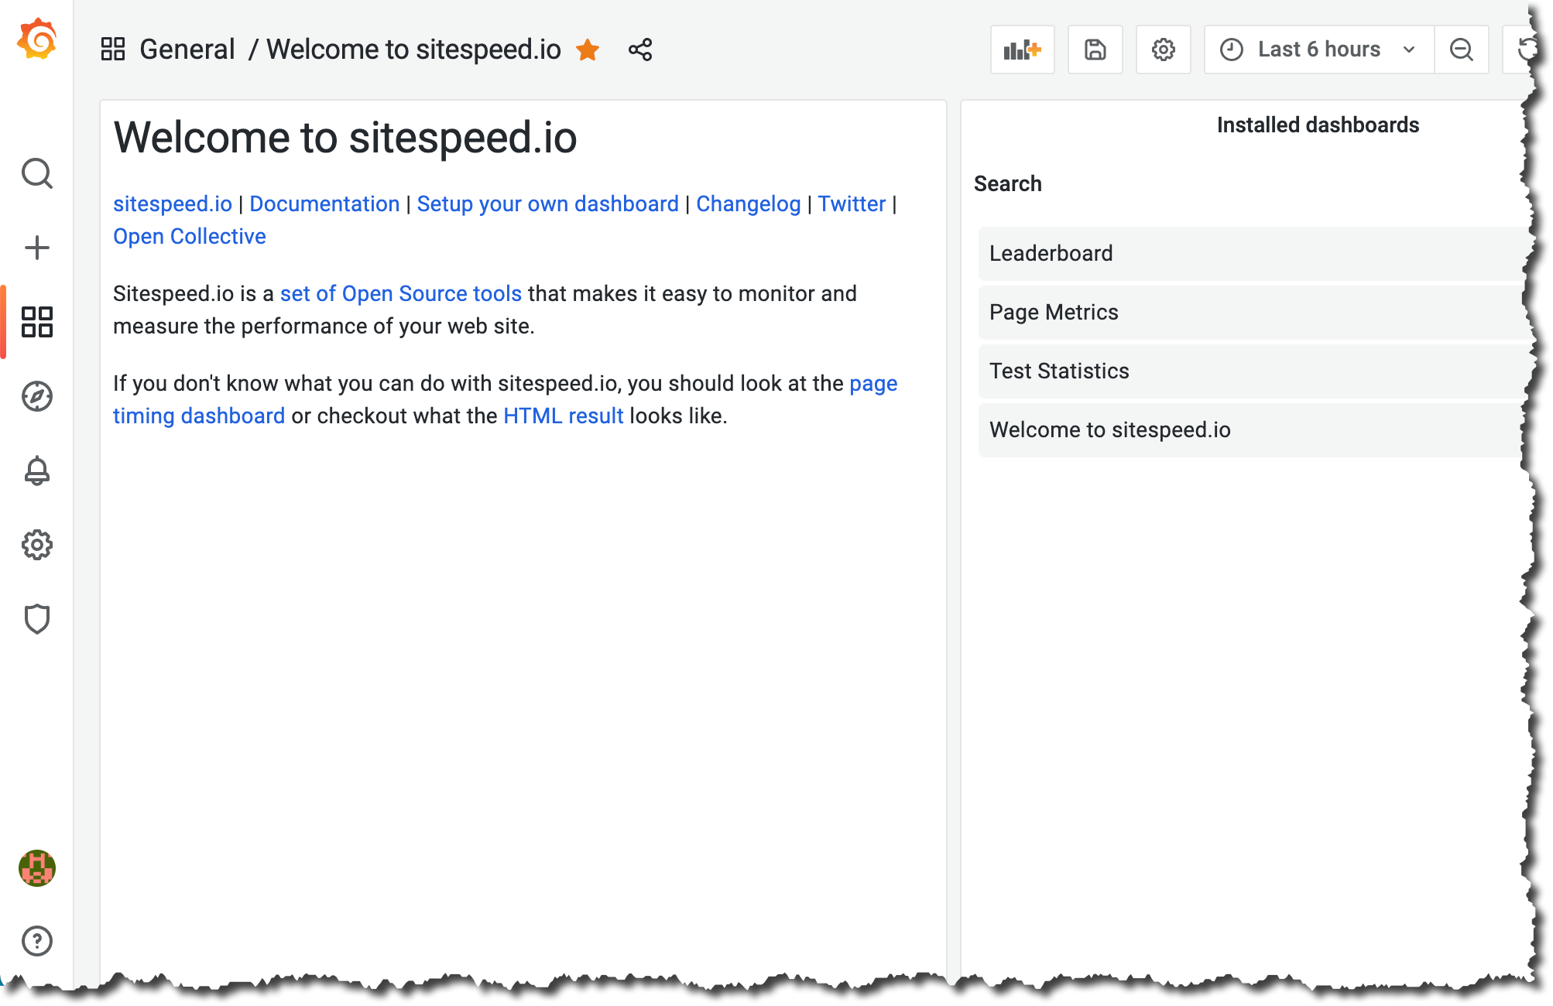
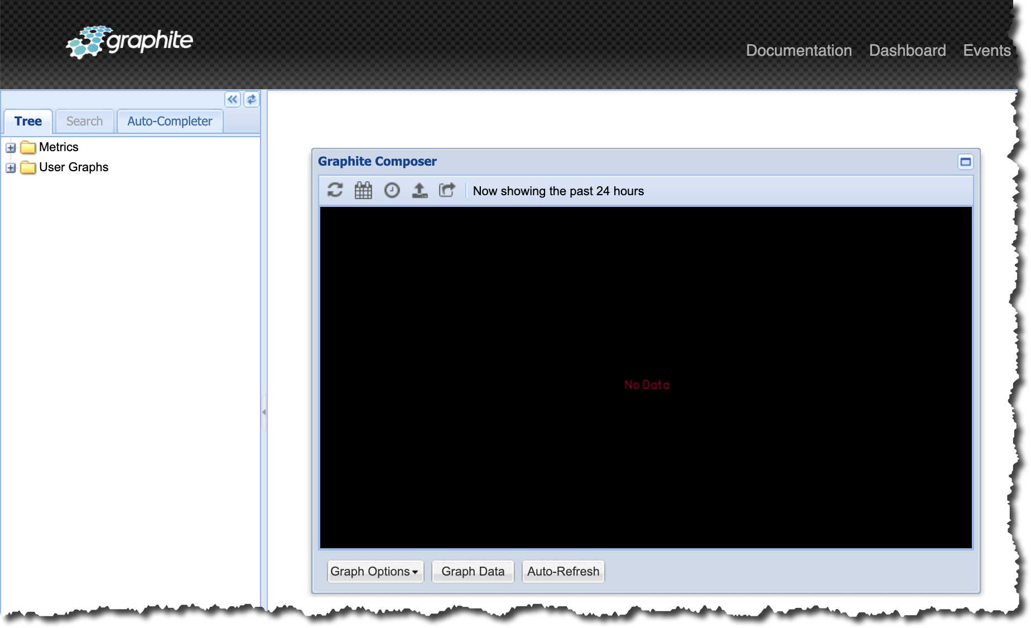
Interfaces
Sitespeed.io
Open access
Dynamically updated
Grafana
Restricted access
Rich dashboard capabilities
Graphite
Restricted access
Used only for health check

Slide 6
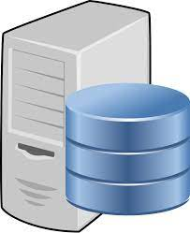

Hardware Architecture
Sitespeed.io
Linode
Graphite/Grafana
CentOS 7
8 CPU, 16GB RAM, 320GB HDD
Static public facing IP
Sitespeed machines operating in:
CentOS 7
16 CPU, 32GB RAM, 1TB HDD
Static public facing IP
Database located in New Jersey
New Jersey
Dallas
California
Toronto
London
Frankfurt
Singapore
Tokyo
Mumbai
Sydney

Slide 7



Software Components
Sitespeed.io
Graphite/Grafana
Sitespeed.io running in Docker
nginx web server
HTTP 80 HTTPS 443
Graphite running in Docker
HTTP 8888
Carbon TCP 2003
Grafana runs natively
Embedded Apache server
HTTP 3000
Notes:
Web access to Graphite is restricted via F/W rule only from home network
All Docker related data is mapped outside container for persistence
Grafana installed natively for more control of configuration and frequency of updates

Slide 8
Use Cases
Single source of data for TBAs, web site analysis, general research, etc.
Collect data for competitive benchmark studies
One stop for all vital metrics
Domain and Page Metrics
Site Construction
1st & 3rd Party Information
Largest JS, CSS, and Images
Slowest First and Third-Party Resources
Prescriptive Guidance
Core Web Vitals
Waterfall
Filmstrip
Video
Synthetic testing is a perfect complement to mPulse RUM data
Data can be used for reports and/or used to drive live customer discussions
Notes:
Siteseed.io was chosen for its rich analysis capabilities and ability to store results in a TSDB

Slide 9
Why Sitespeed.io?
Created in 2012 as an open-source project
Easy to configure and run!
Capabilities continue to evolve/improve with 700+ developers
Full integration with tools such as WPT, CrUX, PSI, Lighthouse, S3, GCS, Graphite, InfluxDB
Well documented and great support (Github, Slack, Facebook, Twitter)
All test results saved in a database
Extensive scripting support for multi-page journeys
SPA support
The list goes on …
Sitespeed.io

Slide 10
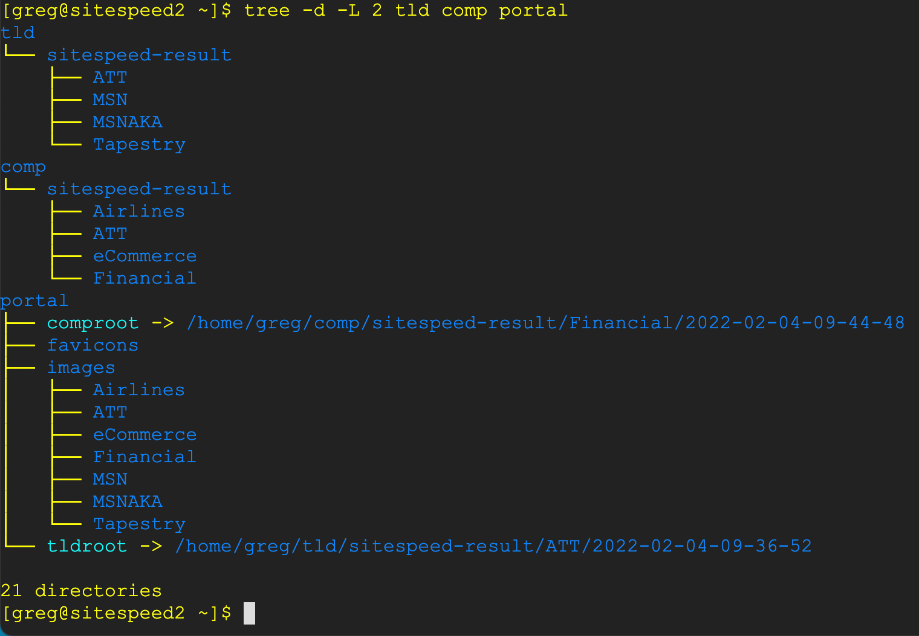
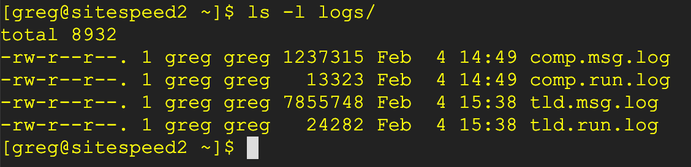
Folder Structure
Single Domain
Competitors
Dynamically changing symbolic links
Logs

Slide 11
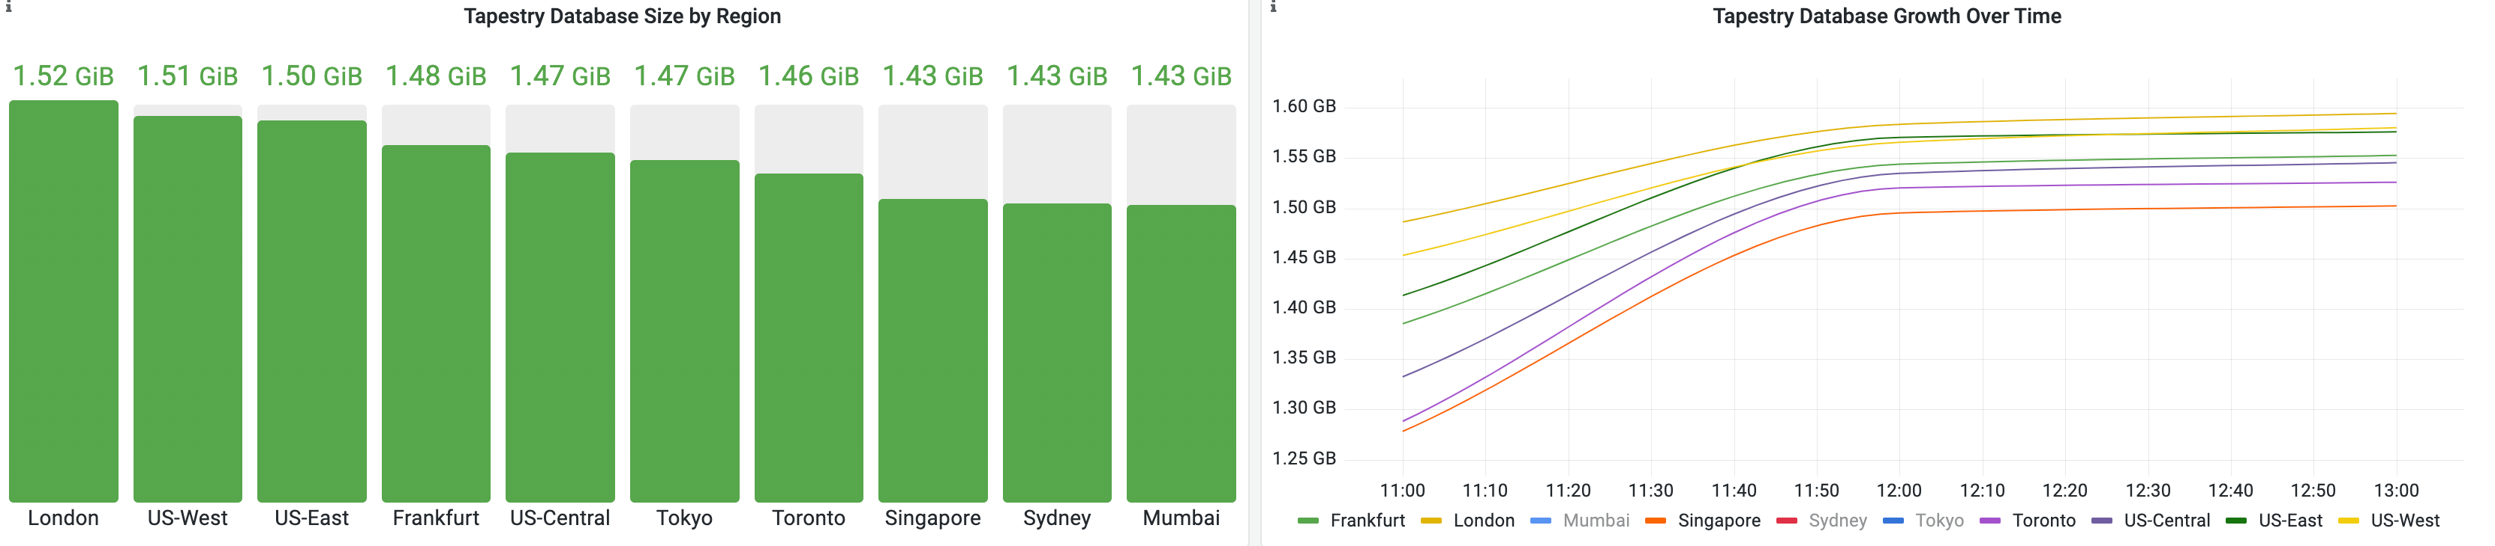
Database Sizing
Database sizing is driven by the frequency of data collection and the amount of time data will be saved
Table size is defined at creation, which makes storage planning very deterministic
Testing consisting of 10 URLs done on an hourly basis that will be saved for 13 months will have an initial size of 1.5GB and then will increase ~100MB per run

Slide 12
Setup and Configuration
Step 1 – Create URL seed file
eCommerce.txt
ATT.txt
https://www.abercrombie.com/shop/us Abercrombie Abercrombie
https://shop.lululemon.com/ Lululemon Lululemon
https://www.gap.com/ Gap Gap
https://www.zara.com/ Zara Zara
https://www.ae.com/us/en American-Eagle American-Eagle
https://www.apple.com/ Apple Apple
https://www.etsy.com/ Etsy Etsy
https://www.nike.com/ Nike Nike
https://www.att.com/ Home ATT
https://www.att.com/deals/ Deals ATT
https://www.att.com/wireless/ Wireless ATT
https://www.att.com/buy/phones/ PLP ATT
Step 2 – Push seed file(s) out to Linode servers
Step 3 – Configure a testing schedule and push schedule to all Linode servers
All scripts and documentation are available on Github

Slide 13
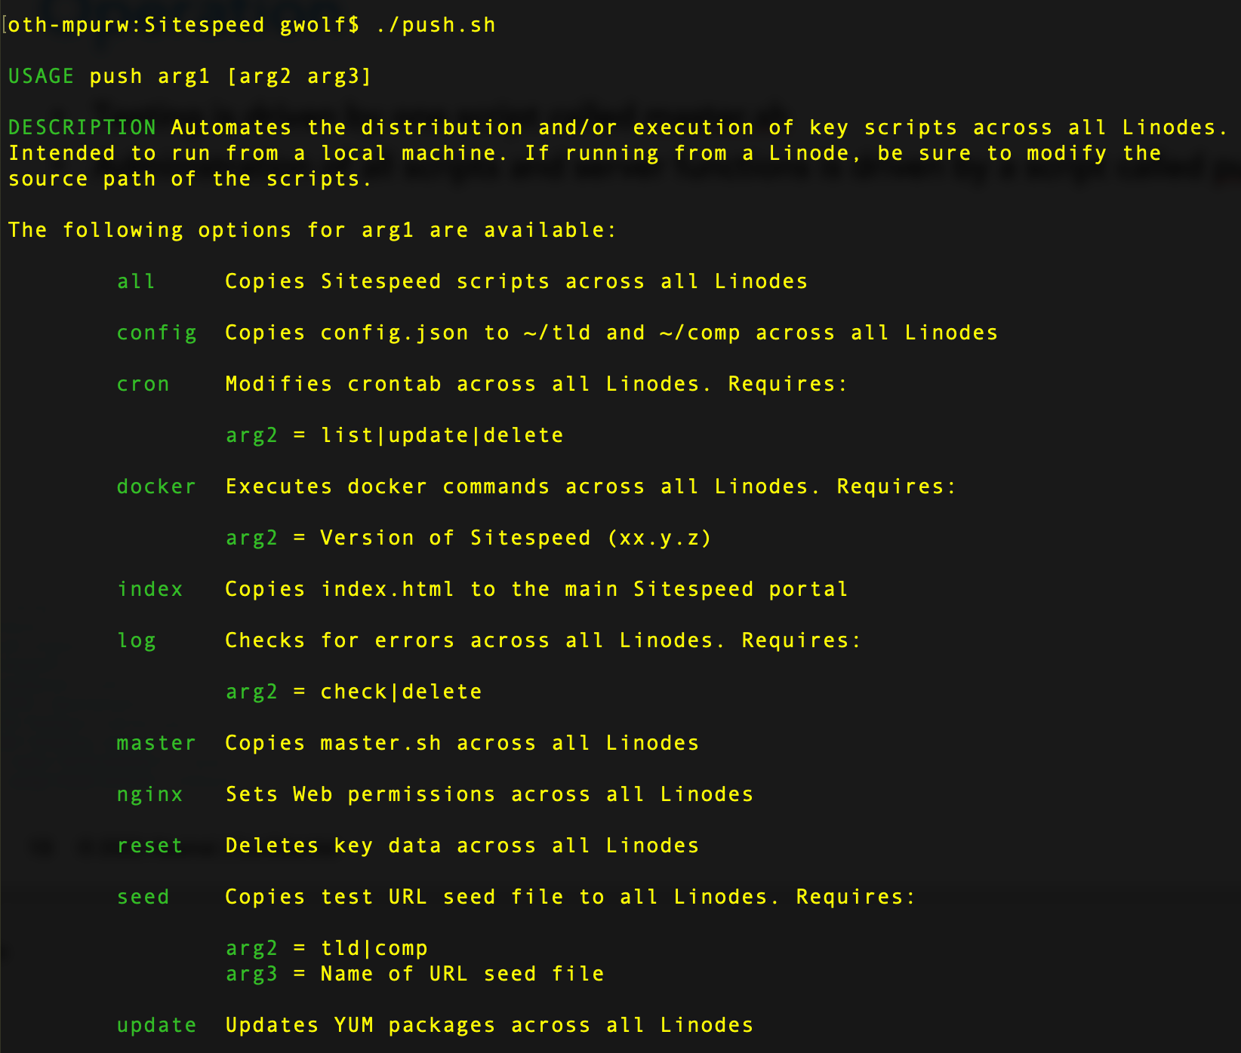
Operation
Testing is driven by one script called master.sh
Administration of scripts and server functions is driven by a script called push.sh

Slide 14

Utilities & Documentation
System check → syschk.sh
Web permissions → nginx.sh
Reset EVERYTHING → reset.sh
Docker installation → install-docker.sh
Graphite → start-graphite.sh
Global administration → push.sh
Fully documented → https://git.source.akamai.com/projects/A2S/repos/sitespeed

