Slide 1
Akamai
AI Engineer World's Fair · 120-minute hands-on workshop
Agents That Own Their Inference
Building production AI agents on dedicated GPUs. Stand up vLLM, drive real load, read the metrics, and tune the server you control.
Du'An Lightfoot · Senior AI Engineer, Akamai Cloud

Slide 2
THE COLD OPEN
Every production agent today is renting its intelligence
You pay per token, and the bill grows with every user.
You send your data to someone else's servers.
You inherit their rate limits, exactly when a launch needs headroom.
Per-token pricing scales linearly with usage. A dedicated GPU is a fixed cost per hour. Somewhere between the two is a crossover you can compute.

Slide 3
WHO CARRIES THE LIABILITY
For four kinds of teams, renting becomes a liability
Regulated industries. Your prompts and data leave your boundary on every call.
High-volume products. The token bill is linear and uncapped; it grows with every user.
Latency-sensitive workloads. You cannot tune a queue you do not own.
Rising token bills. Past some volume, a fixed GPU cost is cheaper than per-token pricing.

Slide 4
THE BREAK-EVEN
Rent versus own is arithmetic, not ideology
Rent (hosted API)
Own (dedicated GPU)
Your tokens on someone else's GPUs
Your card, your cluster
✕
Data leaves your network on every call
✓
Data stays inside your cluster
✕
Cost = tokens x price, linear forever
✓
Cost = GPU hours, fixed regardless of tokens
✕
The provider sets your rate limit
✓
The only ceiling is the card you provisioned
✓
Zero ops to start
✓
You tune the server for your traffic

Slide 5
WHAT YOU DO IN THE NEXT TWO HOURS
Today you build on infrastructure you control
Stand up vLLM on your dedicated GPU.
Point your agent at it with one change: the base URL.
Drive concurrent load until the metrics show you batching, KV cache pressure, and the throughput limit.
Then optimize lift throughput while you hold per-request latency in line.

Slide 6
01
First, the machine under the agent
Four mental models the labs make visible: prefill and decode, the KV cache, continuous batching, and the saturation knee.

Slide 7
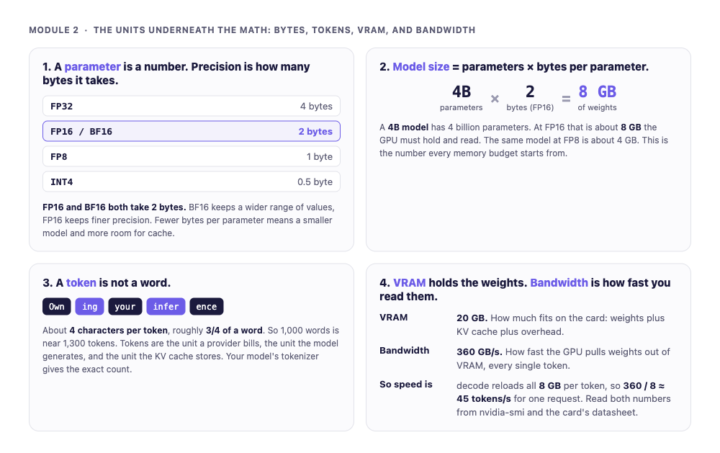
BEFORE THE MENTAL MODELS
Start with the units
A parameter stored in bytes, a model sized in GB, a token of about four characters, and a card described by VRAM and bandwidth. Everything later is built from these.

Slide 8
TWO NUMBERS ABOUT YOUR CARD, ONE ABOUT YOUR MODEL
How big is a 4B model, and how fast can it talk?
Size = parameters x bytes per parameter. A 4B model at 2 bytes (FP16 or BF16) is about 8 GB of weights.
Speed of one request = bandwidth / size. Reloading 8 GB per token on a 360 GB/s card is near 45 tokens per second.
The bill and the cache are counted in tokens. A token is about 4 characters, roughly three quarters of a word.
Model size, VRAM, and bandwidth. These three numbers decide everything that follows.

Slide 9
AUTOREGRESSIVE GENERATION
A model generates one token per forward pass
Each pass loads the full weight set from VRAM, does one matrix-vector product, samples a token, and appends it to the KV cache.
A 1000-token answer is 1000 sequential weight loads.
This is why decode speed tracks memory bandwidth, not raw compute.

Slide 10
TWO PHASES, TWO BOTTLENECKS
Prefill and decode are different machines
Prefill
Decode
The whole prompt at once
One token per step
✓
Matrix-matrix multiply (GEMM)
✓
Matrix-vector multiply (GEMV)
✓
Compute-bound: the tensor cores are busy
✓
Memory-bound: bandwidth is the wall
✓
Sets time to first token (TTFT)
✓
Sets time per output token (TPOT)
✓
Lever: batch prefills, add compute
✓
Lever: batch decode, or quantize

Slide 11
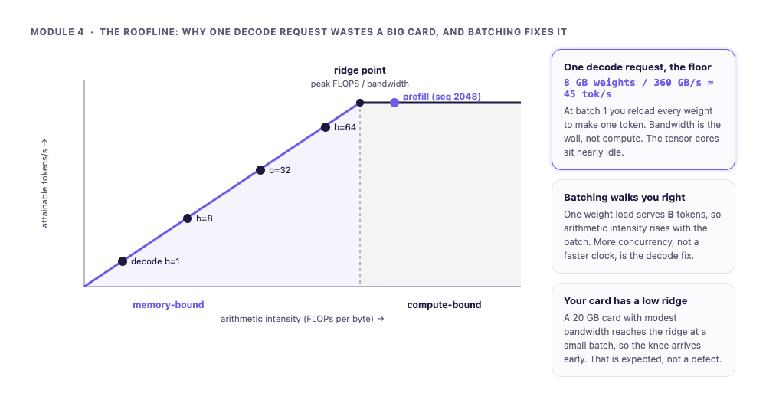
THE ROOFLINE, IN ONE CHART
Below the ridge point, you are memory-bound
Ridge point = peak compute / memory bandwidth. One decode request sits far down the memory-bound slope; batching walks it toward the ridge.

Slide 12
THE DECODE TAX, QUANTIFIED
At batch size one, decode wastes most of the card
A single request reloads every weight to produce one token.
Memory bandwidth is saturated while the tensor cores sit nearly idle.
The fix is not a faster clock. It is more requests sharing each weight load.
One decode request, ~8 GB of weights, a ~360 GB/s card: a ceiling near 45 tokens/s, no matter the software. You are using a fraction of what you paid for.

Slide 13
WHY THE KV CACHE EXISTS
The KV cache trades recomputation for memory
Without it, generating n tokens after a p-token prompt reprocesses the prefix every step, on the order of n-squared work.
With it, each step computes the key and value for just the new token. Decode goes linear.
The cache lives in VRAM and grows with every token and every concurrent request.
Without a cache, 1000 tokens on a 500-token prompt is about a million token-forward-passes. With it, 1000 single-token steps.

Slide 14
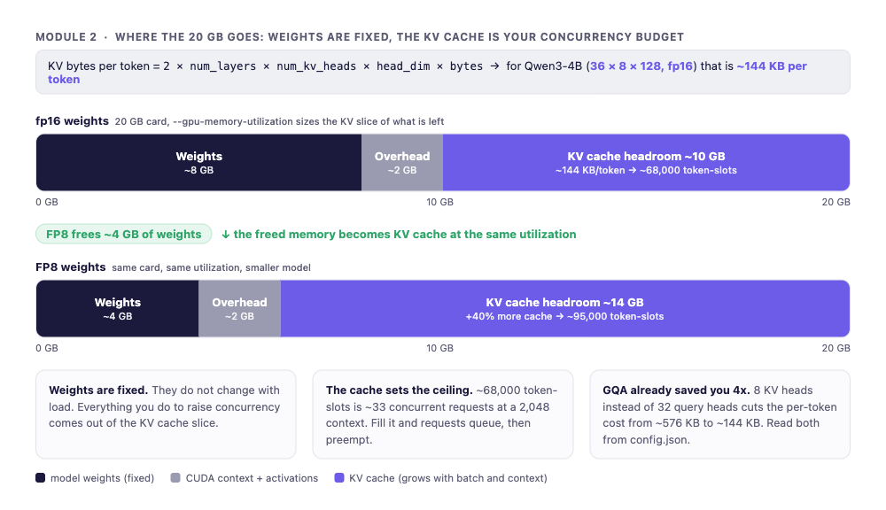
THE MEMORY MATH
Your VRAM budget sets your concurrency ceiling
KV bytes per token = 2 x layers x kv_heads x head_dim x bytes. Weights are fixed; the cache is the variable that decides how many requests fit.

Slide 15
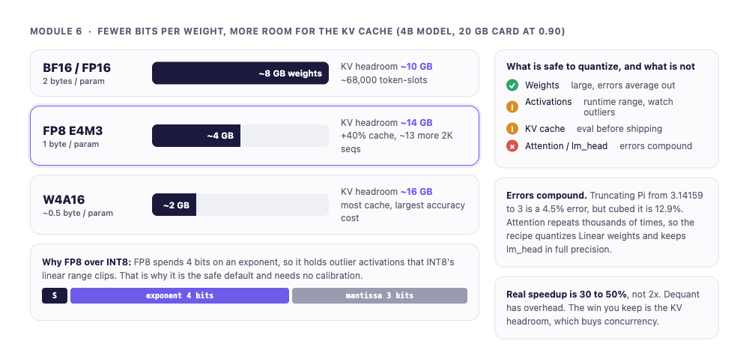
QUANTIZATION MOVES THE WALL
Smaller weights buy back KV headroom
FP8 halves the weights, so the freed memory becomes cache at the same utilization. Weights are safe to quantize; attention is not.

Slide 16
THE FIX VLLM SHIPS
Continuous batching keeps the GPU full
Static batching
Continuous batching
Pad to the longest, hold every slot
Refill slots every iteration
✕
Short requests finish early, slots sit idle
✓
Finished sequences leave, waiting ones enter
✕
About 56% slot utilization on mixed lengths
✓
Utilization holds above 95%
✕
A 1000 tok/s GPU yields about 560
✓
The single biggest throughput technique in vLLM

Slide 17
BATCHING IS THE LEVER
More concurrent requests move decode toward compute
One weight load serves one token at batch 1. At batch B it serves B tokens.
Same memory traffic, B times the output. Arithmetic intensity rises with B.
This is the quantitative reason concurrency, not a faster clock, is the decode fix.
num_requests_running shows the batch forming. max-num-seqs and max-num-batched-tokens are the knobs that set how full it gets.

Slide 18
02
Now drive it until you can see the limits
Saturate the GPU. Watch the metrics. Find the knee where throughput stops and latency takes off.

Slide 19
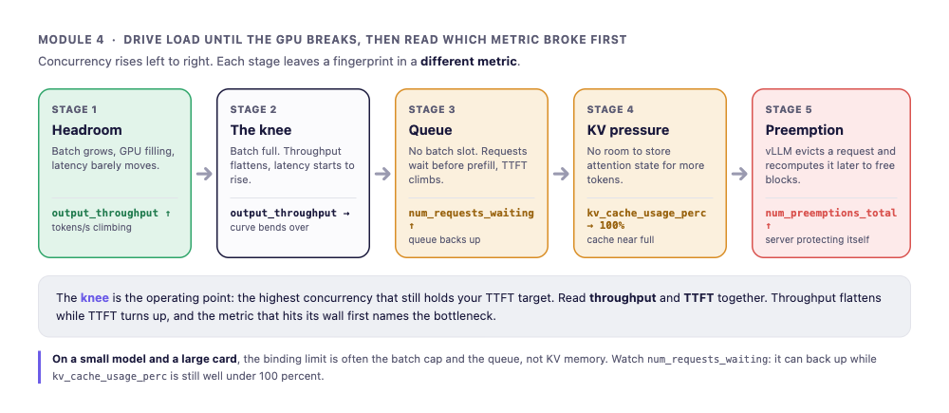
THE SATURATION KNEE
Throughput climbs, then the latency hockey-stick
Little's Law: requests in the server = arrival rate x time in the server. When num_requests_waiting goes above zero, you have passed the knee.

Slide 20
KV PRESSURE AND PREEMPTION
When the KV cache fills, the server starts evicting
KV cache usage climbs toward 100%. There is no room left to store attention state for more tokens.
vLLM preempts a running request, recomputing its cache later to free blocks. num_preemptions_total climbs.
Preemption is the server protecting itself, and the clearest sign you are past the limit, not a crash.

Slide 21
VLLM METRICS TELL THE TRUTH
Four numbers characterize the server
Throughput. Total tokens per second across all requests.
TTFT. The wait before the first token. Prefill-bound.
Inter-token latency. The gap between streamed tokens. Decode-bound.
The GPU view. Cache usage, requests running, requests waiting.
Report percentiles, not means. A wide p50-to-p99 gap is the tail hitting preemption, not steady service.

Slide 22
03
Change one knob. Measure. Keep what wins.
Lift throughput without breaking your latency SLO. Prove every change against the metrics, not against a hunch.

Slide 23
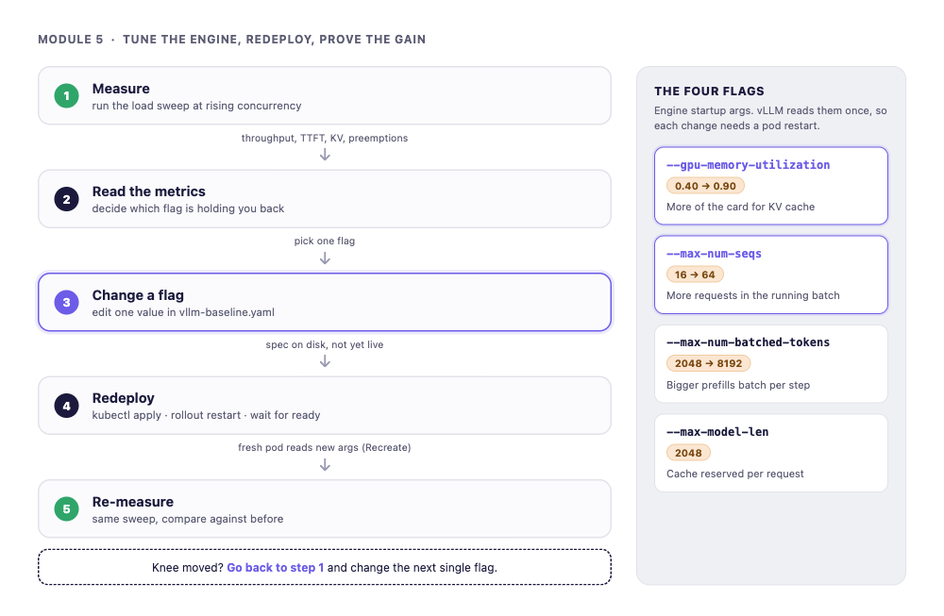
THE FOUR FLAGS THAT MATTER
The tune-and-prove loop, on a server you own
Measure, read the metrics, change one engine flag, redeploy, re-measure. The metrics pick the next flag, not a hunch.

Slide 24
SAME GPU, SAME MODEL
What tuning bought on one 20 GB card
3.4x
5x
64
more throughput from raising the batch caps, no new hardware
more KV cache going from 0.50 to 0.90 gpu-memory-utilization
concurrency at the knee under a 500 ms p95 TTFT target
The bottleneck moved because you moved it. No model change, no new card.

Slide 25
ONE VARIABLE AT A TIME
Prove it, do not assume it
Match your benchmark to production input and output lengths.
Sweep concurrency. Plot p95 TTFT and inter-token latency as you climb.
The operating point is the highest load where p95 still meets your SLO.
Aim for the highest throughput inside the SLO, not the highest average GPU-Util. A server at 60% that holds p99 beats one at 95% that blows the tail.

Slide 26
THE PAYOFF
An agent running on inference you own and understand
The agent points at your vLLM, on your GPU, not a rented API.
You can see batching, KV pressure, and the throughput limit in the metrics.
You tuned the deployment and proved the gain. The token bill is now a GPU-hour line.
Cost per million tokens = GPU hourly rate / tokens per hour at your real utilization. Owning wins when the card stays busy.

Slide 27
What to carry out of this room
✓ Decide rent versus own from volume and utilization, not vibes.
✓ Know your card: weights, KV bytes per token, bandwidth ceiling, before you launch.
✓ Saturate on purpose. Find the knee. Read cache usage and queue depth.
✓ Tune one knob at a time. Hold the latency SLO. Prove every change.
✓ Owning inference is an operations practice, not a one-time setup.
You rented intelligence on the way in. You can own it on the way out.

