Slide 1
Every slide in this deck takes its colours and type from one Vellum theme
A PowerPoint template with ten layouts, figures from the Vellum gallery and native charts
Vellum example deck · A. Kaminas · 12 October 2026

Slide 2
Figures from the gallery
01
PNG twins from matplotlib in picture placeholders; the dark deck takes the dark twins

Slide 3
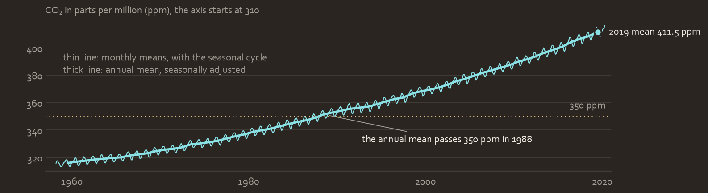
Carbon dioxide at Mauna Loa rose in every year from 1959 to 2019, by 96 ppm in all
Monthly mean CO₂, March 1958 to April 2020

Slide 4
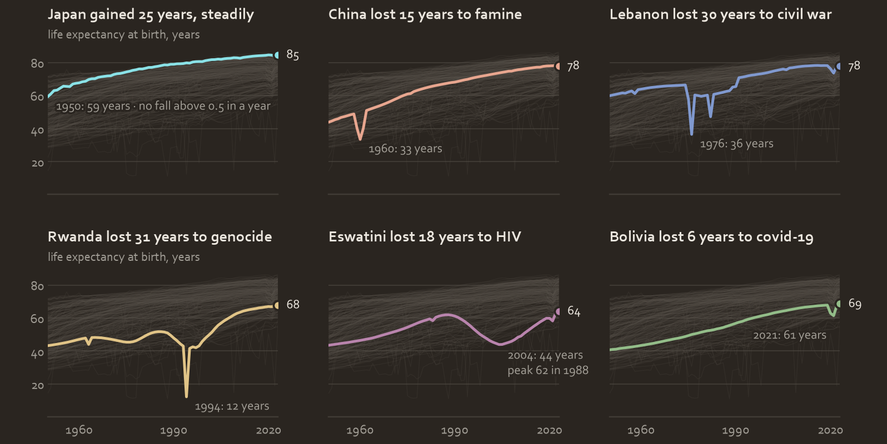
Life expectancy rose in all 236 countries since 1950, but the trend hides collapses
Life expectancy at birth

Slide 5
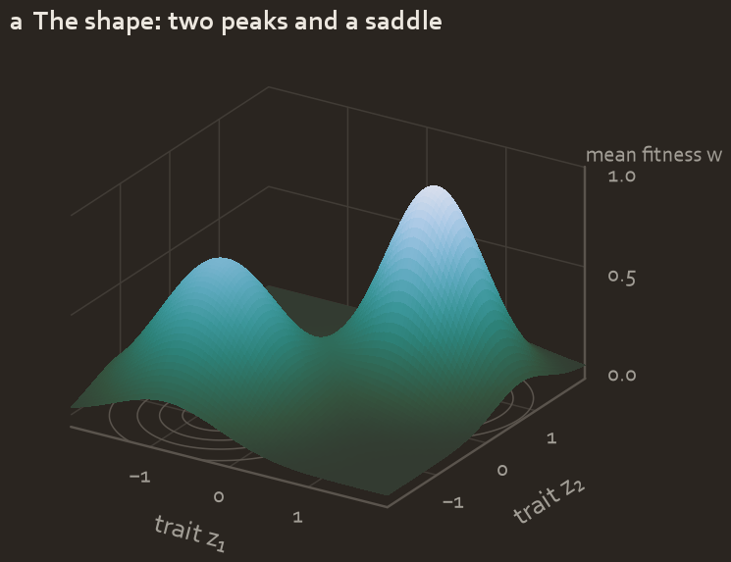
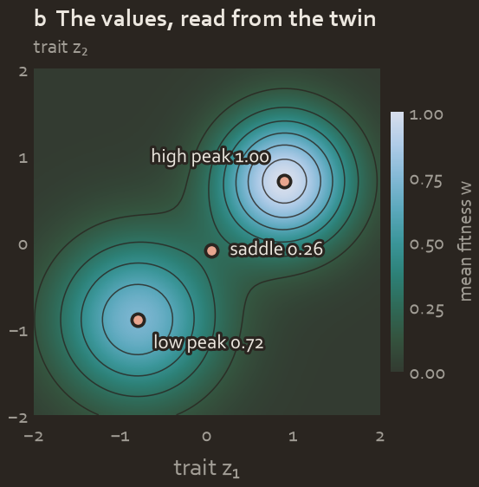
Two adaptive peaks, 1.00 and 0.72, are joined by a saddle at w = 0.26
Illustrative landscape w(z₁, z₂) · the same gradient and limits in both panels
The shape: orthographic view, elevation 24°, azimuth −58°
The values: the same surface as a heat map

Slide 6
Native charts, numbers and tables
02
Drawn by python-pptx in the theme’s colours and fonts, and editable in PowerPoint

Slide 7
Since 1950 life expectancy rose by 33 years in Asia, 27 in Africa and 17 in Europe
life expectancy at birth, years

Slide 8
From 2000 to 2025 wind and solar added 5,460 TWh, more than coal’s 4,663 TWh
world electricity generation by source, TWh

Slide 9
In 2025 low-carbon sources made 42.6 % of world electricity
42.6 %
In 2025 low-carbon sources added 883 TWh, more than the 842 TWh by which generation grew, so fossil generation fell by 41 TWh.
of world electricity generation in 2025
up from 35.3 % in 2000

Slide 10
The life-expectancy series covers 236 countries and territories over 74 years
Period life expectancy at birth, 1950–2023
236
countries and territories
17,464 country-years in all
74
years of annual estimates
1950 to 2023, one value a year
−1.7
years, the world’s fall from 2019 to 2021
the deepest since 1959–60

Slide 11
From 2019 to 2021 life expectancy fell by 0.1 years in Oceania and by 3.4 in Latin America and the Caribbean
Period life expectancy at birth by UN region, years · sorted by the fall
UN region | 2019 | 2021 | 2023 | fall, 2019–21
Latin America and the Caribbean | 75.3 | 71.8 | 75.7 | −3.4
Northern America | 79.3 | 76.9 | 79.6 | −2.3
Europe | 78.8 | 77.0 | 79.1 | −1.7
Asia | 74.0 | 72.4 | 74.6 | −1.7
Africa | 62.4 | 61.8 | 63.8 | −0.7
Oceania | 78.6 | 78.5 | 79.1 | −0.1

Slide 12
Every figure, chart and number here is drawn by a script from open data
A. Kaminas · akaminas.github.io/vellum
Deck: examples/python/office/make_pptx.py · figures: examples/python · data: data/SOURCES.md
Downloads: vellum-slides-light.pptx, vellum-slides-dark.pptx, vellum-office.tsv · git 4c16514-dirty

Slide 13
Using this template in PowerPoint and Canva
PowerPoint: Home → New Slide lists the ten Vellum layouts; Design → Variants holds the theme. File → Save As → PowerPoint Template (.potx) keeps it as a template.
Theme colours, by role in the dark twin: Dark 1 ink ECE7DF, Light 1 surface 2A2520, Dark 2 secondary C9C4BB, Light 2 card 342F2A; Accents 1–6, the tones in slot order: 8AE2E7 E8A68F 8099CF E1C487 B984AD 93BD89.
Fonts: Palatino Linotype for headings, Corbel for body. Canva has neither by default: upload them to the Brand Kit if your licence allows, or set a similar serif and sans such as EB Garamond and Lato.
Canva: drag the .pptx into Canva or use Import file. Text, shapes, pictures and tables stay editable; check the two native charts, which may arrive as Canva charts or as pictures, and the slide numbers.
Text stays ink, secondary or muted A29E96; the tones are for data. Every hex value of both twins is in vellum-office.tsv, ready for the Brand Kit’s colours.

