Slide 1
ECE695GM Project Variational RNN for Joint Neural Latent Generation and Prediction
Akshita Kamsali

Slide 2
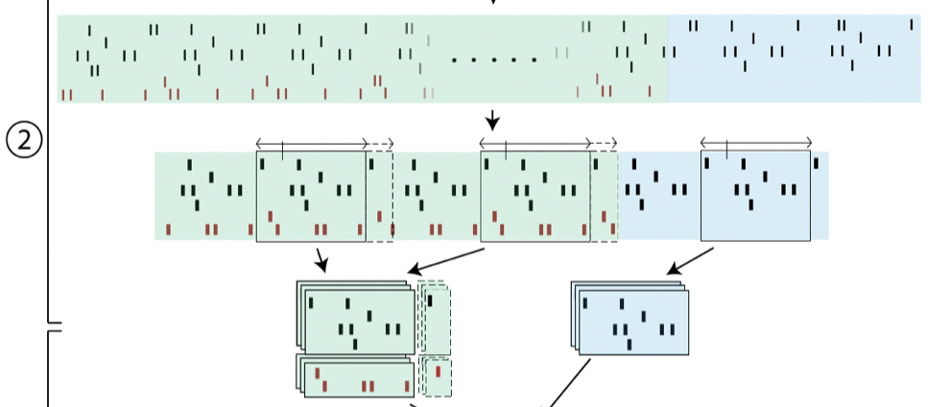
Data
Data is initially in spikes binned at 1ms
Preprocessing:
Resample at 5ms
Collect trials, separate held-out, and future predictions, and stack them
Notes:
The Maze datasets are exceptional in their combination of behavioral richness (number of task con- figurations), stereotyped behavior across repeated trials (tens of repeats for each task configuration), and high total trial counts (thousands) – these attributes support averaging neuronal activity across repeated trials as a simple, first-pass de-noising strategy [3], while retaining enough diversity in task conditions to allow rich investigation into the structure of the population activity

Slide 3
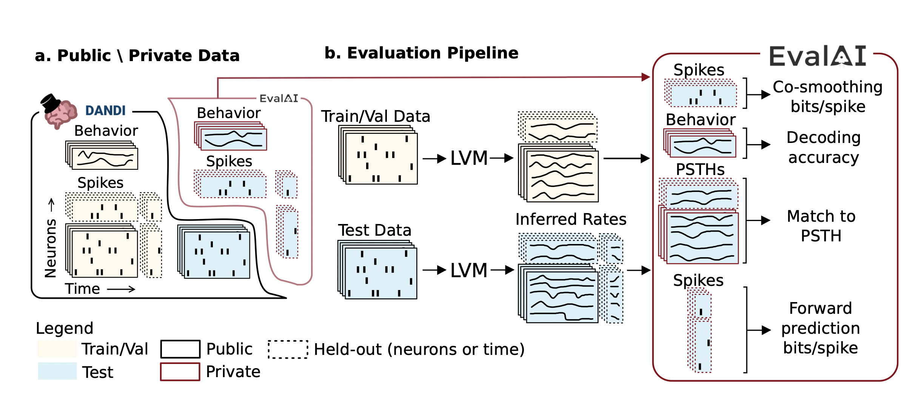
Overview
Notes:
Predict firing rates held-in activity
Predict future time steps
Predict held-out activity
and its future timesteps

Slide 4
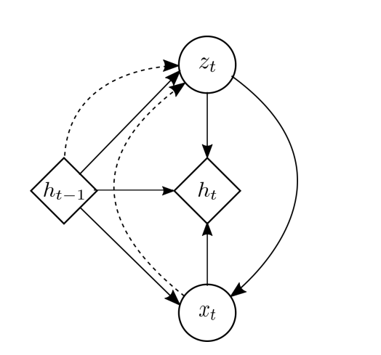
Proposed Model
Add transform layer and modify loss function objective to VRNN(Chung et. al. 2016)
Prior
z_{t} ∼ N(µ_{0,t}, diag(σ ² _{0,t}))
x_{t} | z_{t} ∼ N(µ_{x,t}, diag(σ ² _{x,t}))
Recurrence
h_{t} =f_{θ} (ϕ ^{x} _{τ} (x_{t}), ϕ^{z} _{τ} (z_{t}), h_{t−1}),
Posterior Inference
z_{t} | x_{t} ∼ N(µ_{z,t}, diag(σ ² _{z,t}))
Transform
u_{t} = u * x_{t}
Output
o_{t} = exp(u_{t})
Loss
poisson_nll(o_{t}, y_{t}) + E_{q}[ ∑_{t} - KLD(q(z_{t} | x_{≤t}, z_{<t})|| p(z_{t} | x_{<t}, z_{<t})) + log p(x_{t} | x _{≤t}, z_{<t}) ]
_{u}
o_{t}
Variational ELBO
Notes:
The original VRNN
Transform: linear layer for expanding dim from heldin tp heldin + heldout
VAE + RNN + Linear layer plus poisson for linear transform part , ELBO for enc and decoder
We chose passion because spikes are number of arrivals which is modelled using poisson distribution
Why VAE? 1. compression and decompression, helps model inherent noise in the measurements made and generalize better
2.

Slide 5
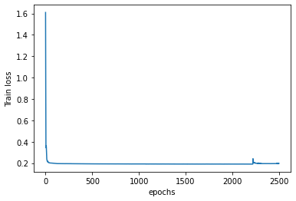
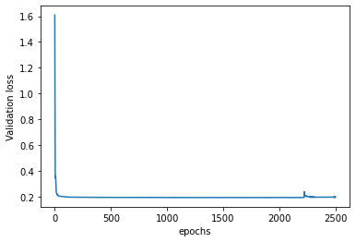
Loss plots

Slide 6
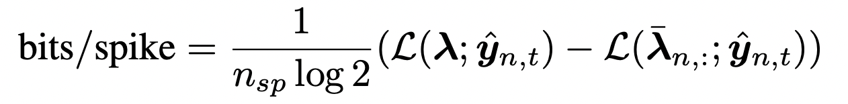
Evaluation criteria
Co-smoothing bits/spike -
Decoding accuracy
Match to PSTH
Forward prediction bits/spike

Slide 7
Results
All results are reported on test set of MC_Maze Large dataset
Metric | Epochs = 250 | Epochs = 2500
co-bps | 0.0176 | 0.0751
vel-R2 | 0.0140 | 0.0258
psth-R2 | 0.0341 | 0.1576
fp-bps | -0.0260 | -0.0304

Slide 8
Conclusion and Future Work
Need models to capture the inherent measurement noise
Having a Variational RNN helps model both the inherent noise and sequential information
Using more complex encoders and decoders (hierarchical), priors and posteriors
Train for longer

