Slide 1
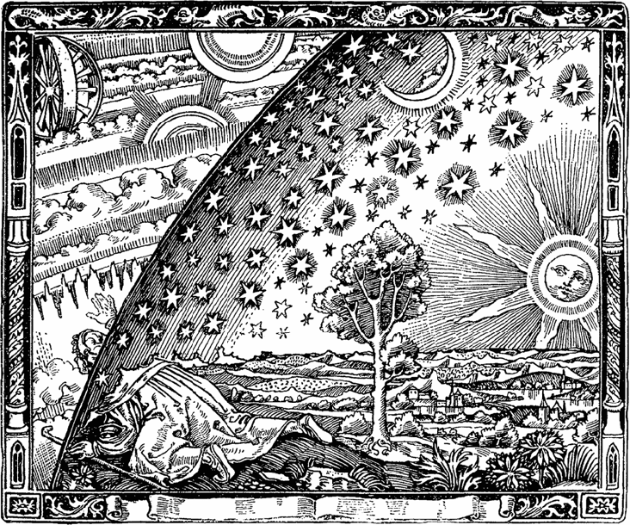
Analytics for the Public Sector
Notes:
Alex

Slide 2







Who are we?
Joint venture between the UNC Institute of Politics Tech Team and Carolina Analytics and Data Science (CADS)
Notes:
Alex

Slide 3
What is R?
R and RStudio:
R: Free software environment for statistical programming
R Studio: Open IDE (Integrated Development Environment) for R
Advantages:
Install packages, import datasets, and view plots within IDE
Built-in version control
Easy access to working directories
Notes:
Danny

Slide 4
R and R Studio
Download R
http://cran.stat.ucla.edu/
Download RStudio
https://www.rstudio.com/products/rstudio/download/#download
Notes:
Danny

Slide 5
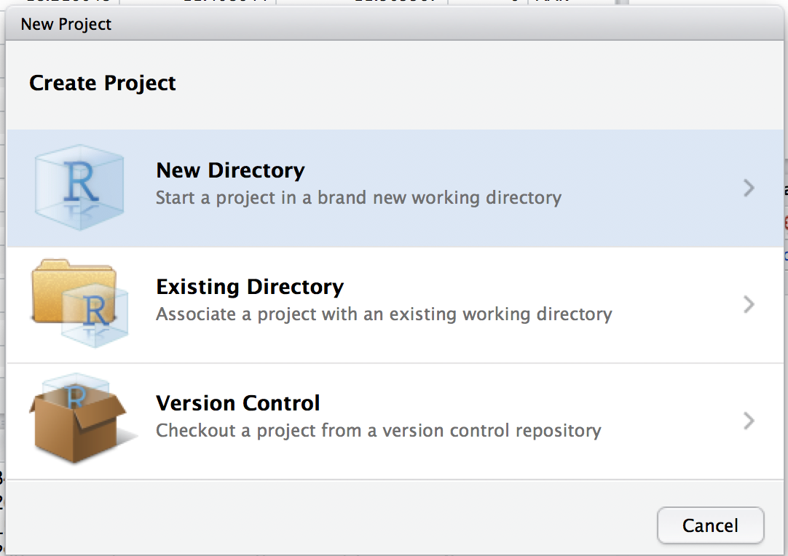
R Projects
Keep workflow consistent and self-contained
Reproducibility
Easy to share with collaborators
Notes:
Danny

Slide 6
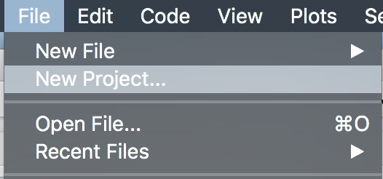
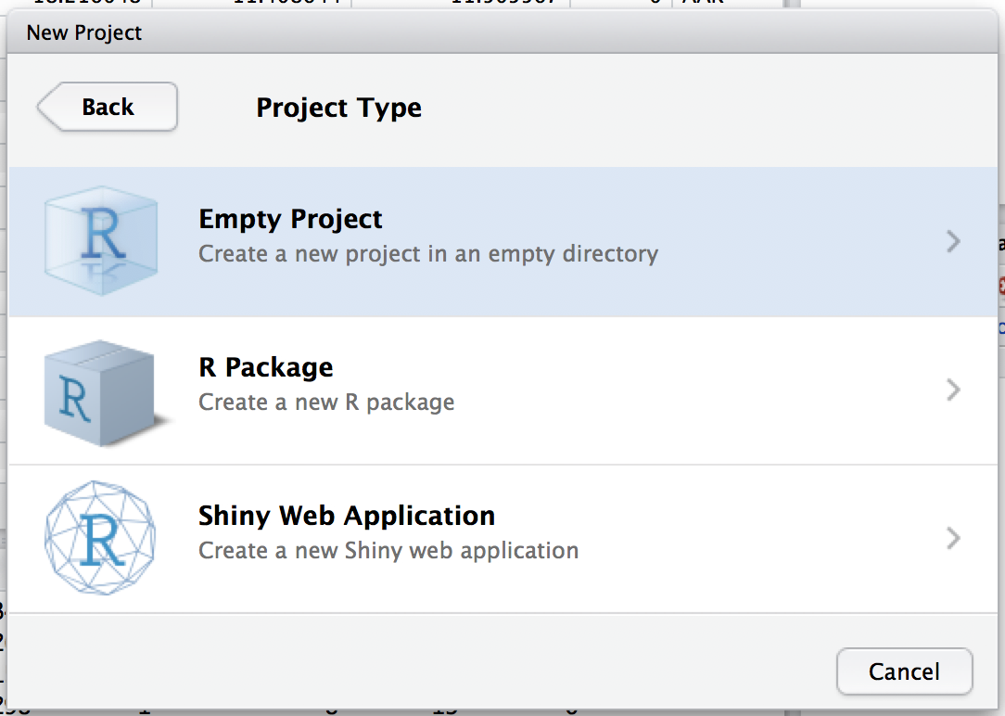
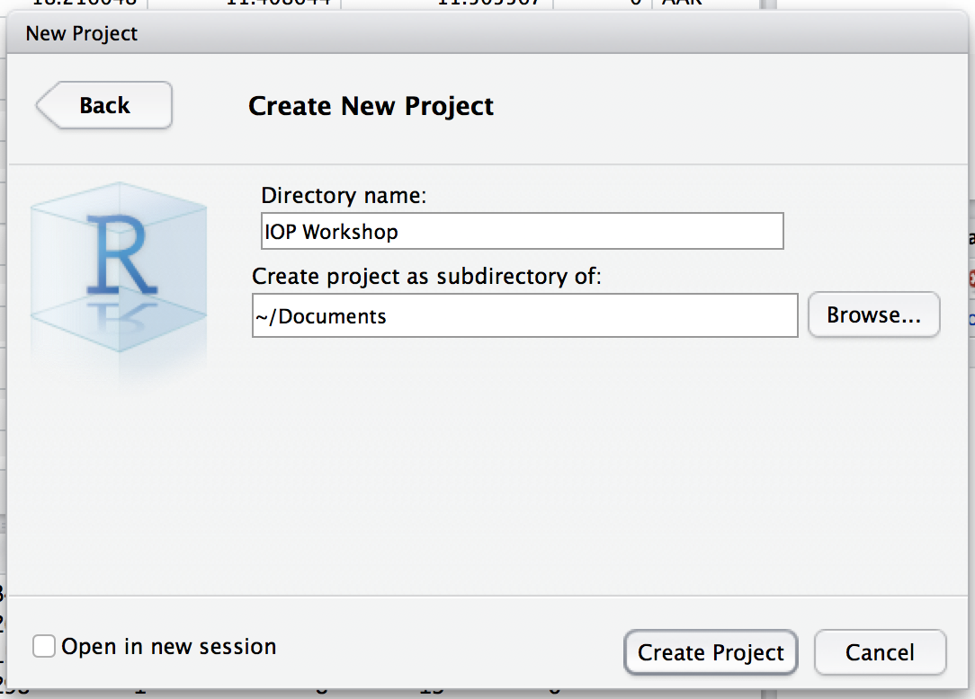
Starting a new Project
File>New Project...
Choose “New Directory” then “Empty Project”
Call your directory “IOP Workshop”
Notes:
Danny

Slide 7
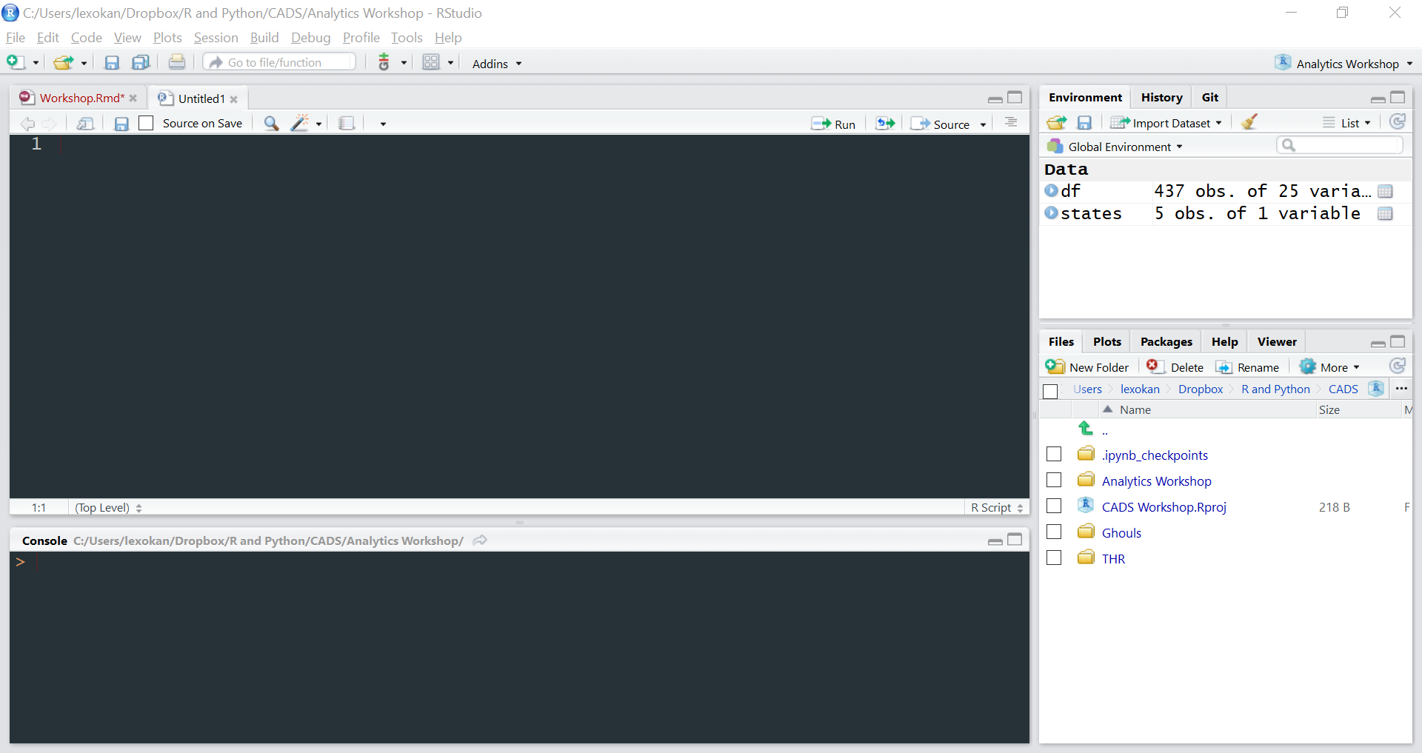
R Studio Panes
Text Editor
Console
Notes:
Alex

Slide 8
R Studio Panes (Continued)
Environment & History
Files, Plots, Packages
Notes:
Alex

Slide 9
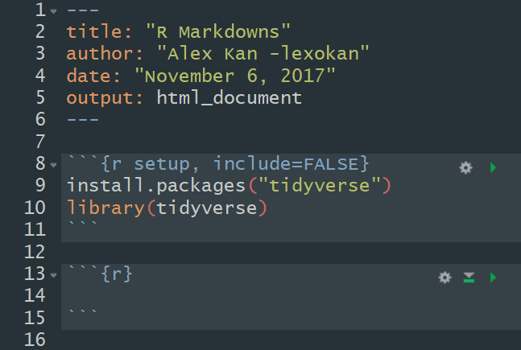
R Markdown
Why use markdowns?
Run code in sections called “chunks”
Embed plots
Easily publish results in popular formats (PDF, HTML, Word)
Ctrl/Cmd + Alt + i for new chunks
Notes:
Alex

Slide 10
Importing Packages
What is a package?
To install a new package:
Only need to do once
To import/load the package:
Need to do during each R session
Note the syntax!
Notes:
Alex

Slide 11
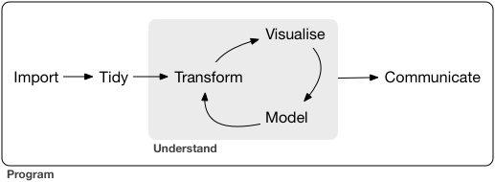
What is the Tidyverse?
Set of commonly used Data Science packages
Dplyr, stringr, modelr, ggplot2, lubridate, readr
Includes many built-in datasets
Import data
Manipulate/Clean data
Exploratory Analysis (Visualization, Summary statistics)
Model data
Communicate results
Notes:
Adam

Slide 12
Dplyr
Useful for data manipulation and cleaning
Basic Dplyr “verbs”
Select: “Select” columns from a dataframe
Filter: “Filter” rows by a condition
Arrange: Sort rows
Mutate: Create a new column, modify an old
Group_by: Group by different variables within a column
Summarise: Used in conjunction with group_by to find statistics
Notes:
Adam

Slide 13

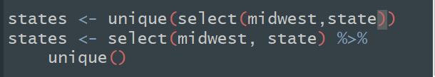
Select and Basic R Commands
Assignment Operators Look at the data!
Cut out “PID”, “category”
Pipes and Higher Order Functions
How is the midwest defined?
Notes:
Adam

Slide 14


Filter
What if we only want to focus in on a single state?
Relational operators
What is the outlier?
Notes:
Adam

Slide 15

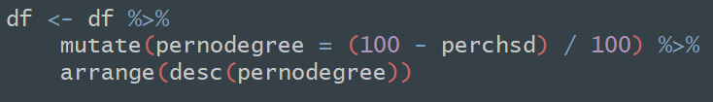
Mutate and Arrange
Subsetting
Two of the ways to select different columns
Creating new variables
What do you notice about the counties with the highest percentage?
Notes:
Adam

Slide 16
Group_by and Summarise
Aggregate counties for each state
Useful for categorial and character variables
Find summary statistics on each state’s population

Slide 17
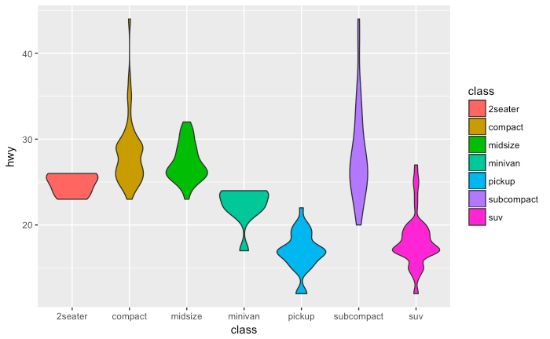
Visualizing Data with ggplot2
Notes:
Jenny

Slide 18

mpg
Fuel Economy data for 38 models of cars
Ctrl/Command + Alt + i
Run in “chunk” or in R Console
Notes:
Jenny

Slide 19
What relationship do you expect to see between engine size (displ) and highway mileage (hwy)?
Notes:
Jenny

Slide 20
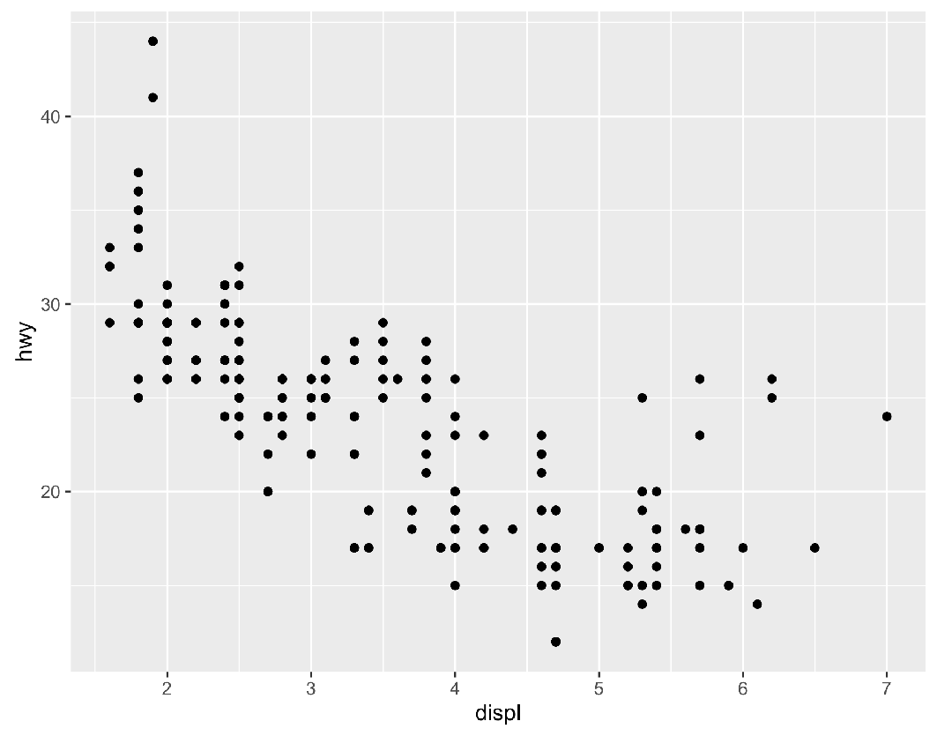
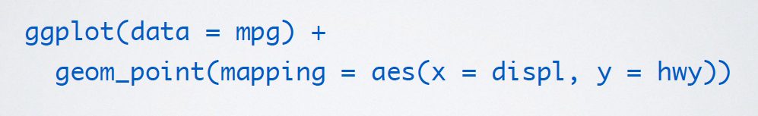
How to graph
Run this code in your notebook to make a graph.
Pay strict attention to spelling, capitalization, and
parentheses!
Notes:
Jenny

Slide 21
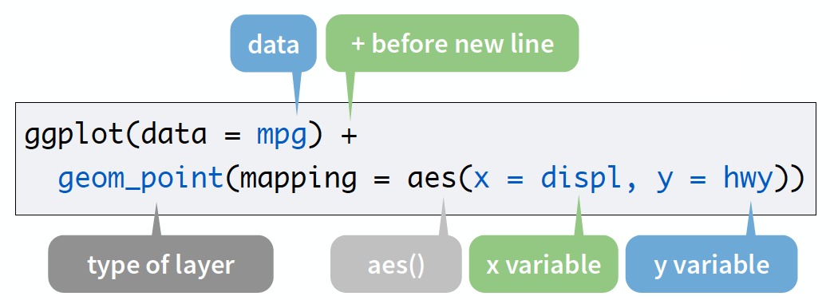
Notes:
Jenny

Slide 22
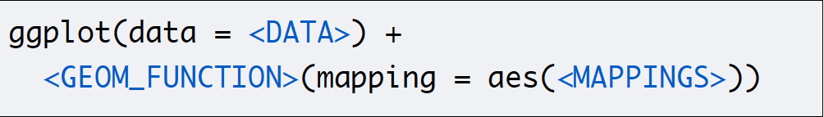
Template
Notes:
Jenny

Slide 23
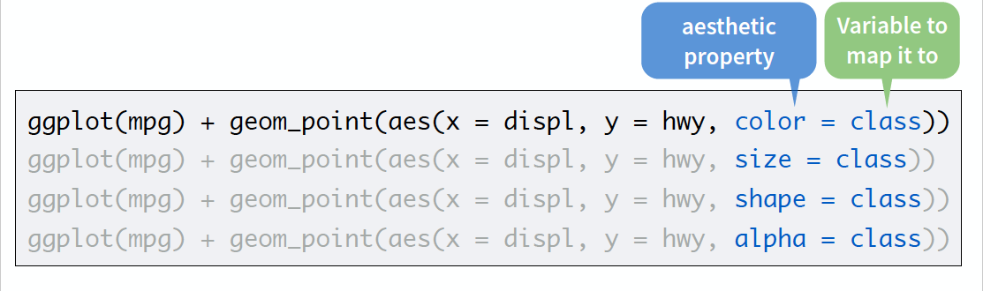
Mappings and Aesthetics
Notes:
Jenny

Slide 24
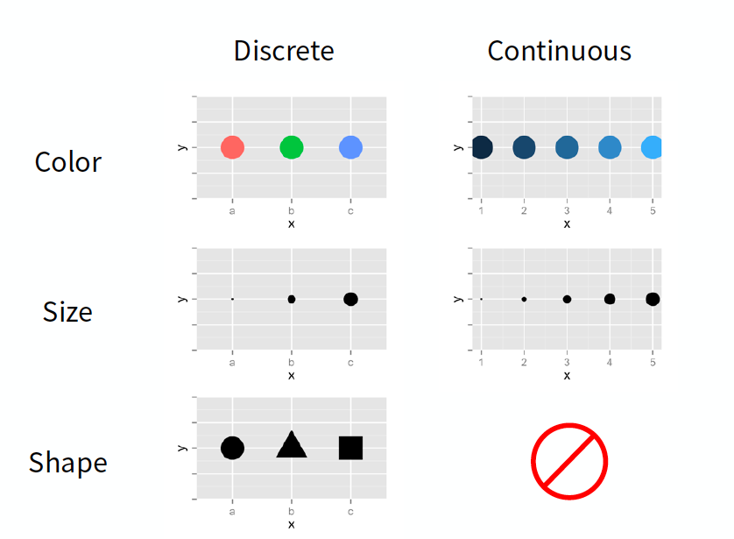

Slide 25
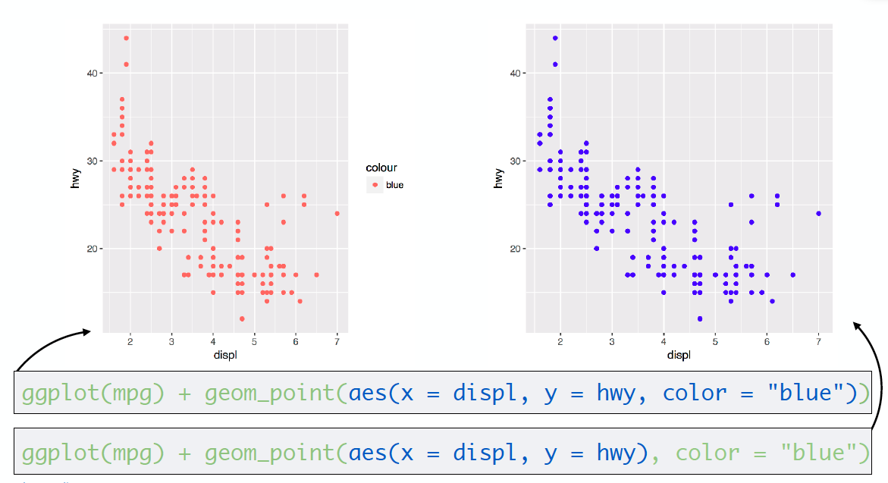
Mapping inside of aes() vs. outside of aes()

Slide 26
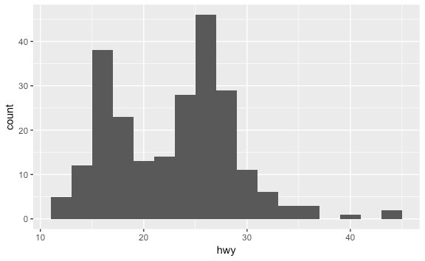
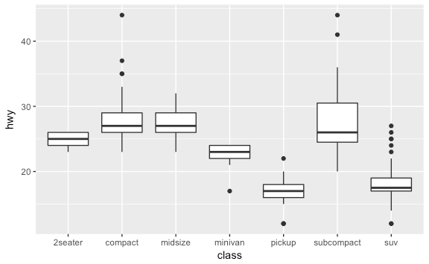
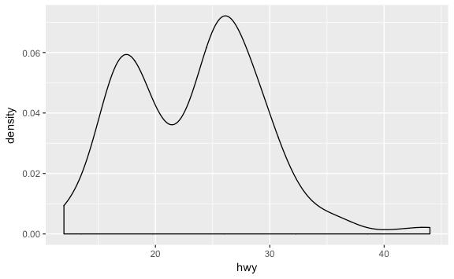
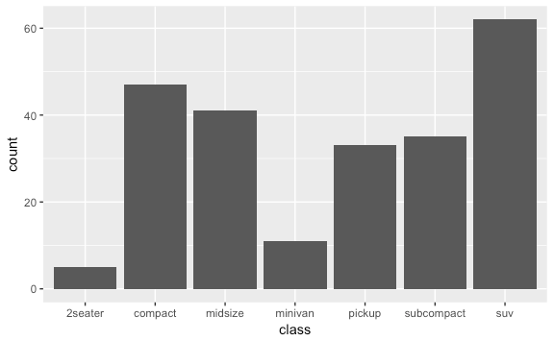
Geoms
Other geoms include:
geom_histogram()
geom_boxplot()
geom_density()
geom_bar()

Slide 27
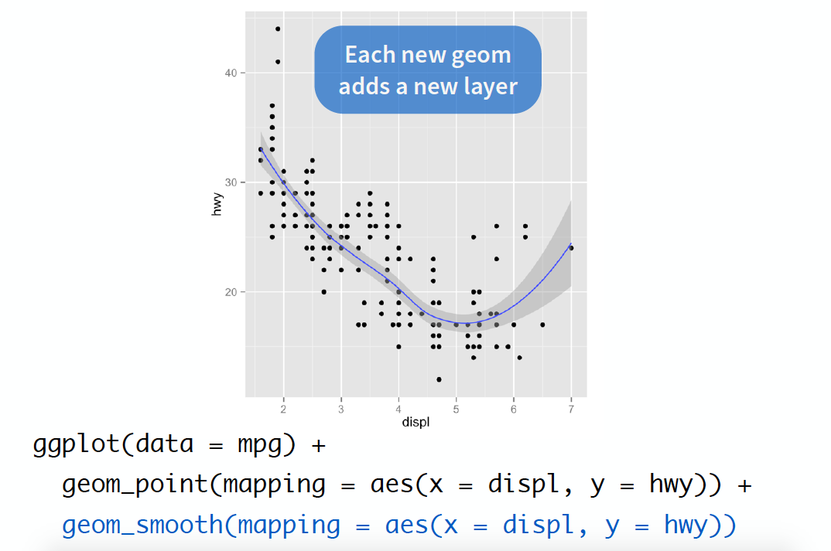

Slide 28

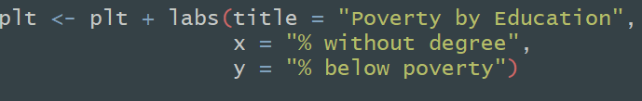
Plotting With Midwest
Is there a correlation between a lack of a degree and being below the poverty line?
Add axis labels and titles to a ggplot
Notes:
Ishan

Slide 29

I/O in R
Read in data from a URL
Read in data from a .CSV file
Notes:
Ishan

Slide 30
Datasets
http://bit.do/iopdata
https://www.chapelhillopendata.org

Slide 31
Additional Resources - Courses
STOR 390 Intro to Data Science (SP 17) - Iain Carmichael (UNC)
https://idc9.github.io/stor390/
STOR 320 Intro to Data Science (FA 17) - Dr. Robin Cunningham (UNC)
https://ncdaddy.github.io/STOR_320/
STA 112 Better Living Through Data Science (FA 16) - Dr. Colin Rundel (Duke)
http://www2.stat.duke.edu/~cr173/Sta112_Fa16/
Coursera Data Science Specification - Dr. Roger Peng (JHU)
https://www.coursera.org/specializations/jhu-data-science

Slide 32
Additional Resources - Reading
R for Data Science Textbook - Dr. Hadley Wickham (FREE!)
http://r4ds.had.co.nz/index.html
R Programming for Data Science - Dr. Roger Peng (Johns Hopkins) (FREE! But pay if you choose)
https://leanpub.com/rprogramming
R Markdown Lessons
http://rmarkdown.rstudio.com/lesson-1.html
R Cheatsheets
https://www.rstudio.com/resources/cheatsheets/

Slide 33
Additional Resources - Documentation
Comprehensive R Archive Network
https://cran.r-project.org/

