Slide 1

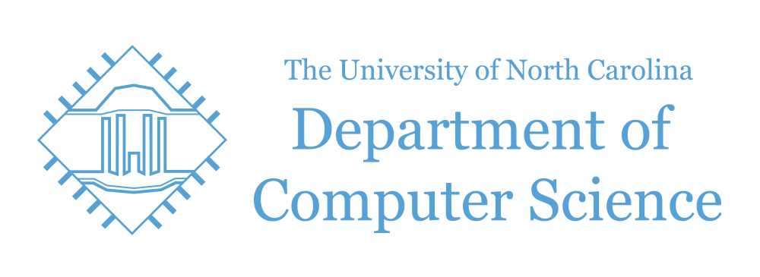
A Deep Learning Approach to Tala Classification
Alex Kan^{1,2}, Svetak Sundhar^{1,2}, Anthony Yang¹, and Akshay Sankar³
¹Department of Computer Science, University of North Carolina at Chapel Hill, NC 27599, USA
²Department of Statistics and Operations Research, University of North Carolina at Chapel Hill, NC 27599, USA
³Department of Biostatistics , University of North Carolina at Chapel Hill, NC 27599, USA
Summary: Type your project summary here
Motivation
Carnatic Music is a sacred art form hailing from South India in the 18th century.
Data
Point one
Point two
…..
Introduction
This form of music has two main aspects: swara, or the melody and laya, or rhythm. In this report, we investigate how we can classify the laya aspect, from audio samples of Carnatic Music. Specifically, we seek to identify the tala, or meter of the sample. This could potentially help discern the tala of a song for students of Carnatic Music, as Carnatic Music teachers are becoming harder and harder to find.
We use the Carnatic Music dataset from the University of Pompeau Fabra. We propose the usage of various networks including: 1D CNN, 2D CNN, RNN with Long Short term memory cells, and the Autoencoder (for de-noising) in order to complete this task.
Experimental Results
Point one
Point two
…..
Method
Point one
Point two
…..
Conclusions
Point one
Point two
…..
References:
[1] Ref1
[2] Ref2
[3] Ref3
Fall 2018, COMP 562 Poster Session

