Slide 1

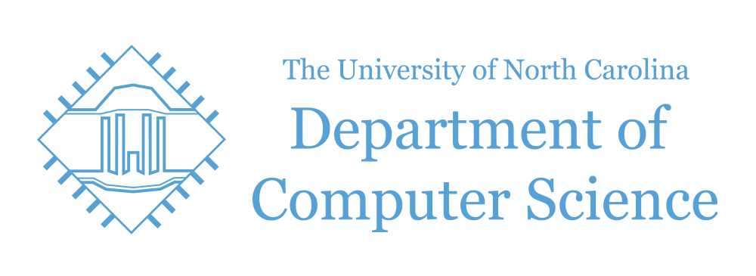
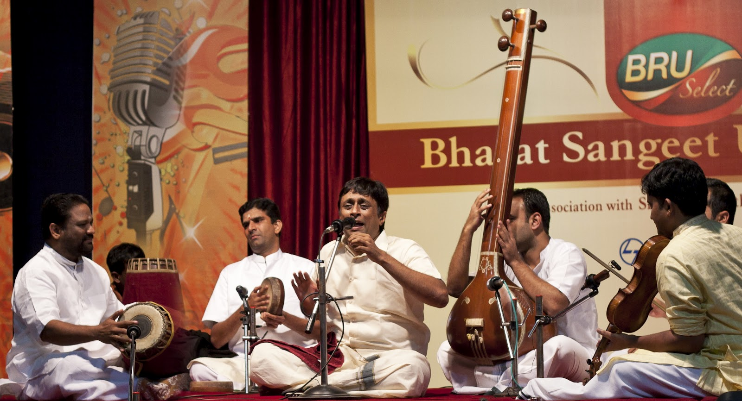
A Deep Learning Approach to Tala Classification
Alex Kan^{1,2}, Svetak Sundhar^{1,2}, Anthony Yang¹, and Akshay Sankar³
¹Department of Computer Science, University of North Carolina at Chapel Hill, NC 27599, USA
²Department of Statistics and Operations Research, University of North Carolina at Chapel Hill, NC 27599, USA
³Department of Biostatistics , University of North Carolina at Chapel Hill, NC 27599, USA
Summary: Investigate how to classify the tala of a specific composition in Carnatic Music. By employing a few deep learning techniques, we believe this could help students self teach compositions.
Motivation
Carnatic Music is a sacred art form hailing from South India in the 18th century.
As immigration to various countries continues to rise, it is becoming harder and harder to find carnatic music teachers.
Our project seeks to classify the tala, or meter of a piece. This will help beginners greatly when approaching a new song.
Data
Point one
Point two
…..
Experimental Results
Point one
Point two
…..
Introduction
This form of music has two main aspects: swara, or the melody and laya, or rhythm
. We investigate how we can use the Carnatic Music dataset from the University of Pompeau Fabra.
We propose the usage of various networks including: 1D CNN, 2D CNN, RNN with Long Short term memory cells, and the Autoencoder (for de-noising) in order to complete this task.
Method
1D Convolutional Neural Network
Used a 1D waveform to predict tala.
2D Convolutional Neural Network
Created a spectrogram of frequency vs time. Then used image analysis to see if tala could be predicted from the image.
Recurrent Neural Network
Conclusions
Point one
Point two
…..
References:
[1] Ref1
[2] Ref2
[3] Ref3
Fall 2018, COMP 562 Poster Session

