Slide 1
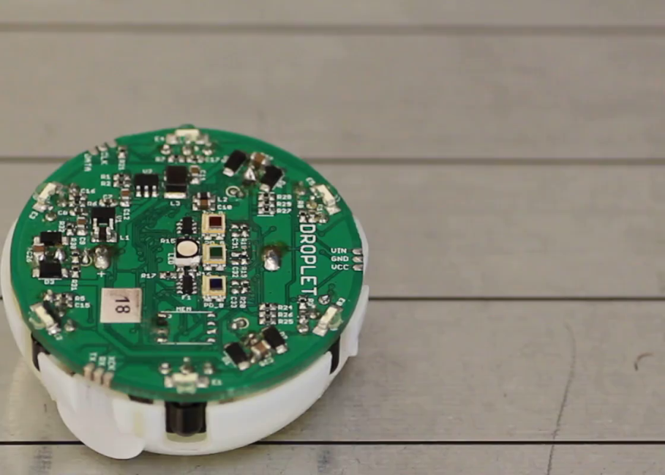
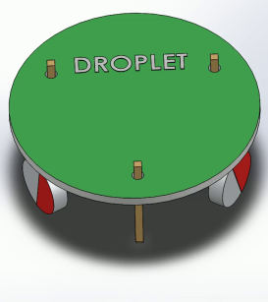
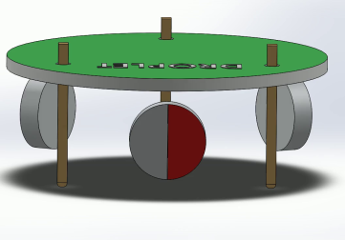
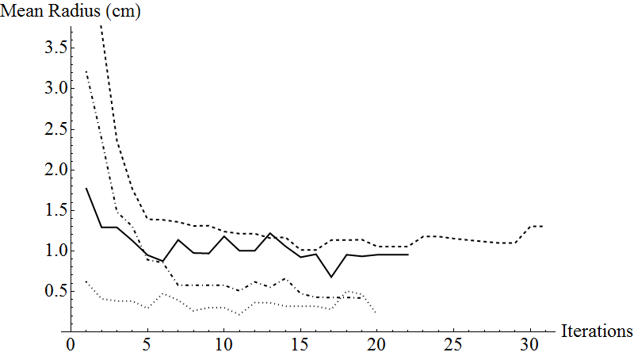
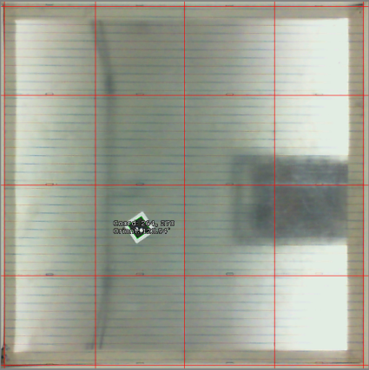
A Stick-Slip Omnidirectional Powertrain for Low-Cost Swarm Robotics: Mechanism, Calibration, and Control
John Klingner, Anshul Kanakia, Nicholas Farrow, Dustin Reishus, and Nikolaus Correll
Mechanism
Forces from the vibration motor cause the robot platform to pivot about the leg opposite each motor.
This video shows a Droplet walking
Calibration
In order to satisfy the requirement that each step be the same size, we calibrate each robot.
Calibration is done using the Nelder-Mead Optimization Technique. The fitness function used is the radius of the Droplet’s path, where the radius is measured by finding the least-squares best fit circle to the robot’s path.
When calibrating for spinning, the ideal radius is 0. When calibrating for walking straight, the ideal radius is infinite.
A Droplet walking with a sequence of steps.
A Droplet taking a single step. The size of the step is exaggerated for clarity.
This chart shows the radius of the Droplet’s turn as our calibration method iterates. The goal is a radius of 0.
Control
If we just turn both motors on at the same time, then the two motors cause the platform to move unpredictably. This could be solved with more precise control of motor phase, but that increases complexity and cost.
Instead, we turn one motor on at a time, for a brief 30ms. This causes the platform to take a small ‘step’. Walking straight requires that each step is of the same size.
This image shows the view from our camera of the Droplet during calibration.

