Slide 1









$$x_{4}$$
$$x_{1}=τ+η_{1}$$
$$+η_{1}$$
$$+η_{2}$$
$$x_{2}=τ+η_{2}$$
task
stimulus = $τ$
$$+η_{3}$$
$$x_{5}$$
$$x_{3}=τ+η_{3}$$
Figure 1: A multi-agent fire fighting scenario set up as a global game with concurrent benefit. Each player's imperfect estimate of the magnitude of the fire is represented by $x_{i}$, comprising the common stimulus $τ$ and noisy sensor measurements $η_{i}$.

Slide 2





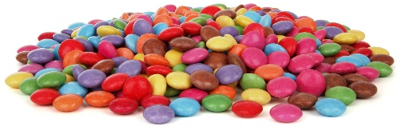




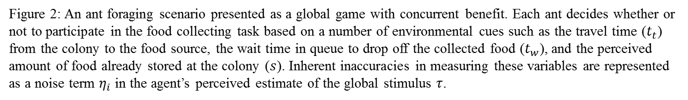

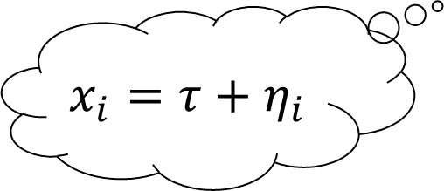
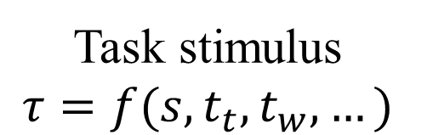
Task stimulus
$$τ=f(s,t_{t},t_{w},…)$$
$$t_{t}$$
$$x_{i}=τ+η_{i}$$
$$t_{w}$$
$$s$$
Figure 2: An ant foraging scenario presented as a global game with concurrent benefit. Each ant decides whether or not to participate in the food collecting task based on a number of environmental cues such as the travel time ($t_{t}$) from the colony to the food source, the wait time in queue to drop off the collected food ($t_{w}$), and the perceived amount of food already stored at the colony ($s$). Inherent inaccuracies in measuring these variables are represented as a noise term $η_{i}$ in the agent’s perceived estimate of the global stimulus $τ$.

Slide 3
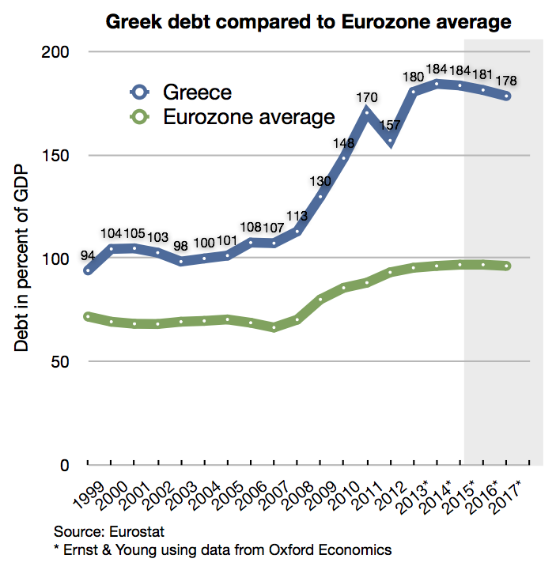

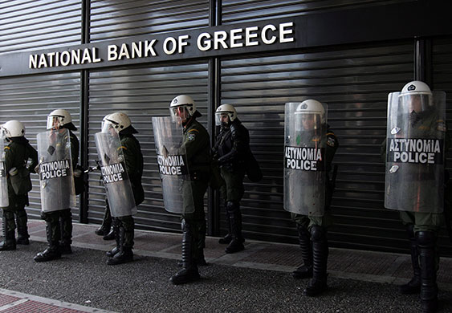


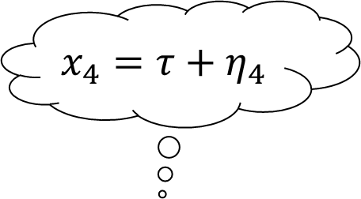
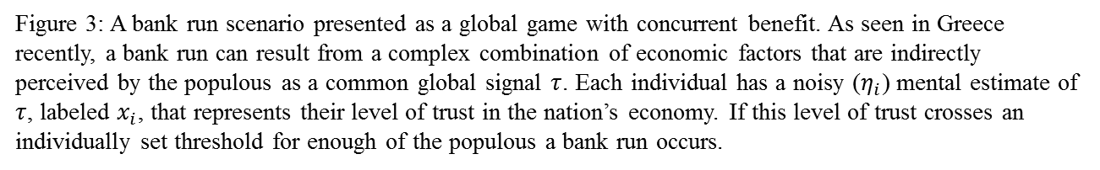
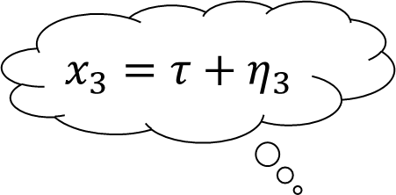
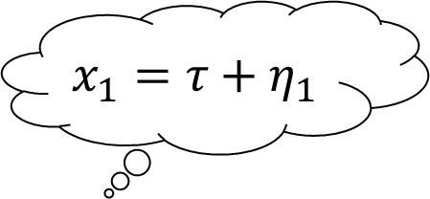
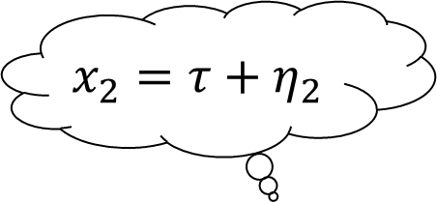
$$τ$$
$$x_{4}=τ+η_{4}$$
$$x_{1}=τ+η_{1}$$
$$x_{2}=τ+η_{2}$$
$$x_{3}=τ+η_{3}$$
Figure 3: A bank run scenario presented as a global game with concurrent benefit. As seen in Greece recently, a bank run can result from a complex combination of economic factors that are indirectly perceived by the populous as a common global signal $τ$. Each individual has a noisy ($η_{i}$) mental estimate of $τ$, labeled $x_{i}$, that represents their level of trust in the nation’s economy. If this level of trust crosses an individually set threshold for enough of the populous a bank run occurs.

Slide 4
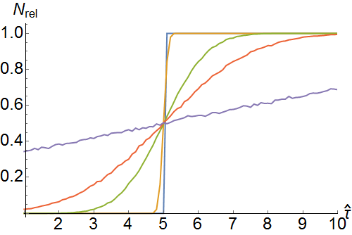
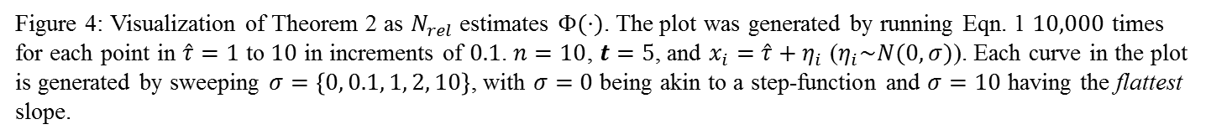
Figure 4: Visualization of Theorem 2 as $N_{rel}$ estimates $Φ(⋅)$. The plot was generated by running Eqn. 1 $10,000$ times for each point in $\hat{τ}=1$ to $10$ in increments of $0.1$. $n=10$, $t=5$, and $x_{i}=\hat{τ}+η_{i}$ ($η_{i}\sim N(0,σ)$). Each curve in the plot is generated by sweeping $σ=\left\{0, 0.1, 1, 2, 10\right\}$, with $σ=0$ being akin to a step-function and $σ=10$ having the flattest slope.

