Slide 1









$$x_{4}$$
$$x_{1}=τ+η_{1}$$
$$+η_{1}$$
$$+η_{2}$$
$$x_{2}=τ+η_{2}$$
Task
magnitude = $τ$
$$+η_{3}$$
$$x_{5}$$
$$x_{3}=τ+η_{3}$$
Agents
Figure 1: A multi-agent fire fighting scenario set up as a global game. Each player's imperfect estimate of the task is represented by $x_{i}$, a sum of the global magnitude parameter, $τ,$ and noisy sensor measurements, $η_{i}$.

Slide 2
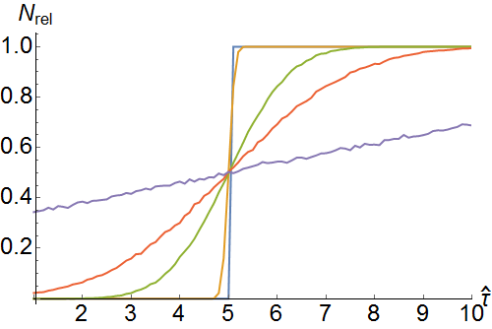
Figure 2: Visualization of Theorem 2 as $N_{rel}$ estimates $Φ(⋅)$. The plot was generated by running Eqn. 1 $10,000$ times for each point in $\hat{τ}=1$ to $10$ in increments of $0.1$. $n=10$, $t=5$, and $x_{i}=\hat{τ}+η_{i}$ ($η_{i}\sim N(0,σ)$). Each curve in the plot is generated by sweeping $σ=\left\{0, 0.1, 1, 2, 10\right\}$, with $σ=0$ being akin to a step-function and $σ=10$ having the flattest slope.

