Slide 1
Alternative approach to inheritance
Samsung R&D Institute Rus, LLC
Alexey V. Kanatov
Eugene Zouev
Dec 2nd 2015

Slide 2
Agenda
Introduction
Inheritance models overview
Alternative approach to inheritance
Summary

Slide 3
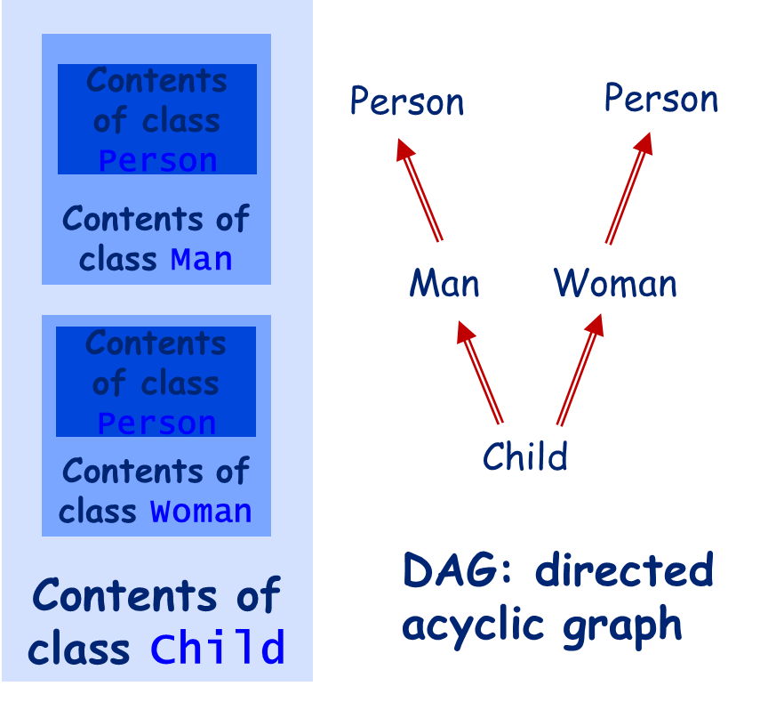
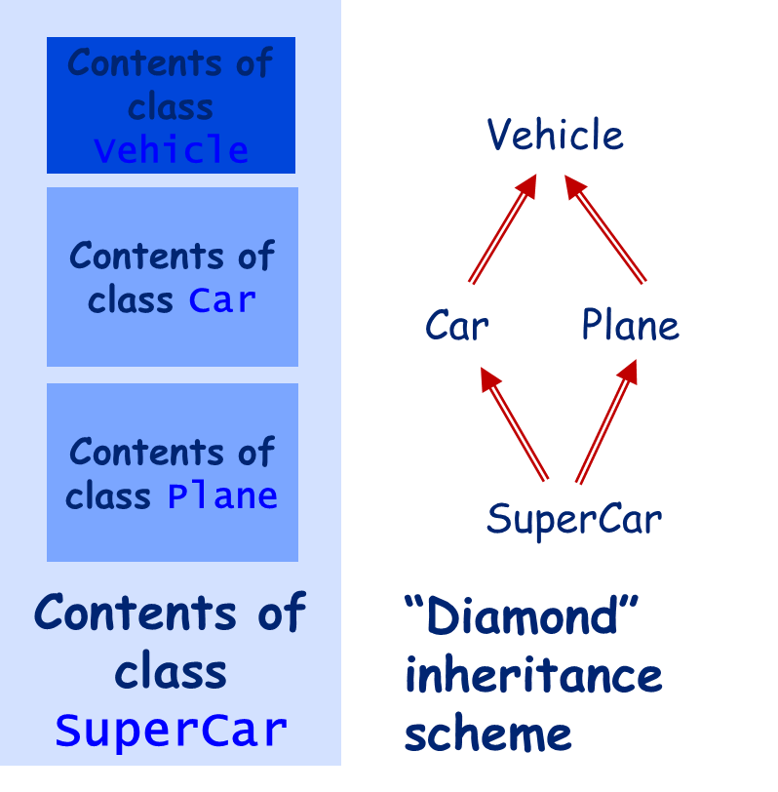
C++ Approach to Inheritance
Multiple inheritance
Virtual base classes & virtual inheritance
Abstract classes
Virtual functions & overriding
The notion of “subobject”

Slide 4
Java, C# Approach to Inheritance
Single inheritance for classes
Multiple inheritance for interfaces
Abstract classes
Virtual functions & overriding
Printable
Iterable
Interfaces: collections of abstract features
Class: implementation of features
Collection
Derived class: inherits base class’ implementation & overrides some features’ implementations
List

Slide 5
“Niche” inheritance models
Zonnon Model
No class inheritance: object are treated as implementations of a number of interfaces (“facets”)
Interfaces can have default implementations; objects implementing interfaces can make use of default implementations
No classes, no inheritance, no virtual functions, no overriding, no static fields
Eiffel Model
Multiple inheritance aligned with genericity
Very powerful feature adaptation while inheriting (rename, redefine, undefine, export, select)
“Flat” object layout (no subobjects)
Programming by Contract © – preconditions, postconditions and invariants aligned with inheritance

Slide 6
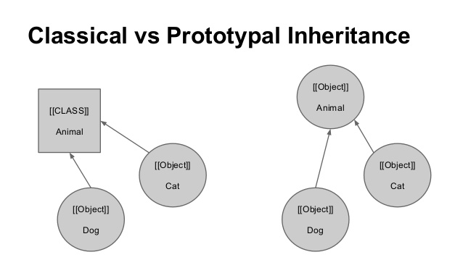
Classical vs. Prototypal Inheritance
Classic: Inheritance is a static relationship; it’s set up for classes of objects
JavaScript: Inheritance is a dynamic relationship; it’s set up for objects (via predefined “prototype” object property)

Slide 7
Inheritance – basic definitions
foo
Unit – is a named set of features where feature can be either routine or data attribute (constant or variable). For this talk there is no difference between unit and class.
Inheritance – is a relation between units when features from the parent unit come to the child one and become its part. Inheritance is typically presented as directed graph.
Conformance (→) – is a relation between units based on the existence of the path in the inheritance graph from one unit to another.
Origin – the unit in which feature was declared first time
Seed – the version of the feature which was its first declaration
A
goo
hoo
B
foo’
‘ means override
a: A
b: B
a := b
b := a
Origin for foo’ from B – unit A;
Seed for foo’ from B – feature foo from A

Slide 8
Inheritance – basic definitions
For unit C units А and В are parents
For units А and В unit С is a child (heir)
Graph direction highlights conformance. So, unit C conforms to A and B. C→A & C→B
Conformance defines if an object of one type can be assigned to an object of another type
B
A
C

Slide 9
Inheritance – how it works
foo
A
For every feature of the parent unit the place in the child class is to be found.
There are some issues when we apply inheritance:
Name clashes.
Versions ambiguity.
Visibility conflict.
foo
C
foo
foo
B
A
foo
Foo’
a: A
a := new C
a.foo ???
B
public foo
private foo
C
A
B
foo, foo’
C
??? foo

Slide 10
Inheritance – name clashes, overloading and ambiguity
foo <S1>
<B1>
foo<S2>
<B2>
When we have name clash – the question which is to be addressed is how many copies of foo are in A?
if foo from B and foo from C is the same feature then there will be only 1 feature foo in A – that feature. The same means they both have the same origin and seed and the same signature and body for routines.
Otherwise we will have 2 features foo – and the name foo is overloaded.
Code a: A; a.foo (<parameters>) can be ambiguous feature call or resolved successfully depending on combinations of <S1><B1><S2><B2>
Note if we do not call the ambiguous feature then the code is valid and can work! So, we are not going to verify the full correctness of inheritance graph and every unit – we verify usage of features of units. If usage (feature call) can be verified then the program is correct. The only check to be done that inheritance graph has no cycles.
B
C
1 or 2?
A
<S> - signature
<B> - body (routine)

Slide 11
Inheritance: overriding
Overriding – we may specify the new version of the feature which will override all the previous versions it conforms to. If there are no such previous versions then it is compile time error – nothing to override. Simple example with identical signature
A, foo (<S>) <B2>
B, foo (<S>) abstract
C, override foo (<S>) <B1>
Overriding – OK!

Slide 12
Inheritance and unit consistency: identical signatures
A, foo (<S>) <B1>
foo (<S>) <B2>
Compile time error – duplicated feature declaration!
A, foo (<S>) <B1>
B, foo (<S>) <B2>
Overriding – OK!
C, override foo (<S>) <B3>

Slide 13
Inheritance: name clashes and overloading with identical signatures
A, foo (<S>) <B1>
B, foo (<S>) <B2>
C
If we try to access foo from the unit C and its descendants
A.foo (<exprS>) // OK!
B.foo (<exprS>) // OK!
foo (<exprS>) // Compile time error! Ambiguity!
If we try to access foo from the client code
c: C
c.foo (<exprS>) // Ambiguity! Compile time error!
But even in case of polymorphic assignment
a: A is C()
a.foo (<exprS>) // OK! Version from A is to be called
The key thing here that foo from A and foo from B come from different seeds!

Slide 14
Inheritance: name clashes and overloading: general scheme
2 routines foo (<S1>)<B1> and foo (<S2>) <B2> inherited
S1 = S2
B1 = B2 – the same routine – OK!
B1 != B2 => ambiguity – on access compile time error!
S1 != S2 – 2 different routines! To solve select case if they come the same origin and seed!
S1 != S2 and override with S3→S1 and S3→S2 – OK!
2 attributes attr: T1 and attr: T2 inherited
T1 = T2 – the same attribute – OK!
T1 != T2- 2 different attributes! To solve select case if they come the same origin and seed!
override attr : T3 – when T3 → T1 and T3 → T2 – OK!
Routines and attributes are not much different while inheriting ☺

Slide 15
Inheritance: name clashes generalization I
…
A₁, foo₁
A_{n}, foo_{n}
A₀
Let’s consider A₀ features:
If A₀ states A_{1.}foo₁ is abstract then there must be one foo_{i} from A₀ which conforms to A_{1.}foo_{1.}In other words that is the mechanism how to kill a version while inheriting.
If A₀ states override A_{2.}foo₂ then it will override all versions from A_{1 ..} A_{n} to which it conforms to.
Then we have 2 sets (potentially empty)
foo₃ .. foo_{k} – the same feature – merged into one in A₀
foo_{k+1} .. foo_{n} – different overloaded features in A₀

Slide 16
Inheritance: name clashes generalization II
…
A₁, foo₁
A_{n}, foo_{n}
A₀, override foo
Let’s consider A₀ features:
Some versions can be killed making them abstract. But for the remaining part we have:
2 sets (potentially empty)
foo₁ .. foo_{k} – overridden with foo from A₀
foo_{k+1} .. foo_{n} – different overloaded features in A₀

Slide 17
Inheritance: overloading: cat calls
A, foo (<S1>) <B1>
B, override foo (<S2>) <B2>
C, override foo (<S3>) <B3>
D, override foo (<S4>) <B4>
S1 != S4, S2 → S1, S3 → S1, S4 → S2 & S4 → S3, <exprType> → S4 (where → means conforms to)
a: A is D()
a.foo (<exprType>) // version from D must be called!
exprType → S1, but may not conform to S4 – that is a cat call! System wide check required.

Slide 18
Inheritance: visibility conflict
A, public foo
B, private foo
C, public foo
Regardless of the way how we keep one version of foo in C its visibility status must be public as at least in parent it was public
private … private => public or private
public … private = > public

Slide 19
Summary
Brief overview of existing approaches to inheritance given
Alternatives approach to inheritance presented, which combines power and generalization of multiple inheritance and at the same time avoiding complications of existing approaches.
The key thing is whether compiler can resolve feature call or not! The unit may have arbitrary number of conflicting versions of the feature under one name.
So, this inheritance may be called potentially conflicting inheritance with overloading and overriding.
Next steps is practical proof of concept ☺

Slide 20
THANK YOU!

Slide 21
Inheritance units: name clashes and overloading
A, foo (<S1>) <B1>
B, override foo (<S2>) <B2>
C, override foo (<S3>) <B3>
D
S2 → S1, S3 → S1, S4 → S2 & S4 → S3, S5 → S1
a: A is D()
a.foo (<S2>) // version from B must be called! OK!
a.foo (<S3>) // version from C must be called! OK!
a.foo (<S4>) // ambiguity
a.foo (<S5>) // cat call

Slide 22
Inheritance: name clashes, overloading and overriding
Overriding is the mechanism which allows to state the fact that within the current unit there is a feature which overrides all versions of this features coming thru different parents. The list of features being overridden is determined by the conformance of the current feature signature to overridden features’ signatures. Better to look at examples
A, foo (<S1>) <B1>
B, foo (<S2>) <B2>
C, override foo (<S3>) <B3>
Overriding – OK!
If <S3> conforms to <S1> and <S2> - we have in C only one feature foo with signature <S3>. If <S3> conforms to <S1> or <S2> only then we will have 2 features foo, one with <S3> signature and another with non-conforming to <S3> signature. Also note that in case of routines abstractness status of <B1>, <B2> and <B3> can be arbitrary

Slide 23
Inheritance: name clashes, overloading and overriding
So, we may override abstract routine with abstract one. We may provide an effective body with overriding. We may merge several abstract routines into one using overriding. We can also do the opposite – if we have effective routine (routine with the internal or external body) we may override it with an abstract routine. This gives us full flexibility to control the level of abstraction while inheriting.
Also if we like to select one version of several versions which come from parent units then we can use override with no body but the name of the current class instead. See the example below
unit A inherit B, C, D
override D.foo // Versions from B and C are overridden
end
Please note that such form of overriding will override only versions to which signature of D.foo conforms to.

Slide 24
Inheritance – feature call ambiguity
. Some leading to ambiguity if we try to call the feature. Note if we do not call the ambiguous feature then the code is valid and can work! So, we are not going to verify the full correctness of inheritance graph and every unit – we verify usage of features of units. If usage (feature call) can be verified then the program is correct. The only check to be done that inheritance graph has no cycles.

Slide 25
Zonnon Object Model (1)
Module
Definition
System managed object: - encapsulates resources - implements definitions - aggregates implementations
Unified unit of abstraction: - represents abstract interface - refines another definition
Object
Implementation
Program managed actor/resource: - implements definitions - aggregates implementations - specifies concurrent behaviour
- def.implementation of a definition - standalone aggregation unit

Slide 26
Zonnon Object Model (2)
Definition D1
Definition D2
Definition D3
Definition D11 (refines D1)
Implementation D3 (default for Def D3)
Implementation D11 (default for Def D11)
Object B (implements D2, reuses default implem for D3, and aggregates I)
Object A (implements D1 & D11 without reusing def implem)
Implementation I (standalone resource)

