Slide 1
Project 2
By: Abdoulaye Kane
Rolando Jule
Olagoke Michael Kupolati

Slide 2
Executive summary
Our project’s goal was to identify a tool to measure and estimate life-expectancy based on GDP expenditures and access to basic sanitation resources.
This tool was developed by:
Generating a random selection of development indicators from the World Bank
One of the indicators was GDP expenditures, with a particular focus on health expenditures based on the United Nations
We found that some of the developed/higher-income countries showed higher GDP expenditures for health, compared to lower-income countries
This tool for comparison will help to predict life expectancy for both high- and low-income countries based on GDP expenditures and access to basic sanitation resources.

Slide 3
Presentation
# Project-2: Health Nutrition and population statistics for 14 governments at random, and applying machine learning to predict GDP expenditure on health government and build a bot for data inquiries:
Three indicators used are:
Life expectancy
GDP expenditure ratio on health
Basic sanitary access;
Apply clustering for classification and Logistic Regression to predict future GDP expenditure on health as follows:
Import data
Prepare the data
Cluster the countries by life expectancy using K-means
Visualize and compare the results
Predict GDP expenditure to improve life expectancy (Countries Classification):
Create a Logistic Regression Model with the original Data
Predict a Logistic Regression Model with Resample Training data
Calculate the accuracy of the model
Generate a confusion matrix and classification report.
Build a Bot for data inquiries.

Slide 4
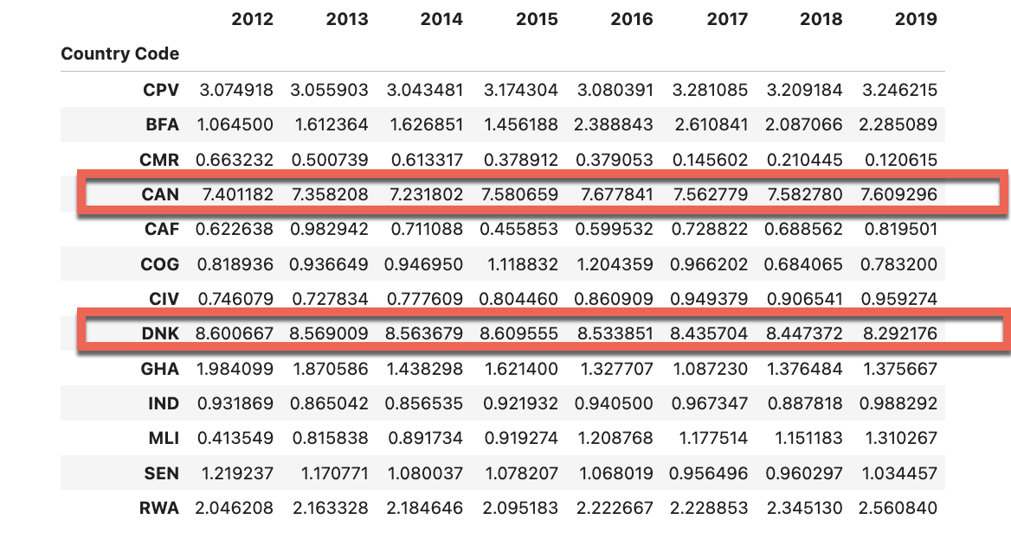
GDP expenditure Ratio Dataset

Slide 5
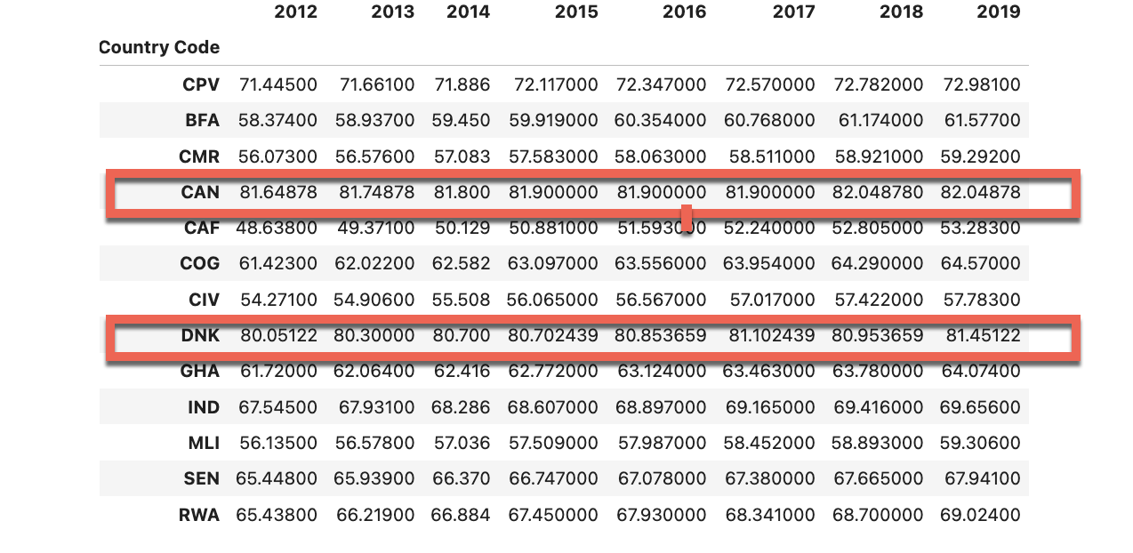
Life expectancy

Slide 6
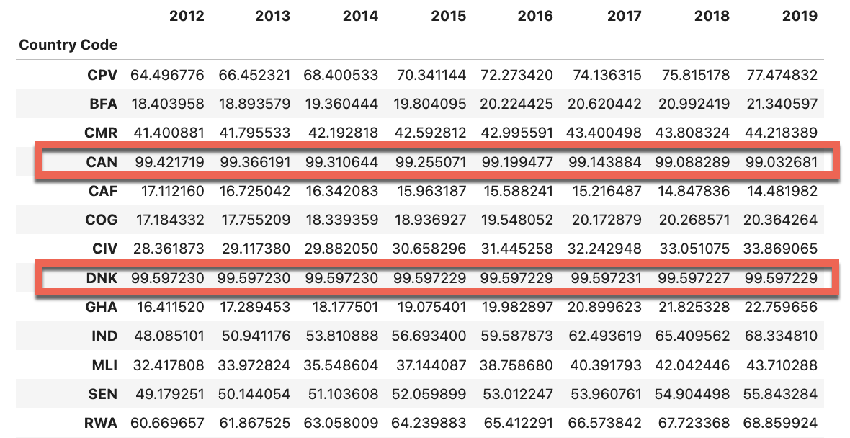
Access to Basic Sanitary Services

Slide 7
GDP Ratio Clustering
We will be using datasets of Country GDP ratio for health expenditure in different periods to apply unsupervised learning:
The steps are broken out into the following sections:
Prepare the Data
Find the Best Value for `k` Using the Original Data
Cluster country GDP ratio with K-means Using the Original Data
Cluster the GDP ratio with K-means Using the original data
Visualize and Compare the Results

Slide 8
Prepare the Data
This section prepares the data before running the K-Means algorithm. It follows these steps:
Use the `StandardScaler` module from scikit-learn to normalize the expenditure GDP ratio original data. This will require utilizing the `fit_transform` function.
Create a DataFrame that contains the scaled data. Be sure to set the `Country Code` index from the original DataFrame as the index for the new DataFrame.
Review the resulting DataFrame.

Slide 9
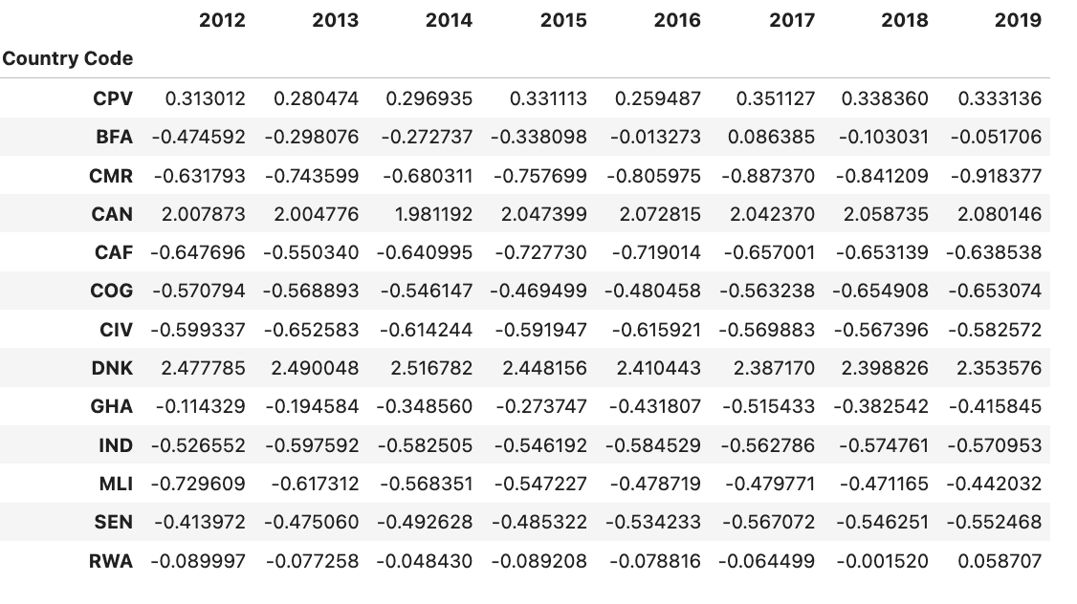
GDP Ratio Scaled Data

Slide 10
Find the Best Value for k Using the Original Data
You will use the elbow method to find the best value for k.
Code the elbow method algorithm to find the best value for k. Use a range from 1 to 8.
Plot a line chart with all the inertia values computed with the different values of k to visually identify the optimal value for k.
What is the best value for k?

Slide 11
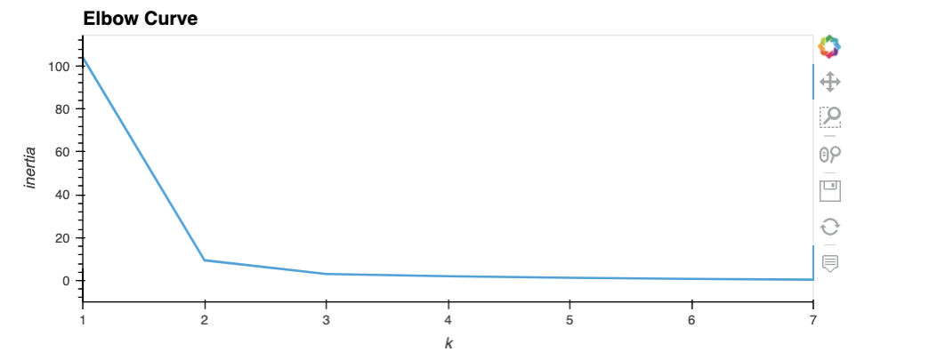
Plot a line chart with all the inertia values The optimal value of k is 2.

Slide 12
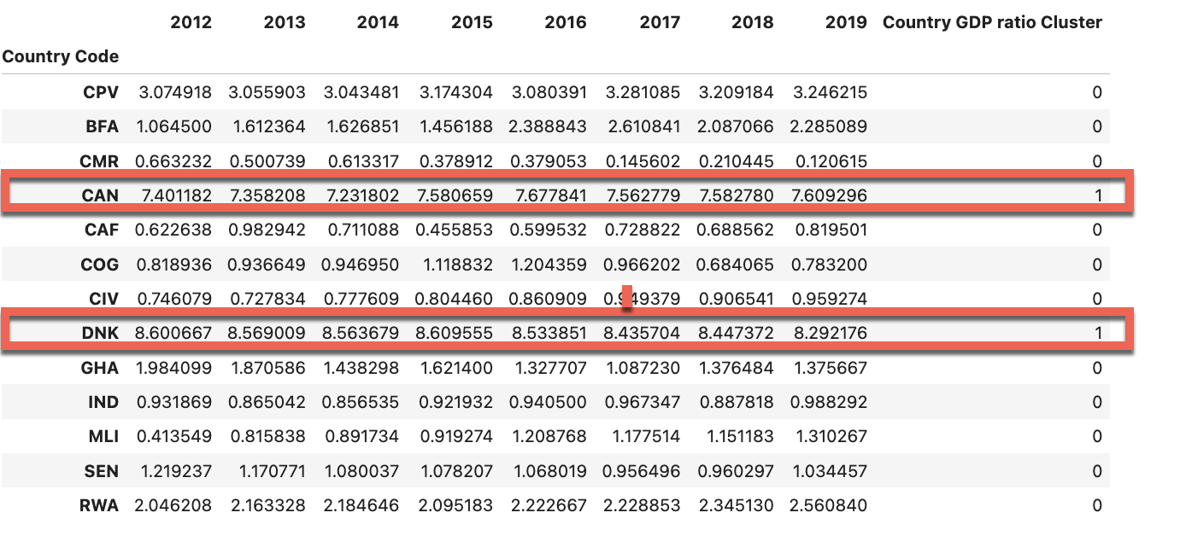
GDP Ratio Prediction Dataframe

Slide 13
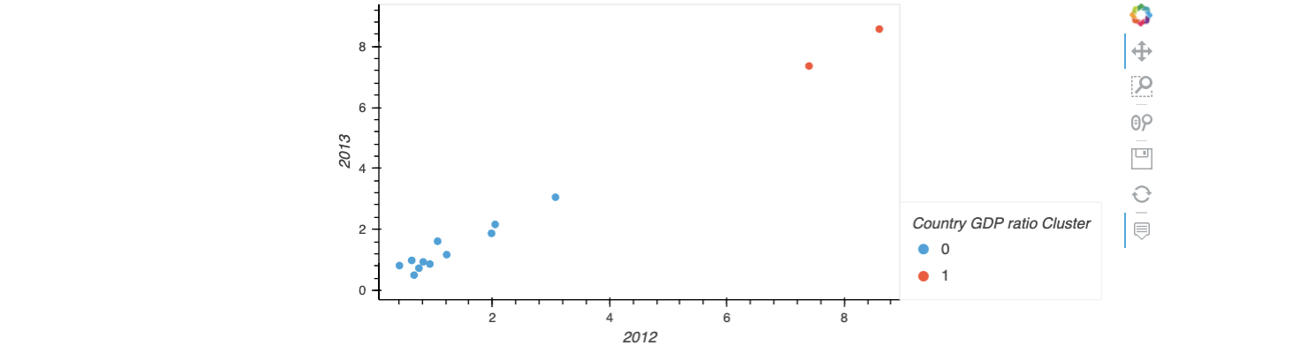
Create a Scatter plot using hvPlot

