Slide 1
Social Work and Care Coordination – Successful Models: Home and Community Services Network
W. June Simmons, MSW - CEO
Partners in Care Foundation
September 19, 2012
CalSWEC Aging Summit

Slide 2
Agenda
An historic opportunity for positive change
Addressing social, environmental and self-care components that drive health outcomes
Unique characteristics required in changing environment – a new business model
Strategies for LTSS impacting Medicare and Medi-Cal service use/health outcomes
Home & Community Services Network

Slide 3
Moving from Presenting Problem to Presenting Person
Managed care seeks best care for best cost, so represents an opportunity for major change
The Duals demonstration moves the risk for nursing home to health plans and provider groups
LTSS resources are crucial to success – reduces both nursing home and Medicare costs
“Buy vs. build” and other competing forces

Slide 4
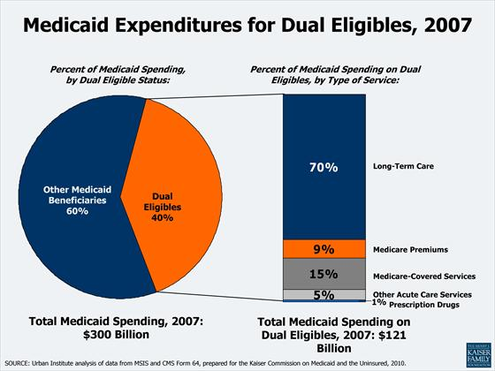
70%

Slide 5
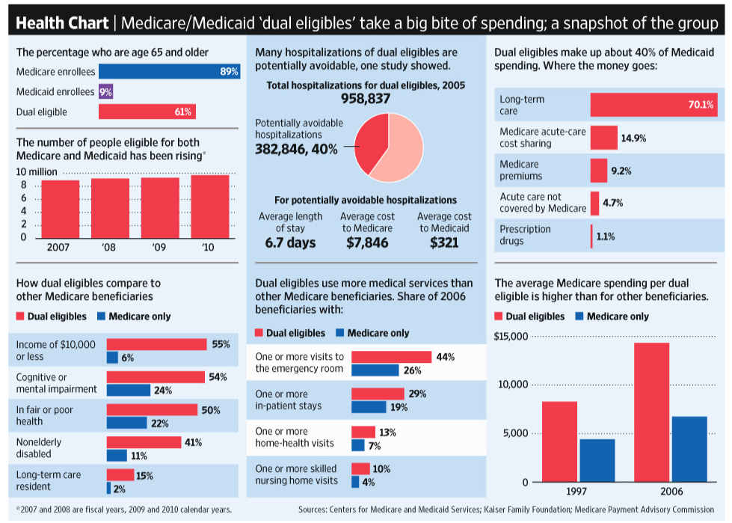

America’s Dual Eligibles
Sources: Centers for Medicare and Medicaid Services; Kaiser Family Foundation, Medicare Payment Advisory Commission

Slide 6
Duals Demonstration Project – How the Risk Will Shift
Total financial responsibility for the full continuum of Medicare and Medi-Cal services will now include:
medical care
behavioral health services, and
long-term services and supports (LTSS):
In-Home Supportive Services (IHSS)
Community-Based Adult Services (CBAS)
Multipurpose Senior Services Program (MSSP)
Nursing facilities when needed
Social/environmental/self-care supports help dual eligible beneficiaries maintain health and extend living at home - this can reduce costs

Slide 7
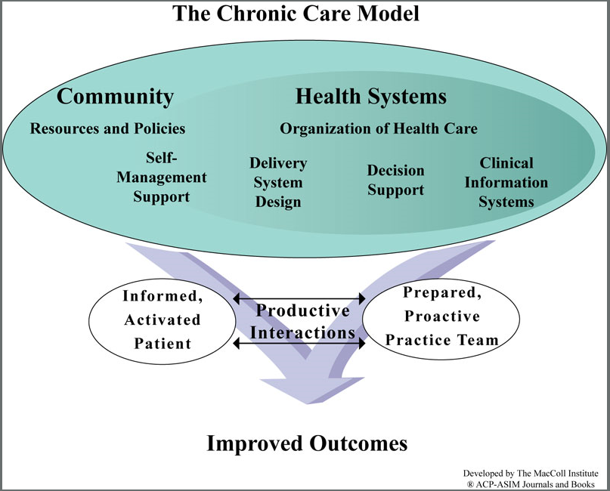

Slide 8
Why the Costs are so High
Nursing Home is expensive and feared
For Medicare, Duals’ high costs driven by elevated need for acute care due to increased prevalence of chronic disease associated with age, disability, poverty AND gaps in the system
Medical interventions alone are not enough- need proven strategies for LTSS in home and self-care - need targeted evidence-based approaches

Slide 9
America’s Dual Eligibles
Sources: Centers for Medicare and Medicaid Services; Kaiser Family Foundation, Medicare Payment Advisory Commission

Slide 10
Clustered “products” enhance results
MSSP model: assessment and mobilizing social and environmental resources
Stabilizes at home and alternate kinds of help
Coordination with CBAS, IHSS and mental health in place
Now must couple with other new approaches:
Transitions – post-hospital interventions
Home-Meds and In-Home Palliative Care
Evidence-based self-management programs

Slide 11
America’s Dual Eligibles
Sources: Centers for Medicare and Medicaid Services; Kaiser Family Foundation, Medicare Payment Advisory Commission

Slide 12
How Home and Community Services Address and Improve Health Outcomes – thus cost effective for both Medi-Cal and Medicare
Multiple, complex chronic conditions & self-care
Evidence-based enhanced self-care programs (e.g, Chronic Disease Self Management (CDSMP), Diabetes Self Management (DSMP)
Complex medications/adherence (HomeMeds℠)
Multiple ER visits – gaps in care/communication
Post-hospital support to avoid readmissions
Nursing home diversion/return to community
In-home palliative care in last year of life

Slide 13
How to Best Care for the Duals to Achieve Optimal Health Outcomes

Slide 14
Hot Spotting - Targeting
High costs come from specific target groups, where the investment of a new intervention yields better health and quality of life outcomes while driving down costs
Evidence-based self-management maintains health
Identify complex patients – screen consistently
Medi-Cal targets keeping people out of nursing homes and……we can also
Impact Medicare more directly by reducing ER, hospital admissions and readmissions

Slide 15
What is Long Term Care?
Encompasses a wide array of medicine, social, personal and supportive and specialized housing services
Social and environmental factors are crucial to determining full positive impact of medicine
Needed by people who have lost some capacity for self-care
Care at home or in a nursing home
Most who need LTC are over age 76 (63%)

Slide 16
Activities of Daily Living (ADLs)
Personal care activities people engage in every day
Fundamental to caring for oneself to maintain personal independence
Assessment determines level of care/ assistance needed
Certifies LTC level of care/payment level

Slide 17
ADL Functions
ADL Functions
Bathing
Dressing
Grooming
Mouth care
Toileting
Transferring bed/chair
Climbing stairs
Eating
Each function is rated
to determine level of support required:
-INDEPENDENT
-NEEDS SOME HELP
-VERY DEPENDENT
-CANNOT DO

Slide 18
Instrumental Activities of Daily Living (IADLs)
Related to independent living
Valuable for evaluating level of disease
Determinant of person’s ability to care for themselves and their environment

Slide 19
IADL Functions
IADL Functions
Shopping
Cooking
Managing medications
Using the phone and looking up phone numbers
Doing housework
Doing laundry
Driving or using public transportation
Managing finances
Each function is rated
to determine level of support required:
-INDEPENDENT
-NEEDS SOME HELP
-VERY DEPENDENT
-CANNOT DO

Slide 20
Home and Community LTC System Helps Avoid Nursing Home Placement
Care at home can sustain independence
Comprehensive in-home assessment identifies risks, basis to craft an in-home careplan
Currently 6 separate MSSP agencies across LA County and 41 in the state offer MSSP care in the home to Medi-Cal beneficiaries
MSSP program moves under managed care and is a great prototype for care coordination
Work across agency lines to integrate

Slide 21
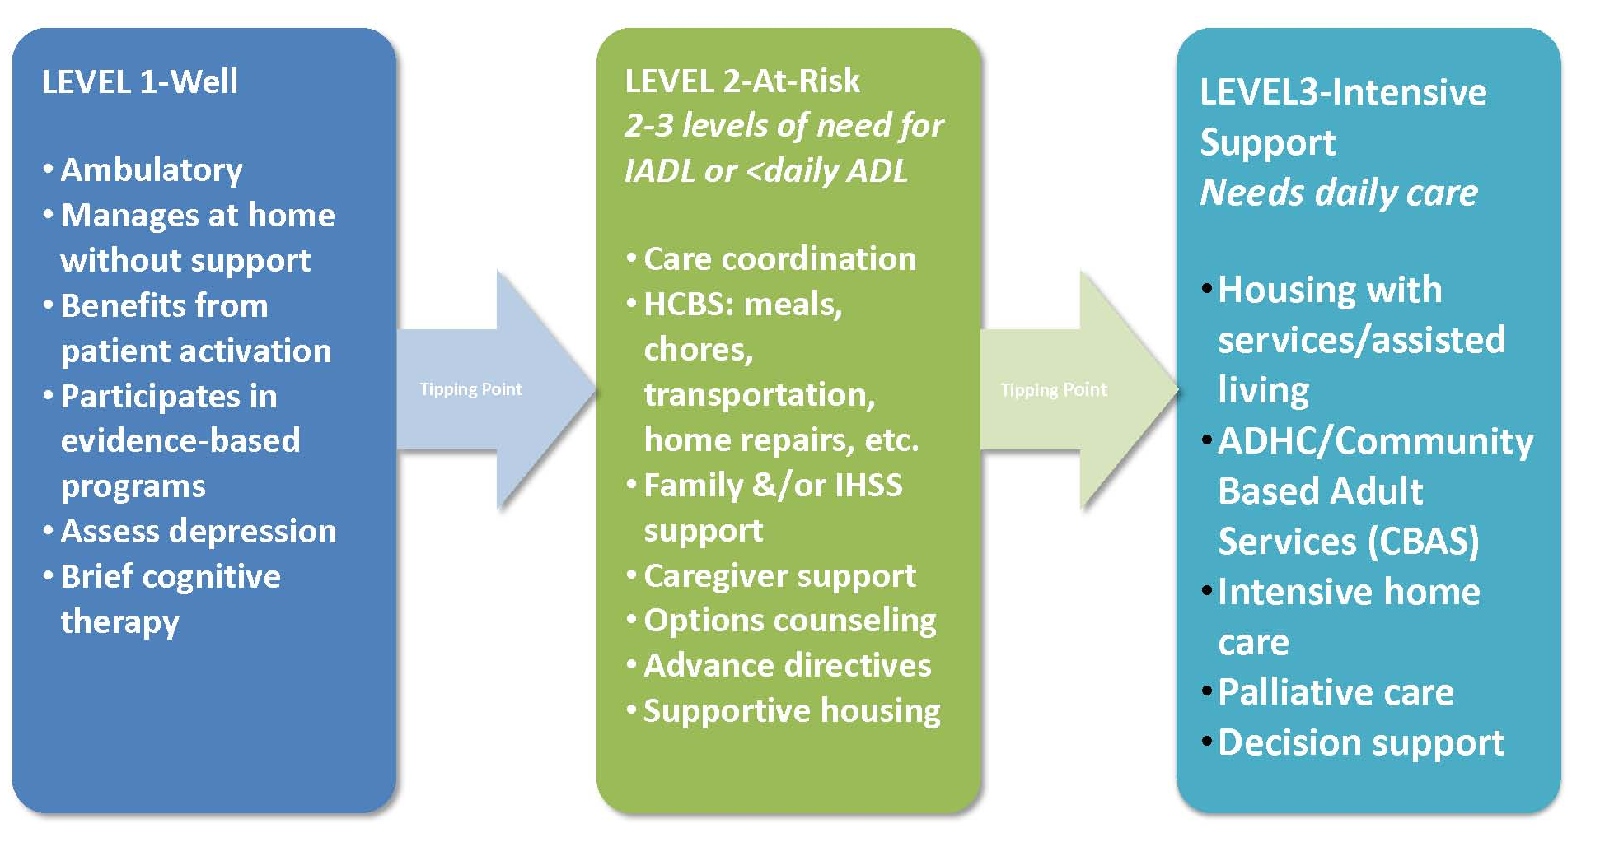
Tiered Service Needs
Initial HRA Conducted to Triage and Determine Level of Care Required

Slide 22
What Our Network of Services Can Provide
Referred Services
AAA
IHSS
Community Based Adult Services (formerly Adult Day Health Center)
Regional Center
Independent Living Centers
Home Health
In-Home Palliative Care
Hospice
DME
Families / Caregivers Support Programs
Senior Center Programs
Evidence-based Health Impacting Self-Care programs
Long-term home-delivered meals
Housing Options
Communication Services
Legal Services
HICAP
Ombudsman
Benefits Enrollment for services (i.e., food stamps)
Money management
Transportation
Utilities
Volunteer services
Purchased Services (Credentialed Vendors)
Safety devices, e.g., grab bars, w/c ramps, alarms
Home handyman
Emergency response systems
In-home psychotherapy
Emergency support (housing, meals, care)
Assisted transportation
Home maker (personal care /chore) and respite services
Replace furniture /appliances
for safety/sanitary reasons
Heavy cleaning
Home-delivered meals – short term
Medication management (HomeMeds)
Special needs required to maintain independence

Slide 23
AAAs and Sponsors of MSSP Offer Access and Strengths
Area Agencies on Aging – crucial access point
MSSP sponsors can evolve “prototype” into expanded tiered home care approaches
Scaling up from solid base and clinical infrastructure safer than “reinventing”
“Community” is a specialty practice expertise
Evidence-based self-care will be next generation of added interventions - phased

Slide 24
How We Work Together
Home and Community Services Network
Broad geographic coverage with in-home Care Coordination through a central portal
Common assessment tool and EMR
Multi-lingual/cultural competence/home experts
Contracted, credentialed network of trusted vendors and linked partnerships
Administrative simplicity with full access to both arrange and purchase community care resources

Slide 25
Home and Community Services Network - Key Elements
Full geographic coverage of L.A. County - one portal for all
Credentialed contractors for purchase of home and community-based services and personal care
Common data system
Strong business case
MSSP model is prototype
Build on base of 3,400 clients/170 care coordination staff – RNs and Social Workers in 7 locations
Cost effective, proven, and uniform model of care
Ability to scale up and differentiate
Tiered care management models possible

Slide 26
Current System
Area Agencies on Aging/ senior centers and core services
Caregiver Resources Centers
In-home Supportive Services (IHSS)
Adult day health/Community-Based Adult Services (CBAS)
MSSP – nursing home diversion
Mental Health Services

Slide 27
Together – We Can Manage the Duals
Health Plan Functions
Enrollment and disenrollment/UM & CM
Claims and Data Analysis
Coordinating Medicare & Medicaid
Integrated Direct Delivery
Different facility needs – primary care clinic integrated with behavioral health institution
Coordination of referrals, appointments, care mgmt., clinical best practices, staff, clinical records
Clinical integration with health plans/community
Community Resources
Care coordination/in-home support
Access to Public benefits/IHSS/CBAS
Transportation, food assistance, housing
EB Targets -- meds /palliative /coaching /self-care/
mental health/chronic pain

Slide 28
The Time is Now
For more information contact:
-June Simmons, Partners in Care Foundation
-jsimmons@picf.org (818) 837-3775
-

