Slide 1

Effects of IV-E Education on MSW Student’s Attitudes and Professional Commitment
Susan Jacquet & Fangfang Yao
California Social Work Education Center UC Berkeley
Presented October 2007 at the 53rd Annual Program Meeting of the Council on Social Work Education. San Francisco, CA

Slide 2
CalSWEC IV-E Program
California Social Work Education Center (CalSWEC) is the nation's largest state coalition of social work educators and practitioners.
CalSWEC is a consortium of:
California's accredited social work graduate schools;
California Department of Social Services;
58 county departments of social services;
California Chapter of the National Association of Social Workers.

Slide 3
CalSWEC Goals
Prepare social workers for employment in public child welfare systems;
Increase numbers of minorities in professional social welfare positions to reflect the populations served;
Upgrade the professional background of some already-employed public welfare workers interested in gaining additional skills and knowledge in child welfare; and
Educate professionals who will be able to advocate effectively for the needs of minority and disadvantaged children and families.
Notes:
The first goal deals with recruitment of students and is part of the focus of this study.

Slide 4
Research Questions
Does the CalSWEC IV-E program recruit students amenable for work in public child welfare?
Does IV-E MSW education increase IV-E students’ desire to work in public child welfare?

Slide 5
Entry/Graduation Study
Entry Survey
    All entering MSWs in CalSWEC Consortium Universities from 1991-2000 (N = 8871)
Graduation Survey
    All Graduating MSWs in CalSWEC Consortium Universities from 1993-2002 (N = 6194)
    (Part-time through 2004)
Matched Set
    Student matched on data from Entry to Graduation
      (n = 2334)

Slide 6
Comparison Groups
(from the Matched Dataset)
Pre-IVE
    Baseline respondents (1991-1993) prior to CalSWEC IV-E enrollment (n = 252)
Non-IV-E
    All respondents (1994-2004) who were NOT part of the CalSWEC stipend program (n = 1252)
IV-E
    All respondents (1994-2004) who were part of the CalSWEC stipend program (n = 284)

Slide 7
Variables
Attitudes toward Poverty
Role of Social Worker with Client
    individual adaptation
    societal change
Allocation of Social Work Resources
    all groups equally
    primarily to the poor

Slide 8
Variables (cont’d)
Motivations for MSW Degree
Service Orientation
Career Orientation
Preparation for Private Practice

Slide 9
Variables (cont’d)
Preferences for Fields of Practice
Clinical Work
Management and Planning
Direct Services

Slide 10
Variables (cont’d)
Preferences for Client Populations
Families at risk
Fragile populations
Impoverished population
Justice system
Clinical population
Medical population

Slide 11
Variables (cont’d)
Future Career Goals
Career Advancement
Service to others

Slide 12
Analyses
Crosstabs and Chi-Square Tests
Oneway Analysis of Variance
Paired T-Tests

Slide 13
Results
Does the CalSWEC IV-E program recruit students amenable for work in public child welfare?

Slide 14
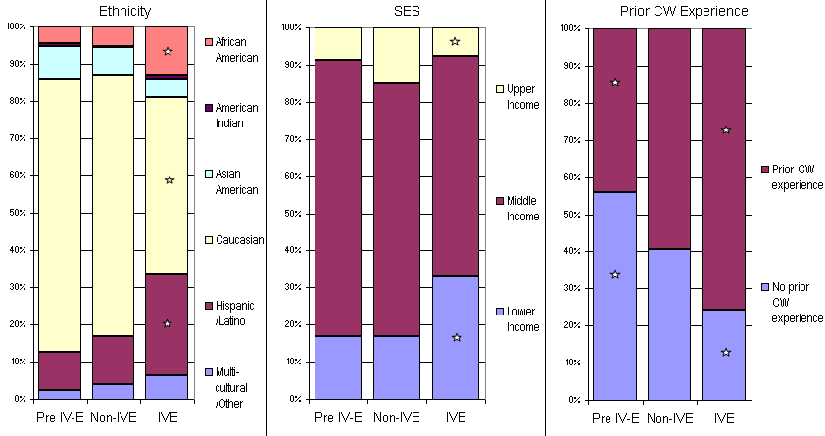
Demographics

Slide 15
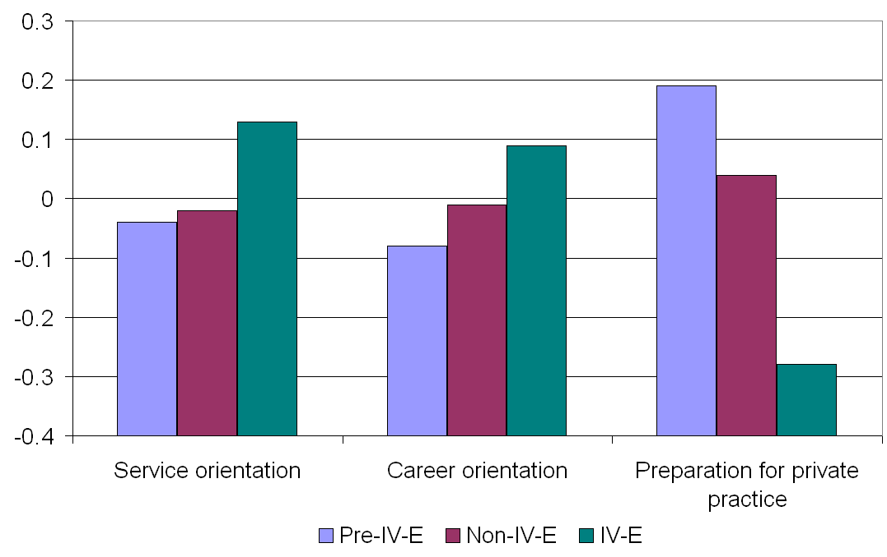
Motives to Enter
Graduate School
Mean Ratings

Slide 16
Results (cont’d)
Does IV-E MSW education increase IV-E students’ desire to work in public child welfare?

Slide 17
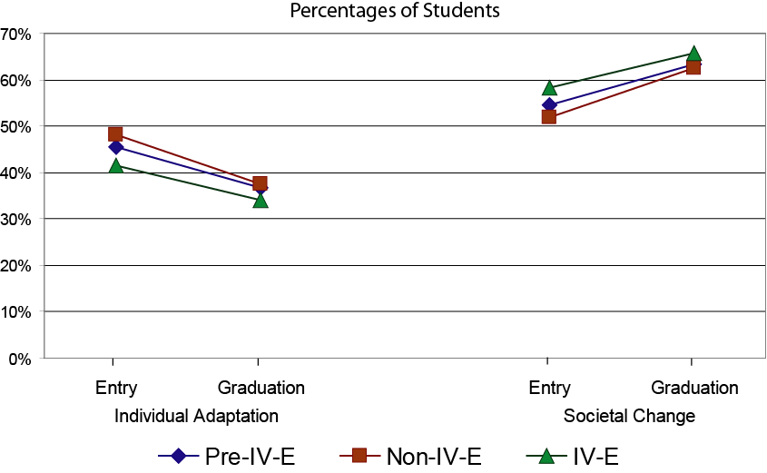
Attitudes toward the poor
Role of Social Worker with Client

Slide 18
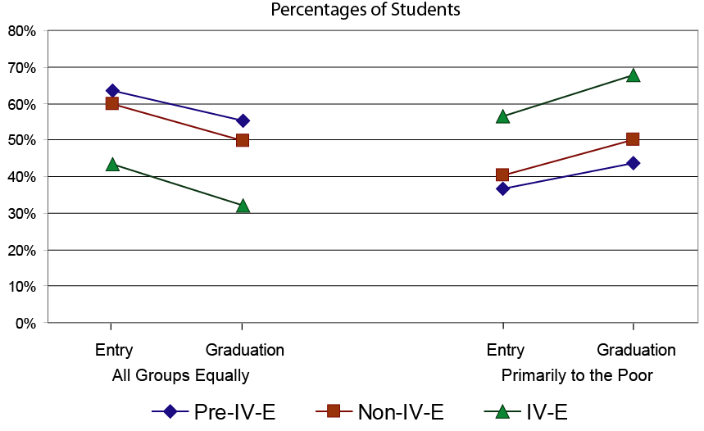
Attitudes toward the poor
Allocation of Social Work Resources

Slide 19
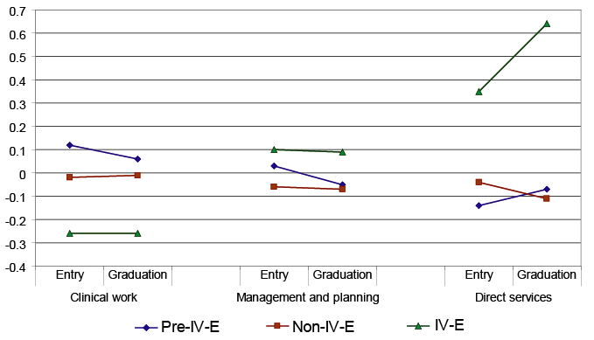
Preferences for Fields of Practice
Mean Ratings

Slide 20
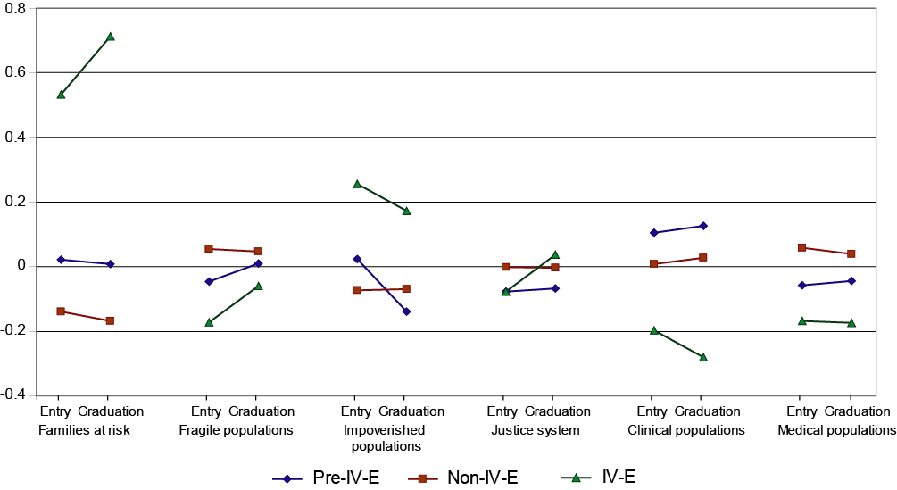
Preferences for
Client populations
Mean Ratings

Slide 21
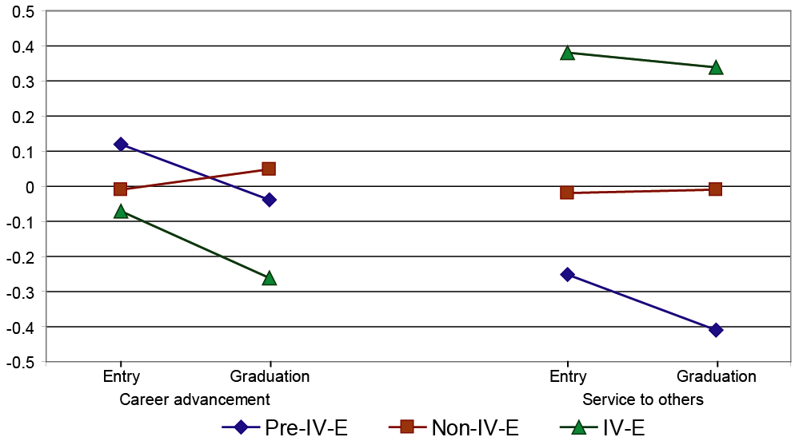
Career Aspirations
Mean Ratings

Slide 22
Conclusions
The CalSWEC IV-E Program does recruit a diverse group of students with a propensity to serve the disadvantaged and work in direct services.
IV-E students have greater diversity and more prior experience working in child welfare and less motivation for work in private practice than do Non-IV-E and Pre-IV-E students.

Slide 23
Conclusions cont’d
IV-E students’ attitudes toward advocacy for the poor families increased whereas other students did not.
IV-E students prefer direct services and working with impoverished populations, families at risk, and populations in the justice system far more than do Non-IV-E and Pre-IV-E students.
IV-E students’ aspire to careers in service to others rather than to advancement.

Slide 24
Contact information
Susan E. Jacquet, Ph.D., Research Specialist
California Social Work Education Center
University of California, Berkeley
School of Social Welfare
Marchant Building, Suite 420
6701 San Pablo
Berkeley, CA 94720-7420
(510) 643-9846
Fax (510) 642-8573
sjacquet@berkeley.edu
http://calswec.berkeley.edu/
Fangfang Yao, Ph.D. Candidate
University of California, Berkeley
School of Social Welfare
120 Haviland Hall
berkeley, CA 94720-7400
ffyao@berkeley.edu

