Slide 1

This Bridge Called My Web Survey: Collecting, Weighting and Displaying Workforce Data
Richard J. Smith, MFA, MSW
Sherrill J. Clark, LCSW, PhD
Skills Workshop for the Council for Social Work Education
Annual Program Meeting San Antonio, TX
Monday, November 9, 2009 7:30 AM
Grand Hyatt Bonham D
University of California, Berkeley
School of Social Welfare
6701 San Pablo #420
Berkeley, CA 94720

Slide 2
Information About the CalSWEC
The California Social Work Education Center (CalSWEC) is the nation's largest state coalition of social work educators and practitioners
CalSWEC is a consortium of:
California's 20 accredited social work graduate schools
California Department of Social Services
58 county departments of social services
California Chapter of the National Association of Social Workers

Slide 3
Objectives of Presentation
Identify three advantages and three disadvantages of using a web-based survey
Identify three ways to adjust estimates of a finite population to compensate for varied response rates within regions
Identify where to obtain and use free GNU (GNU is Not Unix), General Public License software tools such as R lattice graphs to display data in an accurate, attractive and comparative manner

Slide 4
The California Public Child Welfare Workforce Study
This study has taken place five times: in 1992, 1995, 1998, 2004, & 2008
Each time the study was done, there have been two sources:
  The agencies’ administrative data and
  The individual workers’ responses
We’ve used combinations of in-person, mailed and online surveys
This time it was done entirely online

Slide 5
Workforce Study Retention Factors
Agency structural attributes | Career path & demographic variables
Alternative work arrangements | Age
Compensatory time and overtime | Job tenure
Union participation | Educational level
Case assignment procedures | Licensure
Salaries | Title IV-E participation
 | Interest in professional development

Slide 6

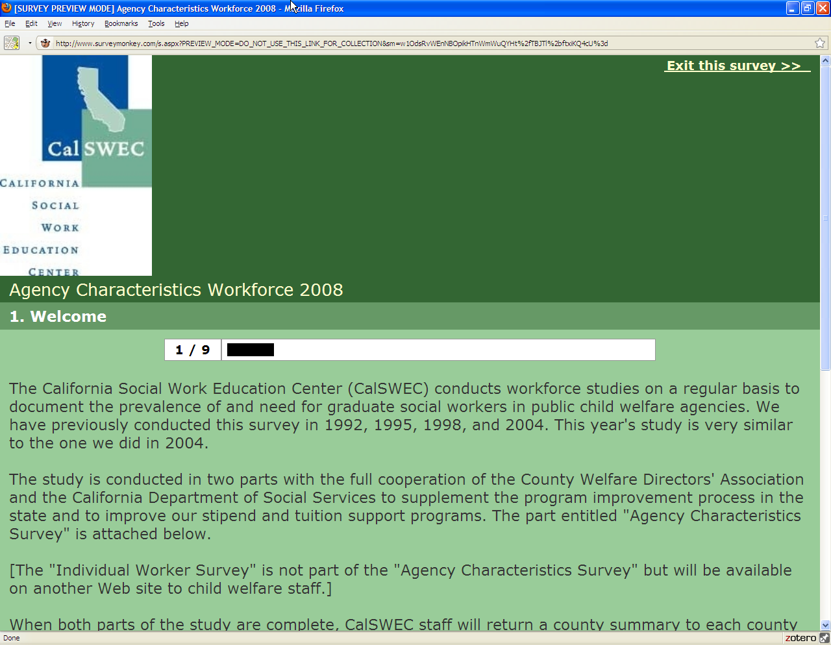
Components of The Workforce Study
This study has two sections:
  Agency Characteristics Survey N = 59
    SurveyMonkey.com
    Primary rationale for this part was to obtain population estimates of the workforce and other information about the county agencies
    Obtained with help from the 58 counties and CDSS

Slide 7

Components of The Workforce Study
  Individual Worker Survey n = 4207
    CDSS Survey tool—Surveynet
    All child welfare social workers, social work assistants, supervisors, non case-carrying social workers, managers, and administrators were eligible for the study
    Included CDSS Adoptions workers
    Primary questions: Levels of education, title IV-E participation, and desire for more education

Slide 8
Population of the California Child Welfare Workforce 2004 & 2008
Position |  | 2004 | 2008
Social Work Assistants | Full time Part time | 763 19 | 1256 27
NON case-carrying social workers | Full time Part time | 1145 14 | 987 40
Case-carrying social workers | Full time Part time | 7246 123 | 8289 195
Supervisors | Full time Part time | 1397 13 | 1733 28
Managers | Full time Part time | n/a n/a | 407 3
Administrators | Full time Part time | n/a n/a | 108 5
Total |  | 10720 | 13078

Slide 9
How do we weight the sample to reflect the population?
Sample data we did not have from the Agency Characteristics Surveys were:
  Worker ages, length of tenure, licensure, educational levels, interest in professional development, title IV-E participation
Data we did have:
  County names
  Number of workers by position from administrative data
  County size (didn’t use)
  Location by region of the state

Slide 10
Lessons Learned
Teaching the art of cut and paste from email to browser
One county with low response rates does not use routinely use email communication.
Agencies the use the computer as a time clock had high response rates
Beware the drop down menu! One slip of the finger gives the wrong answer
Management turnover, competing priorities, competing studies
“Who outsourced my human resource data?”
“Which Instrument Is This Syndrome? (WIITS)—When the client sends the administrator’s survey to line workers
I’m not Hispanic, soy Latina! Census race and ethnicity categories do not work with some populations
Notes:
How many ways can one write a date? 01/01/2009, Jan. 1st, 2009, January 1, 2009
How many ways can one express a percent? (pct., percent, %, PCT, Per cent)

Slide 11
Weighting Options
Population Weights: For state and regional estimates, weight by the inverse of the sample in each agency to the known agency population (Lee et al., 1989)
Spatial Weight Smoothing: Weighted estimates were smoothed using GeoDA’s empirical Bayes spatial rate smoothing package (Anselin, 2003)
Notes:
Simple weights down weighted agencies with higher response rates and up weighted those with low response rates.

Slide 12
Example: Two States, One Flag
We hold a census to find out if people prefer a blue flag or a red flag
Different response rates
Is the response rate related to flag preference?
Little State Pop. = 25 n = 20
Big State Pop. 75 n = 31
Notes:
In an ideal world, you get a sample from each subpopulation that exactly matches proportion of the sample subpopulation to the population. Say you live in a world with two regions: Big and Little. The population of the world is 100 people. In Big, there are 75 people and in little there are 25 people. Since the world is small, we attempt to get a census because we need to find out if people prefer a blue flag or a red flag. However, we only get 51 responses. Because little is little and we can sit down in one room and bug them, we get 20 of 25 responses from Little. Big, however, is too busy doing Bigger things that filling out surveys. In fact, they tell us that they only fill out surveys unless we buy them movie tickets. That being said, we get 31 responses. At this point, we have to assume that this selection bias into the survey is either completely at random or in this example, perhaps an intrinsic characteristic of the subpopulation itself. In other words, people in Big had a lower response rate because they only do Bigger things. However, their preference for Blue or Red has NOTHING to do with being a Biggie or their desire to fill out surveys. In Little, we know that the selection bias was completely at random, because the one person who did not fill out the survey had one the lottery the day before, and quit her job to move to Big. So in this case, we feel comfortable weighting the response of Blue versus Red.
Be careful! If we think that an anti-Red activist in Big organized a boycott of the census, this would not work.

Slide 13
Simple Population Weights
 | Sample Size (C1) | Population Size (C2) | Percent of Population (C3) | Percent of Sample (C4) | Adjustment Factor
 |  |  |  |  | (C3 / C4)
Big | 31 | 75 | 75% | 60.7843% | 1.233871
Little | 20 | 25 | 25% | 39.2157% | 0.6375
TOTAL | 51 | 100 | 100% | 100%
The adjustment factor is the state’s percent of total population divided by the state’s percent of the total sample

Slide 14
Two States, One Flag (cont)
Before weights, Red wins
Applying weights gives Blue a five point lead
Weighted values add up to the sample size!
Within region numbers not meaningful
 | Weight (1/3) | Likes Blue | LB Weighted | Likes Red | LR Weighted | Total Weighted
Big | 1.233871 | 20 | 25 | 11 | 14 | 38.25
Little | 0.6375 | 5 | 3 | 15 | 10 | 12.75
TOTAL |  | 25 | 28 | 26 | 23 | 51
Notes:
The raw response shows Red winning by a hair. Applying the weights gives the Blues an advantage by five points. Note that the weighted values add up to the population size, not the the sample size! As such, don’t forget that the purpose of this exercise is to get a estimate of the WORLD preference for Blue vs. Red. Don’t take the weighted values within the region to be meaningful. After all, we KNOW there are at least five Littlies that like blue. We’re just letting the Big sample temporarily borrow those responses.

Slide 15
Spatial Smoothing
Tobbler’s Law: Everything is related to everything else, but closer events have more in relationship than those far away
GeoDa creates a weight matrix for spatial rate smoothing to harness spatial dependency:
  Rook: Places up or down or right or left are considered near
  Queen: Any places that touch at a point
  Euclidian distance: As the bird flies distance from a point
Notes:
Tobbler’s law of geography says that everything is related to everything else, but closer events have more in relationship than those far away. As such, in geographic information science (GIS), there are ways to model nearness. This nearness can be seen as a threat to validity—for example, nearby geographies are not independent, therefore we have to model the dependence to get rid of it. Alternatively, if we are collecting data from geographic regions and we know that data from some regions suffer from outliers or poor response rates, then we can smooth the results and potentially improve estimates by taking advantage of the assumption that near events would have similar values.
GeoDa creates a weight matrix for spatial rate smoothing. The weights may be one of the following:
Rook: Places up or down or right or left are considered near
Queen: Any places that touch at a point
Euclidian distance: Any place within an as the bird flies radius of a point is considered near
For our study, this method did not generate results that improved upon the simple weights. Some were simply not plausible. This is because California’s counties are very large and some of them have unique characteristics.

Slide 16
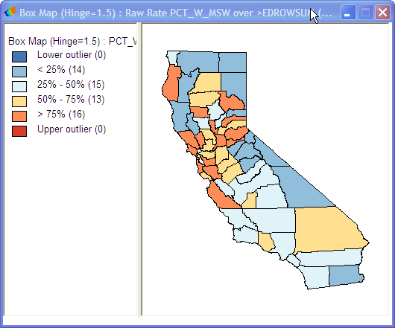
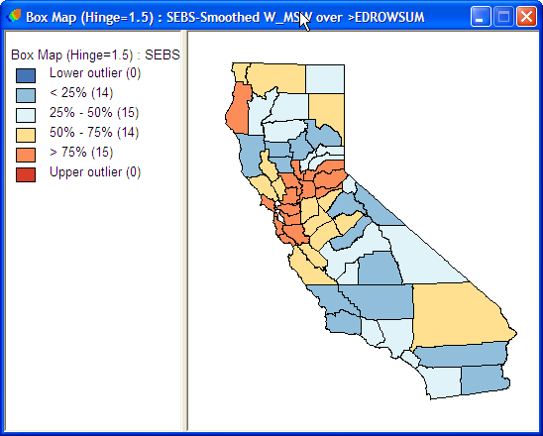
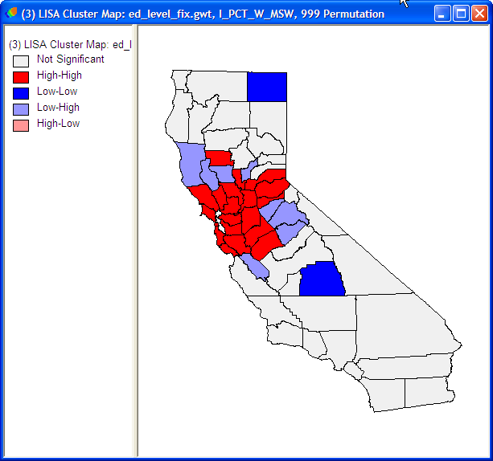
Examples of Spatial Smoothing
Top: Raw % in Child Welfare who have MSW Bottom Left: Smoothed Bottom Right: Clustered

Slide 17
Literature on Web Surveys
While the Internet promises an efficient way of organizing information…
  Oudshoorn & Pinch (2003) theorize that technology can be rebuilt or resisted by users
  Converse et al. (2008) found that in a survey of 1500 secondary school teachers, a mail survey had a higher response rate from a web based survey
  Cook et al. (2000) found low response rates on email surveys unless the researcher relied on personal contacts

Slide 18
Free Software for Stats
Free software does not infringe upon the rights of users to modify or redistribute software
GNU (GNU is Not Unix)/GPL (General Public License) does require that the software and modifications remain free (Copy Left)
Free does not mean “no cost.” You pay for the service, not the software
Social justice values, maintaining a public commons and freedom of information and scientific inquiry
Notes:
Proprietary software is not so much about capitalism and profit motive as stupidity. Because software is by definition an “intangible”, it makes it difficult to value
Because it is easy to hack, it makes it difficult to monitor
Because innovation depends on open flows of information, proprietary software slows innovation by restricting access to business to business commerce
It has no place in academic life and socially unjust

Slide 19










Free GNU
GIS Packages
HostGIS/Linux with PostSQL GIS
OpenJUMP
GRASS
Quantum GIS
Spatial Stats
R-Geo, RGDAL, Maptools
OpenGeoDa
STARS/REGAL

Slide 20
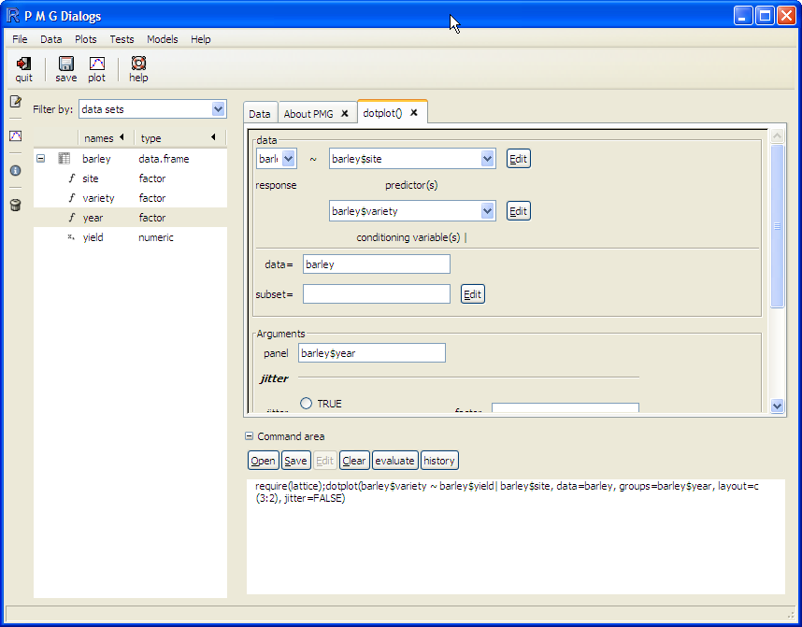
R with Poor Man’s GUI
R is the leading free software framework based on S-Plus, the mother of M-Plus
As with all professional stats software, it has both command line and graphical user interface

Slide 21
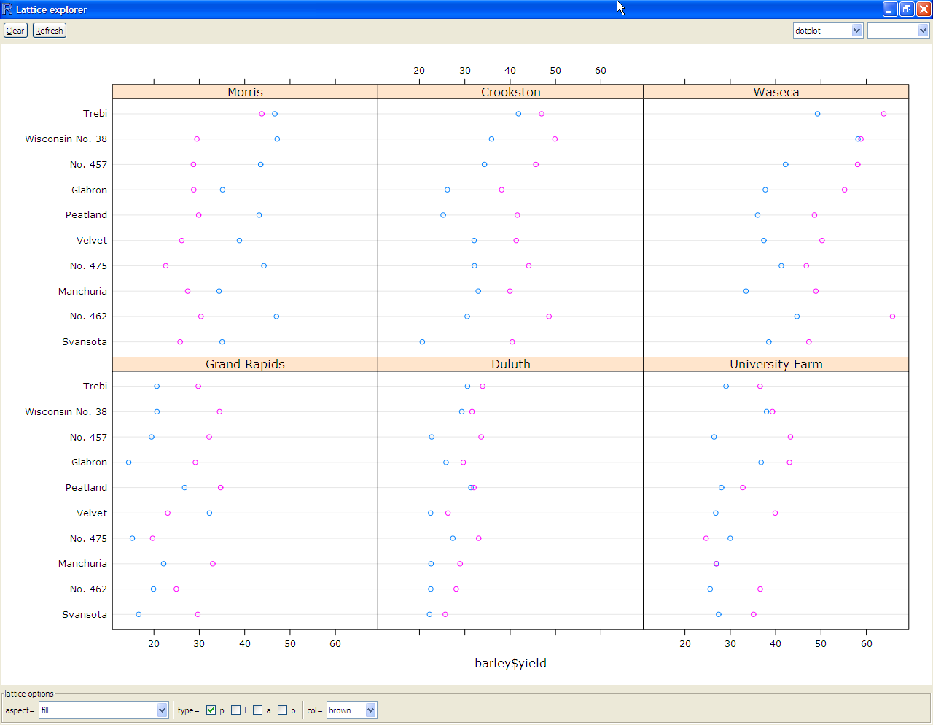
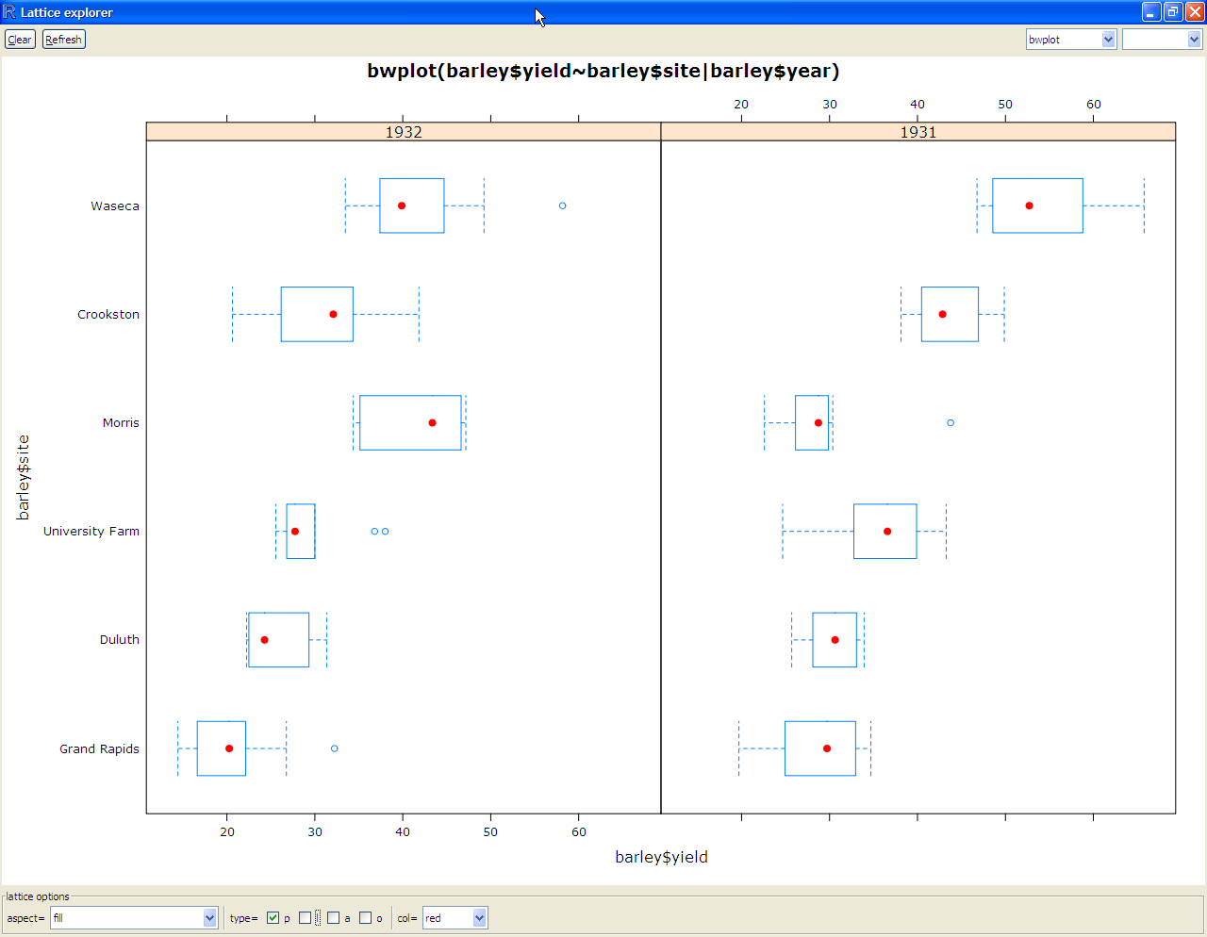
Lattice Graphs

Slide 22
GNU Gone Wilde
GIS GNU
http://www.hostgis.com/home/
http://grass.itc.it/
http://www.qgis.org/
http://www.openjump.org
Stats GNU
http://geodacenter.asu.edu/software
http://regionalanalysislab.org/index.php/Main/STARS
http://www.r-project.org/
http://r-spatial.sourceforge.net/

Slide 23
References
Anselin, L. (2005). Exploring spatial data with GeoDa. Urbana, 51, 61801.
Anselin, L. (2006). GeoDa™ 0.9 user’s guide. Urbana, 51, 61801.
Converse, P. D., Wolfe, E. W., Huang, X., & Oswald, F. L. (2008). Response rates for mixed-mode surveys using mail and e-mail/web. American Journal of Evaluation, 29(1), 99-107.
Cook, C., Heath, F., & Thompson, R. L. (2000). A meta-analysis of response rates in Web-or Internet-based surveys. Educational and Psychological Measurement, 60(6), 821-836.
Lee, E. S., & Forthofer, R. N. (2005). Analyzing complex survey data. Sage Pubns.
Oudshoorn, N., & Pinch, T. (2003). How users matter: The co-construction of users and technology. MIT press Cambridge MA.

