Slide 1
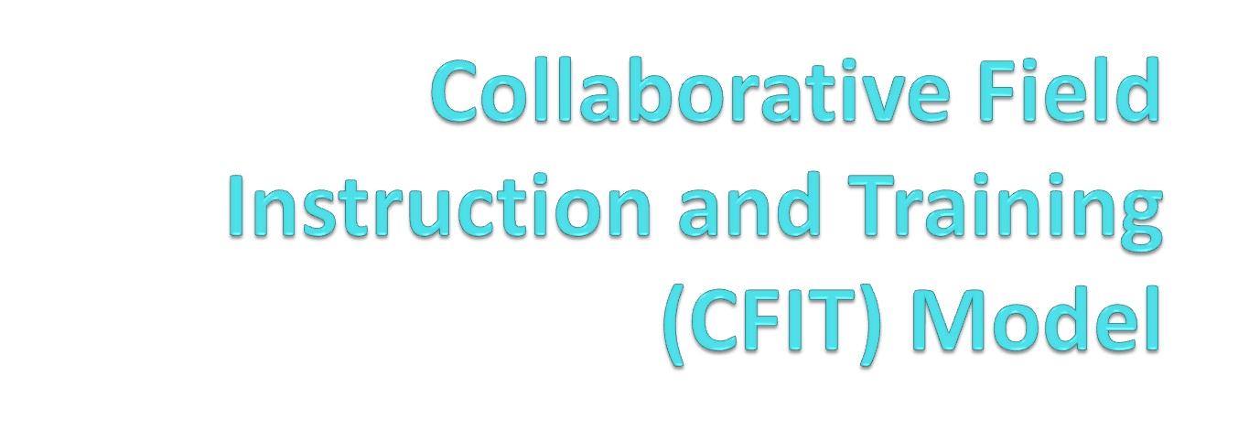
Working with Foster Youth in
Higher Education
CSU DOMINGUEZ HILLS

Slide 2
PROGRAM DEVELOPMENT
NEEDS:
● Develop quality field placements for Foundation students
● Previous experience/success at LBCC

Slide 3
PROGRAM DEVELOPMENT
● Research has reflected that the percentage of foster youth who enter college and remain to the point of certificate or degree attainment is significantly lower when compared to non-foster care youth
● Colleges and Universities who have committed resources to serve Foster Youth transitioning into higher education are in need of additional resources to better serve this population.

Slide 4
PURPOSE
Combining of Resources
- Participating colleges provide MSW Interns with a quality learning experience
and
- MSW Interns provide the resource of time, social work interventions and staffing

Slide 5
STRUCTURE (INDIVIDUAL SUPERVISION MODEL)
One MSW intern placed at each of the following Community Colleges:
- Cerritos College
- Long Beach City College
- Los Angeles City College
- Pasadena City College

Slide 6
STRUCTURE
Long Beach City College – Field Instructor
- Intern: Chris Stretch
Cerritos College - Preceptor and Field Instructor
- Intern: Stephanie Cooper
Los Angeles City College – Preceptor and Field Instructor
- Intern:
Pasadena City College - Preceptor and Field Instructor
- Intern: Viviana Mercado

Slide 7
ROLE OF FIELD INSTRUCTOR
Field Instructor will:
Familiarize self with CSUDH MSW Program and theoretical framework of CRT and Intersectionality. (Written materials will be provided by CSUDH)
Familiarize self with Field site(s), related campus programs and specific program hosting your MSW intern
Provide a minimum of 1 hour supervision per week, per student at the field site
Maintain regular communication with the Preceptor and/or CSUDH field liaison as needed for consultation, planning and to address any areas of concern including changes in the agency that may impact the fieldwork experience
Assure that the student receives and maintains a sufficient number and variety
of appropriate cases/assignments. (Please keep in mind that 50% of their time during internship should be in direct client contact)

Slide 8
ROLE OF FIELD INSTRUCTOR
Support the requirement of Educationally Based Recordings (EBR) throughout the semester.
Utilize the EBR as a tool to provide written feedback to the intern regarding their practice.
In collaboration with the student intern and preceptor, develop learning agreement
Notify liaison of any changes in the student's schedule, including extended time agreed to at the end of the field period
In collaboration with preceptor, complete end of the semester student evaluation
Participate in 4 joint meetings identified in model description
Participation in CalSWEC Pilot Field Model evaluation process.
Completion of Field Instructor Training (if new field instructor)

Slide 9
ROLE OF THE PRECEPTOR
Preceptor will:
Make arrangements to provide physical work space and needed equipment for intern.
Familiarize self with CSUDH MSW Program and theoretical framework of CRT and Intersectionality. (Written materials will be provided by CSUDH)
Provide an agency orientation to the student at the beginning of the internship period, to include safety procedure
In collaboration with the student intern and field instructor, develop learning agreement

Slide 10
PRECEPTOR ROLE
Provide day to day oversight of intern’s work and provide availability of self or other identified staff member to provide information, respond to questions, etc.
Assist in the development of learning activities and work assignments in conjunction with Field Instructor
Assist with student evaluation at end of each semester
Participation in 4 meetings to be scheduled throughout the year.
Participation in CalSWEC Pilot Field Model evaluation process.

Slide 11
STRUCTURE
In addition to their regularly scheduled weekly field seminar, MSW Interns participate in a specialized seminar for CalSWEC students.
SEMINAR: Total of 8 sessions – 1.5 hours per session
to be held:
September – December 2011
January – May 2012

Slide 12
CalSWEC Specialization Seminar Series
DATE | TOPIC
September 2011 | Introduction to Specialized Seminar Choosing the Profession of Public Child Welfare VIDEO: Multiple Transitions
October 2011 | Exploring Professionalism in Public Child Welfare Goals of CalSWEC Education and Training Program Seminar Pre-test 2.1.1 Identify as a professional social worker and conduct oneself accordingly
December 2011 | Utilizing CRT and Intersectionality to explore Culture and Racism Discussing stereotypes, privilege and personal narratives 2.1.4 Apply critical thinking to inform and communicate professional judgments 2.1.5 Advocate human rights and social and economic justice

Slide 13
CalSWEC Specialization Seminar Series
DATE | TOPIC
January 2012 | Practice in Los Angeles County: Katie-A – Guest Speaker: Robin Sims, DCFS Katie A: History and Overview How is it reshaping child welfare practice? 2.1.8 Engage in policy practice to advance social and economic well-being and to deliver effective social work services
February 2012 | AB 12 and Other Foster Youth Policy – Guest Speaker: Jenny Serrano, DCFS 2.1.8 Engage in policy practice to advance social and economic well-being and to deliver effective social work services
March 2012 | Working with LGBTQ Youth and Families in Public Child Welfare Interviews, Assessments and Interventions 2.1.4 Apply critical thinking to inform and communicate professional judgments 2.1.5 Advocate human rights and social and economic justice

Slide 14
CalSWEC Specialization Seminar Series
DATE | TOPIC
April 2012 | PRACTICE: Developing your interview and Assessment skills when Working with Families in PCW 2.1.10 Engage, assess, intervene, and evaluate with individuals, families, groups, organizations, and communities
May 2012 | PRACTICE: Integration of Assessment and Evaluation of work with Clients in PCW Case presentations on client referred for evaluation for abuse or neglect Seminar Post-test and evaluation 2.1.10 Engage, assess, intervene, and evaluate with individuals, families, groups, organizations, and communities

Slide 15
MEETINGS
1st Joint Meeting: September 12, 2011
CalSWEC PC, FI’s and Preceptors
2nd Joint Meeting: November 2, 2011
CalSWEC PC, FI’s, Preceptors, Interns and Community Partners
3rd Joint Meeting: March 21, 2012
CalSWEC PC, FI’s, Preceptors, Interns and Community Partners
4th Joint Meeting: April-Early May 2012
CalSWEC PC, FI’s, Preceptors and Interns

Slide 16
JOINT MEETING #1 - AGENDA
Introductions
Overview of CFIT Model
  Purpose
  Structure (Roles/Meetings)
  Goals/Evaluation
Information Sharing re: Programs at Participating Sites
Needs Assessment
CSUDH Overview
  MSW Program
    Single Concentration
    Critical Race Theory (CRT) and Intersectionality
    Field Calendar

Slide 17
AGENDA cont
CalSWEC Overview
  Mission and Goals
  Competencies
  Requirements
Roles of Field Instructor and Preceptor
Developing the Learning Agreement
Working with our Community Partners
  Identifying Partners
  Goals of Joint meeting
  Identify possible meeting date options
Other Business

Slide 18
COMMUNITY PARTNER’S MEETING
Working with Foster Youth Transitioning to Higher Education:
Community Partners Meeting
November 2, 2011
10:00 a.m. – 2:00 p.m.
Long Beach City College
10:00 – 10:15 Welcome, Introduction and Overview
10:15 – 10:45 Legislative Updates and Discussion
AB 12: Jenny Serrano – DCFS
AB 1393 and AB 194: Jenny Vinopal – California Youth Connection
10:45 – 11:45 Panel: Foster Youth Perspective
11:45 – 12:15 Lunch
12:15 – 1:30 Workgroups
1:30 – 2:00 Reporting Back and Wrap-up

Slide 19
GOALS and EVALUATION
Goals:
- Create a collaborative learning experience for MSW interns and develop knowledge and framework for field instruction.
- Increase knowledge and enhance relationships with community partners
- Enhance services to foster youth

Slide 20
GOALS and EVALUATION
Evaluation:
- Needs/Self Assessment of FI’s and Preceptors
- Pre-Post Test and student evaluation for MSW Interns re: CalSWEC competencies, knowledge related to interventions with foster youth and Critical Race Theory (CRT) and Intersectionality (Conducted in Seminar)
- Community Partner’s Evaluation re: joint meetings
- Mid-semester site visits with CSUDH Field Liaison
- End of the semester evaluations

Slide 21
GOING FORWARD
GOALS:
▪ Expand the number of sites
RESOURCE ISSUE:
▪ Lack of MSW’s within College/University sites to serve as Field Instructors

