Slide 1
WHAT HAS CHANGED IN COMMUNITY MENTAL HEALTH SINCE PROP. 63 WAS PASSED?
STATE BUDGET, REORGANIZATION AND OTHER ISSUES
CALSWEC BOARD MEETING
Patricia Ryan, Executive Director, California Mental Health Directors Association
February 3, 2012

Slide 2

Changes
The question should be, what HASN’T changed since 2004?

Slide 3
Outline
How Funding Structure Has Changed
Federal Health Reform: the Accountable Care Act of 2009
Mental Health Parity
2011 Realignment
AB 109: Public Safety Realignment
AB 100: Changes to the MHSA
State Administration Reorganization
What’s Next? Questions for Counties and CalSWEC to Ponder

Slide 4
How Funding Structure Has Changed

Slide 5
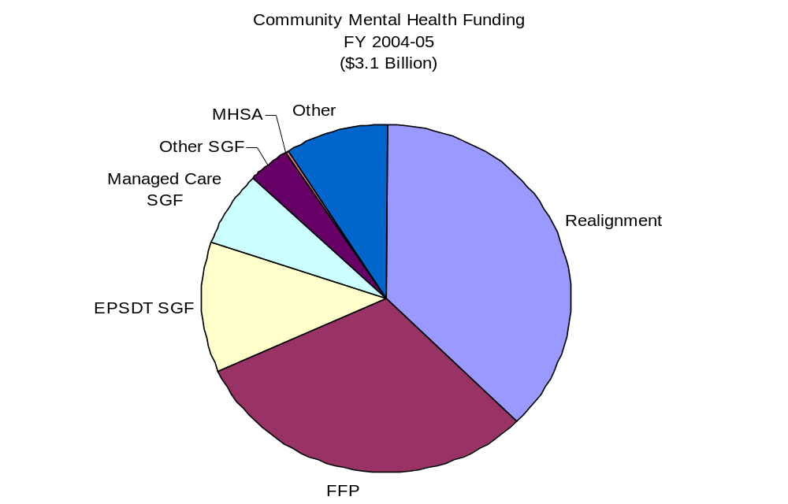
The MHSA = A Growing Percentage Statewide for Direct Services

Slide 6
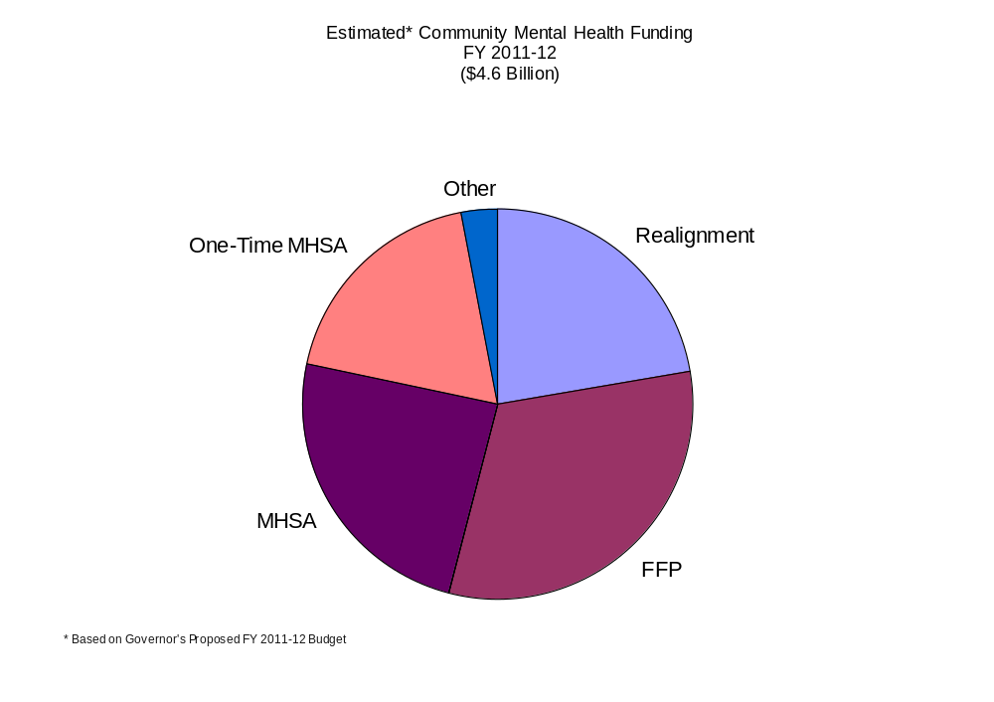
The MHSA = A Growing Percentage Statewide for Direct Services

Slide 7
Federal Health Reform

Slide 8
Affordable Care Act of 2009: More People will be Covered
Provides tax credits and government subsidies for people (individuals, families, and adults without children) with incomes 133% - 400% of the federal poverty level.
Employers with 200+ employees will have to offer health benefits to all (including low-income employees).
Medicaid Expansion (2014): Covers single adults up to 133 % of federal poverty
Those employers with at least 50 employees will be required to pay a fine if they don’t offer health insurance (including fining waiting periods).

Slide 9
Expanding Coverage - Medicaid
Medicaid expanding eligibility (as of 2014) with feds picking up 100% share of cost for those under 65 who are at or below 133% the Federal Poverty Level
  This means: $14,404 individual income and $29,326 family of four income.
  Includes an estimated 16 million new people nationally, 1/5 or more are likely to have mental illness and/or substance use disorder service needs.
  The Congressional Budget Office estimates almost a quarter of Americans who lack health insurance today will be covered under Medicaid over the next 10 years.

Slide 10
CA’s 1115(b) Waiver
California has received approval for a new 5-year Medicaid waiver (2010-2015) as a “bridge to federal reform”
  The new waiver began in November and will be implemented over the course of 2011 and throughout the demonstration period.
  Under the “Managed Care Expansion (MCE)” provision, counties may provide the match to expand coverage to individuals up to 133% of federal poverty before 2014 and receive 50% federal matching dollars. It is optional for counties to participate, and they may set their own eligibility level (for example, all eligible individuals up to 100% of FPL).
  If savings are achieved & milestones met, it could bring as much as $10B in new federal funds to support expanded coverage, access to care, improvements in health care delivery.

Slide 11
Minimum MH Benefits Required in 1115(b) Waiver
For MCE enrollees (under 133% of FPL), each participating county must provide the following minimum package of mental health benefits:
  Up to 10 days per year of acute inpatient hospitalization in an acute care hospital, psychiatric hospital, or psychiatric health facility.
  Psychiatric pharmaceuticals.
  Up to 12 outpatient encounters per year. Outpatient encounters include assessment, individual or group therapy, crisis intervention, medication support and assessment. If a medically necessary need to extend treatment to an enrollee exists, the plan can optionally expand the service(s).
  Substance Use Services are Optional in MCEs.

Slide 12
Federal MH/SA Parity

Slide 13
Mental Health & Substance Use Coverage – Parity
MH & SU Services must be provided at parity with general healthcare services. This prohibits discrimination of MH/SU against medical/surgical coverage.
“Parity” means:
  Coverage restrictions cannot differ from medical or surgical coverage charges (copayments, deductibles, etc)
  Lifetime limits/costs must be the same
  Limits on treatment (number of doctor visits or hospital days covered) must be the same.
Parity is included within a range of areas:
  Large Employers – Parity Act
  Medicaid – Parity Act and Health Care Reform Legislation
  Health Insurance Exchanges for Individual and Small Group Policies – Health Care Reform Legislation
  Medicare – Medicare Improvements Act (MIPPA)

Slide 14
2011 Realignment
“Decisions are best made closer to the people, not in Sacramento... by those who have the direct knowledge and interest to ensure that local needs are met in the most sensible way.” – Governor Jerry Brown

Slide 15
2011 Realignment
The primary vehicle for 2011 Public Safety Realignment is AB 118, which creates the account structure and initial allocations.
Funding Source (~$5.5 billion/year)
  1.0625% of existing sales tax revenue
  Continuously appropriated to counties
Account Structure for FY 2011-12 at state and county levels
  Eight accounts, nine subaccounts
  One account is a “Mental Health Account”

Slide 16
Programs Realigned to Counties
Court Security
Local Public Safety Subventions
Local Jurisdiction of Lower‐level Offenders and Parole Violators
Adult Parole
Foster Care, Child Welfare Services, Adoptions Assistance Program, Child Abuse Prevention
Adult Protective Services
Community Mental Health
  EPSDT *
  MH Managed Care *
  1991 MH Realignment
Substance Use Treatment
  Women and Children’s Residential Treatment Services
  Drug Court
  Nondrug Medi‐Cal Substance Abuse Treatment Services
  Drug Medi‐Cal
  *Not realigned until 2012-13

Slide 17
Realignment Funding for Mental Health
 | 2011-12 | 2012-13 ^{(Proposed*)}
EPSDT | 0 (AB 100) | $544 million
Medi-Cal MH Managed Care | 0 (AB 100) | $188.8 million
1991 Community MH Realignment | $1.083 billion | $1.164.4 billion
Since AB 100 diverted MHSA funding in 2011-12, Medi-Cal Specialty Mental Health not realigned until 2012-13.
Only the funding source for 1991 community mental health realignment changed. Funds will be deposited monthly.

Slide 18
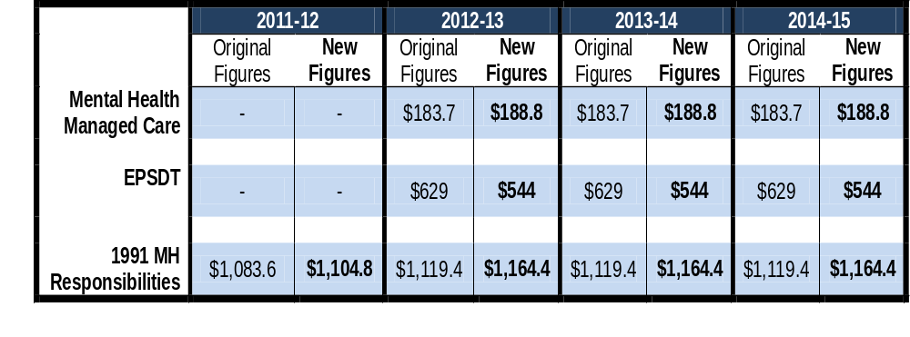
New FY 2012-13 Proposed Baseline Allocations for Realigned Mental Health Programs
In total, reduced by $34.9 M in new figures.
Critical to determine adequacy of baseline figures.
EPSDT impacted by Katie A., Healthy Families proposal.

Slide 19
AB 109: Public Safety Realignment
Effective October 1, 2011.
Statewide $354.3 million available in FY 2011-12 for two components:
  Local custody, alternative custody, and alternative supervision services for new adult offenders that are either non-violent, non-serious, or non-sex offenders.
  Post-release community supervision for adults paroled out of state prison (excluding violent, serious, 3rd strike, high risk sex offenders).

Slide 20
Public Safety Realignment from the County Behavioral Health Perspective
County mental/behavioral health directors are in the midst of working at the local level with their probation departments in developing their Community Corrections Partnership Plans pursuant to AB 109 – the public safety realignment of low level parolees from the state to the local level.
The state provided funding for these parolees, and counties must determine how to make the best and most cost-effective use of the limited funding to help limit avoid recidivism.
Many of these parolees have mental health issues and/or substance use disorders that require treatment.

Slide 21
AB 100: MHSA Changes

Slide 22
AB 100: MHSA Changes
Deleted requirement that the Department of Mental Health (DMH) and the Mental Health Services Oversight and Accountability Commission (MHSOAC) annually review and approve county plans and updates.
Deleted requirement that a county annually update the 3-year plan but still required that there be updates.
Specified that the “state” instead of DMH will administer the Mental Health Services Fund (MHSF), and issue regulations.
Required that starting July 1, 2012 the Controller shall distribute on a monthly basis to counties all unexpended and unreserved funds on deposit in the MHSF as of the last day of the prior month.
Specifies that “unreserved funds” are those funds that are not held in trust or are not set forth in component allocations.

Slide 23
AB 100: MHSA Changes
Reduced the state administrative funds reserved for DMH, MHSOAC, California Mental Health Planning Council (CMHPC) and other state agencies from five percent (5%) to three and half percent (3.5%).
Provided for a one time (2011-12) transfer of $862M from the MHSF, which is not subject to repayment, to be distributed in the following order:
  $183,600,000 for Medi-Cal Specialty Mental Health Managed Care;
  $98,586,000 for mental health services for special education pupils (formerly referred to as AB 3632);
  $579,000,000 for Early and Periodic Screening, Diagnosis and Treatment (EPSDT).

Slide 24
AB 102: Transfer of Medi-Cal Specialty MH/SU Administration
Legislative Intent in AB 102
Improve access to culturally appropriate services
Effectively integrate financing of services
Improve state accountability and outcomes
Provide focused, high- level leadership for behavioral health

Slide 25
Other State Administration Reorganization Proposals

Slide 26
DMH Functions Transferred to DHCS
MHSA-Specific Functions
Other Functions
MHSA state level issue resolution
Suicide prevention
Stigma and discrimination
Student Mental Health Initiative
MHSA housing
Training contracts
Financial oversight
County data collection, reporting
Certification, compliance, quality improvement
Co-occurring disorders
Veterans mental health
SAMHSA, PATH grants
CA Health Interview Survey
MH Planning Council

Slide 27
DMH Functions Proposed to be Transferred to Other Departments/Organizations
OSHPD: MHSA WET Regional Partnerships, CalSWEC Stipend Program, Statewide Technical Assistance Center (Working Well Together Collaborative), Psychiatric Residency Program
Department of Public Health: MHSA Reducing Disparities Project, Other Cultural Competency Functions; MH Facilities Licensing
MHSOAC: Client and Family Member Contracts

Slide 28
What’s Next? Questions for Counties to Ponder
What is the role of the counties with HCR, parity and the 1115 waiver in the context of realignment?
Will HCR require a change in county structures?
How will HCR, parity, realignment and the 1115 waiver impact our system’s capacity to provide mental health and substance use services?
How will MH/SU advocates ensure that sufficient resources and progressive models of service remain available for the populations that we serve?
How can we both protect MHSA resources, and use them strategically to create and maintain the best community-based, recovery-oriented mental health system possible in the context of all of this change?

Slide 29
Expanding County Responsibilities and Maximizing Leadership
Counties are providing services during a historic change to the structure and function of state and local government.
Local programs will now lead the development and implementation of services resulting from healthcare reform, public safety realignment, economic restructuring etc.,
They (counties) must take charge of their own destiny and develop new relationships among themselves (e.g., regional partnerships), the state and other relevant partners.

Slide 30
CalSWEC Leadership Must Consider
How counties and educational programs will meet growing behavioral workforce development and training needs? What is CalSWEC’s role?
Will CalSWEC work with MSW programs and employers to prepare qualified students who are work ready in future integrated health/behavioral health settings brought about by Health Care Reform?
Can MSW programs become integrated, linking Title IVE services with mental health services, especially in the context of the Katie A. settlement?
How MSW programs will pay more attention to new proactive models that address adult and juvenile justice, substance use/co-occurring disorder populations, cross disability populations, prevention and early intervention, etc.

Slide 31
Recommendations
Become organizationally informed of the changing governance and financing occurring statewide. CalSWEC must communicate sustainability, through long term strategies that recognize the new roles of county mental health, DHCS, CalSWEC, CalMHSA, OSHPD or others.
Work more closely with county mental/behavioral health and provider organizations to identify local workforce, education, and training needs to ensure quality among graduates and maintain credibility among employers.
Recognize and teach new proactive models that are emerging , such as integrated healthcare, collaborations between child welfare and mental health, local criminal justice and substance use/co-occurring populations.
Develop a stronger MSW curricula focus on management practice and policy, e.g., funding for MH/SU services.
An area of potential mutual interest and partnering opportunities is documenting the positive outcomes of MHSA WET Funds.

