Slide 1

Gender Disproportionality among Social Workers: What are the Implications for Training?
Susan Jacquet & Amy Benton
CalSWEC
With assistance from Cindy Parry
Presented May 21, 2009 at the 12th Annual National Human Services Training Evaluation Symposium, Berkeley, CA.

Slide 2
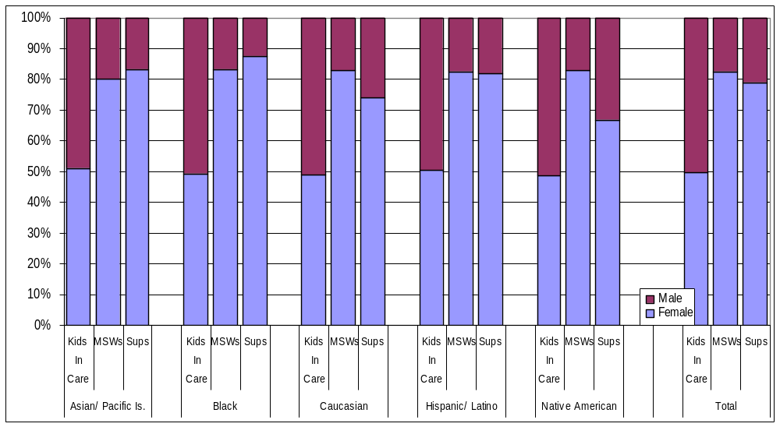
Gender Proportions by Race/Ethnicity of:
Kids in Care, New MSW hires, New Supervisors

Slide 3
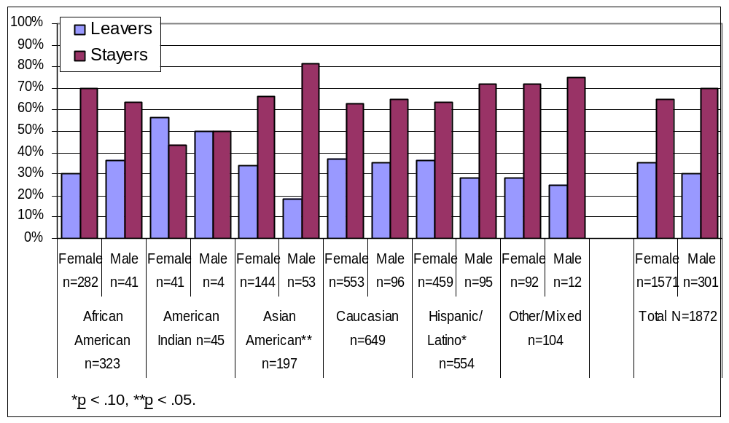
Retention Percentages of IV-E MSWs
By Gender and Race

Slide 4
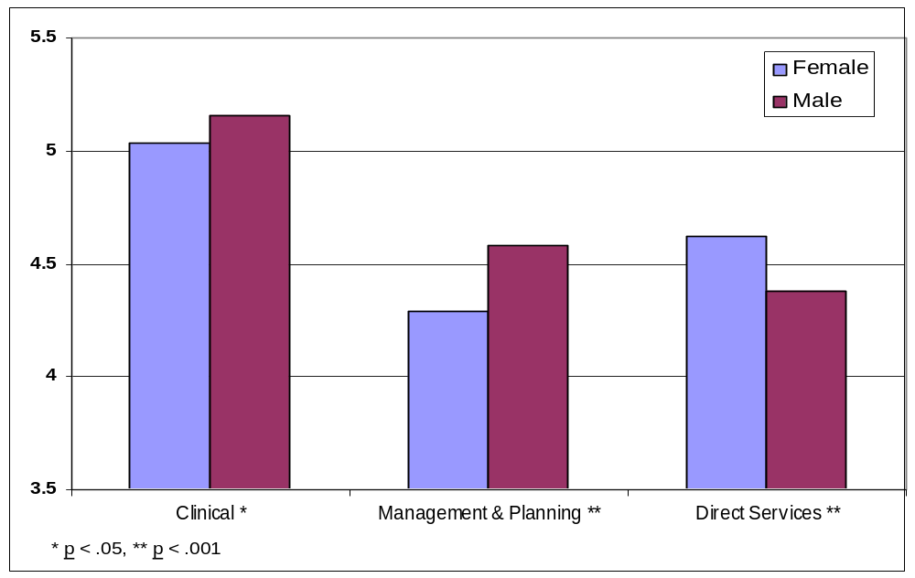
MSW Student Practice Preference Means by Gender
N = 6056 (Female n = 5064, Male n = 992)

Slide 5
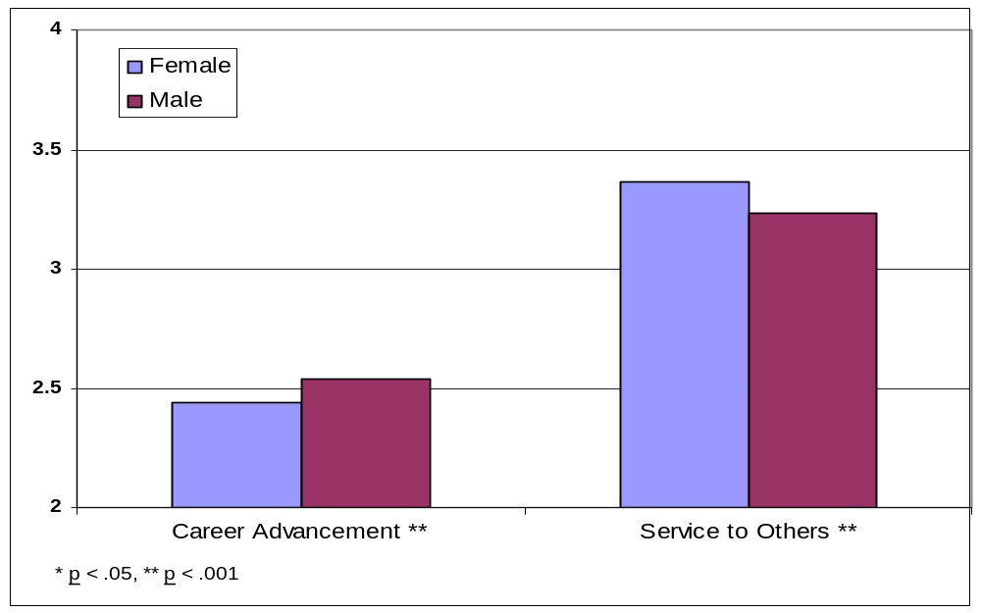
MSW Student Career Aspiration Means by Gender
N = 6056 (Female n = 5064, Male n = 992)

Slide 6
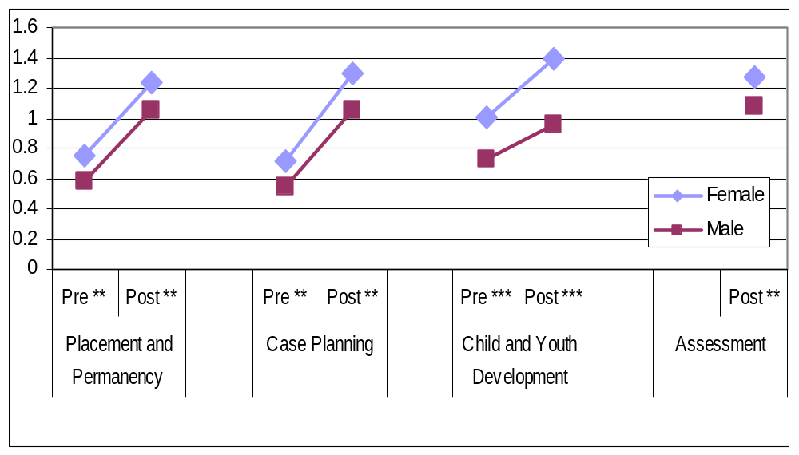
Knowledge Pre & Post Test Mean Scores by Gender
** p < .01, ** p < .001

Slide 7
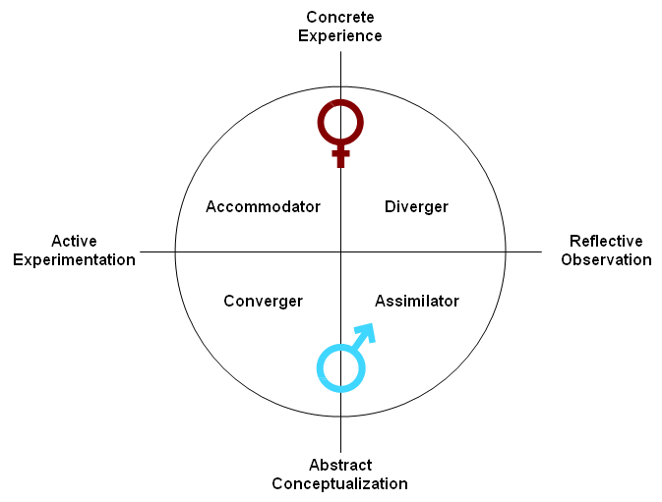
Kolb’s Model of Experiential Learning
With Gender Tendencies

Slide 8
Gendered Learning/Teaching Characteristics
Women | Men
Intuition | Rationalism
Personal Knowledge | Objectivity
Connectedness | Individuation
Contextualism | Conceptualization
Inductive | Deductive
Mutual understanding | Impartiality
Responsibility & Care | Fairness
Concrete Examples | Abstraction
Rapport | Report

Slide 9
Incongruous Findings
On use of evidence, three studies indicated that males scored higher. Two studies showed no difference.
Generally lower scores for women on the Abstract Conceptualization scale, however younger women were more abstract than younger men. (Age effect or cohort effect?)

Slide 10
Questions for Discussion
How would we describe child welfare training curricula?
Is it by nature more concrete than abstract?

Slide 11
Questions for Discussion (cont’d)
We provided data on gender differences in training evaluation.
Have other evaluators noticed similar or different results?

Slide 12
Questions for Discussion (cont’d)
What do we think leads to these differences in training outcomes?
Could there be affective reactions to gender of group majority and trainer that influence outcomes along with learning style preferences?

Slide 13
Questions for Discussion (cont’d)
What should we (as training evaluators) look at next?
What would we like to understand better in regards to gender and training?

Slide 14
Questions for Discussion (cont’d)
Any other thoughts?

Slide 15
Contact Information
Susan Jacquet – sjacquet@berkeley.edu
Amy Benton – ymabenton@berkeley.edu
Cindy Parry - cfparry@msn.com

