Slide 1

Do Personal Resources Reduce Job Exit and Burnout in Child Welfare Social Workers?
Sherrill J. Clark, Ph.D
Richard Smith, MFA, MSW
SSWR 2009 New Orleans, LA
University of California, Berkeley
School of Social Welfare
6701 San Pablo #420
Berkeley, CA 94720

Slide 2
Table of Contents
Focus of the presentation
Definition: burnout, resources
Theories of Burnout
Empirical literature of effect of burnout on child welfare turnover
Burnout and turnover in Title IV-E graduates

Slide 3
Focus of the Presentation
How does burnout relate to personal resources?
Are some personal resources protective against burnout?
How is burnout related to turnover?
Is all burnout pathological?

Slide 4
Definitions
Conservation of Resources: Physical objects, social conditions, personal characteristics or energy that support health (Neveu, 2007)
Co-ethnic resources (eg. Light)
Burnout: “a syndrome of emotional exhaustion and cynicism that occurs frequently among individuals who do ‘people-work’ of some kind” (Maslach & Jackson, 1981, p. 99).

Slide 5
Theories of Burnout
Person Environment Fit
Job Demands
Maslach Burnout Inventory Scale

Slide 6
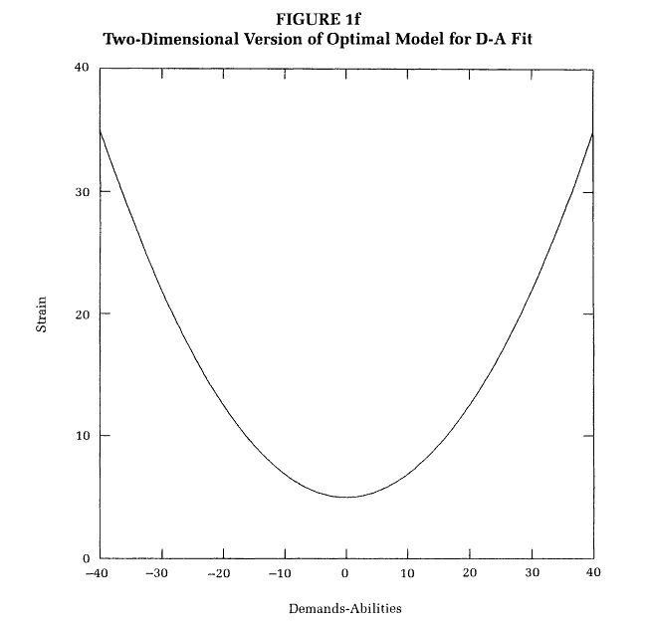
Person Environment Fit (PE)
Stress would occur if mismatch:
1) between the job requirements and worker’s abilities (DA Fit);
2) between supplies in the environment and worker values (SV Fit) (Edwards, 1996).

Slide 7
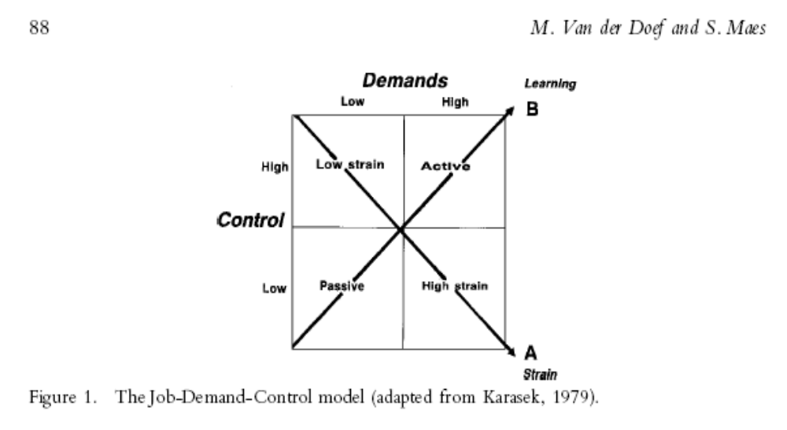
Job Demands Theory
Stress is a result of having a job with the following:
high strain
low control (Van Der Doef & Maes, 1999).

Slide 8
Maslach Burnout Inventory (MBI)
22 Questions grouped into three factors (aka subscales):
Emotional exhaustion (EMO),
Depersonalization (cynicism),
Personal accomplishment (self-efficacy).

Slide 9
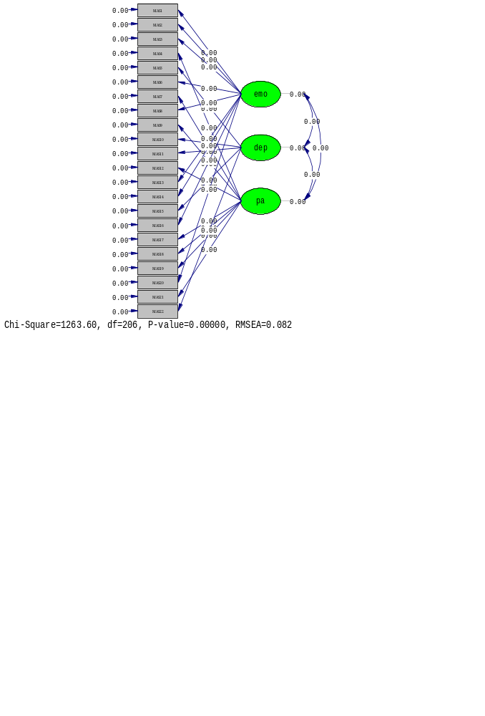
MBI Scale
Maslach used factor analysis to identify these after administering over 11,000 tests to human services professionals broadly defined that included social workers, nurses, teachers, police and others (1981).

Slide 10
MBI Ranges (Guntupalli & Fromm, 1996)
Subscale | Low | Moderate | High
Emotional exhaustion (54 max) | <18 | 18-29 | >29
Depersonalization (30 max) | <6 | 6-11 | >12
Personal accomplishment (48 max) | >39 | 39-34 | <33

Slide 11
Burnout in Social Work
Soderfeldt et. al. (1995) reviewed 18 articles on burnout in social work.
Only 10 of the reviewed studies reported scores and only six were comparable.
They concluded in contrast to reviewed articles that burnout in social work was low and no cause of alarm.
Causes of stress and organizational factors need systematic investigation before recommending policy.

Slide 12
Turnover in Social Work
Found that the five largest predictors of turnover are
role overload,
stress,
negative affectivity, and
emotional exhaustion and burnout.
The five largest predictors of intention to leave:
job problems,
stress,
emotional exhaustion,
role overload
burnout (Mor Barak et. al. 2001).

Slide 13
Turnover in Child Welfare
Zlotnik, et. al’s (2005) presents a concept map of general trends to improve retention that has three broad areas:
personal characteristics, such as burnout prevention and being bilingual;
organizational factors and improved training (sense of efficacy) through the Title IV-E program.

Slide 14
Influences of Public Child Welfare Worker Turnover
Model
Environmental
Attributes
Turnover
Organizational
Attributes
Individual
Attributes

Slide 15
Turnover Rates in Child Welfare
Zlotnik includes turnover rates from two studies:
32% in Arkansas (2002),
20% in Oklahoma (Rosenthal, et. al.; 1998), and
California (2003) reported 9.5% turnover for all counties excluding Los Angeles (CalSWEC, 2004).

Slide 16
CalSWEC Retention Study
Study Design
Secondary data analysis of data collected using a mailed exit survey collected in voluntary, repeated cross sections.
Participants
1001 Title IV-E MSWs from 1993- 2008.

Slide 17
CalSWEC Retention Study
Procedures
Within one year of completing payback, CalSWEC mailed a survey with two follow up mailings to eligible graduates yielding a response rate of 51%.
Non-responders had no observed significant differences except greater than expected proportion of African-Americans and Leavers.

Slide 18
CalSWEC Retention Study
Measures
MBI (Imputed)
Controls for age, race, gender, partnership status.
Implicit control for education level.
Salary, year, region, school considered as controls but dropped for parsimony.

Slide 19
CalSWEC Retention Study
Data Analysis
Do these IV-E graduates report burnout after two years?
What are the differences in odds of job exit for different racial and ethnic groups?

Slide 20
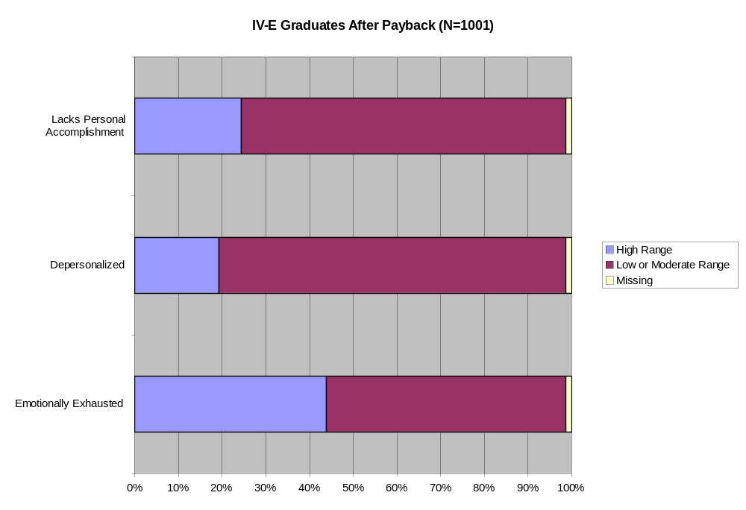

Slide 21
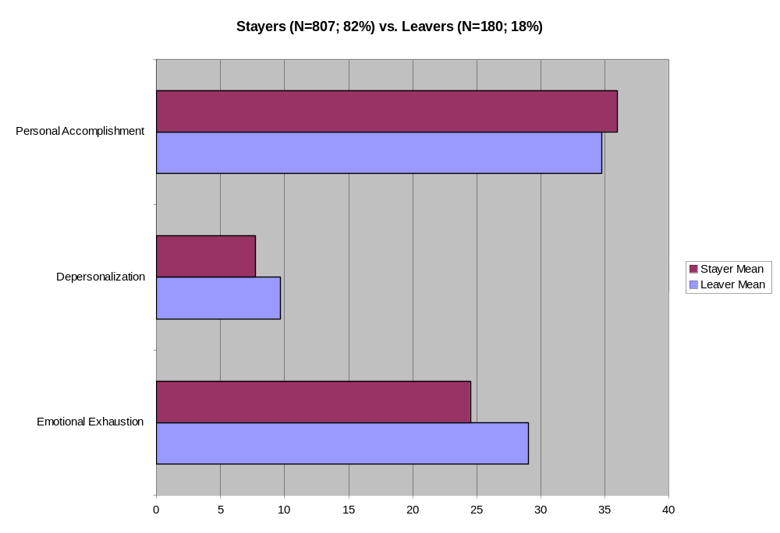

Slide 22
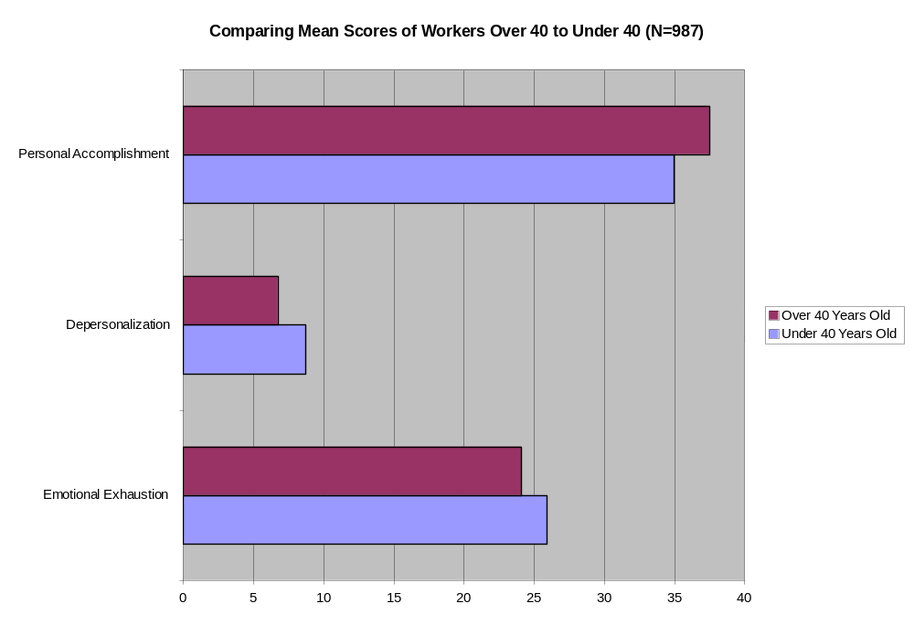

Slide 23
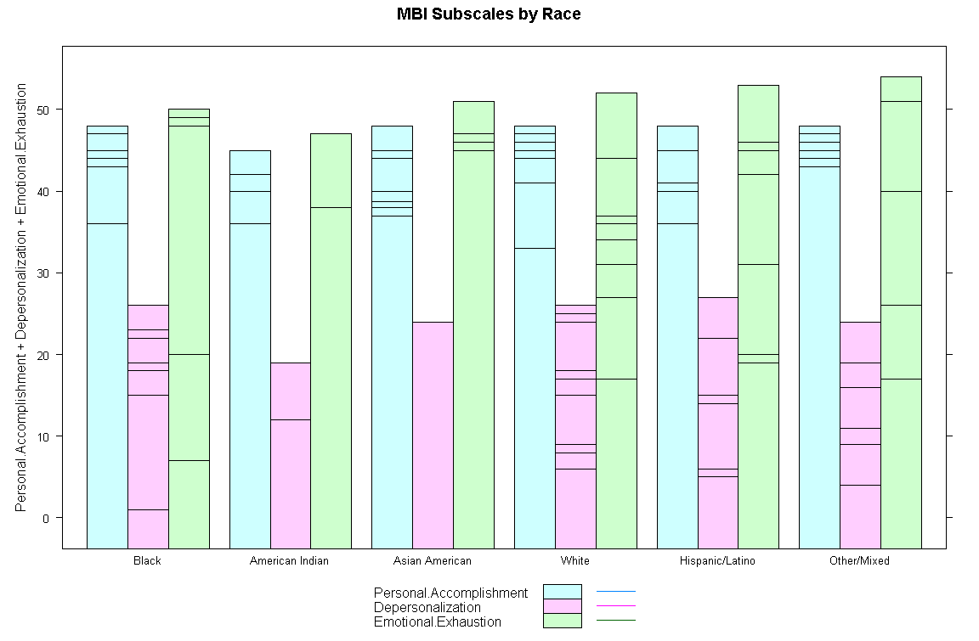

Slide 24
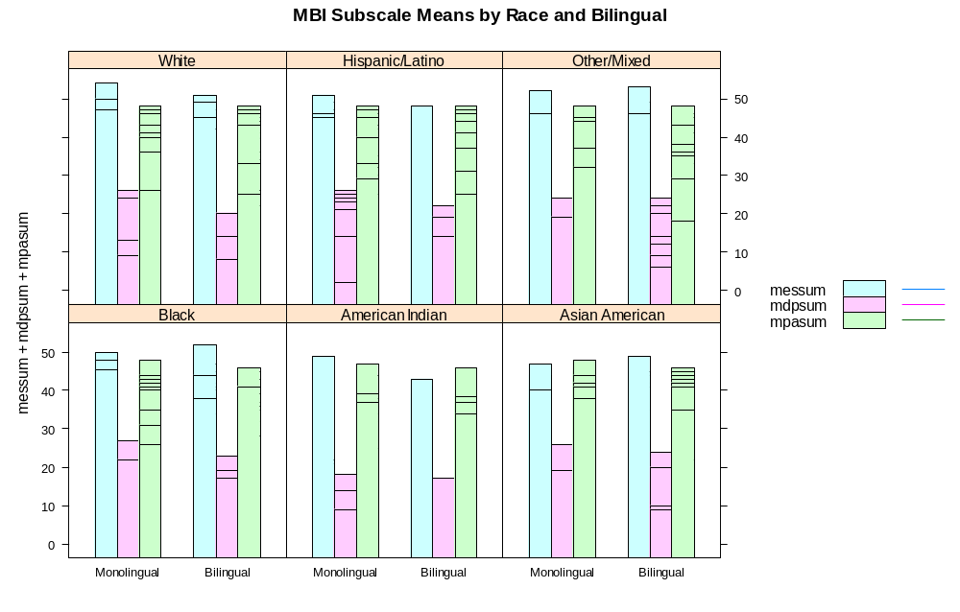

Slide 25
Effect of Burnout Subscales on Job Exit (N = 987)
DV | PA |  | SE | DP |  | SE | EE |  | SE
Over 40 | 2.54 | *** | 0.48 | -1.83 | *** | 0.41 | -1.59 | ** | 0.80
Bilingual | -0.99 | * | 0.53 | -0.22 |  | 0.45 | 0.52 |  | 0.89
Female | -1.50 | ** | 0.60 | -0.91 | * | 0.50 | 2.04 | ** | 1.00
Partner | 0.55 |  | 0.44 | 0.18 |  | 0.37 | 0.24 |  | 0.74
Native | 0.74 |  | 1.73 | 1.11 |  | 1.46 | 2.73 |  | 2.89
Other | 0.73 |  | 0.91 | 0.93 |  | 0.77 | 1.32 |  | 1.52
Asian | -0.93 |  | 0.99 | 2.17 | *** | 0.84 | 2.11 |  | 1.67
Hispanic | 0.11 |  | 0.82 | 0.36 |  | 0.69 | -0.72 |  | 1.37
White | 1.27 | * | 0.69 | 1.75 | *** | 0.58 | 0.99 |  | 1.16
N | 981 |  |  | 979 |  |  | 977
R^2 | 0.05 |  |  | 0.04 |  |  | 0.01

Slide 26
Effect of Burnout Subscales on Job Exit (N = 987)
Job Exit | Odds Ratio |  | Std. Err.
Emotional Exhaustion | 1.017 |  | 0.011
Depersonalization | 1.012 |  | 0.020
Over 40 | 0.839 |  | 0.163
White | 1.554 |  | 0.451
Asian | 1.219 |  | 0.470
Hispanic | 1.499 |  | 0.464
Other | 2.237 | ** | 0.775
Native | 3.336 | ** | 1.905
EE X Over 40 | 1.029 | * | 0.017
DP X Hispanic | 1.089 | ** | 0.038
EE + EE X Over 40 | 1.047 | *** | 0.015
DP + DP X Hispanic | 1.102 | *** | 0.036

Slide 27
Results
Being female reduces depersonalization and increases personal accomplishment and emotional exhaustion. Being over 40 reduces depersonalization and emotional exhaustion, but lowers personal accomplishment. The effect of being bilingual of increasing personal accomplishment one point on average is approaching significance.
There is no significant protective effect for being bilingual having a partner, gender or age on job exit.

Slide 28
Results
Burnout increases job exit for those over 40 who are one standard deviation above the mean in emotional exhaustion and Hispanics who are one standard deviation above the mean in depersonalization.
Black, Asian, and some Hispanic social workers as likely to stay as whites. Native Americans have 3.3 greater odds of leaving than African Americans. Those who identify as multiracial or other race have 2.2 times the odds of leaving as Blacks. Because 23% speak Spanish, they probably are Latino.

Slide 29
Conclusion
Consistent with previous research, social workers experience emotional exhaustion, but this does not lead to job exit all things being equal. Personal resources do not appear to protect from job exit in this sample, unless they all equally benefit from MSW IV-E training.
Older and arguably more experience social workers who are also burnt out probably feel they do not have time to spend in an emotionally exhausting job. This would support theories that job exit is a healing response.
Mixed/other race workers might be deprived of coethnic resources. One Native worker cited applying the Indian Child Welfare Act as a frustration in the job. Future research should pay attention to these populations.
See Jacquet et. al. (2007) for the impact of the work environment, supervisor support and workload on job exit.

