Slide 1

Exploring Service Delivery Models for Reunification in Child Welfare
Amy D’Andrade
San Jose State University
CalSWEC Board Meeting
May 3, 2013
Los Angeles, CA

Slide 2
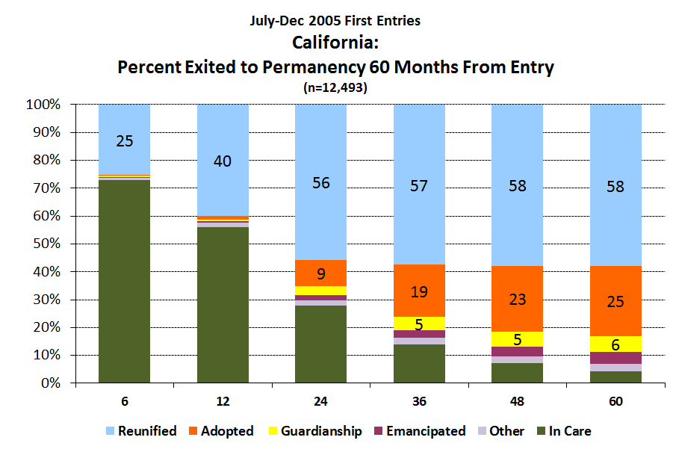
California’s Child Welfare Performance Indicators Project: Q3 2011 Slides
Center for Social Services Research, U.C.Berkeley

Slide 3
Services Matter
Stakeholder Perceptions
Social workers: Parents’ participation in services “major component” in successful reunification (Cole & Caron, 2010)
Empirical evidence
SA service episode completion
(Choi & Ryan, 2007; Green et al., 2007; Grella, 2009; Smith, 2003)
Progress in SA services:
(Choi et al., 2012; Huang & Ryan, 2011)
Other services for SA parents:
(Choi & Ryan, 2007; Marsh et al., 2006)
Parenting or counseling:
(Brook et al., 2012; D’Andrade & Nguyen, under review).

Slide 4
Service Use in the Context of Reunification
Mandated

Slide 5
Service Use in the Context of Reunification
Mandated
Time limited

Slide 6
Service Use in the Context of Reunification
Mandated
Time limited
Parents’ hampered functioning

Slide 7
Percentage of Reunifying Parents with Treatment Problems

Slide 8
Substance Abuse Problems and Life Challenges

Slide 9
Service Use in the Context of Reunification
Mandated
Time limited
Severely hampered
Multiple service requirements

Slide 10
Number of Services Ordered
Number of services ordered
Required attendance per week

Slide 11
Typical Case Plan
Visitation 1 x per week
Counseling 1 x per week
Parenting classes 1 x per week
Outpatient treatment 1 x per week
12 step program 2 x per week
Drug testing 2 x per week
Notes:
Calculated this and averaged for each parent, about 8

Slide 12
Total Problems and Challenges

Slide 13
Models of Service Delivery in Child Welfare Reunification
“…There is a lack of well known, well articulated models of reunification practice that have been implemented in large scale and no single program model has captured the attention of the field as a whole.”
- (Westat & Chapin Hall, 2001, 4-7)
“…Over the past 20 years, little progress has been made in defining and implementing meaningful reunification programs.”
- (Wulczyn, 2004)

Slide 14
Primary Goals of Study
Identify models or delivery strategies for providing reunification services being used in California
Determine whether particular approaches to providing services are associated with improved reunification outcomes
Develop an in-depth understanding of several innovative/promising service delivery models or approaches

Slide 15
Methods Goal 1 (Identify Strategies)
On-line survey to all 58 Child Welfare Directors/CWDA Children’s Committee Contacts
Survey asked about reunification program practices, service delivery and organization approaches, and barriers or challenges to delivering services.
84% response rate (49 counties)

Slide 16
Service Delivery and Coordination Strategies
Delivery Strategies
Coordination Strategies

Slide 17
Barriers to Service Delivery

Slide 18
Methods Goal 2 (Test Approaches)
Organized interventions into different “approaches” to service delivery

Slide 19
Reunification Service Approaches
Supportive
Assessing
Additional aftercare services [beyond FM] provided after reunification
Parents’ Anonymous available
Parent Partner or Parent Mentor programs available
WrapAround services provided
Additional case manager provided through DDC
Family Team Meetings held
IceBreaker meetings held
Formal needs assessment done
Formal reunification assessment done
Visitation used as assessment opportunity (therapeutic visitation)
Children assessed for likelihood of reunification at entry to care

Slide 20
Reunification Service Approaches
Linking
Burden-Easing
County has LINKAGES program
Service providers attend DDC hearings
Service providers coordinate efforts via DDC
Service liaisons provided
County uses Intensive Family Reunification Services
Services available at DDC
CPS clients have priority status

Slide 21
Methods Goal 2 (Test Approaches)
Clustering of interventions into different “approaches” to service delivery
Creation of a time-varying measure of county’s use of each approach [high use]
Merging of survey data with performance indicator data for reunification (18 months), re-entry (12 months) and control variables
Fixed effects regression analysis [county and bi-annual period as fixed effects].

Slide 22
Methods Goal 2 (Test Approaches)
Clustering of interventions into different “approaches” to service delivery
Creation of a time-varying measure of county’s use of each approach [high use]
Merging of survey data with performance indicator data for reunification (18 months), re-entry (12 months) and control variables
Fixed effects regression analysis [county and bi-annual period as fixed effects].

Slide 23
Methods Goal 2 (Test Approaches)
Clustering of interventions into different “approaches” to service delivery
Creation of a time-varying measure of county’s use of each approach [count, high use]
Merging of survey data with performance indicator data for reunification (18 months), re-entry (12 months) and control variables
Fixed effects regression analysis [county and bi-annual period as fixed effects].

Slide 24
Results
Reunification
No association between approaches and improved reunification rates.
Re-Entry
High use of Supportive approach and Burden-Easing approach each associated with reduced re-entry rates.

Slide 25
Methods Goal 3 (In-depth Exploration)
Four counties each with high rates of 1-2 approaches participated
Focus groups and interviews with parents attorneys, service providers, case workers, and managers

Slide 26
Methods Goal 3 (In-depth Exploration)
 | Attorneys | Service Providers | Social Workers | Managers
COUNTY A | 1 Group (n=6) | 3 Groups (n=12) | 1 Group (n=7) | 1 Interview
COUNTY B | 1 Group (n=8) | 1 Group (n=15) | 1 Group (n=15) | 1 Interview
COUNTY C | 1 Group (n=6) 1 Interview | 1 Group (n=2) 3 Interviews | 2 Groups (n=10) 2 Interviews | 1 Interview
COUNTY D | 1 Interview | 1 Group (n=2) 3 Interviews | 1 Group (n=10) | 1 Interview

Slide 27
Results
Case Plans
Service Access
“Models”
Promising Strategies

Slide 28
Concerns about Case Plans
Case plans are not adequately tailored
“(We should be) personalizing services instead of: ‘Here’s this parenting class, there’s three of them, you go for two hours and you get your certificate and you’re good.’ You know, I don’t know how many times I’ve heard parents say, ‘You know what, that was just a waste of my time.’ “
Service provider, Orange

Slide 29
Concerns about Case Plans
Case plans require “Herculean” efforts
Because they’ll have a case plan that goes on for two and a half pages. Seriously. My client is living under a bridge riding a bike sometimes, when they can find one. And here’s all this stuff they’re supposed to do. So I just put it to the judge, and I list: ‘Well, okay, they have to do this, and then they have this twice a week, they have this thing. Your honor, by my count they have twenty-seven things they have to do every week’
Attorney, Santa Clara

Slide 30
Concerns about Case Plans
Case plans require “Herculean” efforts
“I think a lot of the time … the number of services the parents are being required to do can be very problematic because lots of our clients don’t have transportation. They’re given bus passes and then told, ‘You gotta go to 6 classes a week and then drug testing on top of that,’- so they’re literally spending half their week getting on fifteen different buses to go from one place to another.”
Attorney, Orange

Slide 31
Concerns about Case Plans
Setting parents up to fail
“…A lot of people (workers) just like to slam them (parents) with a lot of stuff. And they can’t do it. And then it defeats the whole purpose. The whole purpose is for somebody to get their child back. And so you set them up for failure.”
Case worker, Santa Clara

Slide 32
Concerns about Case Plans
“I couldn’t do it.”
Attorney 1:
I would just say I think like for me, I think the parents really have to hustle. …And I think sometimes, I don’t know I could do what they do.
Attorney 2:
I am certain I couldn’t do it. I’m absolutely certain that what our clients are able to accomplish, the ones that are successful, it’s amazing. And if everyone here, courts, and out in the community, could understand that. What they have to do and then to get on the bus. It scares me. It’s amazing.
Attorneys, Santa Clara

Slide 33
Problems with Service Access
Service Availability
Service Location/Transit
Wait lists
No programs for men
No Spanish-speaking groups
Service only available in one part of county
Time involved in bus travel
Don’t know bus system
Service Cost
Co-Pay or Fee
No TANF or Medical
County doesn’t pay for services

Slide 34
The Perfect Storm
PARENTS’ PROBLEMS
REDUCTION IN RESOURCES
Staffing cuts
Reduced services
Stress
HEAVILY LOADED CASE PLANS
SERVICE ACCESS
Availability
Transit
Cost

Slide 35
“Tell me a bit about your reunification services program. First, does it have an organizing philosophy, a formal mission statement, anything like this? If yes, what is it? Can you tell me about it? If not - if you had to invent this statement, what would you come up with?”

Slide 36
No Clear Guiding Framework
“…It’s interesting to talk about it that way because it’s, you know, basically under state and federal laws and guidelines about how services are delivered. And the timelines under which people are bound … what service component … family maintenance, family reunification. So it’s very much prescribed and sort of dictated what that looks like…”

Slide 37
Promising Service Delivery Strategies
“MAPs”
Service workers at DI/CI
Parent Partners
CoLocation
Service staggering

Slide 38
Promising Service Delivery Strategies
“MAPs”
Service workers at DI/CI
Parent Partners
CoLocation
Service staggering

Slide 39
Promising Service Delivery Strategies
“MAPs”
Service workers at DI/CI
Parent Partners
CoLocation
Service staggering

Slide 40
Promising Service Delivery Strategies
“MAPs”
Service workers at DI/CI
Parent Partners
CoLocation
Service staggering

Slide 41
CoLocation
“…It’s such a good idea to have everybody be (here), that so many of the services are here. To have the counseling and the supervised visits and the people that work with the kids all in the building, you know. …We say to the parents, ‘What you learn in (parenting class) this week? Why don’t you demonstrate it today?’ And I taught the parenting class so I know the material… …I think it’s super important because already the parents have way more services required of them then they’ve probably ever done. And they’re so overburdened ……I think it’s so important to have one stop service …to me that’s the only way we’re really going to increase our reunification (rates).”
- Service provider, Santa Cruz

Slide 42
Service Staggering
Inpatient Drug Treatment
Outpatient Drug Treatment
Counseling
Parenting
Visitation
Removal
6 month review
12 month perm hearing

Slide 43
Service Staggering
“…The parenting class, we can wait a little while, you’re not going to have your kids back for a while. So let’s focus on the most important thing --you’ve got a heroin addiction issue, or whatever. And sort of helping them understand that they don’t have to do everything right now, because it’s overwhelming to try to get around and many of our clients are on the bus trying to get from one end of the county to the other, to get to services.”
– Case worker

Slide 44
Service Staggering
“I got to say, for me personally, (if) I had to do everything at the same time, I wouldn’t have done anything. It would have been very very overwhelming for me. Really. Because I did my treatment and everything else fell into place after I did my treatment.…. I completely staggered my case to where therapy was the very last thing I did … if I had to do everything at one time, honestly, I would have been so overwhelmed.”
- Parent Partner, Contra Costa

Slide 45
Service Staggering
“…The one biggest thing is - what we’re told in continuing services is we don’t want to get unreasonable services (a finding that the agency did not meet its reasonable efforts requirements). So in an FR case we have to give it all to them. …If they have a really good attorney that’s fighting for them, then they're going to say ‘Well, we’re going to find you ‘unreasonable services’ because you didn’t give her a chance to do parenting.’ Well yes, we were trying to work with her. ‘No, you should have done a referral. You should have done this.’ So although in theory, it sounds great - in court, no.”
- Social worker, Orange

Slide 46
Summary / Discussion
Did not find “models” of service delivery
Use of more Supportive and Burden-Easing strategies may enable parents to make better use of services
Innovation piecemeal and discretionary
The strategy for ensuring “reasonable efforts” may be undermining the provision of efforts that are effective.
Calls into question whether we are truly meeting the “reasonable” efforts requirement

Slide 47
What Do “Reasonable Efforts” Entail?
Parental Capacity
Service Access
Plan Feasibility
Service Effectiveness

Slide 48
Other Efforts
Child Welfare Council
Prioritization Task Force
Permanency Committee
Chapin Hall
Smithgall et al. (2012). Parents’ Pasts and Families’ Futures: Using Family Assessments to Inform Perspectives on Reasonable Efforts and Reunification
Child and Family Policy Forum, 5/14/13

Slide 49
Suggestions for practice/policy
Conceptualize the work – goals, units
Facilitate service staggering – trainings for courts, workers, attorneys
Contract for this population specifically
Service providers: combine and/or co-locate services [parenting/visitation]
Use graphic calendars, and travel times, in case planning.

Slide 50
Vision
Funding stream for reunification services programs/models
Integrated, intensive, one-stop delivery models incorporating housing/employment services
Technology used to facilitate DAILY visits/visual conversations

Slide 51
Next steps
Reaching out to counties to offer webinars/discussions
Continued exploration of datasets
Website with current services and delivery approaches
Future studies:
Logistical/structural hurdles to reunification: A qualitative study of case planning
GIS mapping study - service locations
Quantitative study - travel time
Case studies
Intervention study of innovative model

Slide 52
Acknowledgements
Barry Johnson, CalSWEC
Stuart Oppenheim, CFPIC
Diana Boyer, CWDA
Advisory Board members Carolyn Barret, Susan Brooks, Jonathan Byers, James Cook, Laura Frame, Ellie Jones, Hillary Kushins, Maria Ortega, Sarah Roberts
Survey respondents
Consultants Neal Wallace, Lonnie Snowden, Jill Duerr Berrick
County contacts Richard Bell, Denise Churchill, AnnaLisa Chung, Valerie Earley, Wendy Kinnear, and Judy Yokel
Student assistants Katie Fahrer, Lun Wang, Stephanie deLeon, Jonathan Cowden, Bernadette Gholami
Stakeholder interviewees
CalSWEC

Slide 53
Questions? amy.dandrade@sjsu.edu 408-924-5830

