Slide 1

CalSWEC 2014: Aging Initiative Summit
Preparing Social Workers for an Interprofessional Environment
Nora OBrien-Suric, PhD
The John A. Hartford Foundation

Slide 2

The John A. Hartford Foundation
Mandate for Change We believe that as a society we can and must improve health care for older Americans to better meet their needs and maintain their independence and dignity. If we succeed, society will benefit from the continuing contribution of older people and from reducing health care spending.

Slide 3

Hartford’s Vision
Older adults receive quality health care from sufficient numbers of well-trained health care professionals.
Health professionals are trained to, and work in, interdisciplinary teams, and our country’s financing and delivery systems support them.

Slide 4

Hartford’s Vision continued
Care for older adults is integrated, patient-centered and coordinated.
Older people and their families are active partners in their care.
Greater attention is paid to the financing of disease prevention, the adoption of healthy life styles, and the preservation of function.
Health care is seamless across various delivery sites and all clinicians have immediate access to patients’ health information and communicate with one another.
Our health care system takes account of the increasing social, cultural, demographic and geographic diversity of older adults.

Slide 5
Hartford’s Objectives
1. Prepare a geriatrically competent workforce.
2. Infuse geriatrics in the education programs of all schools of social work in the country.
3. Ensure that there are sufficient geriatrics faculty members.
Develop, test and disseminate innovative, cost-effective models of care that improve services to older adults.
Draw national attention to the importance of social work in improving the health care of older people.
6. Communicate the idea that older adults are “a core business” of health care & its professions.
5

Slide 6
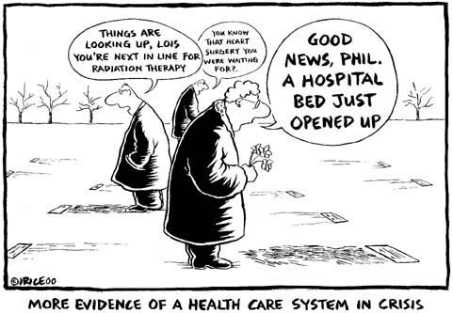
Why are We focusing on health care/reform?
Demographic changes
Chronic diseases
Inadequate and poorly prepared health care workforce
Failure to deliver care cost-effectively
Use and cost of long term support and services
Important financial, ideological and ethical issues
Discrimination and ageism

Slide 7

Opportunities for Social Work
Affordable Care Act (ACA)
3026: Community Based Care Transitions
CMS Mandate – Meeting the Triple Aim:
1. Improving patient experience
2. Improving population health
3. Reducing costs
CMS - “new rules” re readmission rates and emergency room visits/admissions
Duals Demonstrations

Slide 8

Social workers need to:
be advocates and leaders for change
better define their “value-added” contribution to improving health outcomes
make a business case with evidence of their cost-effectiveness
be proactive with other health professions, health care systems, national organizations, community-based organizations, politicians, etc.

Slide 9

Care Coordination
✔The answer to the health care crisis
✔The realm of Social Work
✔Social Work’s Leadership Opportunity

Slide 10

Recommendation 1
Make the business case for care coordination and its sustainability using available data and clarifying what data are not available.
Include:
Clear definitions of the components of the care coordination model
Identifying populations who can benefit most from care coordination
Replicate the strongest programs that are able to achieve the Triple Aim

Slide 11

Recommendation 2
Refine core competencies for interprofessional care coordination and incorporate these into general professional education, credentialing and continuing professional education opportunities.
Incorporate all professional groups central to patient centered care coordination.

Slide 12
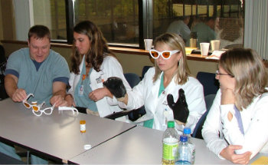
Recommendation 3
Pre-clinical experiences should be developed to prepare students from multiple disciplines for more effective interprofessional clinical training.
Schools and agencies should develop opportunities for continuing experiences with individual and families that persist across settings and changes in health status.

Slide 13

Recommendation 4
Identify/develop new and/or share existing curricula that emphasize collaborative practice, partnership with and for patients, and multi-cultural approaches, and establish metrics against which to assess interprofessional learning.

Slide 14
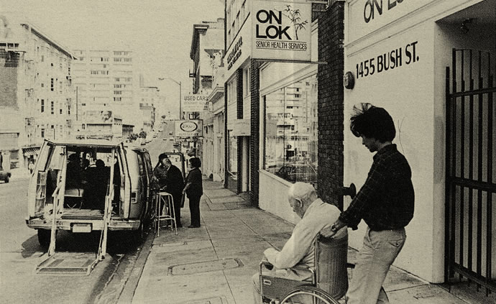
Recommendation 5
Identify clinical settings that are delivering interprofessional care coordination, both generic and specialized models that currently include educational opportunities for clinical practice in medicine, nursing, social work and other health professionals and share them widely with health professions schools leaders and faculty.

Slide 15

Recommendation 6
Integration of students into interprofessional teams in non-traditional settings and at different points in time must be evaluated in order to determine what level and model of educational preparation is the strongest predictor of interprofessional teamwork and care coordination and in which practice settings for each involved health profession.

Slide 16


Recommendation 7
Work with private insurers for recognition of interprofessional education as part of interprofessional care coordination models that they will fund.

Slide 17

Recommendation 8
Create academic recognition and incentives for faculty who teach and do
research in interprofessional settings and consider special academic recognition for students who complete more advanced interdisciplinary coursework and care coordination practicums.

Slide 18
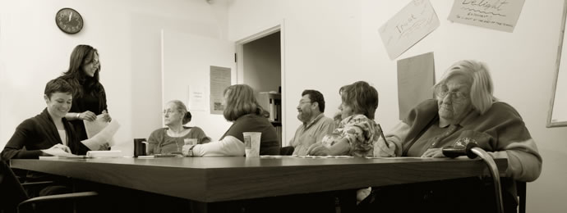
Recommendation 9
Promote the importance of educational and practice environments needed for training in interprofessional practice and care coordination to educational leaders.

Slide 19

Recommendation 10
Strengthen the link between social work education and practice including collaborating with community-based organizations to provide social workers with the skills they need to survive and thrive in the new health care reform world:
acquiring business acumen
providing evidence-based research into practice

Slide 20

Linking Education to Practice
“Vision without action is merely a dream.
Action without vision just passes the time.
Vision with action can change the world.”
-Joel A. Barker

Slide 21
Resources
nora.obrien@jhartfound.org
www.jhartfound.org
http://www.cswe.org/CentersInitiatives/GeroEdCenter.aspx
http://www.gswi.org/
http://www.hartfordign.org/practice/gitt/
http://www.americangeriatrics.org/pha/multidisciplinary_competencies/

