Slide 1
Looking Back – Moving Forward: WORKFORCE DEVELOPMENT FOR HEALTHCARE REFORM
2011 CMHACY CONFERENCE
May 12, 2011
Presenters: Gwen Foster, S. Sirojudin,
Sarah Taylor, Meghan Morris,

Slide 2
MENTAL HEALTH WORKFORCE NEEDS
2001: Approx. 4 million adults in California needed
MH services
2004-05: 600,000 clients received county MH services
2008: Vacancy rate for MH providers in California =
20-25%, higher in rural areas.

Slide 3
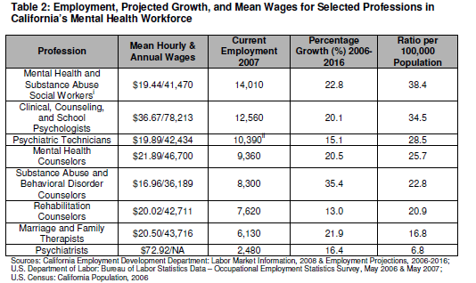
MENTAL HEALTH WORKFORCE SHORTAGES
Lok, V., & Chapman, S. (2009). The Mental Health Workforce in California : Employment, Education, and Diversity. UCSF Center for the Health Professions

Slide 4
DIVERSITY IN CALIFORNIA’S MENTAL HEALTH WORKFORCE Lok, V., & Chapman, S. (2009).
Psychology: doctoral and master’s level degrees are predominantly received by White graduates. Percentage of White grads dropped from 78% to 71% in last decade. Hispanic/Latino and Asian /Pacific Islander grads have increased.
MFT: Diversity is increasing, but there continues to a lack. White graduates decreased from 85% in 1996 to 62% in 2000. Hispanic/Latino grads increased from 7% in 1997 – 21% in 2006.
MSW: Diversity is increasing. White graduates have decreased from 52% in 2000 to 43% in 2006. Hispanic Latino grads increased from approx. 23% to 30%. Change among African-American, Native American, and API grads has been flat between 2008-2008.
Psychiatric Tech: Fairly diverse. In 2006, White and Hispanic grads each comprised approximately 30% of the grads. African American grads comprised approx. 18%, and API approx. 22%.

Slide 5

CalSWEC
1991 - California Social Work Education Center started at UC Berkeley School of Social Welfare, to strengthen the child welfare workforce with funding from Title IV-E Federal, State DSS, and matching funds from participating universities.

Slide 6
CalSWEC TODAY
20 schools of social work, county departments of social services or mental health (CWDA and CMHDA), the California Department of Social Services, and the California Chapter of the National Association of Social Workers
CalSWEC’s workforce development programs:
child welfare (undergrad, grad, and in-service training);
mental health (graduate); and
aging (under construction).

Slide 7
MENTAL HEALTH INITIATIVE 1993-2003
Mental Health Directors, social work educators, and practitioners explored how to create a program, modeled on the CalSWEC Title IV-E program, to alleviate shortages of social work professionals from diverse backgrounds with skills to serve public mental health clients.
2003 - Developed a set of core competencies to prepare graduate students for careers in public mental health services.

Slide 8
2004
MENTAL HEALTH SERVICES ACT

Slide 9

No longer “business as usual…”

Slide 10
MHSA WORKFORCE, EDUCATION, AND TRAINING GOALS
Address critical MH workforce shortages
Retool the existing workforce to create and sustain system transformation
Create/strengthen career pathways for consumers and family members.

Slide 11
CalSWEC DMH CONTRACT
MHSA funding since 2005 for stipends and program activities.
$5.8 million per year through CalSWEC to Schools of Social Work throughout California for:
Stipends ($18,500) for up to 196 second-year students
Operating costs

Slide 12
ELIGIBILITY AND PAYBACK OBLIGATION
Final-year students who are enrolled full-time and interested in a career in public mental health systems, including contract agencies, are eligible.
Each student commits to one year of employment in a county or contract MH agency following graduation
Students have 180 days after graduation to find eligible employment; they may appeal for time extensions to graduate and/or to complete payback obligation.

Slide 13
MENTAL HEALTH SOCIAL WORK CURRICULUM COMPETENCIES
Foundation and Advanced/Specialization Curriculum Areas
Cultural and Linguistic Competency
Foundation Social Work Practice / Advanced MH Practice
Human Behavior and the Social Environment / Human Behavior and the Mental Health Environment
Workplace Management
Mental Health Policy, Planning and Administration

Slide 14
MHP PROGRAM EVALUATION
UC Berkeley SSW Outcome Study:
Cohort characteristics
Payback obligation performance
Post-payback employment
Loma Linda University, Dept. of SW & Social Ecology:
Implementation of the curriculum competencies
Preparation of MHESP graduates to work in recovery-oriented mental health systems

Slide 15
Mental Health Program Diversity

Slide 16
Ethnic Background
 |  | 2005-06 |  | 2006-07 |  | 2007-08 |  | 2008-09 |  | 2009-10 |  |  | SUB-TOTAL
ETHNIC GROUPS |  | N | % | N | % | N | % | N | % | N | % | N |  | %
Minority | American-Indian | 2 | 1 | 0 | 0 | 2 | 1 | 3 | 2 | 1 | 1 | 8 |  | 1
Students | Asian/Pacific Islander | 24 | 14 | 35 | 19 | 23 | 13 | 20 | 11 | 24 | 13 | 126 |  | 14
 | African-American | 17 | 10 | 19 | 10 | 18 | 10 | 21 | 11 | 19 | 10 | 94 |  | 10
 | Hispanic/Latino/ | 40 | 23 | 47 | 25 | 45 | 24 | 49 | 27 | 50 | 27 | 230 |  | 25
 | Chicano
 | Other | 9 | 5 | 8 | 5 | 16 | 9 | 12 | 7 | 12 | 6 | 57 |  | 6
 | Declined to state |  |  |  |  |  |  | 0 | 0 | 1 | 1 | 2 |  | 0.2
Total Minority Students |  | 92 | 53 | 109 | 59 | 104 | 57 | 105 | 57 | 107 | 58 | 517 |  | 57
White/ Caucasian |  | 82 | 47 | 78 | 41 | 80 | 43 | 78 | 43 | 76 | 42 | 394 |  | 43
TOTAL |  | 174 | 100 | 187 | 100 | 184 | 100 | 183 | 100 | 183 | 100 | 911 |  | 100

Slide 17
Language Spoken
LANGUAGE GROUPS | 2006-2007 |  | 2007-2008 |  | 2008-2009 |  | 2009-2010 |  | TOTA L
 | N | % | N | % | N | % | N | % | N | %
English only | 77 | 38 | 91 | 48 | 83 | 44 | 77 | 41 | 328 | 43
Asian or Asian-Pacific (Tagalog, Chinese, Vietnamese, Korean, Hindi) | 37 | 18.3 | 23 | 12 | 21 | 11 | 22 | 12 | 103 | 13.4
Native North American | 0 | 0 | 0 | 0 | 0 | 0 | 0 | 0 | 0 | 0
Spanish | 65 | 32.2 | 56 | 29 | 69 | 37 | 75 | 40 | 265 | 34.4
European (Russian, Italian, Portuguese) | 17 | 8.5 | 15 | 8 | 12 | 6 | 12 | 6 | 56 | 7.2
African (Amharic, Zulu, Swahili) | 2 | 1 | 3 | 2 | 3 | 2 | 1 | 1 | 9 | 1.2
American Sign Language | 4 | 2 | 2 | 1 | 0 | 0 | 0 | 0 | 6 | 0.8
TOTAL* | 202 | 100 | 190 | 100 | 188 | 100 | 187 | 100 | 767 | 100

Slide 18
Payback Employment
EMPLOYMENT RECORD |  | COHORTS |  |  |  |  |  | TOTAL
 |  | 2005-2006 |  | 2006-2007 |  | 2007-2008 |  | 2005-2008
 |  | N | % | N | % | N | % | N | %
A. | NUMBER OF GRADUATING STUDENTS | 174 | 100 | 187 | 100 | 182 | 100 | 543 | 100
B. | ENTERED EMPLOYMENT PAYBACK
1 | Payback requirement
 | a. Met payback requirement | 154 | 88.5 | 177 | 95 | 171 | 94 | 502 | 92.4
 | b. Dropped out and paid back stipend | 20 | 11.5 | 10 | 5 | 11 | 6 | 41 | 7.6
2 | Field of Services (completed)
 | a. Mental Health | 154 | 100 | 175 | 99 | 171 | 100 | 500 | 99.6
 | b. Non Mental Health | 0 | 0 | 2 | 1 | 0 | 0 | 2 | 0.4
3 | Type of Agency
 | a. Public | 98 | 63.6 | 90 | 51 | 89 | 52 | 277 | 55.2
 | b. Contracting CBO | 56 | 36.4 | 87 | 49 | 82 | 48 | 225 | 44.8

Slide 19
Post-payback Employment
EMPLOYMENT PROGRESS |  | COHORTS |  |  |  |  |  | TOTAL
 |  | 2005-2006 |  | 2006-2007 |  | 2007-2008 |  | 2005-2008
 |  | N | % | N | % | N | % | N | %
A. | TOTAL TRACED | 139 | 100 | 145 | 100 | 143 | 100 | 427 | 100
B. | CURRENT EMPLOYMENT
1 | Employer (Agency)
 | a. The same agency where initially employed | 103 | 74 | 109 | 75 | 83 | 58 | 295 | 69.1
 | b. Different Agency | 36 | 26 | 36 | 25 | 60 | 42 | 132 | 30.9
2 | Field of Services
 | a. Mental Health | 128 | 92 | 133 | 92 | 139 | 97 | 400 | 93.7
 | b. Non Mental Health | 11 | 8 | 12 | 8 | 4 | 3 | 27 | 6.3
3 | Type of Agency
 | a. Public | 82 | 60 | 78 | 54 | 67 | 47 | 227 | 53.2
 | b. Contracting CBO | 57 | 40 | 67 | 46 | 76 | 53 | 200 | 46.8
4. | Place of Employment
 | a. California | 136 | 98 | 145 | 100 | 143 | 100 | 424 | 99.3
 | b. Out of state | 3 | 2 | 0 | 0 | 0 | 0 | 3 | 0.7

Slide 20
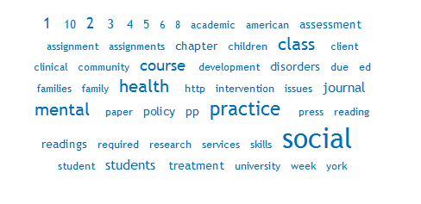
CalSWEC Mental Health Curriculum Analysis Project California Mental Health Advocates for Children and Youth May 12, 2011, Monterey, CA Sarah Taylor, PhD
663
781
1235
937
1291
Project funded by the Zellerbach Foundation via Loma Linda University.
Thanks to Jan Black and Bev Buckles for supporting this project.

Slide 21
Project Overview
Purpose
Review of how CalSWEC schools are integrating KSAs, key themes of the MHSA, and the CalSWEC MH Competencies
Methods
Letter requesting syllabi sent late September 2010
100% response rate (20 schools; ~115 syllabi)
Research team: 3 MSW students + Sarah
Surveymonkey for data collection (www.surveymonkey.com)
Discovertext for title page word cloud and counts (www.discovertext.com)
Competency word cloud in Wordle (www.wordle.net)
Study strengths and limitations
Syllabi are a contract between students and faculty
Study team included MSW students, the consumers of MSW education
Syllabi are an incomplete portrait of what happens in the classroom
Schools interpreted call for syllabi differently

Slide 22
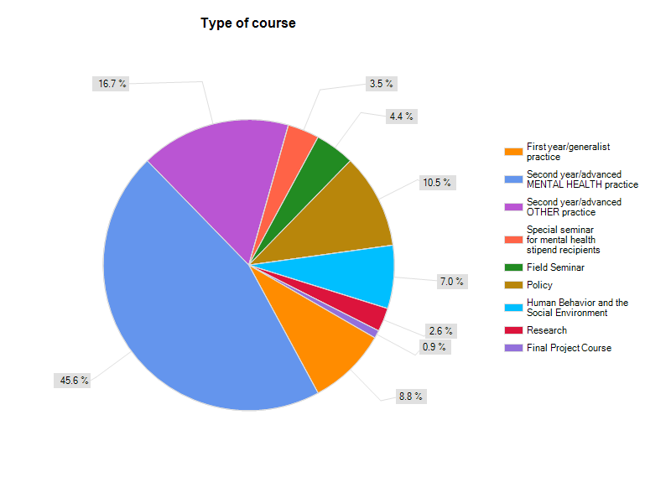
Sample Characteristics
Notes:
Schools sent between 1-17 syllabi. Syllabi ranged in length from 4-37 pages.

Slide 23
Integration of Knowledge, Skill, and Ability (KSA) Areas: Knowledge
Notes:
Based on feedback during the oral presentation, additional searches were done for terms relating to co-occurring disorders/dual diagnosis. The results of these additional searches are as follows:
Co-morbidity: 14
Co-morbid: 9
Co-morbidity OR co-morbid OR "dual diagnosis" OR co-occurring: 43

Slide 24
Integration of Knowledge, Skill, and Ability (KSA) Areas: Skills

Slide 25
Integration of Knowledge, Skill, and Ability (KSA) Areas: Abilities

Slide 26
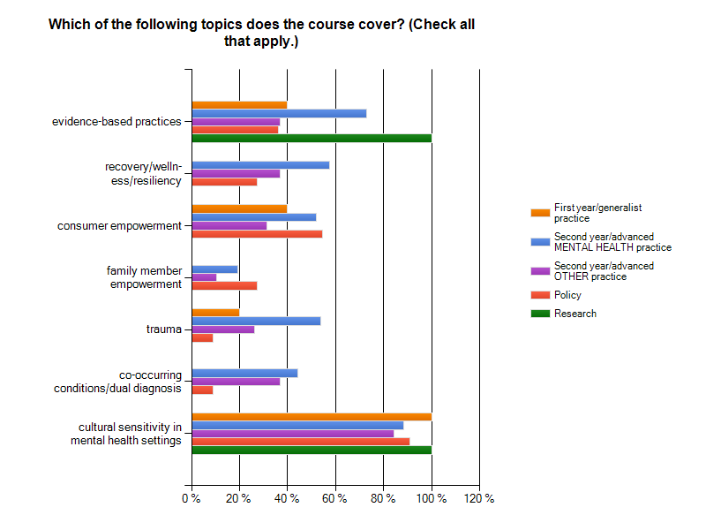
Integration of MHSA Key Themes

Slide 27
Integration of CalSWEC MH Curriculum Competencies
About 19% of syllabi explicitly listed the CalSWEC Mental Health Competencies that the course met.
Of those that listed the competencies specifically, the majority were in the areas of culturally and linguistically competent mental health practice and foundation or advanced practice.
Though most syllabi did not explicitly list competencies, the research team indicated that all syllabi covered at least some of the competencies.

Slide 28
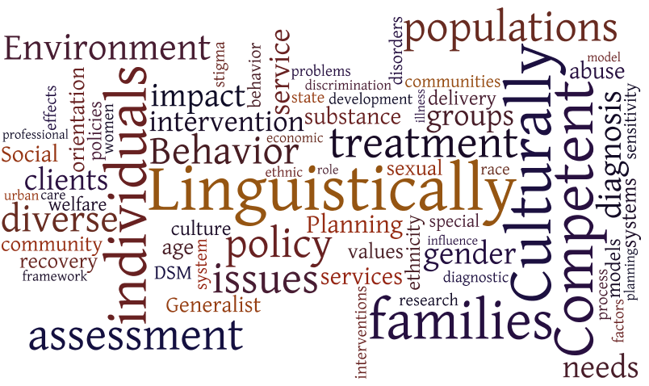
How do syllabi reflect the competencies?

Slide 29
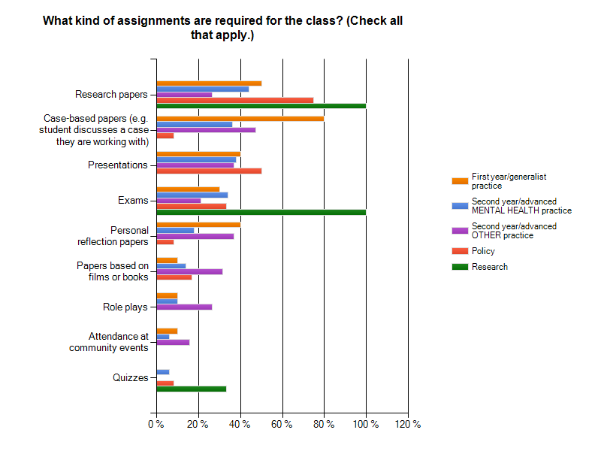
Assignments

Slide 30
Innovation
Research team selected 48% of syllabi as innovative.
Most of what the team identified as innovative were the assignments. Some of the assignments described were:
Agency visits
A “menu” of assignment choices
Attending a self-help meeting
Advocacy-related assignments
Community meetings
Experiential learning assignments
WRAP plans
Self-assessment assignments
Other aspects of courses identified as innovative included:
Guest speakers
Comprehensiveness of material covered
Group field trips
Recovery focus
Notes:
Agency visits: in which students must interview staff and/or clients and/or integrate what they observed at the agency with research
Menu: in which the student chooses projects and creates a contract with the instructor, including how work should be evaluated

Slide 31
Conclusion: Strengths
Based on the findings of this survey, CalSWEC schools are doing an excellent job in the areas of:
Assessment
Intervention
Professional use of self
Ethics
Cultural sensitivity in mental health settings
Notes:
Cut off was more than 65%

Slide 32
Conclusion: Areas in Progress
Some areas where about half of courses seem to have good coverage and about half may need additional focus include:
Recovery
Trauma
Evidence-based practice
Consumer empowerment
Agency/organizational issues
DSM-IV
Advocacy
Managing resistance/motivational interviewing
Psychopharmacology
Collaboration
Integrating theory into practice
Notes:
Cut off was 30-65%

Slide 33
Conclusion: Areas for Consideration
Some areas that may require additional focus include:
Co-occurring disorders/dual diagnosis
Family member empowerment
Empathy & listening skills
Conflict resolution
Peer support/self-help
Use of software and other technology
Documentation
Relationship-building
Self-care
Supervision
Treatment planning
Continuing professional education and development
Notes:
Cut off was less than 30%

Slide 34
Contact Info
Sarah Taylor, PhD
CalSWEC-II Mental Health Project Coordinator/Lecturer
California State University, East Bay
25800 Carlos Bee Blvd.
Hayward, CA 94542
(510) 885-2155
Sarah.taylor@csueastbay.edu

Slide 35

Health Care Reform and Mental Health Workforce Development
Changes and Needs under the Patient Protection &
Affordable Care Act of 2010

Slide 36
Overview
Major changes affecting Mental Health
Ethnic & Racial Disparities in Access to Coverage and Care
Care Coordination
Funding for Mental Health initiatives
Professional Development Implications and Discussion Questions.

Slide 37

Major policy changes under ACA affecting Mental Health
Nearly universal insurance coverage:
Increased demand for health and mental health care.
Over 31 million previously uninsured to access health insurance.

Slide 38

Major policy changes under ACA cont.
Section 1311 (j), 1563(c) (4)
Parity of coverage for mental health services.
Makes health and addiction services become “on par” with medical services covered by insurance agencies.
Co-payment amounts for consumers will be smaller.

Slide 39
Major policy changes under ACA cont.
Section 5604: Co-location of Primary and Specialty Care in Community-Based Behavioral Health Settings.
$50 million dollars in grants for coordinated and integrated care settings.
More medical clinics within behavioral health settings.

Slide 40
Major policy changes under ACA cont.
Section 3501: Medicare Medical Home Pilot Program
Integrated care in community-based settings.
Care coordination.
Greater partnerships and medical teams of mental health professionals and physicians.

Slide 41

Care Coordination
Coordinated and case management services for patients
More client-centered.
Should reduce expenses.
Should eliminate duplicate services.
Role for Mental Health Workers as care coordinator, particularly social workers.

Slide 42
Ethnic & Racial Disparities in Access to Coverage and Care
Institute of Medicine conducted analysis of 100 studies, and found inequalities in care delivery:
In CA: 55% of Hispanic patients received no pain meds compared to 26% of white patients.
Black patients with severe conditions treated less aggressively than whites.

Slide 43

Ethnic & Racial Disparities in Access to Coverage and Care
IOM found this discrepancies to continue regardless of insurance coverage.

Slide 44
Funding for Mental Health initiatives
Mental and Behavioral Health Education and Training Grants: 2010-1013:
$8 million for social work studdents
$12 million for psychology students
$10 for training in professional child and adolescent mental health
$5 million for training paraprofessionals in child and adolescent mental health.

Slide 45
Funding for Mental Health initiatives
Section 5203: Loan Repayment Program for Pediatric Behavioral Health Specialists in Underserved Areas- $50 million
Section 5306: Allows HHS secretary to award grants to schools for the development, expansion a or improvement of graduate or professional programs in child and adolescent mental health.

Slide 46
Professional Development Implications
Curriculum may need to refocus for some mental health professionals on preparation for integrated health settings.
Curriculum and training needed on changes that will impact workers.
Internship and Practice settings for graduate students may appear different in next 3-5 years.
Concentrations and emphases may change for some professional schools.

Slide 47

Discussion Questions
How do you envision the ACA affecting your own professional development needs or those of your organization?
How will the ACA alter the way that you deliver or receive mental health services?
What are ways that you believe universities should train or expose future mental health professionals to prepare them for health care reform changes?

Slide 48
CONTACT INFO
Gwen Foster: gwen77f@berkeley.edu
Meghan Morris: meghanbrennamorris@berkeley.edu
Sarah Taylor, Ph.D. Sarah.taylor@csueastbay.edu
Sirojudin: siroj@berkeley.edu

Slide 49

Council on Social Work Education
Developing A Mental Health Recovery Curriculum: Social Work
APA
San Francisco, Ca.
October 28, 2011

