Slide 1
NARMH 2011
Mental Health Workers: Future Growth and Critical Shortages
Gwen Foster, MSW, Director Mental Health Program, California Social Work Education Center
Adrienne Shilton, MPPA, Program Director, Local Workforce Education and Training, California Institute for Mental Health
Brian Keefer, MA, Project Manager, Human Resources Project, California Mental Health Planning Council

Slide 2



Introductions: Who we Are
Gwen Foster
Adrienne Shilton
Brian Keefer

Slide 3

California Mental Health Planning Council
Mandated in federal and state law:
  To advocate for persons with serious mental illnesses and children with serious emotional disturbances
  To provide oversight and accountability for the public mental health system
  To advise on priority issues and participate in statewide planning
  Forty members, including consumers, family members, public and private providers, professionals, and state agency representatives
Notes:
Six committee structures: System of Care (CSOC, ASOC, OASOC) and functional committees (quality improvement, policy system and development, and human resources)

Slide 4
National Perspective
The President’s New Freedom Commission on Mental Health”.. the Commission heard consistent testimony from consumers, families, advocates, and public and private providers about the workforce crisis in mental health care. Today, not only is there a shortage of providers, but those providers who are available are not trained in evidence-based and other innovative practices. This lack of education, training, or supervision leads to a workforce that is ill-equipped to use the latest breakthroughs in modern medicine.”
Notes:
Institute of Medicine report

Slide 5
National Findings (1999- today)
Workforce Shortages and Maldistribution of the Workforce
Insufficient Diversity
Variation in Amount and Type of Education
Deficiencies in Professional Education
Lack of Assurances of Competencies in Discipline Specific and Core Knowledge
Inadequate Faculty Development

Slide 6
1. Workforce Shortages and Distribution
1999: Surgeon General’s Report-
  The Supply of well-trained mental health professionals is inadequate in many areas of the country, especially in rural areas. Particular keen shortages are found in the numbers of mental health professionals serving children and adolescents and older adults.

Slide 7
2. Insufficient Diversity
2000 US Population:
75.1% White persons
12.3% Black persons
3.6% Asian or Pacific Islander persons
0.9% Native American persons
5.5% Persons Claiming and identity or than those listed
2.4% Persons Identifying as more than one race

Slide 8
2010 Census Data
72.4% White persons
12.6% Black persons
0.9% American Indian and Alaska Native persons
4.8%
0.2% Asian persons Native Hawaiian and Other Pacific Islander
2.9% Persons Reporting two or more races
16.3% Persons of Hispanic or Latino origin
63.7% White persons not Hispanic, person
12.4% Foreign born persons 2005-2009

Slide 9
Ethnicity by Occupation
Source: Mental Health, United States (2002)—Mental Health Practitioners and Trainees, Chapter 21
Occupation | American Indian/ Alaskan | Asian/ Pacific Islander | Hispanic | Black (not Hispanic) | White (not Hispanic) | Other
Psychiatrists (1999) | 0.1% | 9.5% | 4.5% | 2.4% | 75.5% | 8.0%
Social Workers (1996) | 0.5% | 1.7% | 2.7% | 5.0% | 88.9% | 1.2%
Psychiatric Nursing (1996-women only) | 0.2% | 1.9% | 1.1% | 2.3% | 94.6% | No data
Psychosocial Rehabilitation (1996-men only) | 0.4% | 2.0% | 6.4% | 20.8% | 69.8% | 0.6%

Slide 10
3. Variation Among Providers and Delivery Systems: An Occupational Mosaic
General Medical/Primary Care Providers
Psychiatry
Psychology
Psychiatric Nursing
LCSW
Marriage and Family Therapy
Social Work
Counseling
Advanced practice Nursing
Substance Abuse Treatment
Peer Support
Parent partners
Family Member
Pastoral Counseling
Psychosocial Rehabilitation
Psychiatric technicians
Occupational Therapy

Slide 11
3-6. What is Known About Providers?
Little Assurance of Competencies
Lack of Understanding on the Skills, Abilities, Attitudes, and Knowledge
Inability to Incorporate Educational and Training Programs Across Providers and Among Systems
A Growing Gap Between Education, Work Place Realities, Licensing, and Communities Being Served

Slide 12
National Intentions: Short-Lived and Unheeded
Commissions and Expert Panels
Publishing Recommendations to improve capacity and quality
  cultural and linguistic diversity and broader inclusivity
  competencies throughout programs of study, curricula and training
  financial development and deployment of the mental health workforce
  educational and training capacity
  reduce stigma
Notes:
Improving the Quality of Health Care for Mental and Substance-Use Conditions. Institute of Medicine Report.

Slide 13
California’s Current Perspective
Similar Issues with future trends to be considered
Aging workforce : (2018) 33.1% 55 and older
Increasing diversity (2018) 37.3% Hispanic, 12.9% Asian, 5.5% Black, and 41% White
An increase in the number of workers with only two years of education beyond high school, currently at 29.3%

Slide 14
California’s Public Mental Health System
Delocalized Community Mental Health Programs that are County Operated
Community-based Agencies
Serve across the lifespan, yet funding is categorical by age group
Lack of A Common Understanding of the Duties and Tasks Performed by Occupations
Inconsistency Among Training Programs

Slide 15
Rural Workforce Challenges
Small pool of workers from which to draw
Additional retention challenges
Few local educational opportunities
Geographic barriers

Slide 16
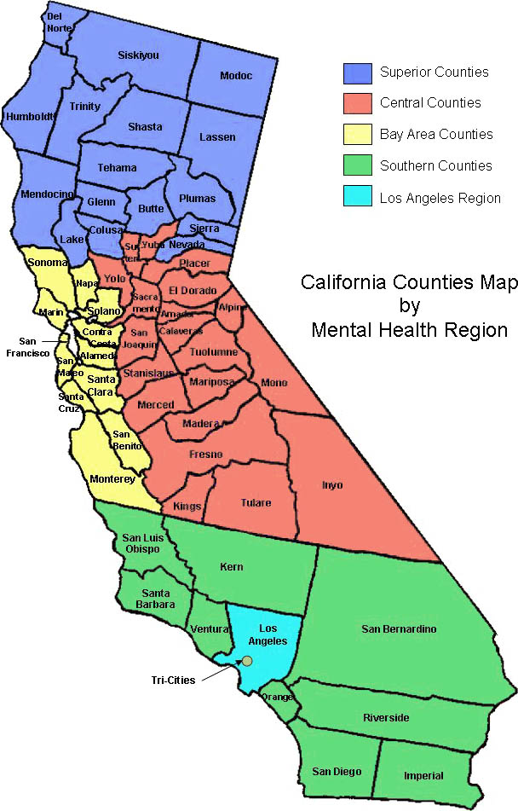
“The small population makes it hard to find a pool of potential staff big enough to try to gain interest……”
“The rural areas of our county have very limited educational opportunities so even if you interest staff, they move away and often don’t move back.”
“A program administrator has to be able to find the balance between meeting documentation standards and the time it takes to investment in ongoing public mental health delivery skill coaching.”
“Either we have to “grow our own” or attract people from other areas who are not familiar with the unique opportunities and difficulties working in our areas. Lack of public transportation, long distances between services sites and consumers, reduced funding, and fewer educational options all limit our ability to attract or train our workforce.”

Slide 17
Mental Health Services Act (MHSA):
A Unique Approach
Voter-approved, dedicated funding
New approaches to Services +
Prevention, Housing, Innovation, Workforce
Core Values:
  Recovery, Resilience, Wellness
  Integrated Services
  Community Development
  Consumer and Family Driven
  Cultural Competency

Slide 18
Workforce, Education, and Training (WET)
$450 million for workforce development
  $230 million: State and Regional
  $210 million: Counties
Create a local, regional and statewide infrastructure to develop and deploy a qualified workforce
Increase cultural and linguistic diversity

Slide 19
Statewide WET Programs
Stipends (MSWs, MFTs, Psychiatric Mental Health Nurse Practitioners, Psychologists)
Loan Repayment
Psychiatric Residency Programs
Physician Assistant Programs
Regional Partnerships

Slide 20
County Approaches
Locally driven, consumer planned programs
Range of approaches reflects unique challenges faced by geographically and culturally diverse counties
Supported by California Institute for Mental Health
  Technical Assistance
  Policy and Program Support
  Best Practices and Collaboration

Slide 21

San Bernardino County
Covers more land than state of Rhode Island
More than 21,000 square miles
2 million + residents
Notes:
Largest land area of any county in the contiguous United States

Slide 22

Siskiyou County
Population of 46,000
Over 6,347 sq. miles
Geographically isolated communities
19.4% unemployment
Limited public transit
Underserved populations include Native American, Hispanic, Asian, Older adults and Transition Age Youth

Slide 23
County Workforce Initiatives
Rural MSW Program
Scholarship and Loan Repayment Programs
Career Ladders
Distributed Education
Consumer and Family Member Employment
Mental Health Professional Shortage Area Designation
“Roving” Clinical Supervisors

Slide 24
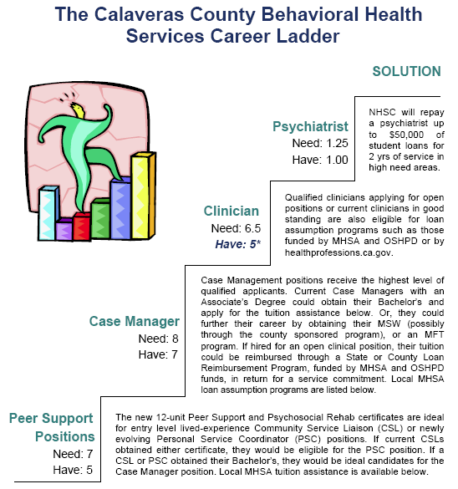

Slide 25

Columbia Community College Graduates from Calaveras County
Calaveras County funded two new certificate programs for consumers and family members returning to school

Slide 26



Distance Learning in San Bernardino County
Funded a Training Institute with technology

Slide 27
Rural Opportunities
“Economic downturn is the ideal time to return to school; by the time our students have completed their education, we will have a wealth of qualified staff.”
“Education in rural areas is about much more than tuition assistance. In counties like Calaveras, it requires a cohort approach, transportation, and peer support”
“The WET programs have enabled us to develop innovative programs including regional efforts; long distance learning; and financial assistance which have not been available in our areas.”
“Learning and appreciating each community’s unique and special culture, and then reaching out to the residents in these communities to hire local mental health professionals who will be warm and welcoming to their neighbors who might be seeking behavioral health services… this has been and continues to be a challenge and a joy as we provide integrated behavioral health services in rural health clinics.”

Slide 28
The Future
Health Care Reform
Changing roles of practitioners
Fiscal challenges
What would you add?

Slide 29



CalSWEC
1991 - California Social Work Education Center started at UC Berkeley School of Social Welfare, to strengthen the child welfare workforce with funding from Title IV-E Federal, State DSS, and matching funds from participating universities.

Slide 30
CalSWEC TODAY
A consortium of 21 schools of social work, county departments of social services (CWDA), county mental health departments (CMHDA), the California Department of Social Services, and the California Chapter of the National Association of Social Workers
CalSWEC’s workforce development programs:
  child welfare (undergrad, grad, and in-service training);
  mental health (graduate); and
  aging (under construction).

Slide 31
MENTAL HEALTH INITIATIVE
1993 - Mental Health Directors, social work educators, and practitioners started to explore how to create a program, modeled on the CalSWEC Title IV-E program, to alleviate shortages of social work professionals from diverse backgrounds with skills to serve clients in county/contract behavioral health systems.
2003 - Developed a set of core competencies to prepare graduate students for careers in public behavioral health services.

Slide 32
2004
MENTAL HEALTH SERVICES ACT

Slide 33

No longer “business as usual…”

Slide 34
MHSA WORKFORCE, EDUCATION, AND TRAINING
GOALS
Address critical MH workforce shortages
Retool the existing workforce to create and sustain system transformation
Create/strengthen career pathways for consumers and family members.

Slide 35
CalSWEC - DMH
INTERAGENCY AGREEMENT
  MHSA funding since 2005 for stipends and program activities.
  $5.8 million per year through CalSWEC to Schools of Social Work throughout California for:
    Stipends ($18,500) for up to 196 final-year graduate students
    Program operating costs, including curriculum implementation.

Slide 36
MENTAL HEALTH SOCIAL WORK CURRICULUM COMPETENCIES
Cultural and Linguistic Competency
Foundation Social Work Practice / Advanced MH Practice
Human Behavior and the Social Environment / Human Behavior and the Mental Health Environment
Workplace Management
Mental Health Policy, Planning and Administration

Slide 37
MENTAL HEALH PROGRAM ELIGIBILITY AND PAYBACK OBLIGATION
  Students who are enrolled full-time in their final year and are interested in careers in public mental health systems, including contract agencies, are eligible.
  Each student commits to one year of employment in a county or contract MH agency following graduation.
  Students have 180 days after graduation to find eligible employment; they may appeal for time extensions to graduate and/or to complete payback obligation. They may also volunteer in an eligible agency for hours toward payback.

Slide 38
MHP PROGRAM EVALUATION
UC Berkeley SSW Outcome Study:
  Who are the students?
  Do they meet payback obligation, and how?
  Retention post-payback – do they stay?
Loma Linda University, Dept. of Social Work & Social Ecology:
  Implementation of the curriculum competencies
  Preparation of MHP graduates to work in recovery-oriented mental health systems

Slide 39
GEOGRAPHIC DIVERSITY
REGION | UNIVERSITIES | 2006-10 COHORTS | 10/11 COHORT | TOTAL | REGION TOTAL 2006-11
 |  |  |  |  | N | %
Northern Counties | CSU Chico | 40 | 9 | 49 | 71 | 6.3
 | CSU Humboldt | 17 | 5 | 22
Central Counties | CSU Bakersfield | 23 | 5 | 28 | 214 | 19.4
 | CSU Fresno | 43 | 9 | 52
 | CSU Sacramento | 90 | 20 | 110
 | CSU Stanislaus | 20 | 4 | 24
Bay Area Counties | CSU East Bay | 70 | 15 | 85 | 264 | 24.0
 | San Francisco State | 49 | 10 | 59
 | San Jose State | 50 | 10 | 60
 | UC Berkeley | 50 | 10 | 60

Slide 40
GEOGRAPHIC DIVERSITY continued…
Southern Counties | CSU San Bernardino | 71 | 15 | 86 | 218 | 20.0
 | San Diego State | 72 | 15 | 87
 | Loma Linda | 39 | 6 | 45
LA Region | CSU Long Beach | 94 | 20 | 114 | 334 | 30.3
 | CSU Los Angeles | 35 | 7 | 42
 | UCLA | 49 | 10 | 59
 | USC | 99 | 20 | 119
 | TOTAL | 911 | 190 | 1101 | 1101 | 100

Slide 41
ETHNIC BACKGROUNDS
 |  | 2005-06 |  | 2006-07 |  | 2007-08 |  | 2008-09 |  | 2009-10 |  | TOTAL
ETHNIC GROUPS |  | N | % | N | % | N | % | N | % | N | % | N | %
Minority | American-Indian | 2 | 1 | 0 | 0 | 2 | 1 | 3 | 2 | 1 | 1 | 8 | 1
Students | Asian/Pacific Islander | 24 | 14 | 35 | 19 | 23 | 13 | 20 | 11 | 24 | 13 | 126 | 14
 | African-American | 17 | 10 | 19 | 10 | 18 | 10 | 21 | 11 | 19 | 10 | 94 | 10
 | Hispanic/Latino/ | 40 | 23 | 47 | 25 | 45 | 24 | 49 | 27 | 50 | 27 | 230 | 25
 | Chicano
 | Other | 9 | 5 | 8 | 5 | 16 | 9 | 12 | 7 | 12 | 6 | 57 | 6
 | Declined to state |  |  |  |  |  |  | 0 | 0 | 1 | 1 | 2 | 0.2
Total Minority Students |  | 92 | 53 | 109 | 59 | 104 | 57 | 105 | 57 | 107 | 58 | 517 | 57
White/ Caucasian |  | 82 | 47 | 78 | 41 | 80 | 43 | 78 | 43 | 76 | 42 | 394 | 43
TOTAL |  | 174 | 100 | 187 | 100 | 184 | 100 | 183 | 100 | 183 | 100 | 911 | 100

Slide 42
LANGUAGES SPOKEN
LANGUAGE GROUPS | 2006-2007 |  | 2007-2008 |  | 2008-2009 |  | 2009-2010 |  | TOTA L
 | N | % | N | % | N | % | N | % | N | %
English only | 77 | 38 | 91 | 48 | 83 | 44 | 77 | 41 | 328 | 43
Asian or Asian-Pacific (Tagalog, Chinese, Vietnamese, Korean, Hindi) | 37 | 18.3 | 23 | 12 | 21 | 11 | 22 | 12 | 103 | 13.4
Native North American | 0 | 0 | 0 | 0 | 0 | 0 | 0 | 0 | 0 | 0
Spanish | 65 | 32.2 | 56 | 29 | 69 | 37 | 75 | 40 | 265 | 34.4
European (Russian, Italian, Portuguese) | 17 | 8.5 | 15 | 8 | 12 | 6 | 12 | 6 | 56 | 7.2
African (Amharic, Zulu, Swahili) | 2 | 1 | 3 | 2 | 3 | 2 | 1 | 1 | 9 | 1.2
American Sign Language | 4 | 2 | 2 | 1 | 0 | 0 | 0 | 0 | 6 | 0.8
TOTAL | 202 | 100 | 190 | 100 | 188 | 100 | 187 | 100 | 767 | 100

Slide 43
PAYBACK EMPLOYMENT
EMPLOYMENT RECORD |  | COHORTS |  |  |  |  |  | TOTAL
 |  | 2005-2006 |  | 2006-2007 |  | 2007-2008 |  | 2005-2008
 |  | N | % | N | % | N | % | N | %
A. | NUMBER OF GRADUATING STUDENTS | 174 | 100 | 187 | 100 | 182 | 100 | 543 | 100
B. | ENTERED EMPLOYMENT PAYBACK
1 | Payback requirement
 | a. Met payback employment requirement | 154 | 88.5 | 177 | 95 | 171 | 94 | 502 | 92.4
 | b. Dropped out and paid back stipend | 20 | 11.5 | 10 | 5 | 11 | 6 | 41 | 7.6
2 | Field of Services (completed)
 | a. Mental Health | 154 | 100 | 175 | 99 | 171 | 100 | 500 | 99.6
 | b. Non Mental Health | 0 | 0 | 2 | 1 | 0 | 0 | 2 | 0.4
3 | Type of Agency
 | a. Public | 98 | 63.6 | 90 | 51 | 89 | 52 | 277 | 55.2
 | b. Contract CBO | 56 | 36.4 | 87 | 49 | 82 | 48 | 225 | 44.8

Slide 44
POST-PAYBACK EMPLOYMENT
EMPLOYMENT PROGRESS |  | COHORTS |  |  |  |  |  | TOTAL
 |  | 2005-2006 |  | 2006-2007 |  | 2007-2008 |  | 2005-2008
 |  | N | % | N | % | N | % | N | %
A. | TOTAL TRACED | 139 | 100 | 145 | 100 | 143 | 100 | 427 | 100
B. | CURRENT EMPLOYMENT
1 | Employer (Agency)
 | a. The same agency where initially employed | 103 | 74 | 109 | 75 | 83 | 58 | 295 | 69.1
 | b. Different Agency | 36 | 26 | 36 | 25 | 60 | 42 | 132 | 30.9
2 | Field of Services
 | a. Mental Health | 128 | 92 | 133 | 92 | 139 | 97 | 400 | 93.7
 | b. Non Mental Health | 11 | 8 | 12 | 8 | 4 | 3 | 27 | 6.3
3 | Type of Agency
 | a. Public | 82 | 60 | 78 | 54 | 67 | 47 | 227 | 53.2
 | b. Contracting CBO | 57 | 40 | 67 | 46 | 76 | 53 | 200 | 46.8
4. | Place of Employment
 | a. California | 136 | 98 | 145 | 100 | 143 | 100 | 424 | 99.3
 | b. Out of state | 3 | 2 | 0 | 0 | 0 | 0 | 3 | 0.7

Slide 45
FINDINGS
The program contributes to the diversity of the mental health workforce.
  57% of the 2005 – 2010 cohorts are ethnically and culturally diverse; Latino is the largest population
  57% of the cohorts speak at least one language in addition to English; Spanish is spoken most often.
Graduates are meeting their payback obligations
  92% of the graduates of the 2005-08 cohorts completed their employment obligations; 55% worked in county-operated mental health agencies, and 45% worked in contract agencies.
Graduates are continuing their careers in public mental health.
  69% of the 2006-08 cohorts were still at their payback agency in 2010.
  53% were in county agencies and 47% were employed in contract agencies.

Slide 46
FINDINGS
Continued…
Curricula in schools of social work are changing to address mental health competencies
  A survey of the MHP schools of social work identified a number of strategies being used to implement the mental health competencies with a particular focus on content about recovery, inclusion of consumers and family members on advisory boards and as participants in classroom presentations.
Schools are creating pathways for greater collaboration among faculty and with agencies
  Schools have developed specialized seminar courses for MH stipend students, increased involvement of MH Stipend Project Coordinators in their school/department curriculum committee meetings and increased interaction with local county mental health agencies.
Analysis of data from graduate and faculty surveys and supervisor interviews was recently completed.
  Findings indicate that graduates are satisfied overall with their educational preparation for their jobs – and schools need to address some critical gaps (e.g. documentation, evaluation research).

Slide 47
SACRAMENTO STATE UNIVERSITY SCHOOL OF SOCIAL WORK RURAL MH PROGRAM
Launched in 2009 with funding from 4 small counties in Northern Ca. and Regional Partnership
Purpose: to develop a weekend MSW program with a rural, mental health focus.
MSW curriculum is followed, with specialized readings, case vignettes, and assignments in some courses. Curriculum includes strong focus on wellness, recovery, and resiliency; cultural competency, including rural culture; integrated services for clients/families; client/family-driven MH system; and community collaboration.

Slide 48
SACRAMENTO STATE UNIVERSITY RURAL MENTAL HEALTH PROGRAM Cont…
27 students now entering Yr. 2 of 3 year part-time program
Weekends + study at home; internships in Yrs. 2 and 3
Half of students are doing internships at their place of employment
Cost for program = $85,000/year.
Contact: Maura O’Keefe (okeefem@saclink.csus.edu), Professor and Rural MSW Program Coordinator

Slide 49
CSU CHICO/HUMBOLDT STATE UNIVERSITY DISTRIBUTED LEARNING MODEL
“Hybrid” ed. model combining online and in-person learning
16 counties in this region; two universities, CSU Chico and Humboldt State University
The schools of social work are developing educational pathways from AA - MSW, for students planning child welfare or MH careers.
Social work courses are being converted to fit modalities; placements being developed, including at places of employment.
Will start in 2011-12.
Contact: Donna Jensen, Distance Learning Director, CSU Chico. (Djensen@csuchico.edu ).

Slide 50
Contact Information
Gwen Foster, MSW
Director, Mental Health Program
California Social Work Education Center
gwen77f@berkeley.edu
Brian Keefer, MA
Project Manager, Human Resources Project
California Mental Health Planning Council
Brian.keefer@dmh.ca.gov
Adrienne Shilton, MPPA
Project Manager, WET
California Institute for Mental Health
ashilton@cimh.org

