Slide 1
Field Practicum: Innovative Panel
Patty Hunter and Roseanna McCleary

Slide 2
Integrated Behavioral Healthcare Field Placement Project - CSWE
February 2012 - National Association of Deans and Directors (NADD), Council on Social Work Education (CSWE) and National Council for Behavioral Health came together to launch this project.

Slide 3
Objectives for the Project
Phase I: Developing curriculum for an integrated healthcare policy course and an advanced practice course.
Phase II: Implementation and evaluation of these courses
Phase III: Field Placements in integrated healthcare settings for students

Slide 4
Expected Learning Experiences
Opportunity to observe and conduct bio-psycho-social screenings and assessments addressing mental health, substance abuse, trauma & primary care
Observe primary care screenings and assessments, followed by discussion with primary care provider on findings and develop care plan implications

Slide 5
More learning activities
Individual work with clients to address goals in service plan
Co-lead wellness health promotion group
Work along side care manager assisting clients to keep appointments, address urgent medical needs, engage family to support service plans
Attend grand rounds, case conferences

Slide 6
Enhanced Activities
Could include:
Involvement in telemedicine
Electronic health record training
Motivational interviewing
Trauma screening
Pain management
Peer-led services
Developing expertise with health disparities

Slide 7
CSU Bakersfield - IBHC Field Practicum Project
Roseanna McCleary, Ph.D

Slide 8

Notes:
Flyer being disseminated at KMC to promote program

Slide 9
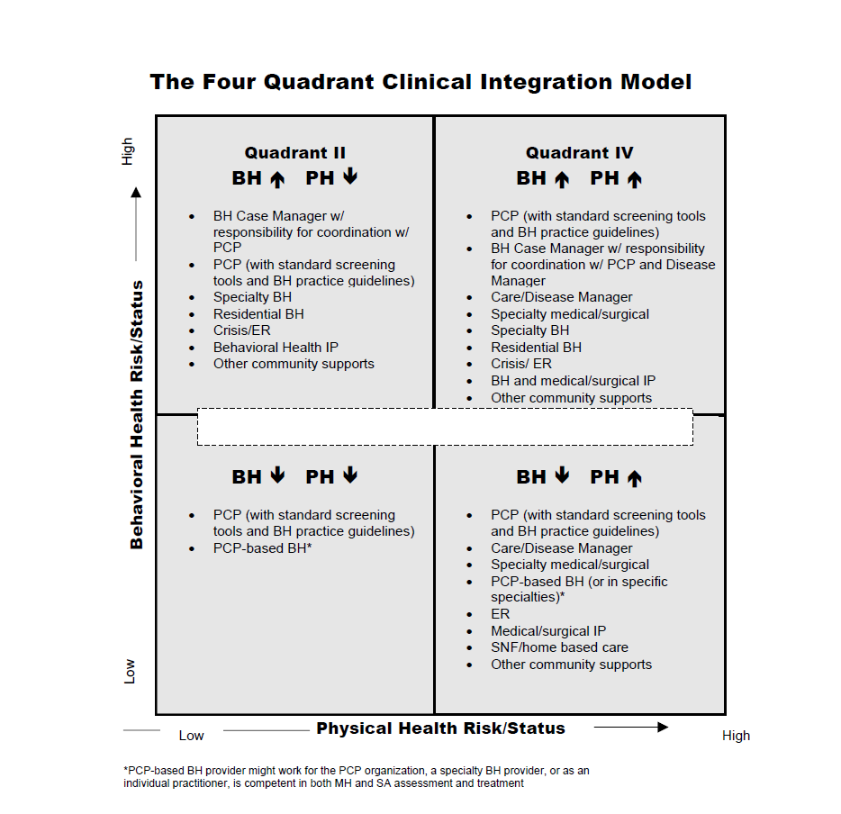
Mauer, B. J. (2006). Behavioral health/primary care integration: The four quadrant model and evidence
based-practices. Rockville, MD: National Council for Community Behavioral Health.

Slide 10
CSU Bakersfield - IBHC Field Practicum Project
4 students (1 student receiving CSWE stipend; 1 student receiving CalSWEC MH stipend)
1 student at Kern Medical Center
3 students at Clinical Sierra Vista
All students completed Advanced Practice Course in Integrated Behavioral Health Care - Fall 2013
All students currently in Advanced Social Policy, focus on ACA/IBHC

Slide 11

Jennifer - Kern Medical Center (Quadrant IV)
KMC: Community hospital, comprehensive inpatient and outpatient services (urban)
Rotation practicum model:
Family Practice Clinic
Immunology Clinic
Internal Medicine Clinic (start up)
Focus on skills building in assessment, case planning, and intervention
Agency policy development also a focus

Slide 12
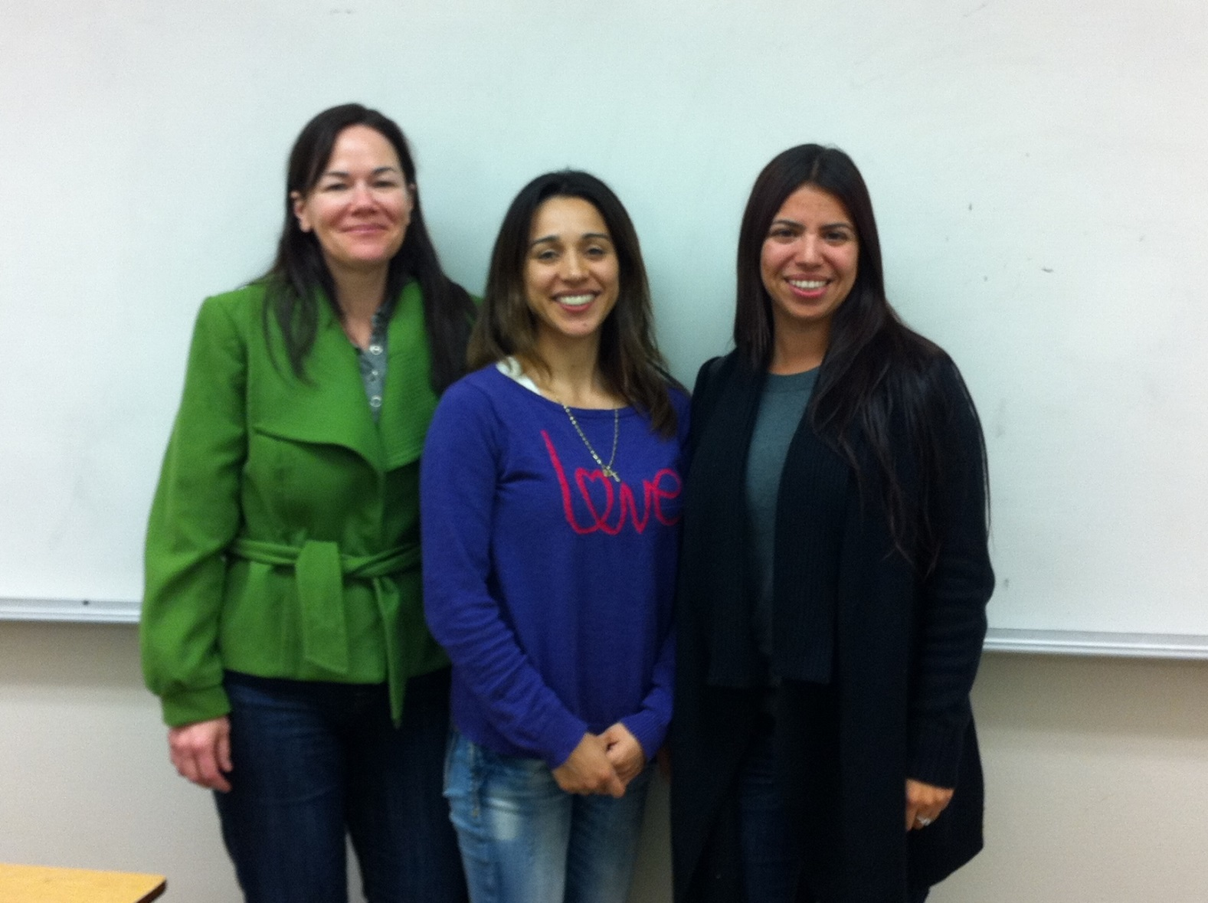
Lorre, Lupita, and Damaris @ Clinica Sierra Vista

Slide 13
Clinical Sierra Vista (FQHC)
3 students at different sites
Lorre: Bakersfield Community College, Student Health Clinic
Damaris: CSV Delano Behavioral Health Clinic
Lupita: CSV Delano, Community Health Center

Slide 14
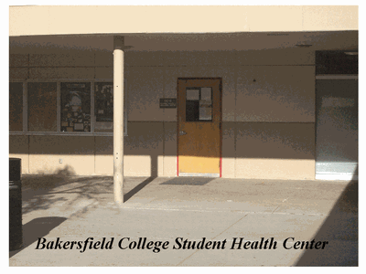
Lorre, Bakersfield College Student Health Center (Quadrant I)
Contract to provide IBHC to community college students (urban)
Staff: PCP, nurse, LCSW, MSW student intern
PCP dominant, first contact – referral to social work staff as needed
No standardized initial assessments
Focus on assessment and intervention

Slide 15
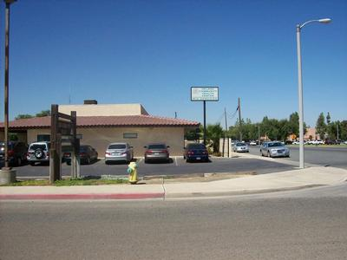
Damaris, CSV, Delano Behavioral Health Clinic (Quadrant 3)
Site 2-3 miles from Community Health Center (rural)
Staff: Behavioral health therapists, substance abuse counselors, psychiatrist, nurse
Higher level of behavioral
health care
Focus on assessment and
intervention
Notes:
Persons seen – varied, from sexual dysfunction, depression, anxiety, couples

Slide 16
Lupita, CSV Delano Community Health Center (Quadrant II)
Federally Qualified Health Center, rural
Staff: PCP, nurse, social workers (on site BH/SA)
All persons served are screened
Possible issues flagged and seen by BH staff (warm handoff)
Focus on assessment, psycho-education, crisis management, suicide assessments, brief intervention

Slide 17
Student Experiences
“Social workers are a vital component of integrated teams. . . They are able to address disparities and inefficiencies in the healthcare system.”
“We know the role we, as social workers, can play at an integrated site, but there is a need for training of other health professionals.”
“When we are able to do a warm hand-off at the Center, the outcomes are good.”

Slide 18
California State University, Chico -Innovative Models of Field Practicum
Patty Hunter, MSW, LCSW

Slide 19
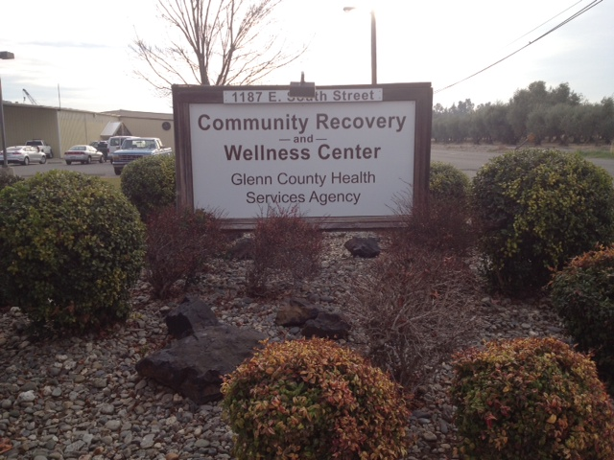
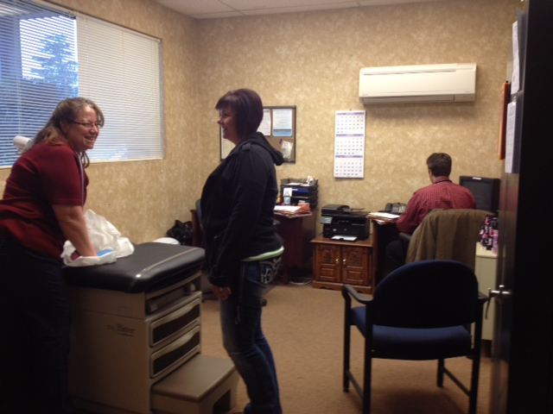

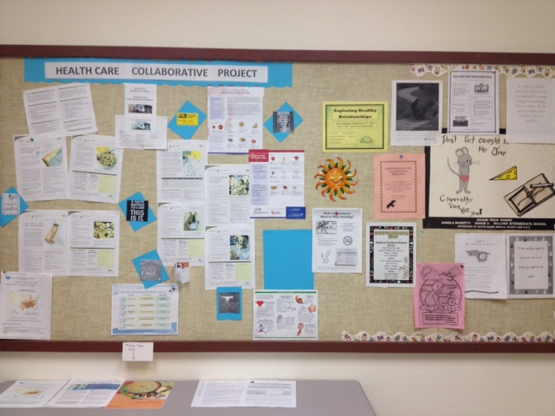
Integrated Behavioral Healthcare

Slide 20
CSU, Chico
1 MSW Student – Ellen Prose
Placement: Glenn County Health Care Collaborative
SAMSHA Wellness model focuses on eight dimensions:
Emotional
Environmental
Financial
Intellectual
Occupational
Physical
Social
Spiritual

Slide 21
The Vision
To serve persons with serious mental illness in the areas of health, wellness and recovery through the development of a person-centered health care home

Slide 22
Health Care Provider Partner
Nurse Practitioner
Nurse Care Manager
Psychiatrist
Mental Health Staff
Client Coaches
Youth Peer Mentors

Slide 23
Other Innovative placements
California Senior Legislature – Intergenerational opportunity to work with CSL representatives to develop legislative proposals to address needs of older adults
Community Time Bank-
Students have the opportunity to work with a time bank, a local effort to give and receive resources. Community outreach, coordinating exchanges, facilitate groups
Notes:
HPPAE programs provide students the opportunity to do rotations during their placements

Slide 24
Preferred Skill Sets for Integrated Healthcare
Engagement Skills – relationship building, listening
Interprofessional Teambuilding
Assessment, screening, care management, health promotion, health self- management
Knowledge of Behavioral Health and substance abuse, trauma
Medical terminology
Assertiveness
Evaluation – Process improvement
Notes:
Interprofessional Teambuilding – willingness to educate other disciplines about what social workers do and willingness to understand how other disciplines are trained, clearly defined roles and boundaries, willingness to consider each other’s expertise and work together
Assertiveness – need to be comfortable putting a voice to insuring the client/consumer is a valued member of the team

Slide 25
Future Considerations
Important to Pay attention to how your discipline is perceived
Some training needs to occur outside of our discipline
Need to understand the culture of other disciplines
Notes:
Pay attention to how your discipline is perceived, this will provide clues to where skill development needs to occur (Example: social workers need to know more about process improvement, marketing, database analysis)
Need to embrace the idea that some of our training needs to occur outside of our discipline

