Slide 1
Information design for the human brain
NICAR 2016, Denver,
Friday, March 11
Peter Aldhous
@paldhous

Slide 2
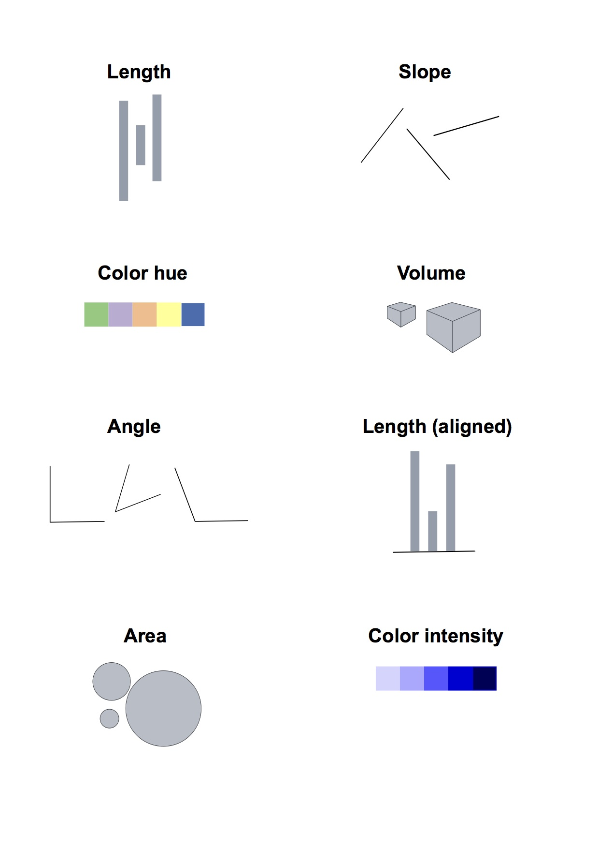
Visualization: encoding data by visual cues
Notes:
Whenever we visualize, we are encoding data using visual cues, or “mapping” data onto variation in size, shape or color, and so on. There are various ways of doing this, as this primer illustrates:

Slide 3
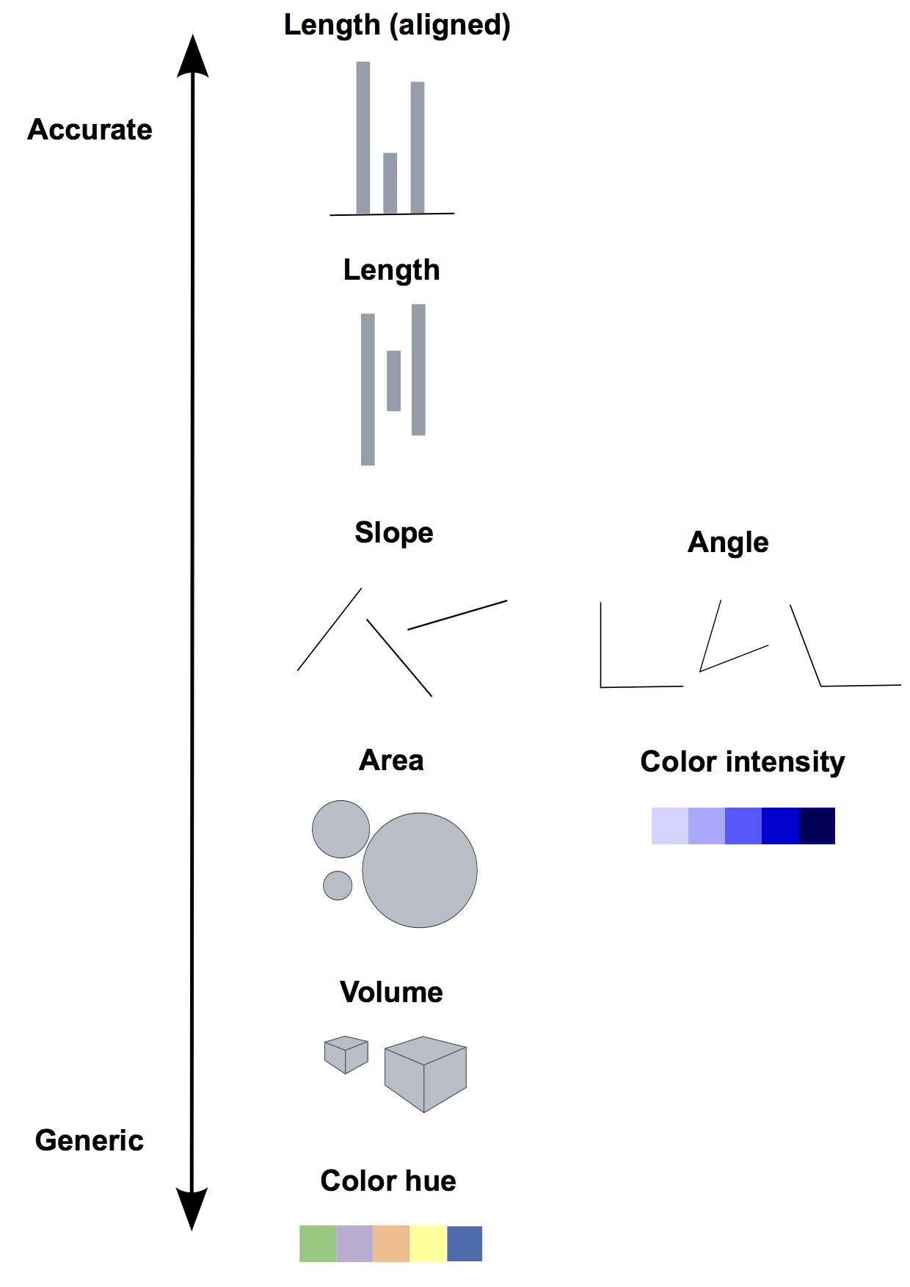
Our brains do not treat those cues equally!
Notes:
These cues are not created equal, however. In the mid-1980s, statisticians William Cleveland and Robert McGill ran some experiments with human volunteers, measuring how accurately they were able to perceive the quantitative information encoded by different cues. This is what they found:
This perceptual hierarchy of visual cues is very important. When making comparisons with continuous variables, aim to use cues near the top of the scale wherever possible.
That doesn’t mean the other possibilities are always to be avoided in visualization. Indeed, as we’ve already noted, color hue can a good way of encoding categorical data. The human brain is particularly good at recognizing patterns and differences. This means that variations in color, shape and orientation, while poor for accurately encoding the precise value of continuous variables, can be good choices for representing categorical data.
You can also combine different visual cues into the same graphic to encode different variables. But always think about the main messages you are trying to impart, and where you can use visual cues near the top of the visual hierarchy to communicate that message most effectively.
3

Slide 4
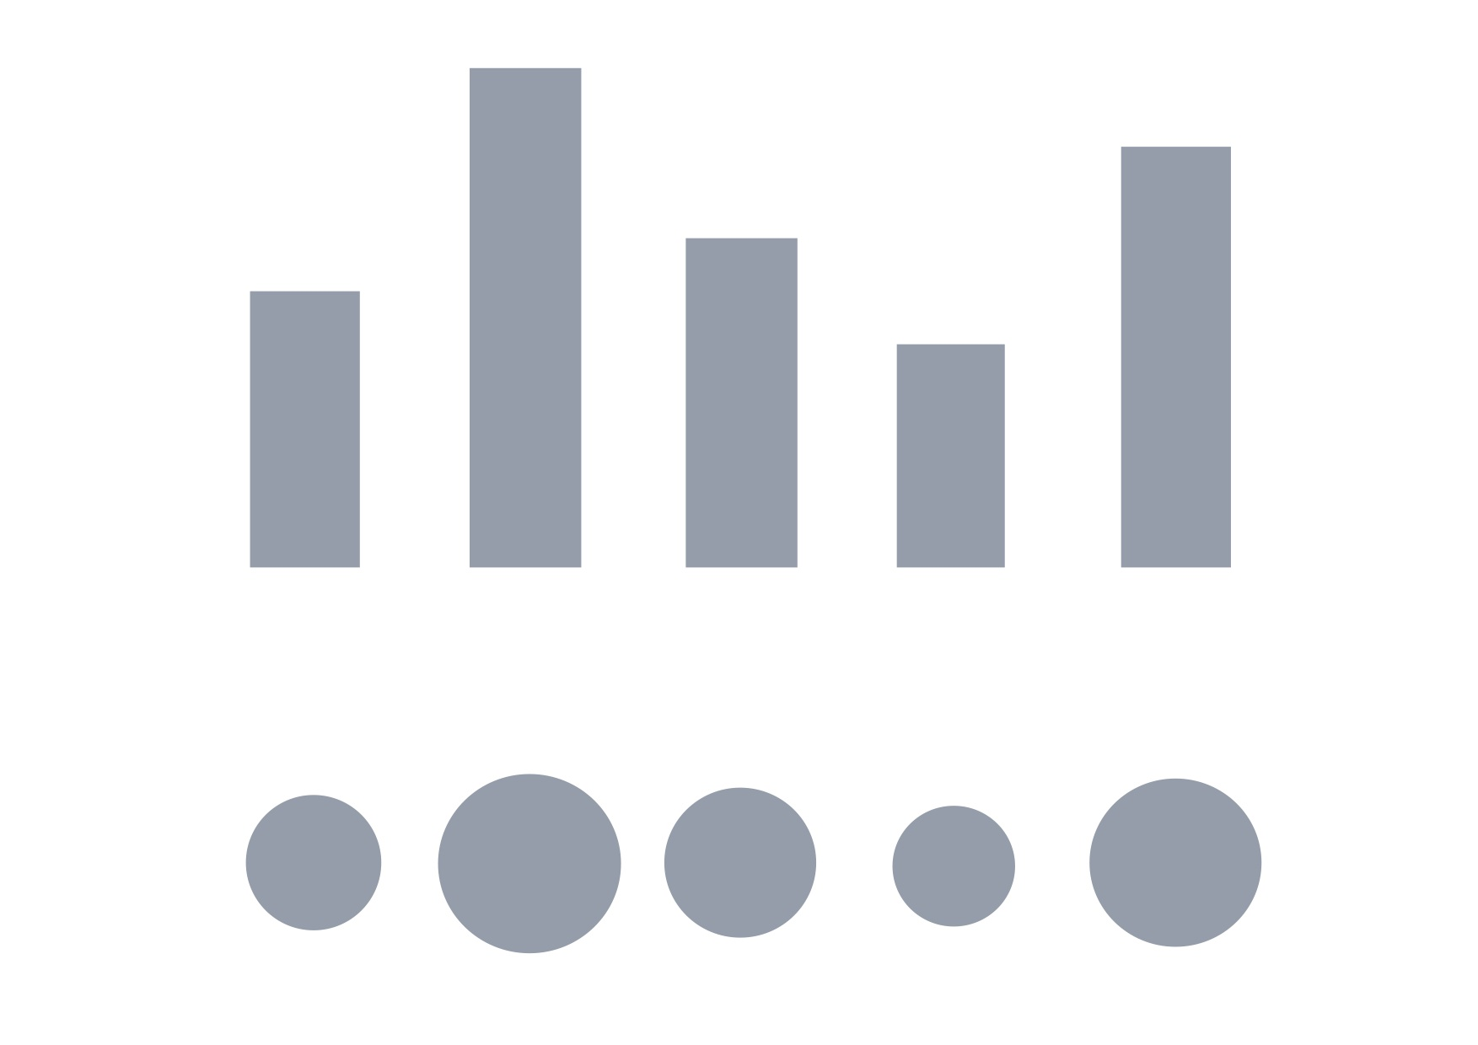
Design for the human brain!
Notes:
To witness this perceptual hierarchy, look at these visual encodings of the same simple dataset. Do the bars, or the circles, make it easiest to “read” the numerical values that are encoded?
4

Slide 5
But it doesn’t mean
everything is a bar chart

Slide 6
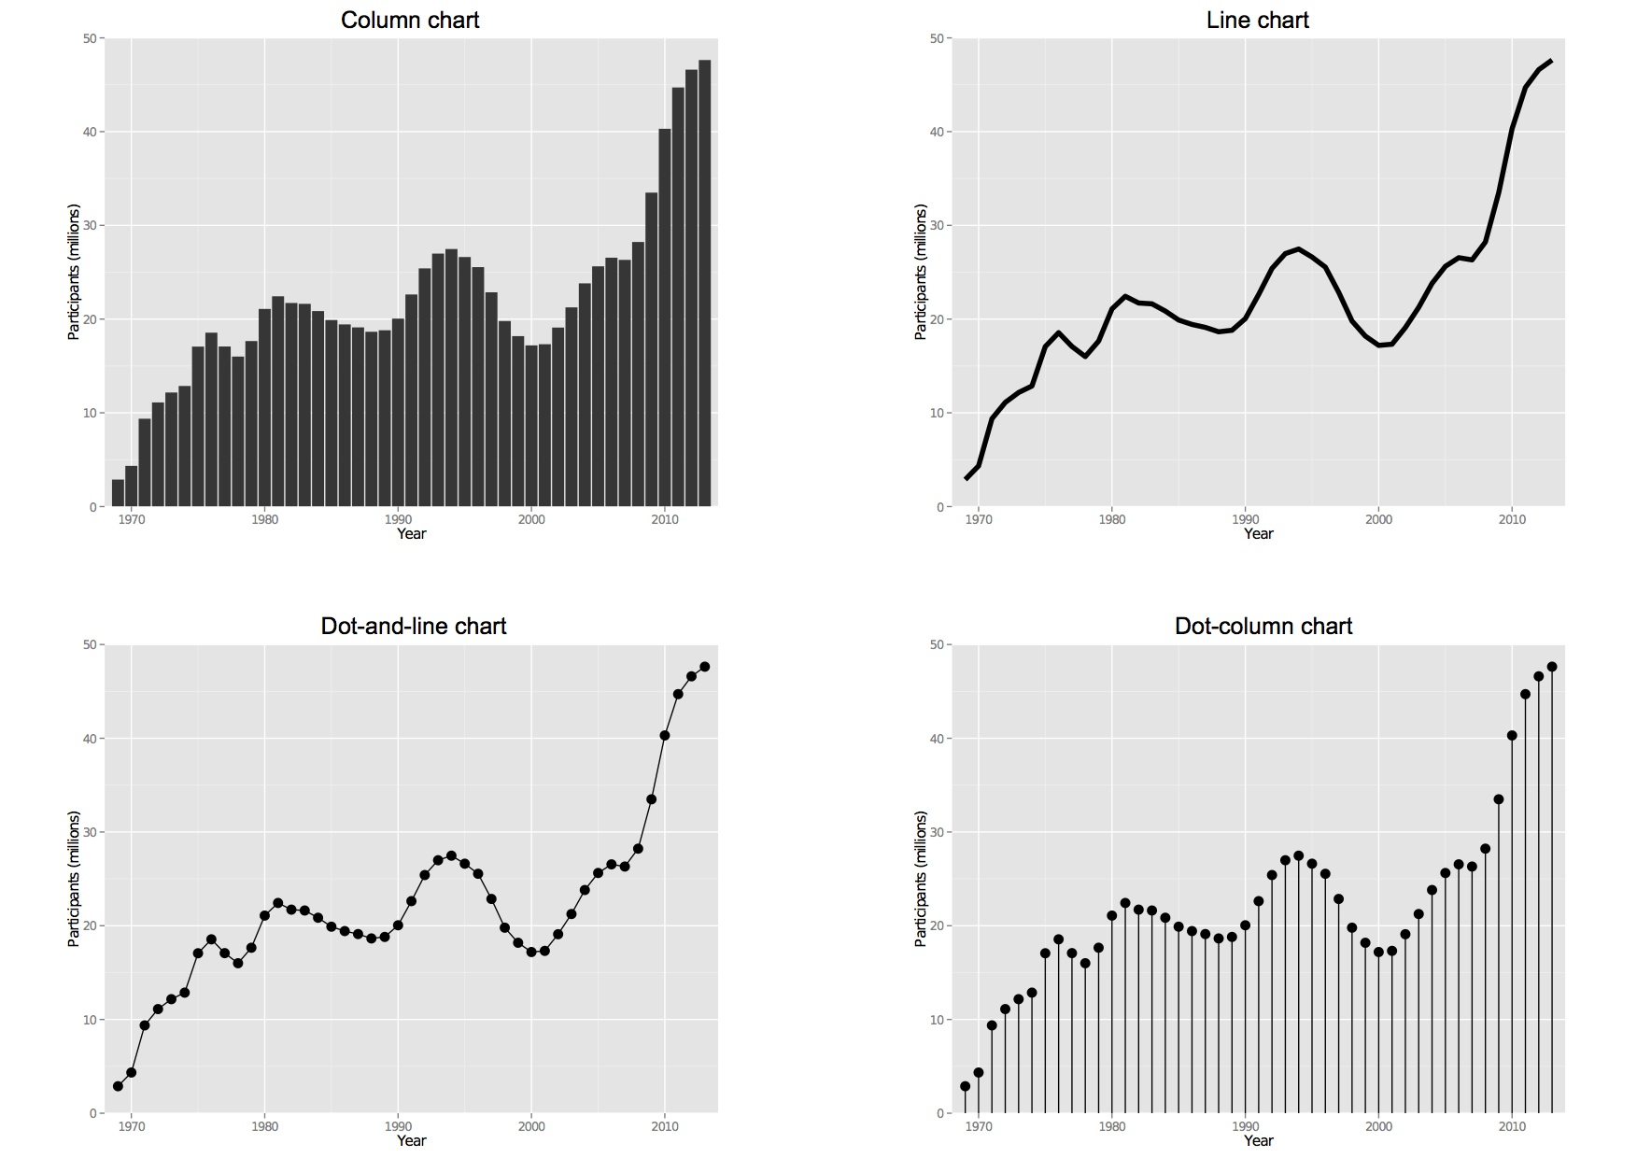
Comparisons: change over time
Notes:
Visualizing change over time is a very common task in journalism.
Bar or column charts can be used to illustrate change over time, but there are other possibilities, as shown in these charts showing participation in the federal government’s food stamps nutritional assistance program, from 1969 to 2014.
Each of these charts communicates the same basic information with a subtly different emphasis. The column chart emphasizes each year as a discrete point in time, while the line chart focuses on the overall trend or trajectory. The dot-and-line chart is a compromise between these two approaches, showing the trend while also drawing attention to the value for each year. (The dot-column or lollipop chart is an unusual variant of a column chart, included here to show another possible design approach.)

Slide 7
Case study: Immunization in
California kindergartens

Slide 8
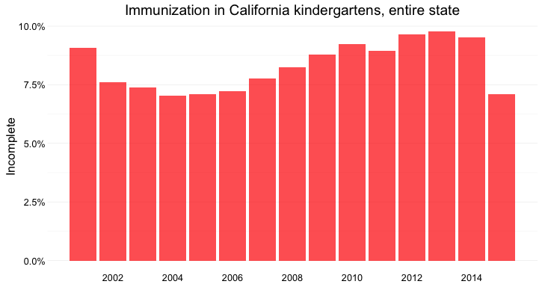
Length on aligned scale

Slide 9
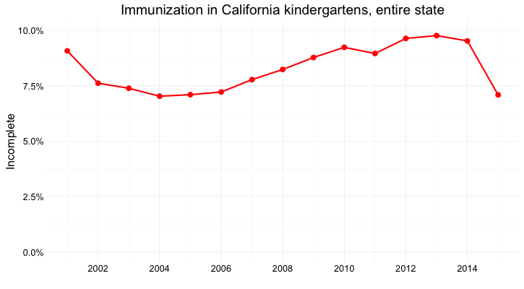
Position on aligned scale + slope

Slide 10
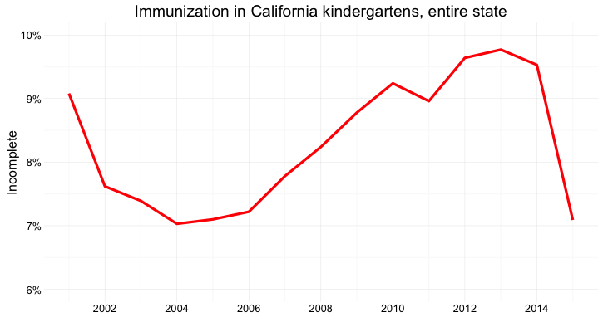
Slope, note the y axis scale

Slide 11
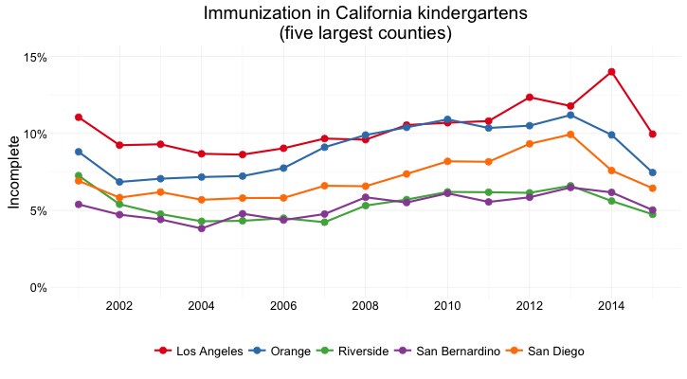
Several counties
Notes:
Position on an aligned scale and slope

Slide 12
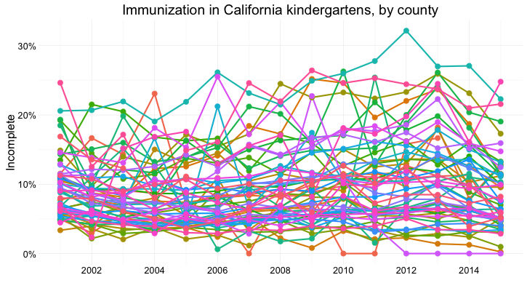
All the counties: Too many lines, too few colors
Notes:
Too many lines, too few colors!

Slide 13
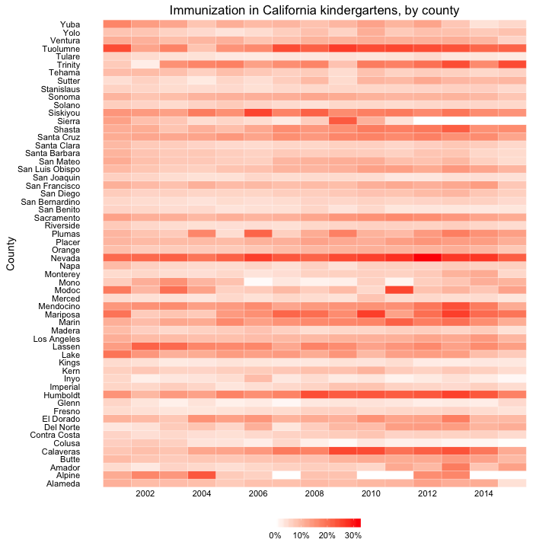
A solution:
color intensity

Slide 14
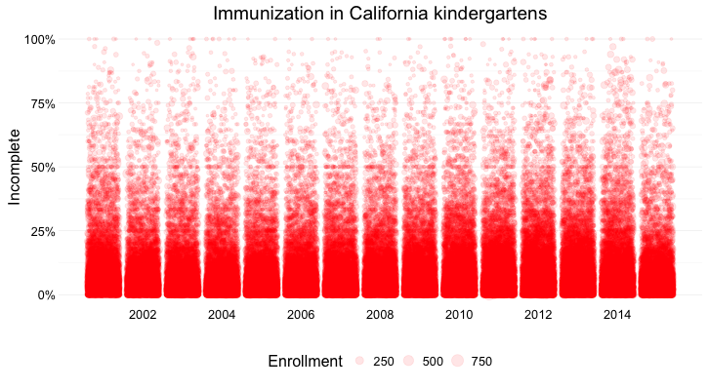
All the schools: Position on aligned scale + area
Notes:
You can also combine different visual cues into the same graphic to encode different variables. But always think about the main messages you are trying to impart, and where you can use visual cues near the top of the visual hierarchy to communicate that message most effectively. The main message here is about the distribution of incomplete rates across schools. The enrollment of each school is secondary, but can be added using area.

Slide 15
Moving up and down the hierarchy
Notes:
In the previous examples, we’ve moved up and down the hierarchy to visualize the same data, aggregated at different levels.
15

Slide 16
What type of chart should I use?
Notes:
This is a frequently asked question, and the best answer is: Experiment with different charts, to see which works best to liberate the story in your data, thinking about the perceptual hierarchy of visual cues.
Some visualization software — notably Tableau Public — will suggest chart types for you to try. However, it is good to have a basic framework to help you prioritize particular chart types for particular visualization tasks.

Slide 17
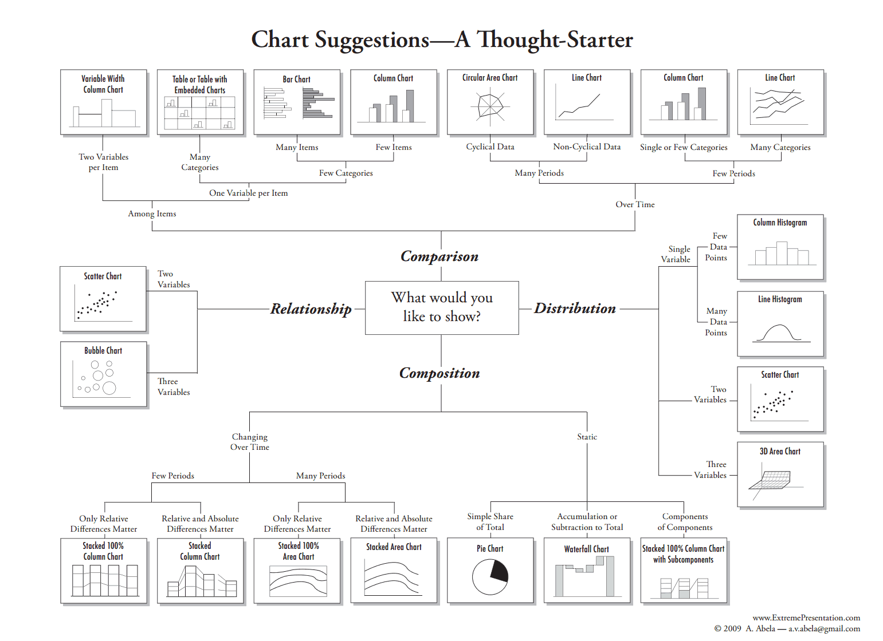
Notes:
Although it is far from comprehensive, and makes some specific chart suggestions that I would not personally endorse, the “chart of charts” published on the Extreme Presentation Method website provides a useful framework by providing answers to the question: “What would you like to show?”
It considers four possible answers: the distribution of a single continuous variable; the relationship between two continuous variables; comparisons between items for a single continuous variable; and composition, or how parts make up the whole.
We’ve already discussed distibutions, so let’s now consider the others one by one:
17

Slide 18
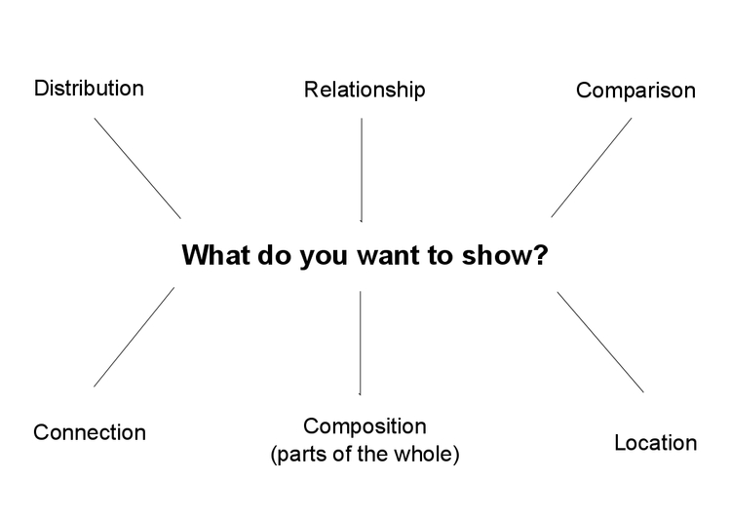
Notes:
I’ll add a couple more answers location (maps) and connection (network graphs).

Slide 19
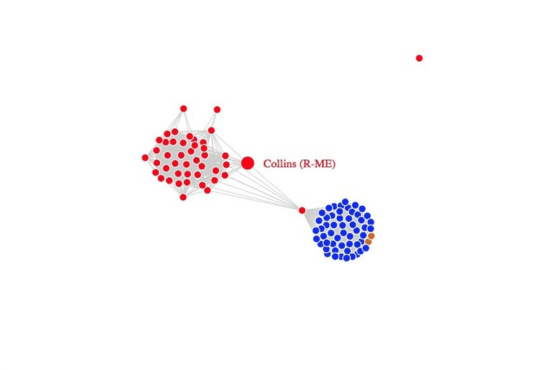
Connection

Slide 20
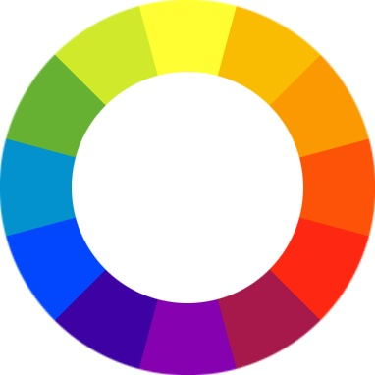
The color wheel
Notes:
It helps to think about colors in terms of the color wheel, which places colors that “harmonize” well together side by side, and arranges those that have strong visual contrast — blue and orange, for instance — at opposite sides of the circle:

Slide 21
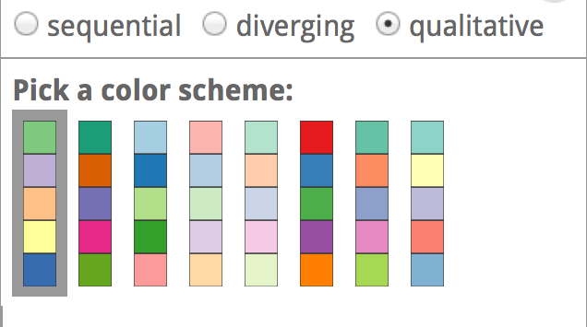
Using color: fit to your data
Notes:
When encoding data with color, take care to fit the color scheme to your data, and the story you’re aiming to tell. As we have already seen, color is often used to encode the values of categorical data. Here you want to use “qualitative” color schemes, where the aim is to pick colors that will be maximally distinctive, as widely spread around the color wheel as possible:
21

Slide 22
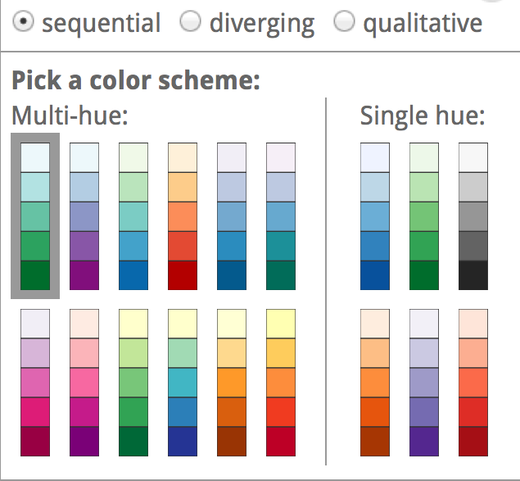
Using color: fit to your data
Notes:
When using color to encode continuous data, it usually makes sense to use increasing intensity, or saturation of color to indicate larger values. These are called “sequential” color schemes:
22

Slide 23
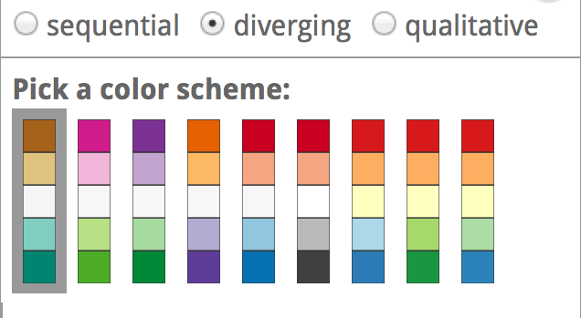
Using color: fit to your data
Notes:
In some circumstances, you may have data that has positive and negative values, or which highlights a division from a central value. Here, you should use a “diverging” color scheme, which will usually have two colors reasonably well separated on the color wheel as their end points, and cycle through a neutral color in the middle:
23

Slide 24
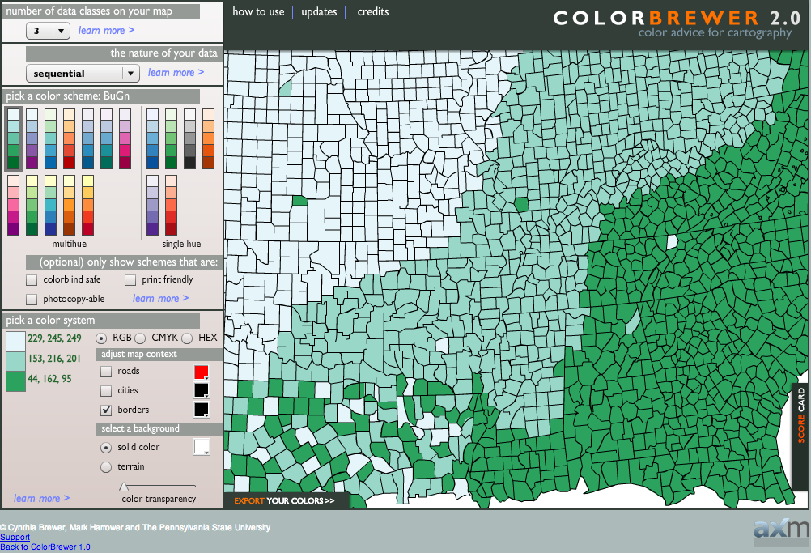
ColorBrewer is your friend
Notes:
Choosing color schemes is a complex science and art, but there is no need to “roll your own” for every graphic you make. Many visualization tools include suggested color palettes, and I often make use of the website from which the examples above were taken, called ColorBrewer. Orginally designed for maps, but useful for charts in general, these color schemes have been rigorously tested to be maximally informative.
24

Slide 25
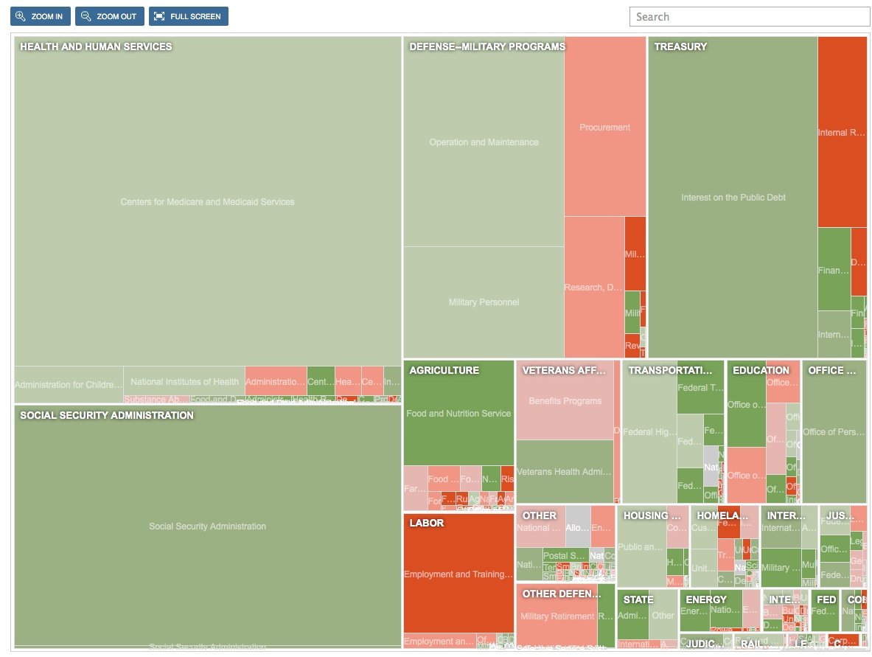
… and will help you avoid this
Notes:
Avoid color schemes that exclude! (Red-green colorblindness affects more than 5% of men.)
25

Slide 26
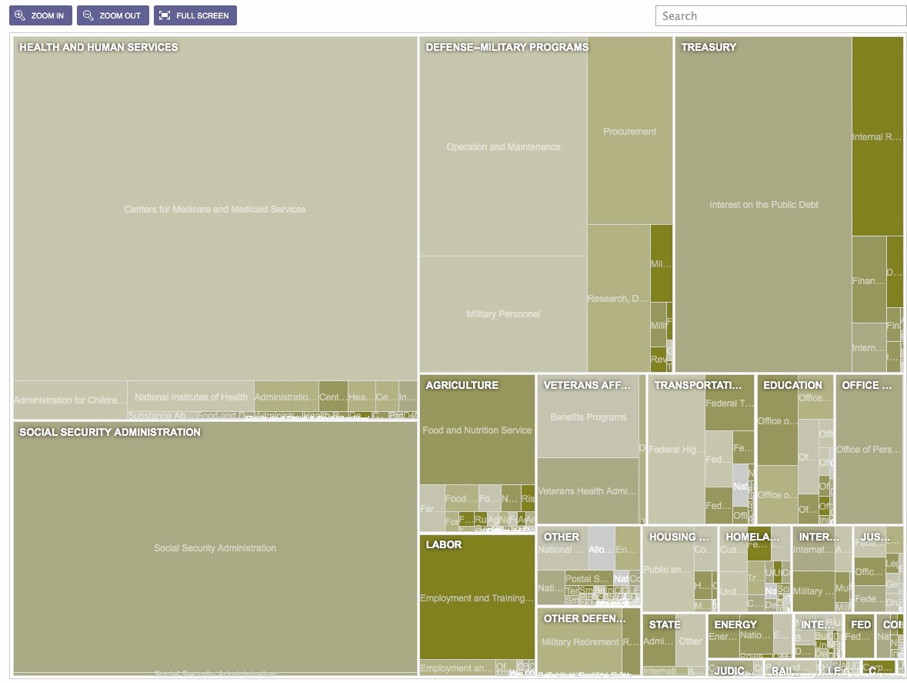
… and will help you avoid this
Notes:
Avoid color schemes that exclude! (Red-green colorblindness affects more than 5% of men.)

Slide 27
Information design for the human brain
NICAR 2016, Denver,
Friday, March 11
Peter Aldhous
@paldhous

