Slide 1
Predictive Demand Forecasting Using Data Science
Data Science Capstone Project
Research Report / Whitepaper Presentation

Slide 2
1. Problem Statement
Organizations need reliable demand forecasts to plan inventory, procurement and operations.
Historical demand contains trend, short-term dependence and effects from marketing events and holidays.
Manual forecasting can be inconsistent and difficult to scale.
This project develops and compares predictive models for short-term demand forecasting.

Slide 3
2. Research Question & Objectives
Research question: How accurately can historical demand patterns be used to forecast future daily demand?
Objective 1: Clean and explore historical demand data.
Objective 2: Identify temporal patterns and external-event effects.
Objective 3: Build and compare baseline, ARIMA and Random Forest models.
Objective 4: Evaluate models using MAE, RMSE and MAPE and translate findings into business decisions.

Slide 4
3. Dataset Description
Records: 30 daily observations (2026-06-01 to 2026-06-30).
Variables: date, demand, marketing_event and holiday.
Demand statistics: mean = 142.1, minimum = 118, maximum = 174.
The dataset is suitable for demonstrating an end-to-end forecasting workflow, but its small size limits generalization.

Slide 5
4. Methodology
Data ingestion → validation → chronological sorting → exploratory analysis
Feature engineering: previous-day demand, 7-day lag and 7-day rolling mean
Time-based train/test split: final 6 days reserved for out-of-sample evaluation
Models: previous-day baseline, ARIMA(1,1,1), Random Forest
Evaluation: MAE, RMSE and MAPE
Select the model with the lowest forecasting error while considering interpretability and deployment needs.

Slide 6
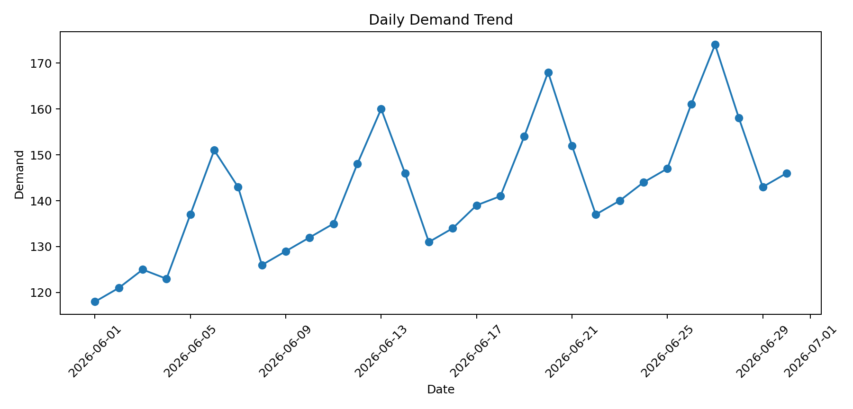
5. Exploratory Data Analysis

Slide 7
6. Predictive Modeling
Baseline: uses the most recent observed demand as the next-day estimate.
ARIMA(1,1,1): models autoregressive structure, differencing and moving-average error.
Random Forest: learns nonlinear relationships from lagged demand, rolling demand, marketing events and holidays.
Chronological validation is used to avoid leakage from future observations.

Slide 8
7. Model Performance
Model | MAE | RMSE | MAPE
Previous-Day Baseline | 9.71 | 11.21 | 6.24%
ARIMA(1,1,1) | 11.58 | 15.76 | 7.13%
Random Forest | 2.99 | 4.28 | 1.87%
Best model on the 6-day holdout by MAE: Random Forest (MAE 2.99).

Slide 9
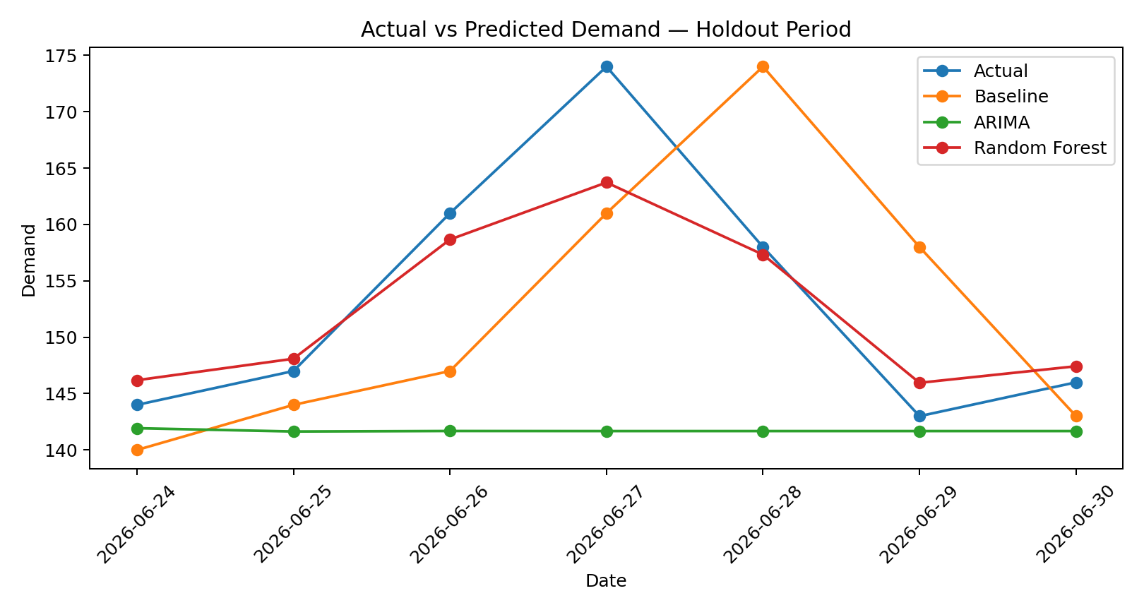
8. Forecast Results

Slide 10
9. Business Implications
Inventory: forecast demand to reduce excess stock and stockouts.
Procurement: use forecasts to schedule replenishment and supplier orders.
Operations: anticipate demand peaks and allocate resources earlier.
Marketing: event indicators can help quantify demand changes associated with campaigns.
Decision support: forecasts should be combined with business judgment and updated as new observations arrive.

Slide 11
10. Limitations & Future Scope
Only 30 observations are available, so results should be treated as a proof of concept.
Longer historical data would support stronger seasonality analysis and more robust validation.
Future work: SARIMA/Prophet/gradient boosting, rolling cross-validation and confidence intervals.
Additional variables such as price, promotions, weather and product category could improve forecasting.

Slide 12
11. Conclusion
The project demonstrates a complete predictive modeling workflow from raw data to business insight.
Three approaches were evaluated using an out-of-sample time-based holdout.
Random Forest achieved the lowest MAE on this dataset.
The solution can support short-term planning, while larger datasets and richer features are recommended for production use.

Slide 13
12. Repository & Deliverables
GitHub repository: dataset + Jupyter notebook/code + results + README + final report PDF.
Research report: 8–12 pages covering abstract, literature background, methodology, modeling, results and business implications.
Expected proof: formal Data Science Research Report PDF and complete GitHub Code Repository.
Suggested repository name: predictive-demand-forecasting-capstone

Slide 14
References
Box, G. E. P., Jenkins, G. M., Reinsel, G. C., & Ljung, G. M. Time Series Analysis: Forecasting and Control.
Hyndman, R. J., & Athanasopoulos, G. Forecasting: Principles and Practice.
Pedregosa et al. (2011). Scikit-learn: Machine Learning in Python. Journal of Machine Learning Research.
Statsmodels documentation — time-series and ARIMA modeling.
Scikit-learn documentation — Random Forest regression and model evaluation.

