Slide 1

Progress Presentation 3
Development of a GUI Based Control Scheme for Ball-on-Plate System
K Akanksh Pratheek Reddy
Reg. No.: 140907050
Sec. : B , Roll No. : 6
Under The Guidance Of
Dr. K Prabhakar Nayak Mr. Mukund Kumar Menon
Professor Asst. Professor Sr. Scale
Department of ECE Department of ICE
MIT, Manipal MIT, Manipal
Department of Electronics and Communication Engineering, MIT, Manipal

Slide 2

Contents
Content | S. Number
Computer Vision – Time Dependency | 3
Controller Simulation | 4
Misc. Progress | 11
Summary | 12
References | 13
Department of Electronics and Communication Engineering, MIT, Manipal

Slide 3
Computer Vision – Time Dep.
Frame Rate – 30 fps → 0.033 sec per frame
Average = 0.36 sec/25 frames → 0.014 sec/frame
Sufficient Overhead
Trial No. | Processing Time per 25 frames
1 | 0.36 seconds
2 | 0.40 seconds
3 | 0.42 seconds
4 | 0.32 seconds
5 | 0.40 seconds
6 | 0.36 seconds
7 | 0.36 seconds
8 | 0.38 seconds
9 | 0.32 seconds
10 | 0.34 seconds
Department of Electronics and Communication Engineering, MIT, Manipal

Slide 4
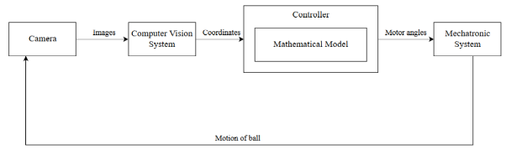
Controller Simulation
Fig. 1 : Control Block Diagram
Mathematical Model – Linearized, Decoupled equations [1]
Open Loop Unstable
Department of Electronics and Communication Engineering, MIT, Manipal

Slide 5
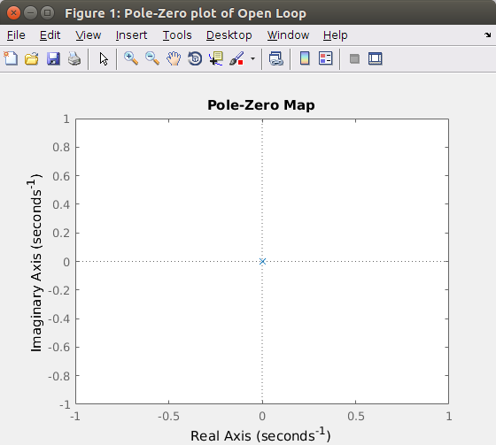
Controller Simulation
Fig. 2 : Two Poles at Center - Unstable
Department of Electronics and Communication Engineering, MIT, Manipal

Slide 6
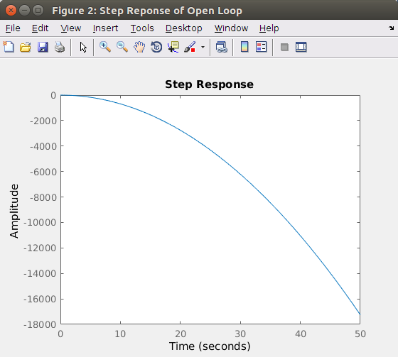
Controller Simulation
Fig. 3 : Step Response – Highly Unstable
Department of Electronics and Communication Engineering, MIT, Manipal

Slide 7
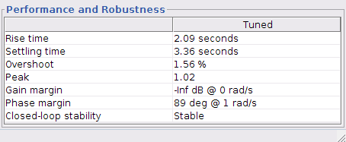
Controller Simulation
First, Major Controller – Classical PD
Two controllers running independently for each axis
Design Criteria: [2]
Settling Time of less than 5 sec
Overshoot less than 5%
Fig. 4 : Design Criteria - Achieved
Department of Electronics and Communication Engineering, MIT, Manipal

Slide 8
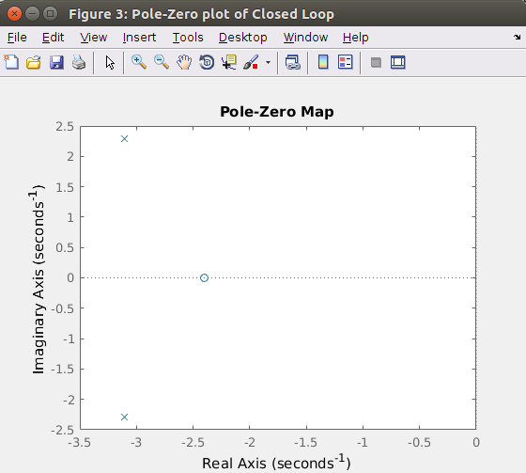
Controller Simulation
Fig. 5 : Two Poles in left half plane - Stable
Department of Electronics and Communication Engineering, MIT, Manipal

Slide 9
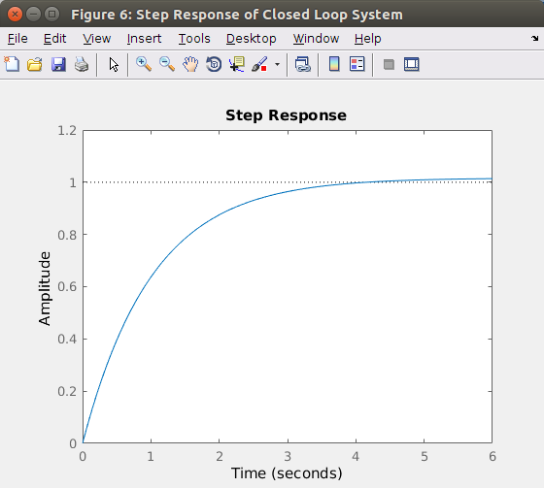
Controller Simulation
Fig. 6 : Step Response – Stable
Department of Electronics and Communication Engineering, MIT, Manipal

Slide 10
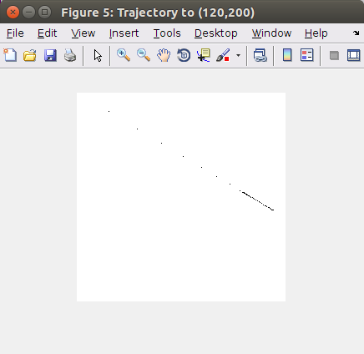
Controller Simulation
Fig. 2 : Trajectory to (120,200) from (0,0)
Department of Electronics and Communication Engineering, MIT, Manipal

Slide 11
Misc. Progress
Further tuning of Mechanical System
Servo Precision Testing
Accurate mounting of camera
Coordination of Plate/Actuator dynamics and sensing
Rewiring of Power Supply – More Rugged
Department of Electronics and Communication Engineering, MIT, Manipal

Slide 12
Summary
Mechanical fabrication completed, tuned and Extensively tested
Computer vision algorithm implemented and tested
Mathematical modeling done
PD Controller designed and Simulated
Miscellaneous bridge tasks completed
Implementation of control in Hardware ongoing
Department of Electronics and Communication Engineering, MIT, Manipal

Slide 13
References
[1] M. Nokhbeh and D. Khashabi, “Modelling and Control of Ball-Plate System”, Amirkabir Institute of Technology, 2011
[2] A. Kassem, C. Albitar and H. Haddad, “Comparision Between Different Methods of Control of Ball and Plate System with 6DOF Stewart Platform”, in International Federation of Automatic Control, Elsevier, 2015
[3]K. Kyu Lee, G. Btz, and D. Wollherr, “Basketball robot: Ball on-plate with pure haptic information," in IEEE International Conference on Robotics and Automation, May 2008
Department of Electronics and Communication Engineering, MIT, Manipal

