Slide 1
Can AI Average Two
Optimization Ideas?
IDEA A
MIX
A controlled pilot study of DiffusionGemma representations for Project Darwin
IDEA B
Research communication package • September 18, 2026

Slide 2
The accessible version: what are we trying to do?
1 • Start with two useful ideas
2 • Combine their numbers
3 • Ask for one new idea
Example A: use a bounded counting sort.
Example B: compile custom loops with Numba.
A language model represents text using large arrays of numbers. We tested whether averaging or mixing those arrays preserves both meanings.
Success means the generated idea is coherent, relevant, and clearly uses both parent techniques—not merely fluent text.
Pilot evidence • September 18, 2026 • research design summarized from experiments/001–013/spec.json

Slide 3
How diffusion text generation differs
Simple conceptual model—not a claim about every implementation detail
Prompt
Continuous state
Token projection
Denoising
describes the task
→
numbers carry contextual information
→
each position becomes a token choice
→
tokens are refined into text
The key risk: averaging can preserve numbers without preserving a valid sequence-level meaning.
Pilot evidence • September 18, 2026 • experiments/005-projection-geometry-diagnostic | experiments/006-top-candidate-projection

Slide 4
Research question, hypothesis, and success rule
Research question
Hypothesis
Can prompt-conditioned numerical representations from two optimization ideas be combined so the model generates one coherent idea retaining both parents?
Careful alignment plus interpolation or logit mixing may create a controllable path between parent concepts.
Success
Control gate
Both parent indicator groups present; coherent task-relevant idea; no prohibited shortcut.
Do not interpret a midpoint unless both endpoints first reproduce their own parent concepts.
Pilot evidence • September 18, 2026 • experiments/004/spec.json | experiments/009/spec.json

Slide 5
Controlled experimental pipeline
Freeze parents
Align prompts
Validate endpoints
Manipulate
Generate
Score
named techniques
same layout
A and B controls
states / tokens / logits
fixed seeds + steps
transparent indicators
→
→
→
→
→
Raw outputs, failures, hashes, seeds, model revision, and runtime are preserved in each experiment directory.
Pilot evidence • September 18, 2026 • experiments/001–013/results/results.json

Slide 6
Twelve experiments formed the diagnostic ladder
Experiment 013 then tested Sergiy's prompt-only follow-up
001 Code controls
002 Prompt controls
003 Specificity
004 Weight sweep
completed
completed
completed
completed
005 Geometry
006 Top candidates
007 Stochastic
008 Dual logits
completed
completed
completed
completed
009 Sorting replication
010 Endpoint repair
011 Nonsorting screen
012 Nonsorting composition
completed
completed
completed
completed
013 follow-up: complete parent records in one prompt, with no parent-derived canvas state.
Pilot evidence • September 18, 2026 • experiments/001–013

Slide 7
Experiments 001–003: controls changed the question
001 • Code states
002 • Prompt states
003 • Specificity
Parent techniques were recognizable, but all generated programs—including the mixture—were invalid Python.
Lesson: move first to shorter idea generation.
The model retained generic counting sort but lost NumPy, bincount, and repeat from Parent B.
Lesson: the midpoint was uninterpretable because an endpoint was weak.
An explicit source prompt recovered NumPy + bincount + repeat from 1 through 8 steps.
Lesson: prompt specificity is a causal control, not cosmetic wording.
Pilot evidence • September 18, 2026 • experiments/001/results/results.json | experiments/002/results/results.json | experiments/003/results/results.json

Slide 8
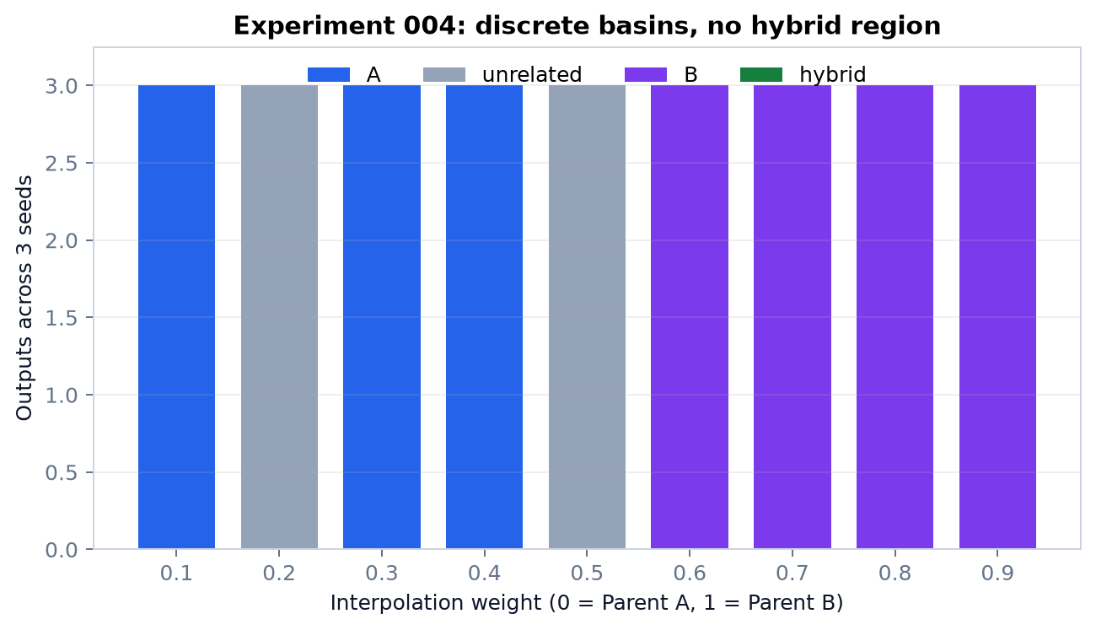
Experiment 004: a controlled sweep found no semantic bridge
Endpoints
Both parents passed across 3 seeds.
Intermediate weights
0/27 hybrids.
Interpretation
Categorical A-like, unrelated, and B-like regions—not a smooth compositional path.
Pilot evidence • September 18, 2026 • experiments/004-controlled-prompt-weight-sweep/results/results.json

Slide 9
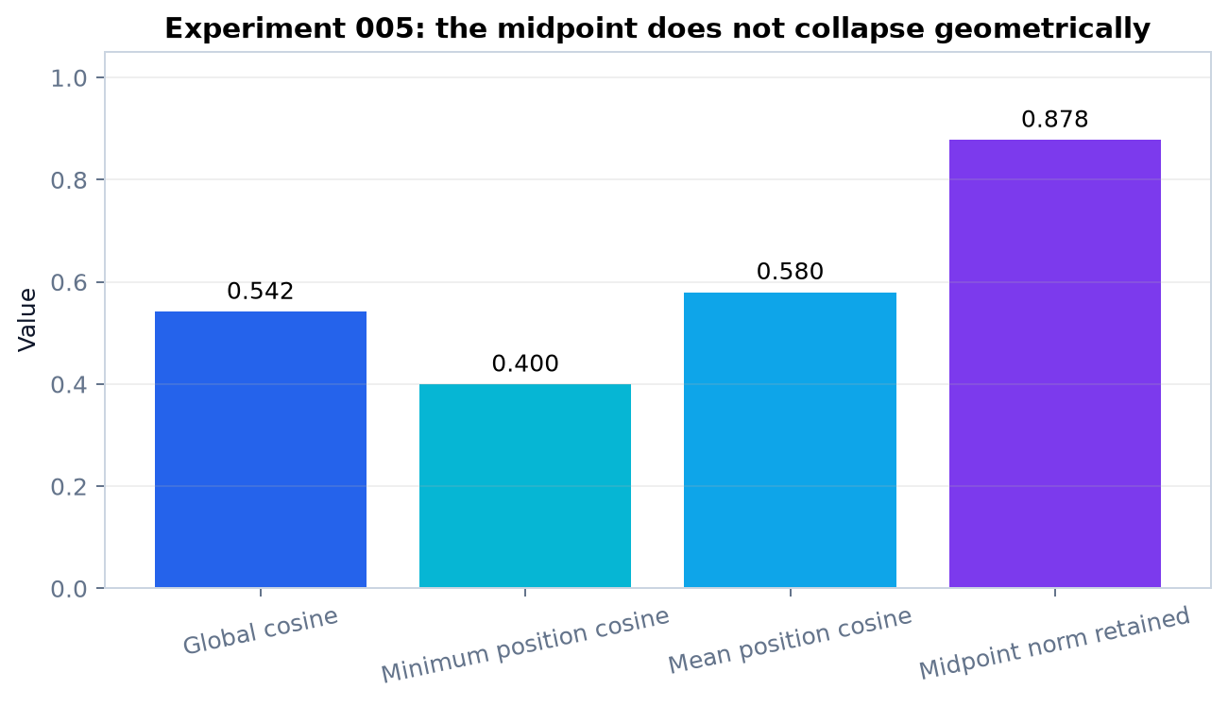
Experiment 005: vector cancellation was not the explanation
Positive similarity
Global cosine = 0.542.
No opposite positions
Negative position count = 0.
Strong retained magnitude
Midpoint retained 87.8% of mean parent norm.
Pilot evidence • September 18, 2026 • experiments/005-projection-geometry-diagnostic/results/results.json

Slide 10
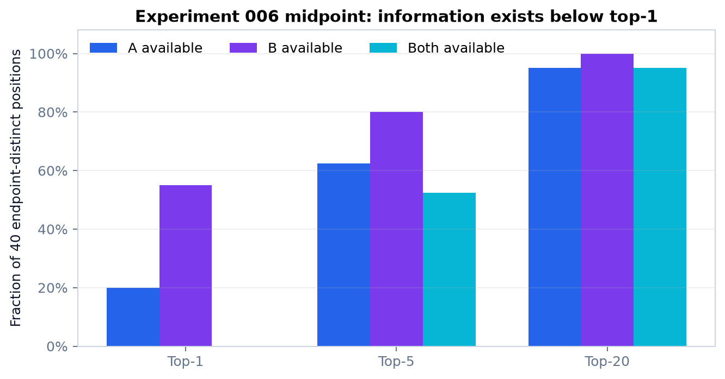
Experiment 006: the hard projection creates a patchwork
Top-1
No endpoint-distinct position had both alternatives available at rank 1.
Top-20
Both alternatives appeared at 95.0% of positions.
Likely bottleneck
Independent per-position argmax discards sequence-level combinations.
Pilot evidence • September 18, 2026 • experiments/006-top-candidate-projection/results/results.json

Slide 11
Experiment 007: stochastic top-20 sampling did not rescue meaning
0 / 15
Controls
Parent A and B endpoints passed at temperatures 0.5, 1.0, and 2.0.
midpoint hybrids
Intervention
Sample independently from temperature-scaled top-20 token candidates, then denoise for 8 steps.
Result
More token variety did not reconstruct a coherent combination of counting sort and Numba.
Pilot evidence • September 18, 2026 • experiments/007-stochastic-projection/results/results.json

Slide 12
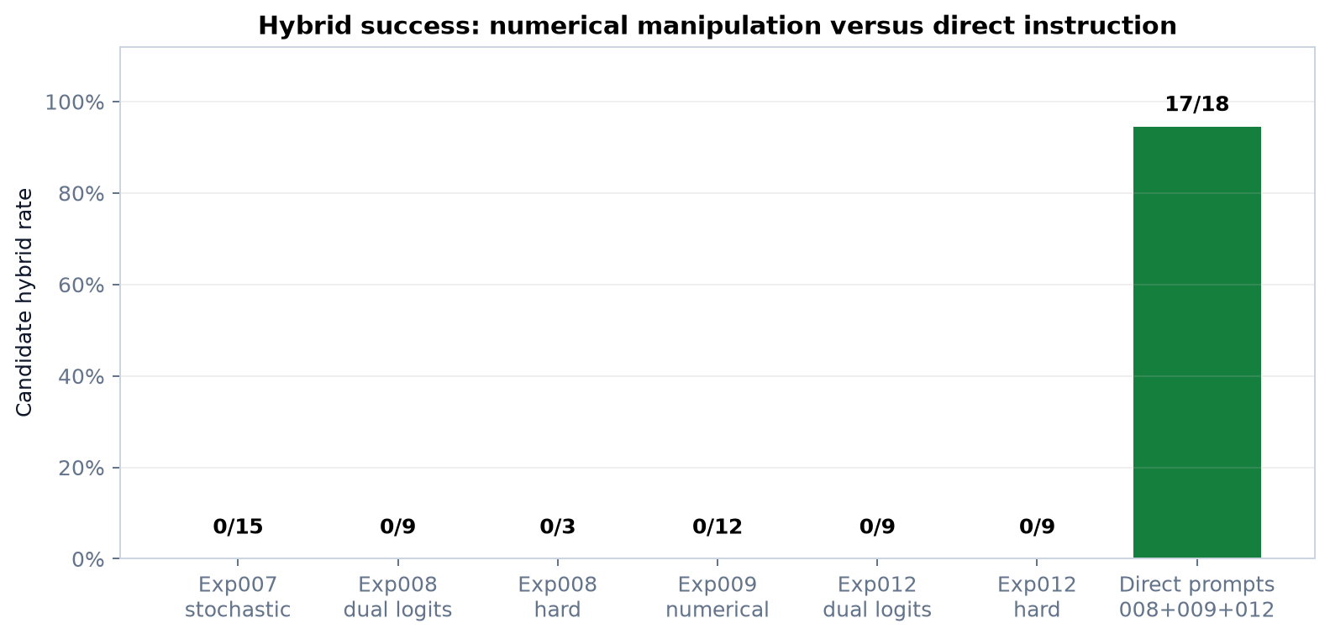
Experiment 008: mixing logits each denoising step still failed
Dual-logit intermediates
0/9 hybrids.
Hard midpoint
0/3 hybrids.
Direct diffusion prompt
3/3 hybrids.
The model could combine the ideas when told explicitly, but not through the tested numerical paths.
Pilot evidence • September 18, 2026 • experiments/008-dual-prompt-logit-mixing/results/results.json

Slide 13
Experiment 009: replication across pairs
Vectorized counting
Fast path + fallback
Parallel histogram
Endpoint gate: PASS
Numerical midpoints: 0/6
Direct prompts: 3/3
Endpoint gate: PASS
Numerical midpoints: 0/6
Direct prompts: 3/3
Endpoint gate: BLOCKED
Parent B failed 2/3 seeds. No midpoint inference was allowed.
Pilot evidence • September 18, 2026 • experiments/009-multi-pair-replication/results/results.json

Slide 14
Experiment 010: reproducibility passed; endpoint specificity did not
Deterministic reproduction
Strengthened Parent A
Strengthened Parent B
3/3 raw outputs reproduced canonically.
1/3 seeds retained all required groups.
0/3 seeds retained all required groups.
Therefore no midpoint was admissible.
Pilot evidence • September 18, 2026 • experiments/010-histogram-endpoint-specificity/results/results.json

Slide 15
Experiment 011: nonsorting endpoint screen
3 / 4
Passed
Blocked
Matrix: BLAS + tiling
Graph: deque BFS + CSR
Image: vectorization + batching
Regex + memory mapping
Compiled-regex endpoint passed only 1/3 seeds, so the pair was excluded from midpoint testing.
pairs passed both endpoints
Pilot evidence • September 18, 2026 • experiments/011-nonsorting-endpoint-screen/results/results.json

Slide 16
Experiment 012: the negative result replicated beyond sorting
Matrix multiplication
Sparse graph BFS
Image normalization
Dual logit: 0/3
Hard midpoint: 0/3
Direct prompt: 3/3 strict
Direct prompts combined BLAS-backed matmul with cache-sized blocks.
Dual logit: 0/3
Hard midpoint: 0/3
Direct prompt: 2/3 strict
The third was human-identifiable but damaged `indptr` to `` ` `ptr``.
Dual logit: 0/3
Hard midpoint: 0/3
Direct prompt: 3/3 strict
Direct prompts combined float32 broadcasting with bounded batches.
Pilot evidence • September 18, 2026 • experiments/012-nonsorting-composition/results/results.json | experiments/012-nonsorting-composition/results/assessment.md

Slide 17
Experiment 013: all parent context in the prompt, blank canvas
Prompt-only configuration
Strict aggregate
Pair-level shift
Both complete frozen parent records were placed in one prompt.
No parent embedding, hidden state, token canvas, or logits were supplied.
Full context: 8/9
Concise baseline: 8/9
Aggregate improvement: none.
Matrix: 3/3
Graph: 3/3
Image: 2/3
The image failure omitted output order but retained vectorization and batching.
Result: Sergiy's blank-canvas prompt-only approach works reliably, but the longer context did not outperform the concise explicit prompt.
Pilot evidence • September 18, 2026 • experiments/013-full-context-blank-canvas/results/results.json | experiments/013-full-context-blank-canvas/results/assessment.md

Slide 18
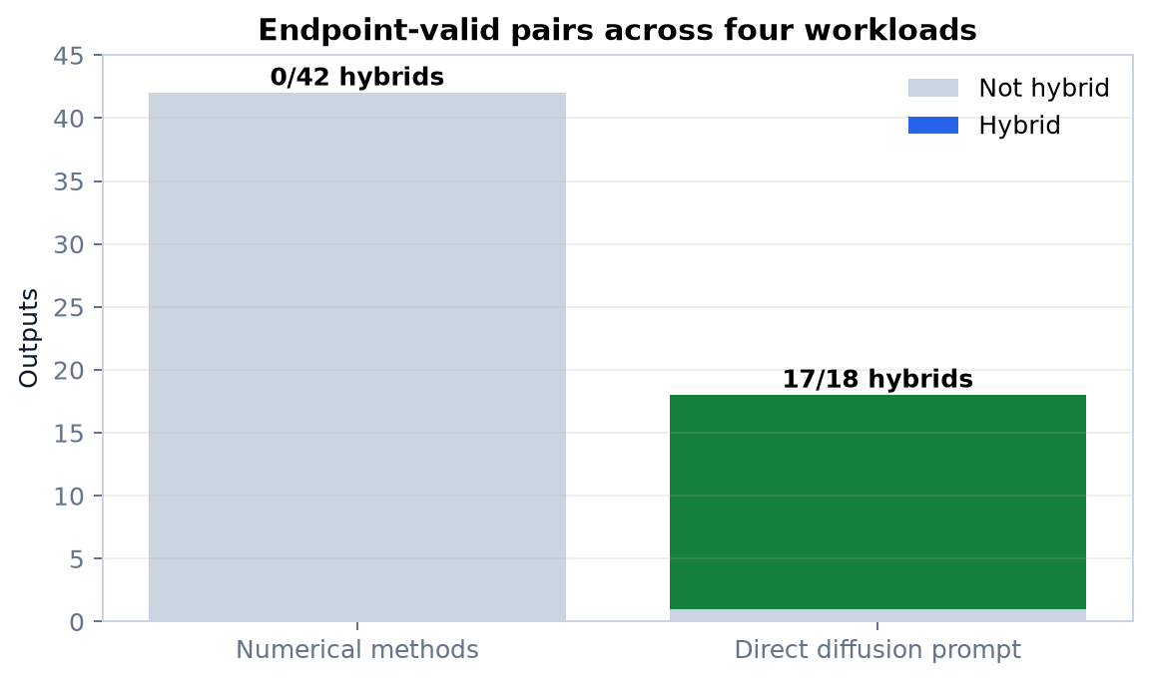
Aggregate endpoint-valid result across four workloads
Numerical representation methods
0/42 candidate hybrids.
Direct diffusion prompting
17/18 strict candidate hybrids.
Pilot contrast—not a population estimate.
Pilot evidence • September 18, 2026 • experiments/008/results/results.json | experiments/009/results/results.json | experiments/012/results/results.json

Slide 19
What actually succeeded?
Reproducible full-model execution with seeds, hashes, revisions, timings, and preserved raw outputs.
Endpoint decoding when prompts named the required implementation details.
A causal diagnostic: poor composition was not explained by simple vector cancellation.
A likely bottleneck: useful endpoint alternatives survived below top-1 but hard projection broke sequence-level meaning.
Direct diffusion prompting composed both parents 17/18 strict times across sorting, matrix, graph, and image pairs.
Full-context blank-canvas prompting independently achieved 8/9, tying rather than improving the concise prompt.
Endpoint gates prevented overinterpreting the blocked histogram and regex pairs.
Pilot evidence • September 18, 2026 • experiments/003–012/results/results.json

Slide 20
Sergiy’s explicit proposal: status of each item
1 • Mix prompt/internal states
2 • Darwin ideas/programs
3 • Partial denoise → larger AR
Blank-canvas final-state and output-logit methods were tested. Result: 0/42 strict numerical hybrids.
Darwin-derived ideas were used; code-state controls were invalid. No Darwin program fitness gain was established.
Earlier pilot: 0/15 useful scaffolds; scaffold-only handoff recovered neither parent in 0/4. It added no useful information.
4 • Bayesian optimization
5 • Darwin search-stage integration
Not justified: the tested coordinate crosses a broad unrelated region rather than a smooth useful bridge.
Not justified for the failed numerical mixer. Direct text-based idea synthesis remains viable; program-level Darwin evaluation is still untested.
Attribution boundary: internal-layer injection, KV-cache mixing, learned sequence-aware mixing, and preregistered confirmation are our later future-work ideas—not Sergiy’s explicit asks.
Pilot evidence • September 18, 2026 • experiments/001–013 | earlier pilot: partial-scaffolds and scaffold-handoff assessments | answers-to-sergiy.md

Slide 21
What was not completed—and why
Implementation aspirations were gated by the research result
No production Darwin stage
No Bayesian optimizer run
No program campaign
The tested numerical synthesis mechanism showed no benefit. Building it into the production sampling pipeline was therefore not scientifically justified.
The smooth-coordinate gate failed: the path crossed a broad unrelated region instead of a useful continuous semantic space.
No end-to-end generated-program compilation, test, and benchmark campaign followed because the numerical method produced no useful synthesized idea to advance.
These were proposal implementation aspirations, not forgotten tasks. The underlying research questions were answered, and stopping at the failed gates was the scientifically justified outcome.
Pilot evidence • September 18, 2026 • experiments/001/results/results.json | experiments/004–012/results/results.json | answers-to-sergiy.md

Slide 22
Limitations: what this study cannot claim
Exploratory/pilot evidence; not preregistered confirmatory evidence.
The strongest composition comparison covers four workloads but one DiffusionGemma revision and public synthetic tasks.
Lexical indicators are reproducible but do not replace blinded human judgment or program benchmarks.
The graph 2/3 strict result includes a human-identifiable third output whose `indptr` token was damaged.
Negative findings apply to final-state interpolation/projection and linear output-logit mixing—not all diffusion methods.
Our later future-work ideas—not Sergiy’s explicit asks—include internal-layer injection, KV-cache mixing, learned sequence-aware mixing, and preregistered confirmation.
Pilot evidence • September 18, 2026 • technical-report.html § Limitations and scope

Slide 23
Our future-work plan—not Sergiy’s explicit asks
1 • Preregister confirmation
2 • Test distinct mechanisms
3 • Keep the viable baseline
Freeze hypotheses, held-out pairs, outcomes, exclusions, seeds, run counts, blinded evaluation, and program benchmarks.
Try internal-layer injection, KV-cache mixing, or learned sequence-aware mixing that preserves sequence structure.
Direct text-based synthesis is simpler and succeeded in 17/18 strict runs across four workloads. Revisit optimization only after finding a smooth useful coordinate.
Conclusion: the tested numerical bridge failed, but the diagnostic ladder produced a clear, reproducible, and scientifically useful negative result.
Pilot evidence • September 18, 2026 • experiments/001–013 | answers-to-sergiy.md

