Slide 1
Incentives based Design for onboarding Legal Service Providers such as Advocates, Arbitrators, Mediators, Notaries, Document Writers, etc on e-Market Place for extending Legal Services to Citizens in India
CSE7101- Capstone Project
Review-1
Batch Number: CSE_264
Under the Supervision of,
Guide: Dr. Saurabh Sarkar
(Electronics and Communication Engineering)
Presidency University
Roll Number | Student Name
20221CSE0276 | Akanksha Bhartiya
20221CSE0336 | S Neha Kauser
20221CSE0397 | Harshvardhan S
Name of the Program: CSE 7101 Capstone Project (Semester VII)
Name of the HoD: Dr. Asif Mohammed , Dr. Blessed Prince
Name of the Program Project Coordinator: Dr. Jayavadivel Ravi, Mr. Muthuraju V
Name of the School Project Coordinators: Dr. Sampath A K , Dr. Geetha A

Slide 2
Problem Statement Number: PSCS_3
Organization: Ministry of Law and Justice
Category (Hardware / Software / Both) : Software
Problem Description:
This project is a direct response to India's unorganized legal sector, which creates a lack of transparency and high costs for citizens. We are developing an incentivized e-marketplace to onboard legal service providers, creating a transparent and accessible platform for everyone. The project's deliverables include a functional prototype, design wireframes, user stories, and a final video demonstration.

Slide 3
Content
Problem Statement
Objectives
Background and Related work for title Selection
Analysis of Problem Statement
Innovation or Novel Contributions
Git-hub Link
Timeline of the Project
References

Slide 4
Problem Statement
The legal service sector in India is largely unorganized, creating significant barriers for citizens. The core problems are:
Lack of Transparency: No clear information on provider qualifications, service fees, or case progress, leading to a trust deficit.
Difficulty in Access: Finding the right legal service provider (LSP)—whether a notary, mediator, or specialized advocate—is a confusing and often intimidating process for the average person.
High & Unpredictable Costs: Without a competitive marketplace, fees can be inconsistent and inflated, making legal services unaffordable for many.
No Centralized Platform: LSPs lack a dedicated, trustworthy e-marketplace to connect with a wider client base, manage their services, and build a verifiable reputation based on merit.

Slide 5
Objectives
Our primary objectives are to:
Design & Develop an e-Marketplace: Build a secure, scalable, and user-friendly web platform using the MERN stack for both Legal Service Providers (LSPs) and citizens.
Create a Robust Incentive Model: Implement a multi-layered system combining financial rewards, gamification (badges, leaderboards), and recognition to motivate LSPs to join and consistently provide high-quality service.
Ensure Trust and Transparency: Integrate a mandatory credential verification process for all LSPs and a transparent, public-facing rating and review system to foster accountability.
Implement Efficient Search & Matching: Develop an advanced search functionality with filters for specialization, location, language, and budget, enabling citizens to easily find the most suitable LSP for their needs.

Slide 6
Background and Related Work
Market Analysis: Our research of platforms like LawRato, Vakilsearch, LawRato, and Legistify shows they are mostly online directories or use subscription models not suited for the Indian market.
The Critical Gap: These existing platforms lack a strong, integrated incentive mechanism to ensure ongoing service quality and provider accountability.
Our Solution: Our project fills this gap by building an e-Marketplace with a gamified, incentive-driven design, creating a more transparent and trustworthy legal ecosystem in India.

Slide 7
Analysis of Problem Statement
Our project is built on the MERN stack, a modern and robust JavaScript-based toolkit.
Frontend: We're using React.js for a fast and responsive user interface, styled with Tailwind CSS.
Backend: Node.js and Express.js will power our secure and scalable RESTful API for all business logic.
Database: We chose MongoDB, a NoSQL database, for its flexibility in handling diverse data like user profiles and reviews.

Slide 8
Analysis of Problem Statement (contd...)
Software and Hardware Requirements:
Software Requirements:
IDE: Visual Studio Code
Runtime Environment: Node.js (v18.x or later)
Database: MongoDB Server / MongoDB Atlas (Cloud)
API Testing: Postman
Design & Prototyping: Figma
Version Control: Git
Hardware Requirements:
No specialized hardware is required. A standard developer laptop with at least 8GB RAM and an internet connection is sufficient for development and deployment.

Slide 9
Innovation or Novel Contributions
Our core innovation is a multi-layered incentive framework built on three key pillars:
Gamified Reputation System: We go beyond simple ratings by using Badges, Leaderboards, and Profile Boosts to reward quality service and foster healthy competition.
Integrated Trust-Building: We build trust through a two-step process: mandatory credential verification for all providers at onboarding and a transparent, un-editable client review system.
Focus on Accessibility: We make legal services more accessible by requiring providers to offer fixed-price packages for common services, making costs predictable for everyone.

Slide 10
Github Link
The Github link provided should have public access permission.
Github Link
https://github.com/akanksha0322/CapstoneProject_CSE_264

Slide 11
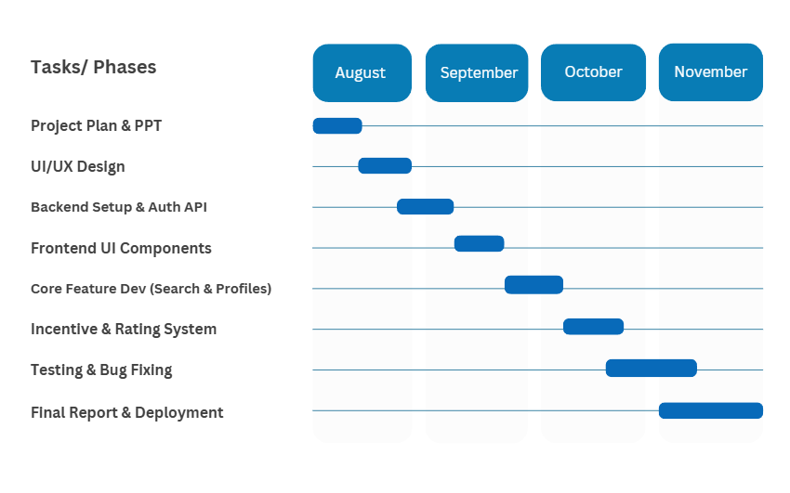
Timeline of the Project (Gantt Chart)

Slide 12
References (IEEE Paper format)
[1] R. G. Vishnu, A. R. Singh, and P. Kumar, “A Framework for an Online Dispute Resolution e-Marketplace using Blockchain,” in 2022 IEEE International Conference on E-Business Engineering (ICEBE), 2022, pp. 112-119.
[2] S. Sharma and R. Trivedi, “Gamification as a Tool for User Engagement in Service-Oriented Web Platforms,” IEEE Transactions on Human-Machine Systems, vol. 51, no. 4, pp. 381–390, Aug. 2021.
[3] A. Gupta, “The Role of Digital Platforms in Transforming India's Unorganized Service Sector,” IEEE Technology and Society Magazine, vol. 40, no. 2, pp. 24–31, Jun. 2021.

Slide 13


