Slide 1
Flight Management System
Akanksha Pandey (MT20048)
Shivani Mishra (MT20062)
Group Number : 2
Project Number : 6

Slide 2
Flight Management System
Flight Management System is a computerized system which is aimed at reducing the manual effort and errors present in a non-computerized system and to enhance the User Experience by making it convenient to book flights according to their need from the comfort of their home.
It allows the users to book a ticket or if required, cancel the current reservation. Additionally it shows the information about the flights and lets the users to do corresponding transactions related to their air travel.
We are implementing an additional feature that will tell the user the exact amount of extra charges according to the weight of their luggage while booking the ticket itself. This feature will help in improving the experience for the user.

Slide 3
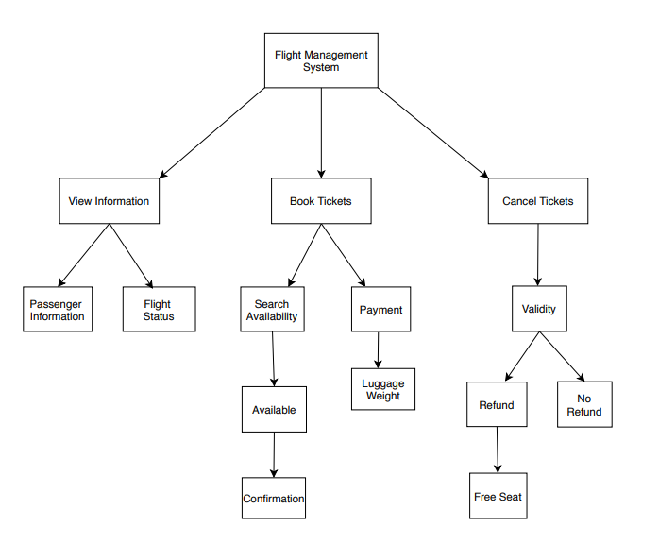
Previous Cartesian Decomposition

Slide 4
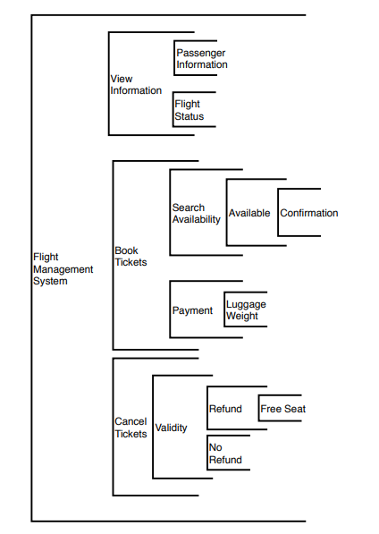
Previous Modular Sturcture

Slide 5
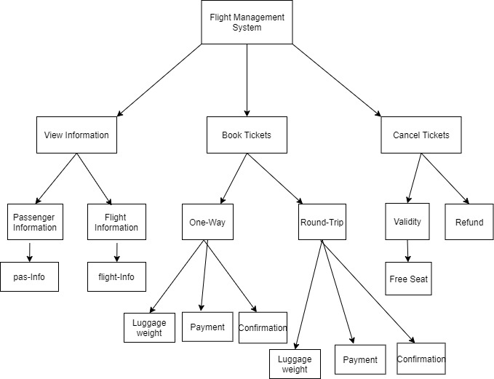
Implemented Cartesian Decomposition

Slide 6
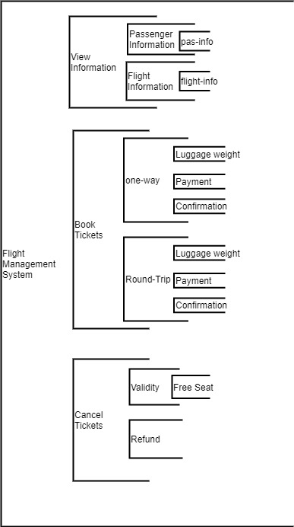
Implemented Modular Structure

Slide 7
Comparison:
View Information module:
We have implemented modules pas-info and flight-info in Passenger Information and Flight Information respectively that are checking for the validity of credentials entered by the user.
Book Tickets module:
We have not implemented the search function and made our data static. Instead of search and payment modules, we have implemented one way and round-trip modules to differentiate between two types of journey and payment as one of the sub-module.
Cancel Tickets module:
We have implemented Refund as a sibling module of Validity module instead of child module.

Slide 8
Implementation
GUI: tkinter
Database: Python's sqlite library (sqlite3)

Slide 9
Implemented list of features
1. View Information: This function will Show the information about the air travel.
Passenger Information: This function will show the information about the passenger when they enter their valid id which is given to them at the time of booking the tickets.
Flight Information: This function will show the status of flight (Whether Cancelled or not) by entering a valid id given to the user at the time of booking the ticket.

Slide 10
Implemented list of features
2. Book Ticket: This function will allow the user to book the ticket by entering the required information.
One Way
Round Trip
User will input the data like source, destination, date, time and class etc according to there preference in both type of trip.
Confirmation: If the day and time are according to there preferable choice, they will confirm the booking. Payment: User has the option of paying the charges with either Credit Card or Debit Card. Luggage Weight: This is the additional feature we are implementing. This feature will allow the user to input the weight of their luggage and will tell them how much money they have to pay extra(If applicable).

Slide 11
Implemented list of features
3. Cancel Ticket: This function will allow the user to cancel the already booked ticket by deducting some fees.
Validity: We will check whether the user has a valid booking for the flight or not.
i) Refund: User will be refunded the money after deduction of fess for cancellation.
a) Free Seat: We will allow the user to free their seat by cancelling the reservation.
ii)No Refund: User will not get refund if the given information is wrong or the
refund will not be applicable for that user.

Slide 12
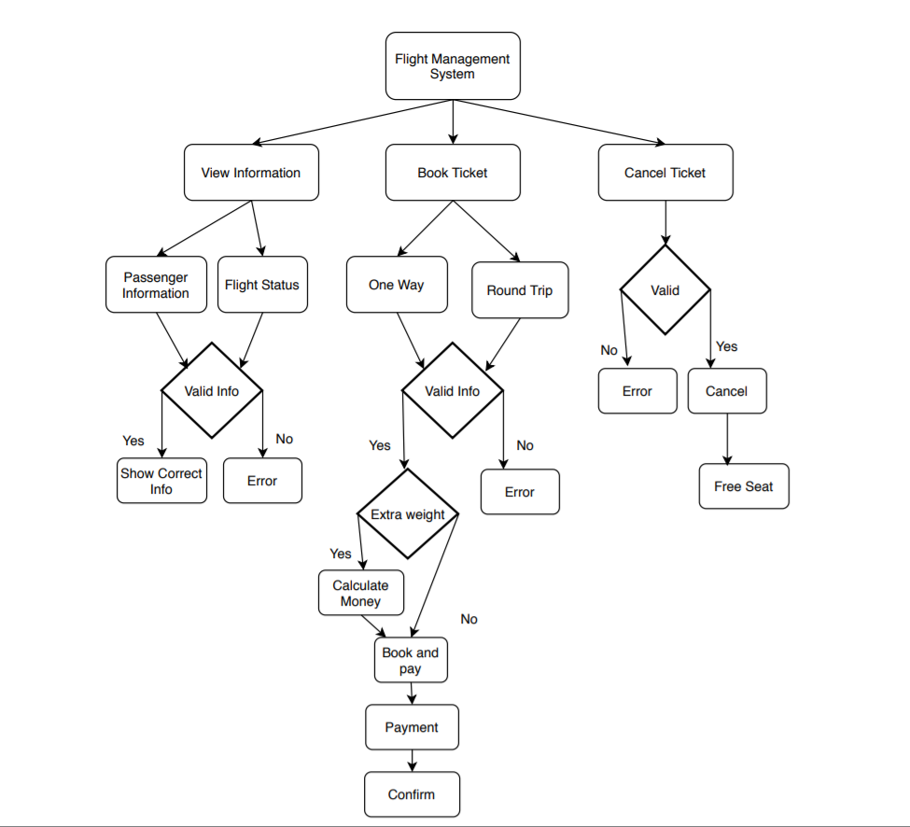
Code Flow

Slide 13
Analysis
This project fulfill the aim to reduce manual efforts in flight management Sytsem.
Future Scope : We can implement this project using Object Oriented Approach and implement it in real time.

Slide 14
Contribution of each member
Shivani Mishra: Implementation (functions: Book Ticket and Passenger-Information), Presentation
Akanksha Pandey: Implementation ( functions: Cancel Ticket and Flight-Information), Presentation, Database Implementation

