Slide 1
Breast Cancer Prediction
GROUP NO-10
AKANKSHA DEWANGAN (MT19049)
PRIYANKA BORAL (MT19127)
REECHA KUMARI GIRI (MT19134)
SHALINI BHARDWAJ (MT19045)

Slide 2
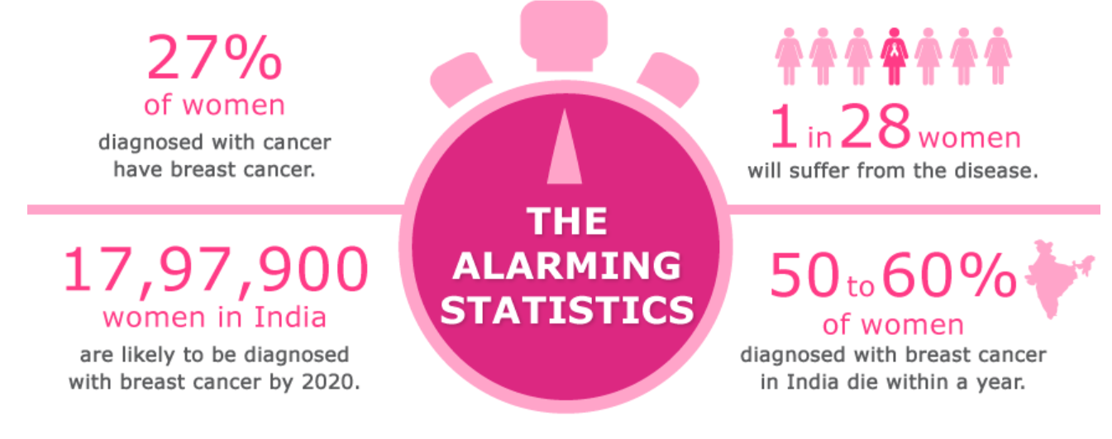
Introduction
➤The most common cancer in women worldwide.
➤The principle cause of death from cancer among women globally.
➤Early detection is the most effective way to reduce breast cancer deaths.
➤Early diagnosis requires an accurate and reliable procedure to distinguish between benign breast tumors from malignant ones.

Slide 3
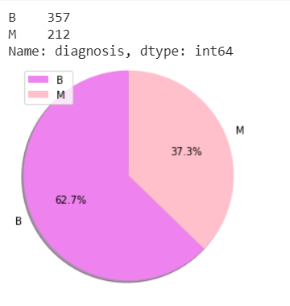
➤We have classified cell to be malignant or benign using various machine learning models on Wisconsin breast Cancer Dataset from the UCI repository .
➤Some of the major preprocessing steps are removal of class imbalance by SMOTE, outlier detection using ensemble method, and feature selection using correlation matrix. We used the 5-fold validation technique in the dataset to select the best model and avoid overfitting
➤Metrics Used :Accuracy, sensitivity, specificity, false discovery rate, false omission rate, Mattews correlation co-efficient, ROC curve.
➤We have implemented models mentioned in most of the research papers like SVM,KNN and also applied Neural network models which have shown better results.

Slide 4

Existing Methods
Some classifiers used for the prediction of breast cancer in research papers are:
KNN: It is used in many papers and considered as a good classifier for prediction. K-Nearest Neighbors (K-NN) algorithm is another supervised machine learning technique used for classification and regression.
SVM: SVM is a discriminative classifier that can be defined by a separating hyperplane. In most of the papers, the false discovery rate is comparatively high in K-NN rather than SVM and hence, he SVM performs comparatively better than K-NN.

Slide 5
Decision Tree: Decision tree is used for predicting the type of tumor present in patient. Relevant variables are chosen and processed by means of decision tree. It results in conditions that are responsible for the possibility of presence of tumor. It gave average accuracy in many papers.
Random Forest: Random Forest, a large number of decision trees are created. An error estimation is made for the classes which are not used for building the tree. This is called as an out of bag error estimate and is represented in percentage. That’s why it is popular in prediction.
Linear Regression: Linear regression is used to find the relationship between the attributes (variables). This helps to determine which attribute is highly related to class variable and helps for identification of type of cancer in distinct papers.
These days, some researchers are also trying various deep learning techniques like neural networks to improve the accuracy of prediction and AUC of ROC curve.

Slide 6
Research Base Paper
➤Base Research Paper:
Prediction of Breast Cancer Using Support Vector Machine and K-Nearest Neighbors.
➤The breast cancer termed as Wisconsin breast cancer diagnosis data set is taken from UCI machine learning repository.
➤Metrics Used : Accuracy, Sensitivity, Specificity, False discovery rate, False omission rate and Matthews correlation coefficient.
➤ 10 Fold cross validation is applied to avoid over-fitting.
➤Supervised machine learning algorithms such as SVM and KNN has achieved accuracy as 98.57 and 97.14 respectively in the paper.

Slide 7
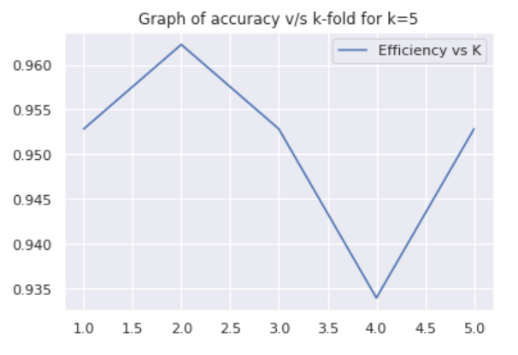
Methods and Models implemented for Novelty
➤ In the given paper preprocessing steps are not much discussed.We have tried and tested different preprocessing steps which have shown better results.
➤Preprocessing steps such as outlier detection,class imbalance,feature extraction by correlation are performed.
➤Probabilistic and Ensemble Models applied other than mentioned in paper: Light GBM,Gaussian RBF
➤ K-fold cross validation is applied keeping k=5 as shown in
graph.

Slide 8
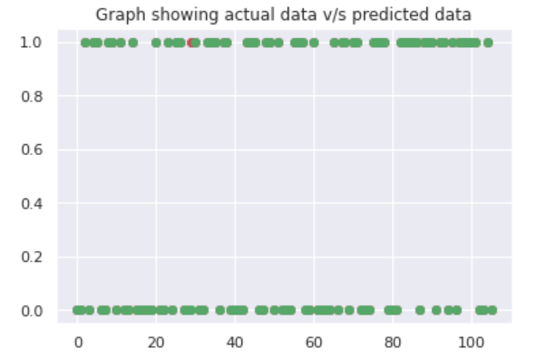
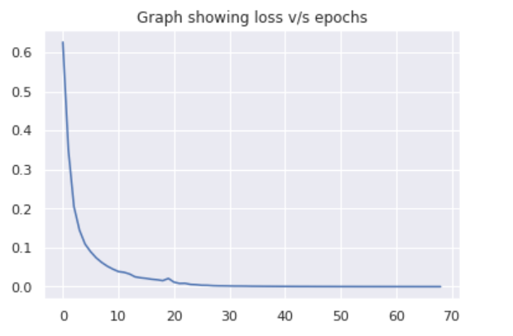
Analysis of Neural Network
➤Neural Models applied other than mentioned in paper: MLP,LSTM,Dense Sequential
➤Metrics used for comparing models other than ones mentioned in are loss functions build for neural network based classifiers and ROC curve.

Slide 9
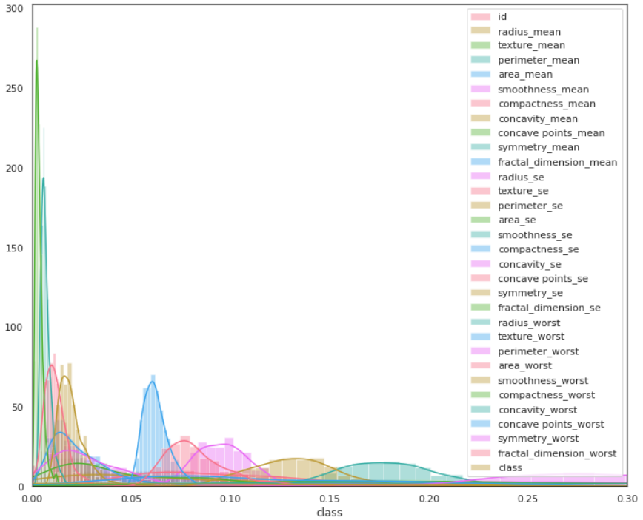
Methods and Materials
➤Dataset is taken from Wisconsin Breast Cancer Dataset from UCI repository. Dataset having 568 rows and 33 columns. Information about the attributes which are regarding nucleus are:
➤Train-test split: We split dataset into 20% test data and 80% train data with random State=0 and then transformed them into standard scalar format.

Slide 10
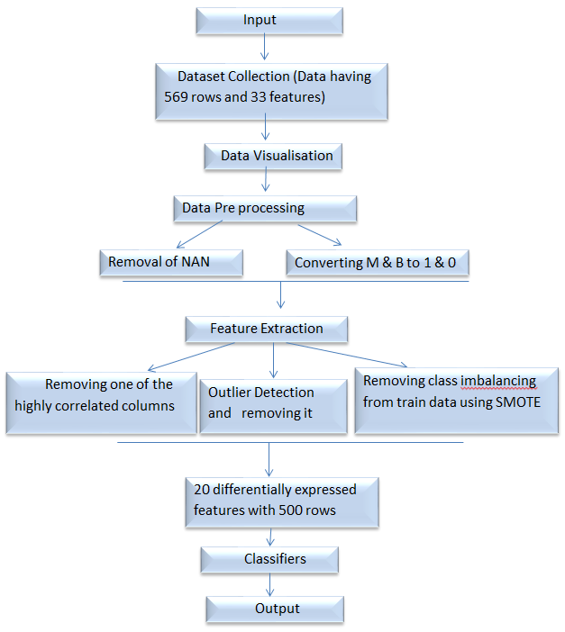
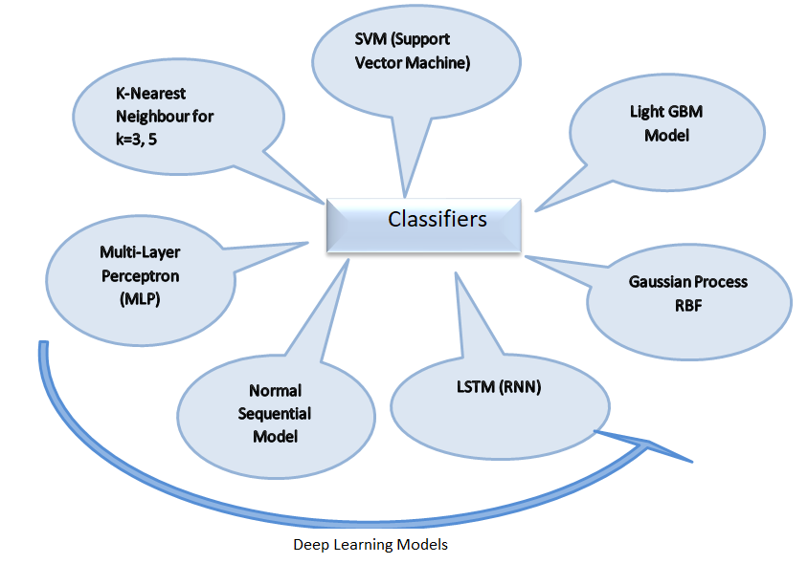
Fig: Classifiers used
➤The neural network is first given a set of high level input data which the system read it and analyses layer by layer. Such neural n/w models applied here are: MLP, LSTM, Sequential. Usually, it gives better results.
➤Light GBM is gradient boosting classifier
➤Gaussian Process classifier is a probabilistic model.
Fig: Flow chart showing Overview of procedure

Slide 11
Result
Gaussian Process Classifier with various kernel and Long Short Term Memory(LSTM that is RNN) are best 97% accuracy with AUC is 99.3%
Gaussian Process Classifier with various kernel,LSTM with return False omission rate(FOR) of 0% which is best.FOR measures the proportion of false negative which are incorrectly rejected.
False Discovery rate are highest in KNN 8.8% which means return more false discovery result among overall experimented.
Mattews correlation coefficient is highest in Gaussian Process Classifier(97.7%)and LSTM(RNN 97.78%) which indicate that it gives purest binary classifier after classifying the classes.
Sensitivity and specificity of Gaussian process and LSTM (RNN) are also highest.

Slide 12
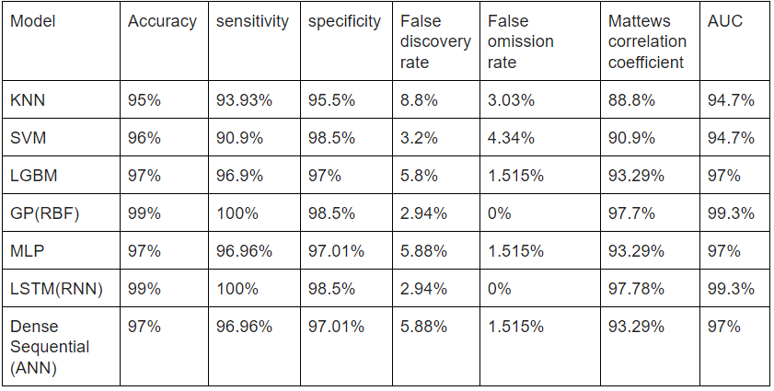
Table: Comparision of Models

Slide 13
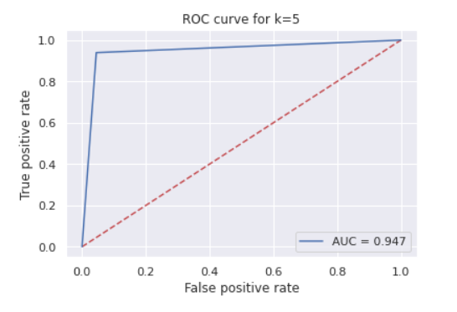
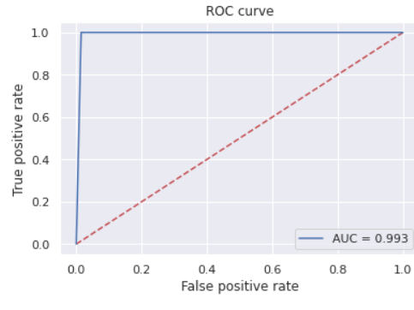
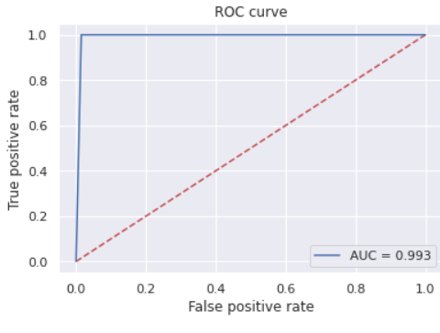
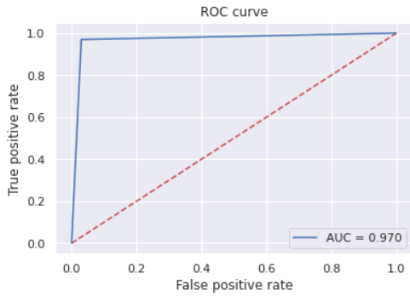
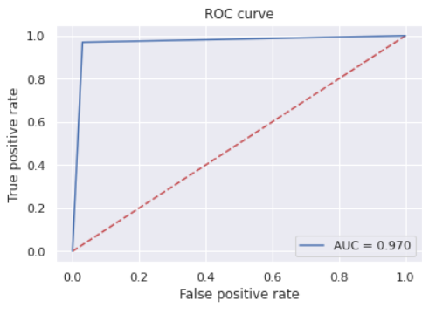
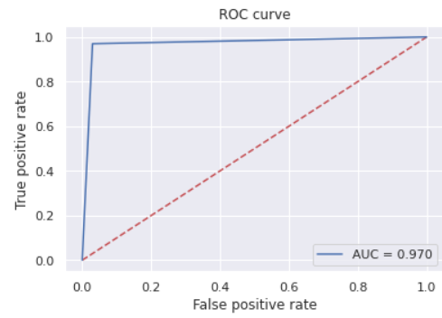
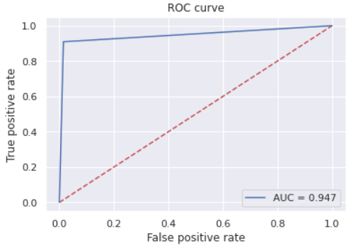
1. KNN
3.GPR
5.LSTM
2. ANN.
4.LGBM
6.MLP
7.SVM
ROC Curve

Slide 14
Discussion
➤We applied various models and among them Gaussian process classifier with RBF and LSTM(long short term memory) which is RNN(recurrent Neural Network) is best among all by observing all the parameters like accuracy,sensitivity,specificity,False Discovery rate,False Omission rate, Matthew’s correlation coefficient.ROC curve is the metric which we have used other than metrics used in research paper.
➤Supervised classifiers like K-nearest neighbours classifier results worst among all the solution with least accuracy 95% compare to others and majorly due to having 8.8% highest.
➤SVM classifier should not be used because it is giving highest false omission rate(4.34%) which is not good in terms of False negative rate it should be less.

Slide 15
Conclusion
➤As per the aim to propose the breast cancer prediction model Gaussian process classifier and Light GBM are best with accuracy 99% and AUC 99.3% .Also it be concluded that using deep learning algorithm predicted accurate result.
➤For controlling breast cancer there are two important aspects of early detection and risk reduction.By using this machine learning techniques we can detect breast cancer in early stages then we can save lives of many women.

