Slide 1
MENTAL HEALTH
PREDICTION
USING MACHINE
LEARNING
DIMPY VARSANI [MT19022]
AKANKSHA DEWANGAN [MT19049]
KOMAL KUMARI [MT19124]

Slide 2
TABLE
OF CONTENTS
01
02
03
04
INTRODUCTION
DATASET AND EDA
METHODOLOGY AND MODELS
RESULT
CONCLUSION
05

Slide 3
INTRODUCTION
Mental health is a major factor for human beings. It will affect emotional, psychological and social factors of an individual which determines the thought process of an individual. With growing age our social surrounding puts out a lot of thoughts, positive ones lead to a healthy & progressive mind and the negative ones contribute to mental illness like stress,depression, social anxiety etc.

Slide 4
SOLUTION
Machine learning is one of the areas that will be good in predicting onset mental illness.
This kind of prediction model will help the society as a monitoring tool for individuals to deviate individual behavior.

Slide 5
DATASET
This dataset is from a 2014 survey that measures attitudes towards mental health and frequency of mental health disorders in the tech workplace.
It has 1259 rows and 27 attributes which help to determine the mental illness of individuals

Slide 6
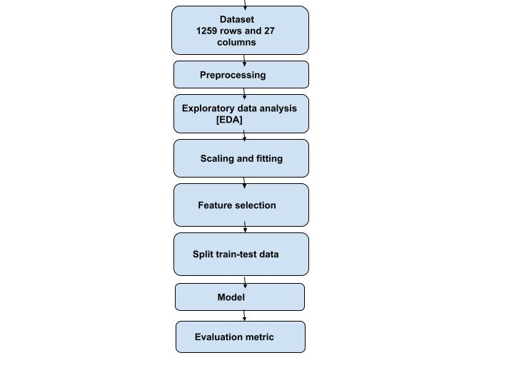
METHODOLOGY
GaussianNB
SVM
Logistic regression
Decision tree classifier
Random forest
Boosting and bagging
Stacking
Clustering
KNN classifier
DNN

Slide 7
Preprocessing
Empty spaces in categorical features were replaced with ‘NaN’ .
Replacing synonymes with similar meaning
Replacing missing values in age feature with median.
Categorization of age attribute based on range of age values.
Label encoding for all categorical attributes.
Replacing NAN values with relevant value like NAN in ‘self_employed’ attribute is replaced with ‘not self-employed’.

Slide 8
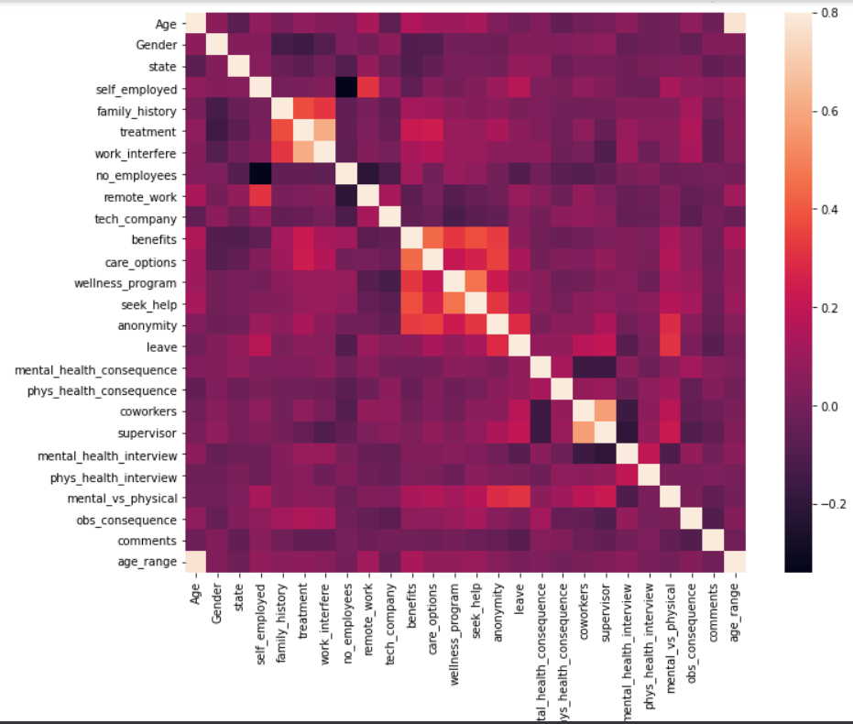
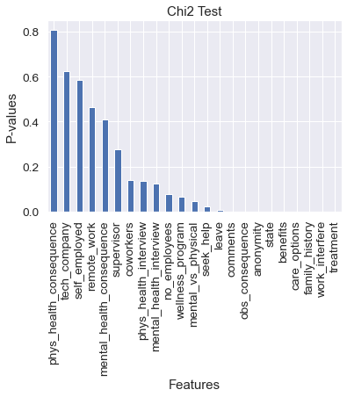
Exploratory Data Analysis [EDA]

Slide 9
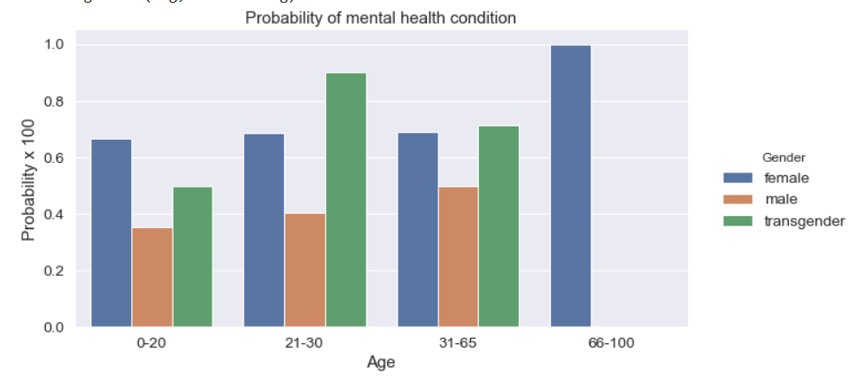
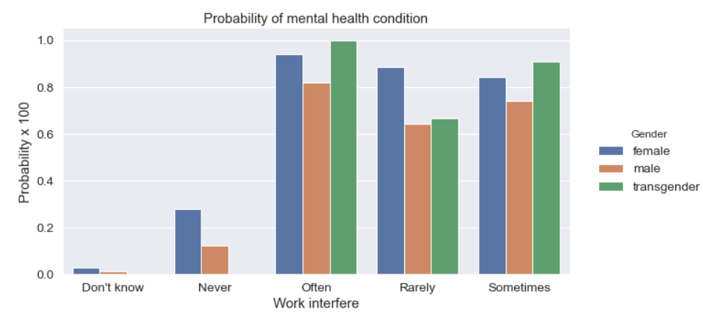
Observation on the basis of work interfered attribute
Observation on the basis of age group attribute.

Slide 10
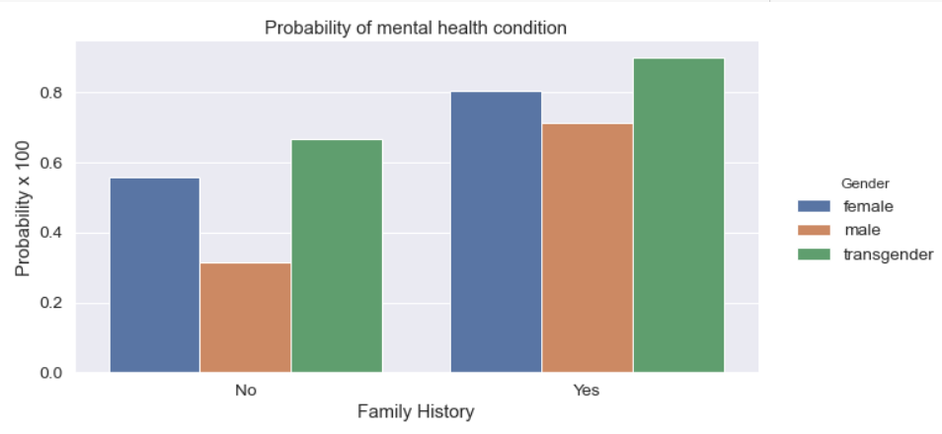
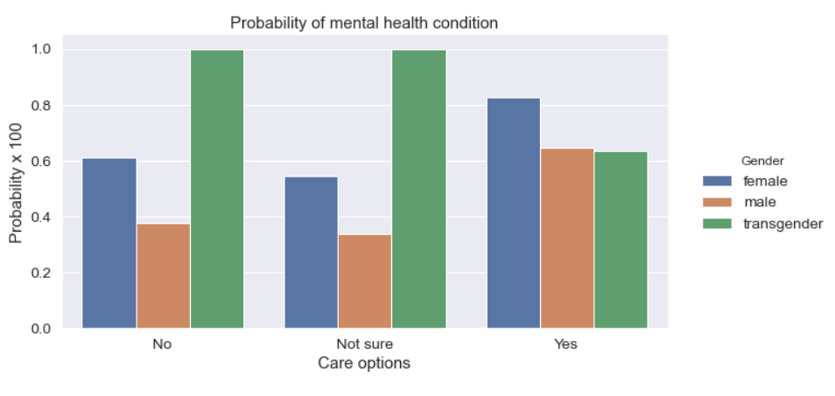
Observation on the basis of family history attribute.
Observation on the basis of cared options attribute.

Slide 11
Feature Selection
Technique
1.Variance Thresholding
2.Select-K Best(chi2)
3.Select-K Best(f-classif)
4.Select-K Best(mutual-information)
5.Linear Discriminant Analysis

Slide 12
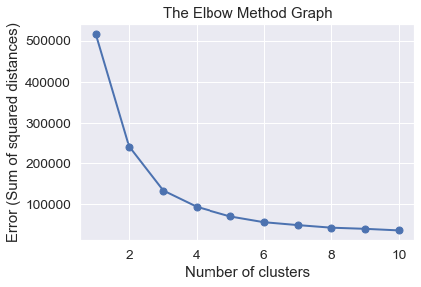
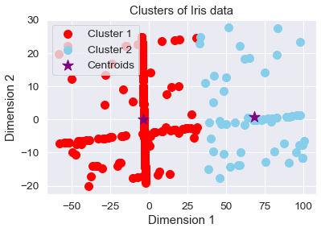
K Means Clustering
Technique

Slide 13
MODELS
1.Logistic Regression
2.KNN classifier
3.Decision Tree Classifier
4.Random Forest
5.Bagging
6.Boosting
7.Stacking
8.DNNClassifier
9.Clustering
10.GaussianNB
11.DNN[Deep learning neural network]

Slide 14
EVALUATION METRIC
Accuracy Score
Confusion matrix: True Positives (TP), True Negatives (TN), False Positives (FP), False Negatives (FN),
Receiver Operating Characteristic Area Under Curve Score
F1-Score
Recall/Sensitivity
Specificity
Cross validation Score
Precision

Slide 15
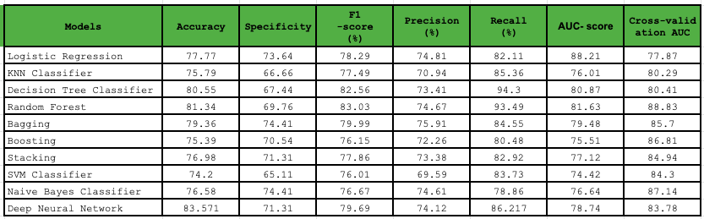
Experimental Results

Slide 16
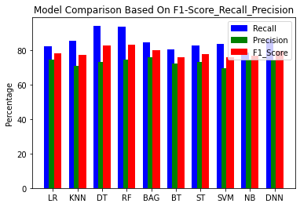
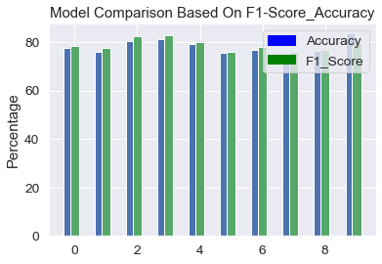
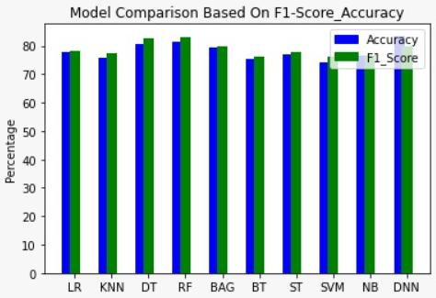

Slide 17
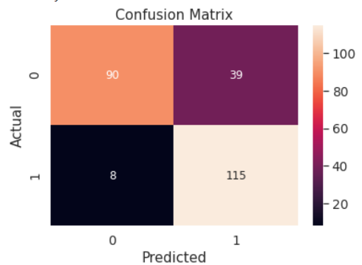
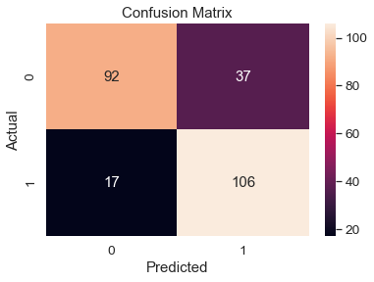
Random Forest Classifier
Deep Neural Network

Slide 18
CONCLUSION
Select k-Best have been used to extract top 20 best features using the chi2 correlation parameter.
K- Means clustering has been used in order to classify the data points into two clusters.
Grid Search CV has been used to fine tune the parameters of machine learning models.
The best machine learning model as per the research paper has been the Random Forest Classifier with 81% as train accuracy.
The novelty introduced was the application of Deep Neural network technique which gave the test accuracy as 83%.

Slide 19
THANKS

