Slide 1
Recommendation and Sentiment Analysis on Amazon Fine Food Review Dataset
Group 28:
Ritesh Singh (MT19044)
Akanksha Dewangan (MT19049)
Anamitra Maji (MT19112)

Slide 2
In this project we have done “ Sentiment analysis ” on reviews of customers on amazon products, where we analysis the sentiment of the particular review whether it is positive or negative. The ground truth whether the particular sentence is positive or negative depends on the rating of the particular product.
Another is “Recommendation system” where on the basis of rating given to the product by the users.Here we will look for mutual use of 2 user and if their products are common then we will recommend their non-common product to each other.
INTRODUCTION

Slide 3
DATASET
The dataset is taken from the kaggle.
We have used “Amazon food product review”, this dataset consist of reviews of fine food from amazon.
Dataset includes reviews from Oct 1999 to Oct 2012
74258 products, 256059 users, 260 users > 50 reviews.
It has 568454 rows(reviews ) and 10 columns.
The columns are Id, ProductId, UserId, ProfileName, HelpfulnessNumerator, HelpfulnessDenominator, Score, Time, Summary and Text.

Slide 4
Sentiment Analysis

Slide 5
Problem Statement
It is very difficult to analyse whether any particular product available online is good for purchase or not.
Solution
The reviews or feedback given by the user can be analyse whether the comment is a positive or negative response. For this we can apply machine learning techniques where we observe text data, along with various preprocessing techniques then apply machine learning model to classify a review statement whether it is of positive or negative category. Hence this helps customers to know about quality of product.

Slide 6
Techniques Used
Preprocessing techniques
-Removing URL from the sentences
-ngrams of sentences
- Remove number from sentence
- Change sentence from upper to lower
- Porter Stemmer
- Remove stopwords
Vectorization
- Tfidf Vectorization
- Count Vectorization

Slide 7
Model
-KNN
-Bagging classifier
-Random forest classifier
-Multinomial Naive Bayes classifier
Evaluation Metric Used
-Accuracy
-Precision
-Recall
-F1-score

Slide 8
RESULT
Voting classifier MultinomialNB KNN Random forest
Tf-idf:
Accuracy: 83.02 83.03 79.8 85.9
Precision: 82.15 82.5 81.8 85
Recall: 99.4 98.7 94.2 98
F1-Score: 89.9 89.9 87.6 91
Countvectorization:
Accuracy: 82.99 85.55 76.2 84.824
Precision: 81 82.5 81.8 85
Recall: 99 98.7 94.23 98
F1-Score: 89.6 89.99 87.2 91.39

Slide 9
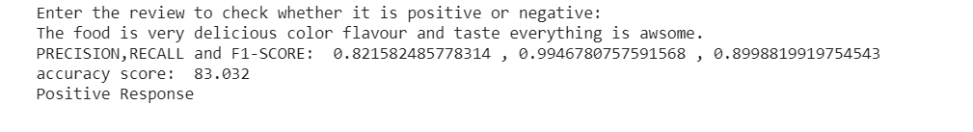
USER INTERFACE
Here user have to give input a review, and then our models will predict whether the review given to the product is positive or negative response:

Slide 10
FEATURE ENGINEERING

Slide 11
Features implemented
● All_capital words count
● POS- count of occurrence of each part of speech
● Hashtag count
● Punctuation
● Emoticons
● Elongated Words
● Negation-Count of negated contexts
● Word-Ngram
● Lexicons

Slide 12
Model
SVM
MLP
Decision Tree
Evaluation metric
Accuracy
Precision
Recall
F1-Score

Slide 13
RESULT
SVM DECISION TREE MLP
Accuracy: 89.4 85.7 90.2
Precision: 90.1 91.6 92.9
Recall: 97.9 90.9 95.5
F1-Score: 93.9 91.3 94.2

Slide 14
Recommendation of food product

Slide 15
Problem Statement
To sell more products based on previous rating given to the products by different customer.
Solution
Recommendation can be performed. So we used the collaborative filtering approach for product recommendations.

Slide 16
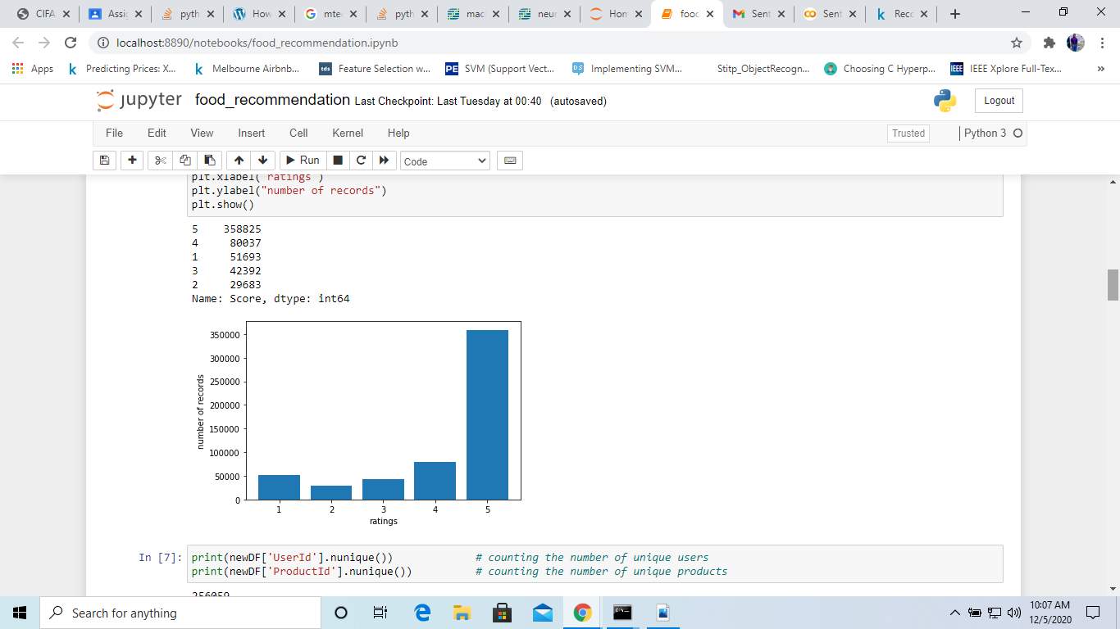
Technique Used
Data prepare
After preprocessing, the count of score of each type is shown in below plot.

Slide 17
Preprocessing
In collaborative filtering based recommendation system, we find the similarity between the rating given by users. So we dropped the rest of the columns except user_id, product_id and score.
We deleted the duplicates rows.
Also for better recommendation, we deleted the product which is rated by less than 30 users.
We also deleted the user who has rated who has rated less than 10 food products. So in last we are left out with 78,737 rows.

Slide 18
Method
For new users:
Since new users don’t have any previous records, the most popular/rated product was recommended to them.
The 10 most popular product_id of food items were:
[ ‘B007JFMH8M’ , ’B003B3OOPA’ , ‘B0026RQTGE’ , ‘B002QWHJOU’ , ‘B002QWP89S’, ‘B002QWP8H0’ , ‘B001EO5Q64’ , ‘B001RVFERK’ , ‘B007M83302’ ,
‘B007M832YY’ ]

Slide 19
For existing users:
We first reshaped the dataframe to a new dataframe having user_id in the rows and each product_id in the columns, where each cell contained the rating given by user.
Then we find the similarity between each items rating using correlation matrices.
Now we separated the scores of the similar product to ones which was rated by the users from the correlation matrix and showed them as recommendation for that user.

Slide 20
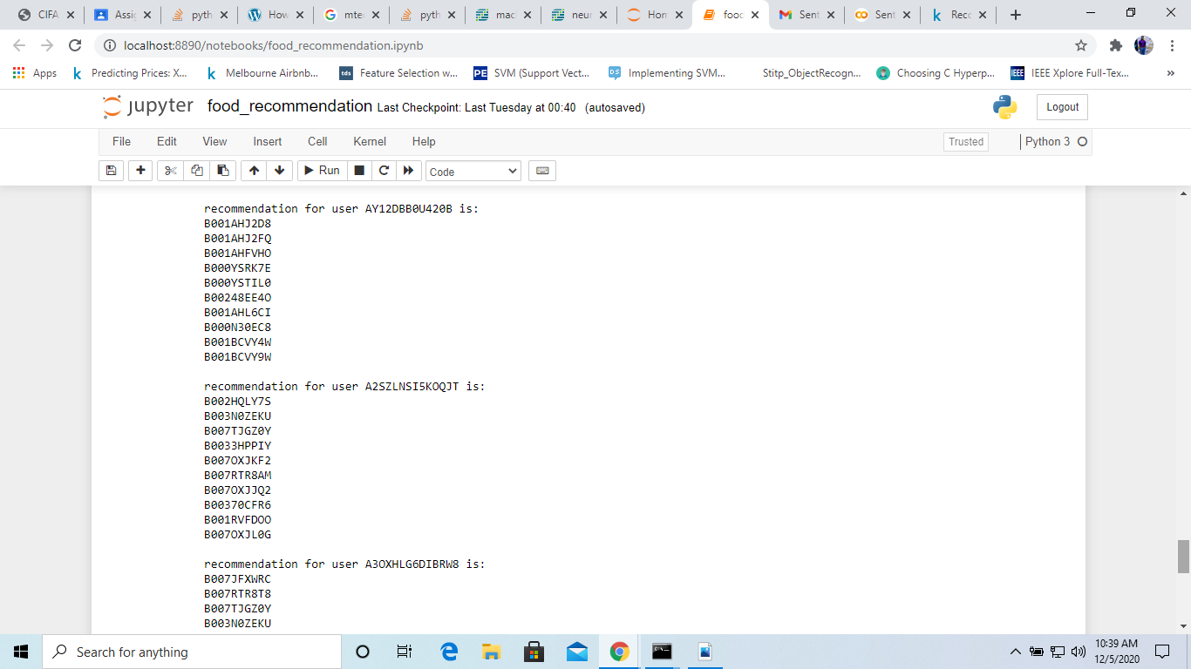
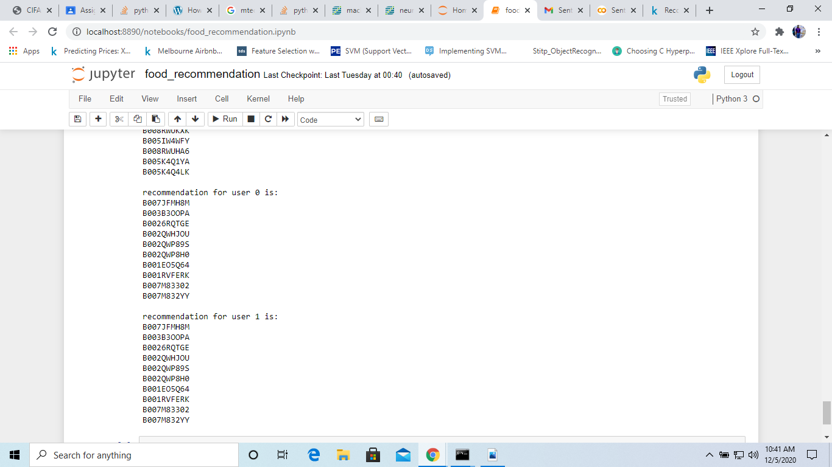
Some Recommendation Results

Slide 21
THANKYOU

