Slide 1
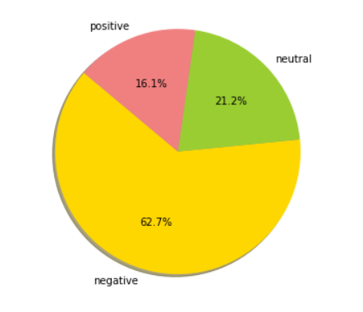
AIRLINE TWITTER SENTIMENT ANALYSIS
NAME :AKANKSHA DEWANGAN
ROLL NO:MT19049

Slide 2
INTRODUCTION
*Sentimental Analysis is a context mining of text datas.
*It analyse the words in group of sentences and predict whether the sentence is positive,negative or neutral on the basis of polarity.
*Aim of these project is to analyse sentiment on “Airline Review” which are tweeted by US airline travelers on twitter in 2015.

Slide 3
PROBLEM STATEMENT
Airlines industry sentimental analysis is done using traditional pen paper method or taking feedback from travellers about services and their satisfaction using certain questionnaires amd to analyse for this time consuming and require manual effort.
SOLUTION
*In this project Models are trained to analyse the sentiment of the tweets and classify them in three classes as positive ,negative or neutral.
*Results reduce manual effort and time.

Slide 4
TECHNIQUE PROPOSED
*Data collection: from kaggle on US airline twitter data of 2015 of total size 1460 rows and 15 columns.
*Data Exploration: visualization technique.
*Data preprocessing and Data Cleaning:
-Inconsistent attributes like having more than 90% NULL datas are removed and missing values are replaced by meaningful data.
-Applying Concepts of Natural Language Processing while preprocessing
-Use of document to vectorization (matrix form) methods:
-CountVectorizer and TFidfVectorizer
*Feature creation
*Classifier Techniques:
-K-Nearest Neighbor and Multinomial Naive Bayes

Slide 5
RESULT AND CONCLUSION
*Accuracy of Multinomial Naive bayes classifier is more as compared to KNN classifier in both CountVectorizer and TFidfVectorizer.
*Accuracies are:
1.CountVectorizer:
-Multinomial Naive bayes: 78%
-KNN classifier: 52%
2.TFidfVectorizer:
-Multinomial Naive bayes: 70%
-KNN classifier: 67%

