Slide 1

Project Title - Seasonal Agriculture Performance Analysis
[Student Name – AKANKSHA SINGH
College Name- Uttar Pradesh Rajarshi Tandon Open University ]
AICTE STU ID : (STU683d7cbfe303c1748860095 )

Slide 2

PROBLEM STATEMENT
(Agricultural activities are influenced by seasonal variations in environmental conditions, farming practices, resource availability and market conditions. As a result, agricultural performance may differ from one season to another. However, raw agricultural data does not clearly explain how agricultural performance changes across seasons or what patterns can be observed in different seasonal conditions. The problem is to analyze the given agricultural dataset and investigate seasonal differences in agricultural performance by identifying meaningful patterns, trends, relationships and variations within the available data.

Slide 3
Project Description This project dives into the heart of seasonal agriculture to see what really drives farm success. By analyzing a comprehensive dataset across different crop cycles, we set out to pinpoint how weather, soil, and resource management impact the bottom line. Our goal wasn't just to look at numbers, but to find the hidden patterns—and the anomalies—that tell us why certain seasons flourish while others struggle.

Slide 4

WHO ARE THE END USERS?
The Modern Farmer: Get clear, data-backed insights on which crops actually pay off in which season.
Decision Makers & Policy Leads: Use hard evidence to steer subsidies and climate-resilience planning where they’re needed most.
Researchers: Fast-track the discovery of which crop varieties are standing up best to environmental stress.
Agri-Tech & Supply Chains: Better forecasting means getting the right fertilizers and tools to the right place at the perfect time.

Slide 5

Technology Used
We kept it lean and powerful, using Python as our engine. We leaned heavily on Pandas for the heavy lifting of data cleaning and crunching, while Matplotlib and Seaborn were our go-to tools for turning raw numbers into clear, visual stories.

Slide 6
RESULTS
Kharif is King: Our data shows Kharif is the heavy hitter for both yield and profit, though it comes with the highest risk of pests and disease.
The Zaid Challenge: While Zaid sees plenty of sun, it’s a tough season for the wallet, often showing thinner margins or even losses on average.
It’s All Connected: We found significant links between rainfall and profit margins, proving just how much the 'economic weather' follows the actual weather.

Slide 7
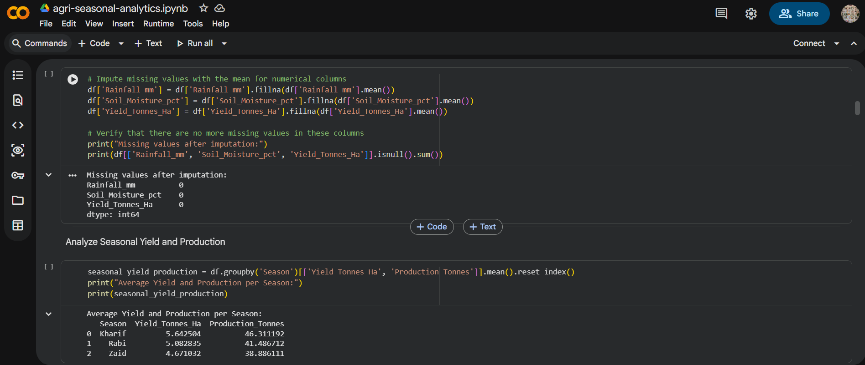
RESULTS

Slide 8
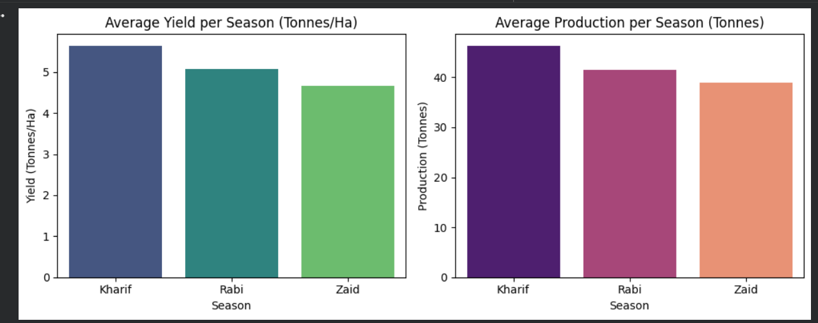
RESULTS

Slide 9
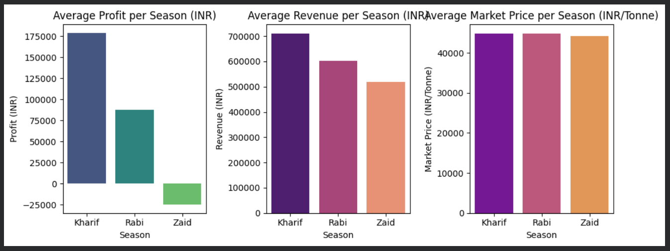
RESULTS

Slide 10
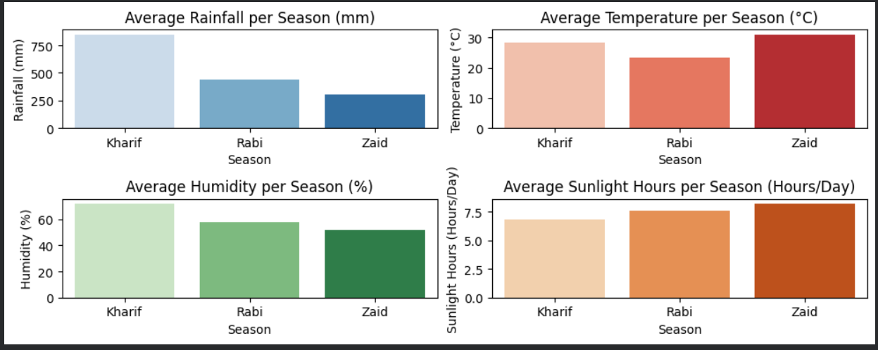
RESULTS

Slide 11
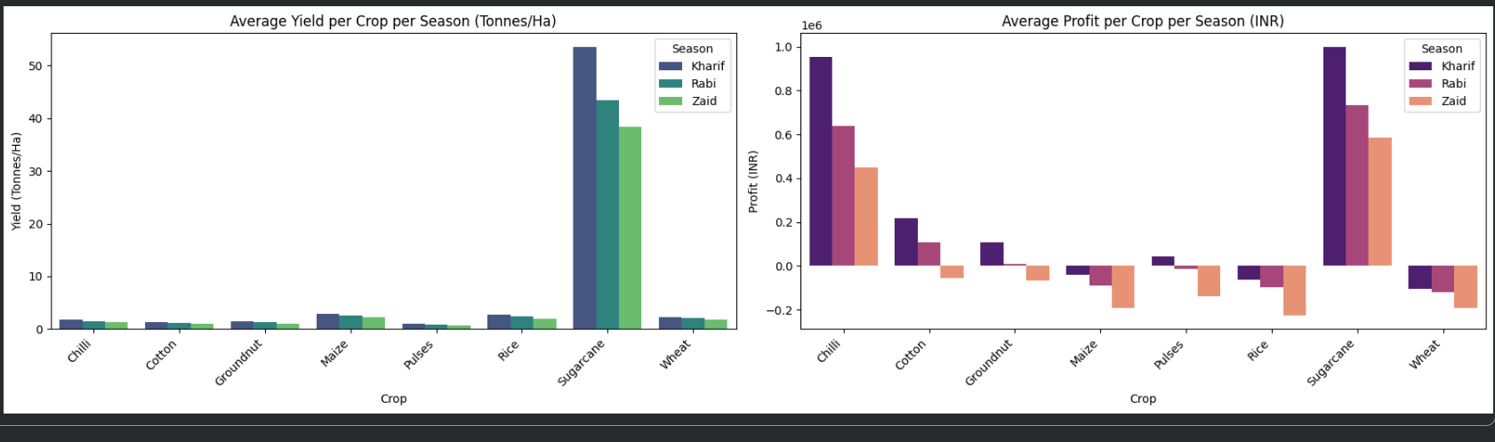
RESULTS

Slide 12
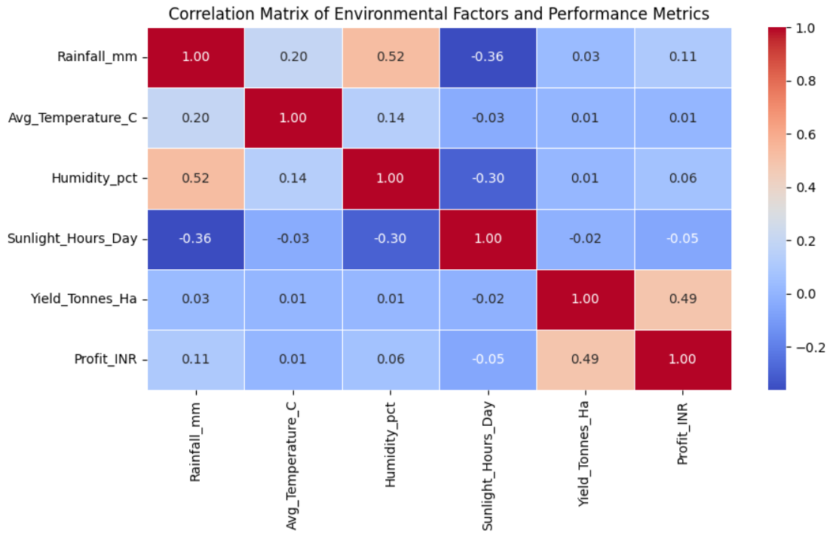
RESULTS

Slide 13
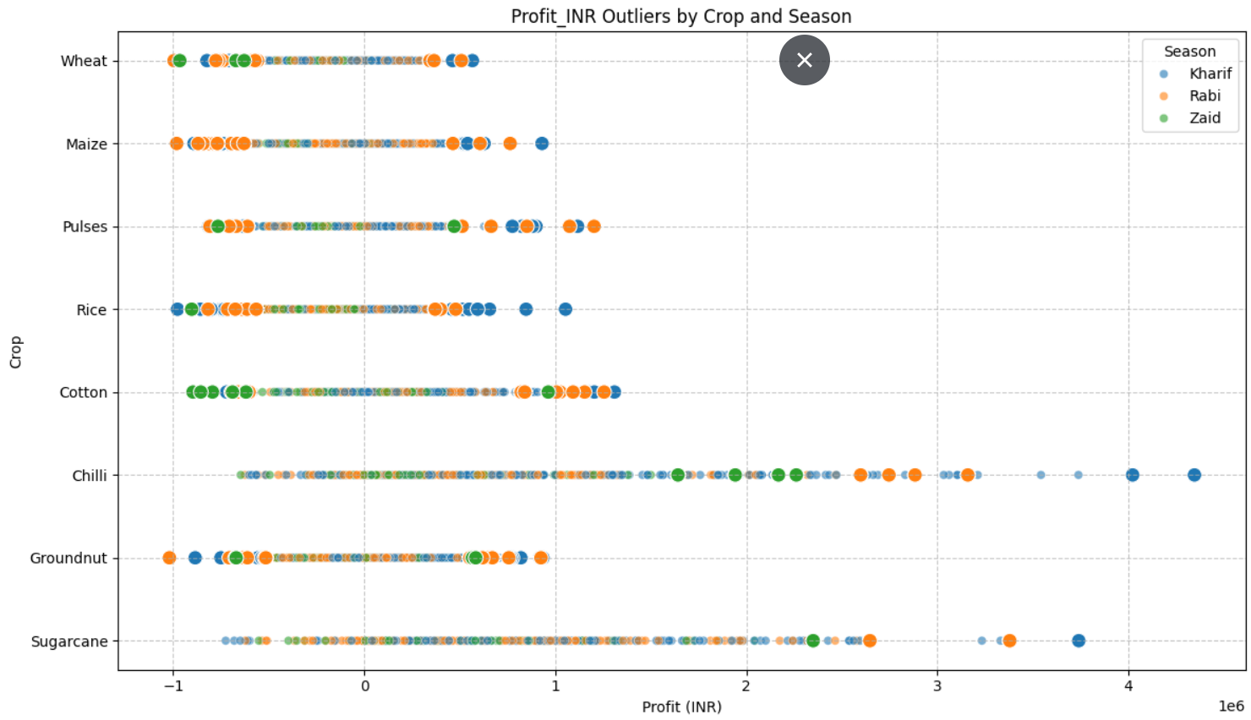
RESULTS

Slide 14
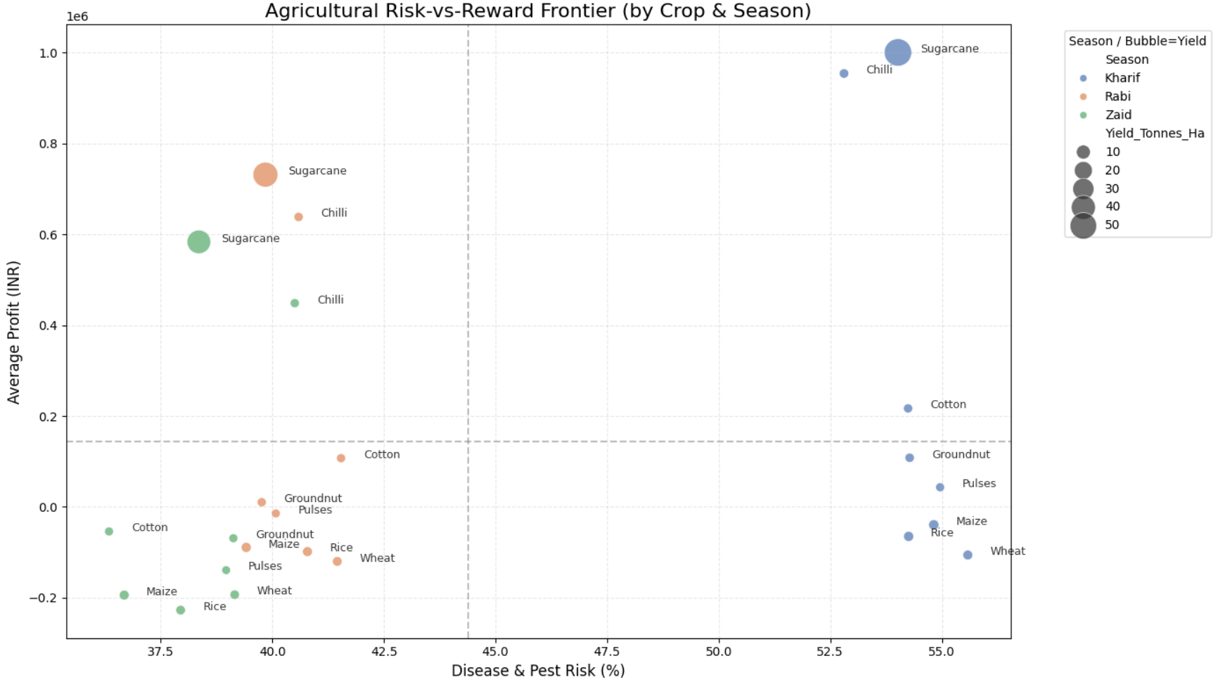
RESULTS

Slide 15
Future scope
Predictive Forecasting: Moving from 'what happened' to 'what will happen' using machine learning.
Smart Recommendations: Building a system that tells a farmer exactly how much water or fertilizer to use based on live data.
Interactive Tools: Turning these static charts into a live dashboard where anyone can explore their own region’s data.

Slide 16
GitHub Link
https://github.com/akanksha726/agri-seasonal-analytics

Slide 17

VOIS Course completion certificate - Course name- Data Visualization

Slide 18
Thank you
Thank you for your time and attention. I hope these insights provide a valuable understanding.
.
.

