Slide 1

Fashion Retailer new store Location prediction
Coursera Capstone Project Week 1 & 2

Slide 2


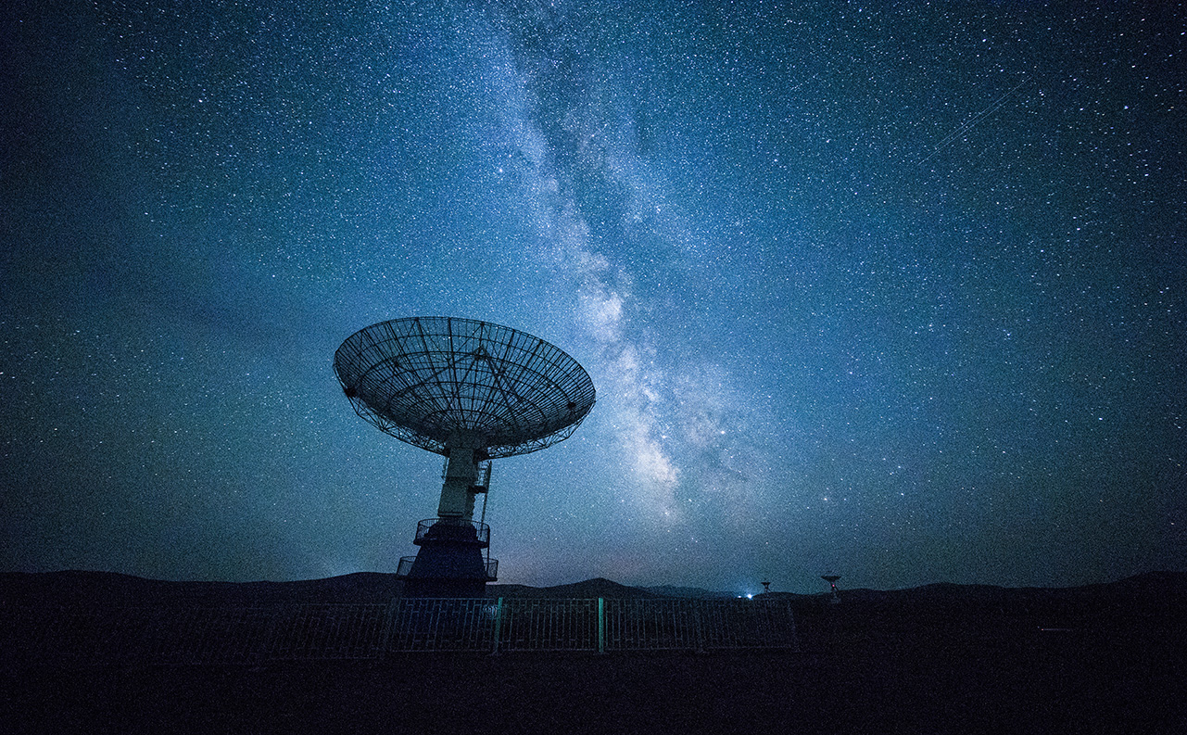
Business Objective
This project is to assist Fashion retailer to make data-driven decisions on the new locations that are most suitable for their new stores in Toronto.
In summary we will be looking for new store locations with below criteria:
- Location with coffee shops or café or restaurants.
- Location must have Fashion retail store / clothing store.
- Location must be from one of the four Boroughs –
East Toronto
Central Toronto,
Downtown Toronto
West Toronto.

Slide 3
Data acquisition and cleaning
Toronto City data that contains list Boroughs, Neighbourhoods along with their Postcodes scrapped from https://en.wikipedia.org/w/index.php?title=List_of_postal_codes_of_Canada:_M&direction=next&oldid=942655364
GeoSpace data that’s contains postcodes along with their latitude and longitude scrapped from http://cocl.us/Geospatial_data
Venues in each neighbourhood of Toronto city with the help of Foursquare API.
In total, raw data frame had 287 rows and 3 features.
After wrangling and cleaning the data, master data frame has all the required components Postal Code, Borough, Neighbourhood, Latitude & Longitude.
Cleaned data contains 39 rows and 5 features.

Slide 4
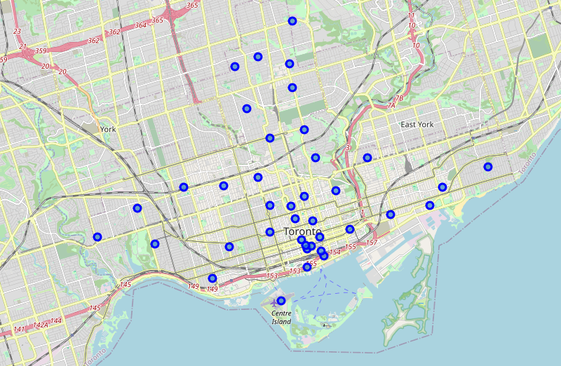
visualizeD geographic details of Clean data in Master data frame of Toronto City

Slide 5
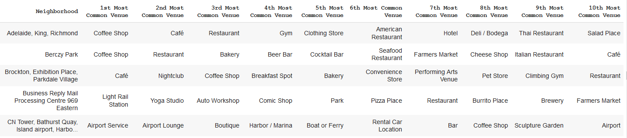
Data analysis and location data
Foursquare location data leveraged to explore venues for each neighbourhood.
Top 10 venues for each neighborhood has been extracted, in total 231 unique venue categories were returned by Foursquare. Below are few records for same.
Venue data further analyzed for frequency of occurrence of clothing store, coffee shops, café and restaurants in each neighborhood as per client criteria.

Slide 6
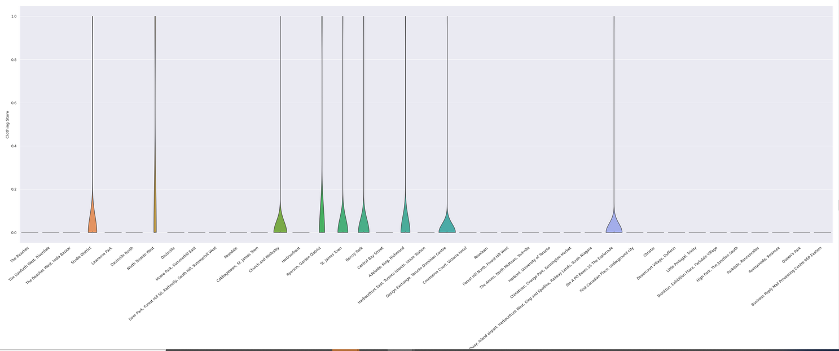
visualized frequency of occurrence of clothing store in each neighbourhood

Slide 7
Further Data analysis
So far we found that only below neighborhoods are having clothing store so for further analysis we will focus on these neighborhoods.
- Studio District
- North Toronto West
- Church and Wellesley
- Ryerson, Garden District
- St. James Town
- Adelaide, King, Richmond
- Design Exchange, Toronto Dominion Centre
further analysis has been performed for frequency of occurrence of coffee shops, café and restaurants in above neighborhood as per client criteria.

Slide 8
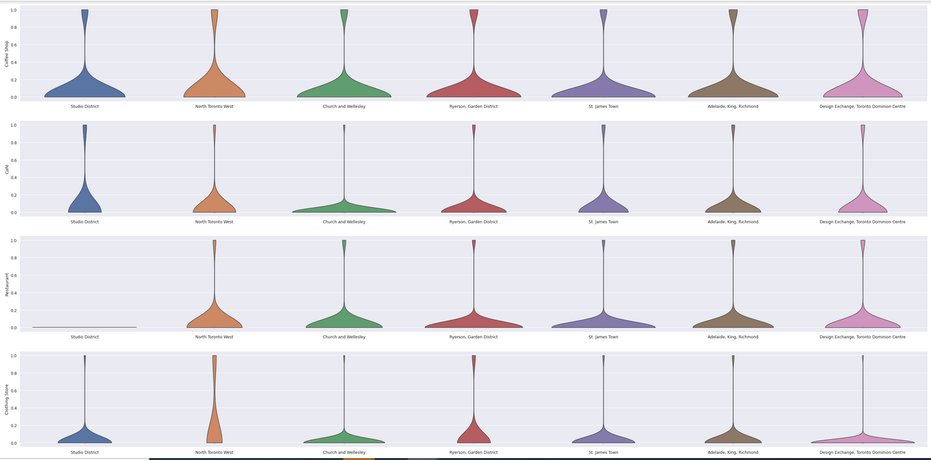
visualized frequency of occurrence of clothing store, coffee shops, café and restaurants

Slide 9
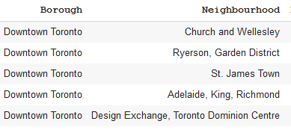
Result
Below 5 neighbourhood in Borough - Downtown Toronto are potential location for Client's new store.
These neighbourhoods have met the criteria set by client as they are lively with Coffee shops, Restaurants, Cafés and Clothing Stores. this will provide a good exposure and eventually help drive traffic into new store.

Slide 10
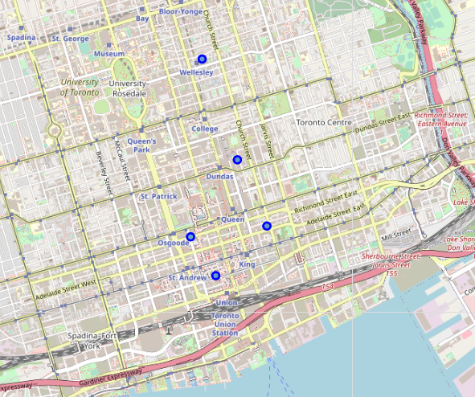
visualizeD geographic details of shortlisted neighbourhoods.

Slide 11
Conclusion and future direction
Built useful model to predict new store location for fashion retailer client.
The accuracy of model depends purely on the data provided by FourSquare.
In future, including financial data can help in improving the predictions

Slide 12

Thank You!
Akanksha Gupta

