Slide 1
TABLEAU_MAJOR assignment
By Akanksha kumari

Slide 2
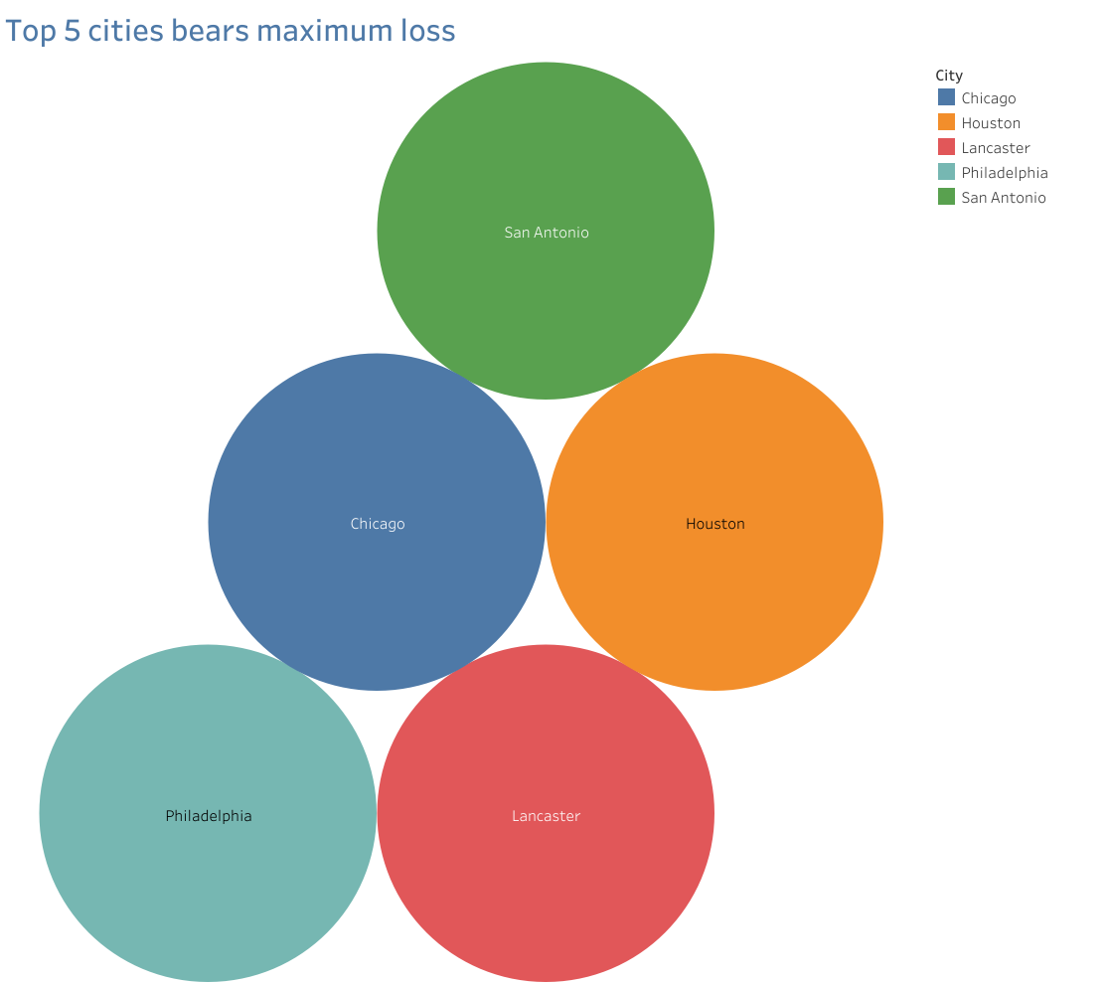

Slide 3
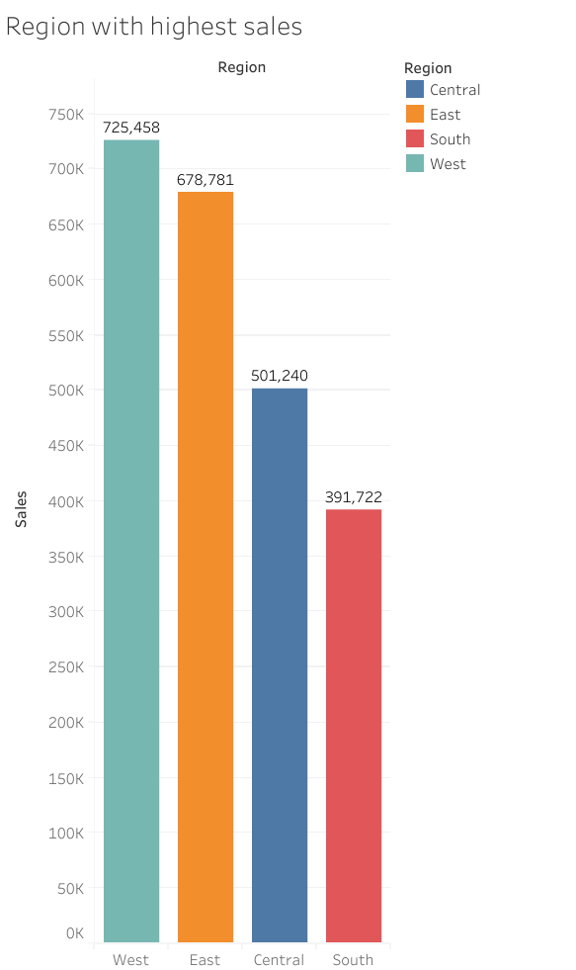

Slide 4
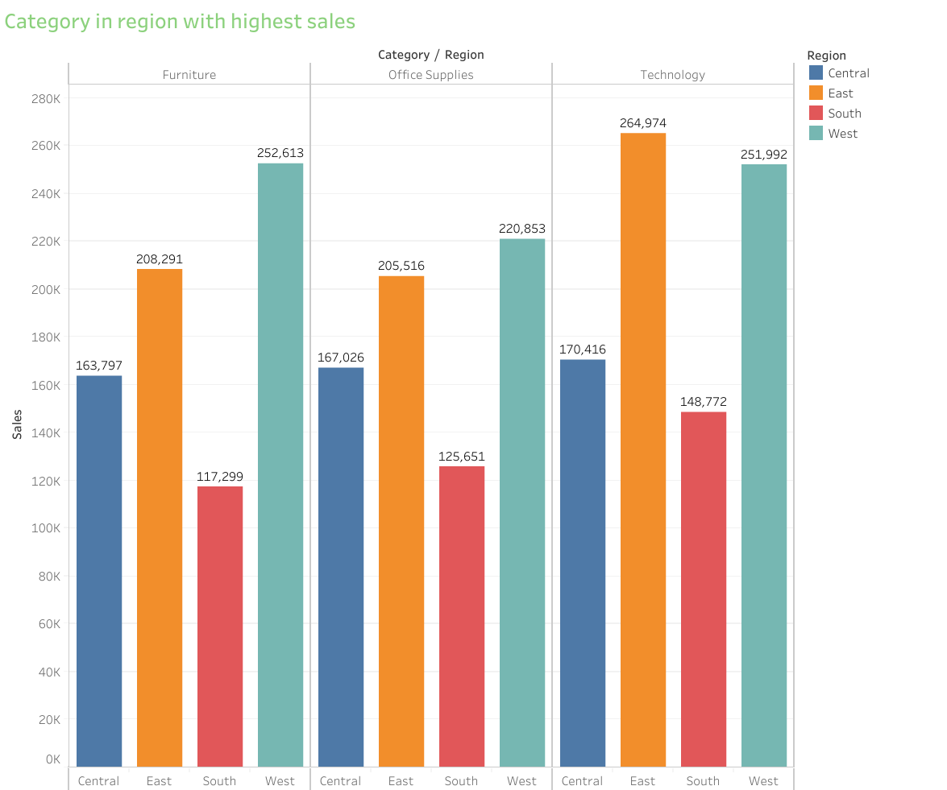

Slide 5
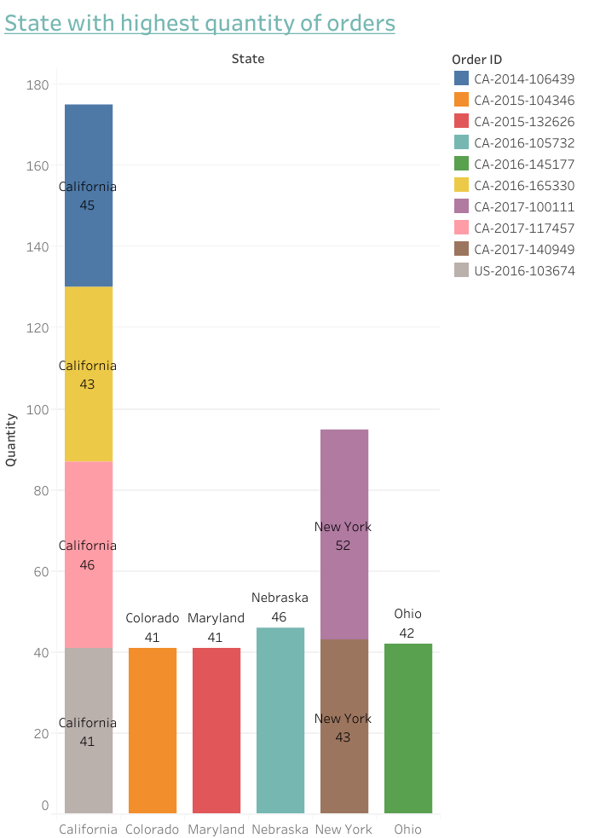

Slide 6
