Slide 1

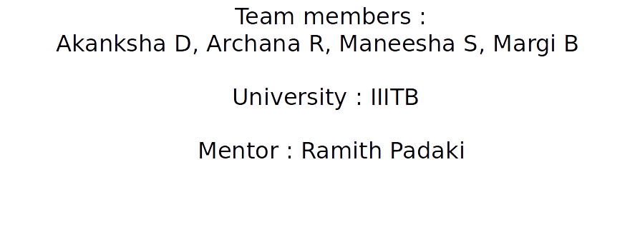
Interview Scheduler

Slide 2
Project Description
Interviews and meetings are a part of day to day activities of every corporate industry.
This project aims at automating the process of scheduling the interviews, thereby reducing the manual effort and human error.
This can be used for scheduling interviews at Amazon.

Slide 3
Problem Statement
Given a set of free room slots and free interviewer slots, schedule the possible interviews.
Send an email invite to the interviewers with the details of the time and place of the interview.

Slide 4
Solution
Approaches tried :
Greedy Algorithm
Maximum Bipartite matching

Slide 5
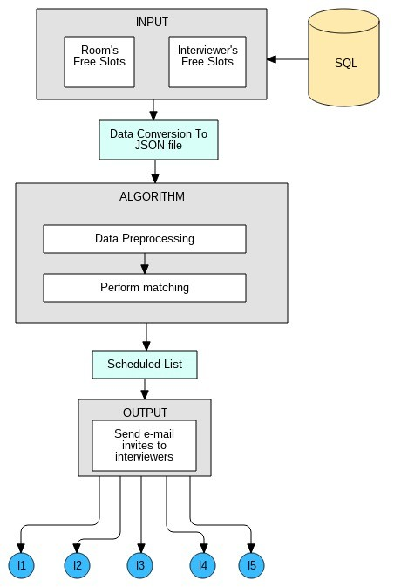

Slide 6
Greedy Approach
Combine all continuous slots of the same room
Sort the room slots and interviewer slots in the increasing order of the end times followed by start time.
Assign an interviewer to an available room, and modify the free-busy timings of that room.
Repeat the above step until all the interviewer slots are scanned.
Time complexity is O(mn + mlogm + nlogn)
where n = # of room slots, m = # of interviewer slots

Slide 7
Maximum Bipartite matching
Interview Scheduling can also be viewed as a Maximum Bipartite Matching (MBP) problem.
One set of nodes consists of free room slots, and the other one represents the interviewer’s slots.
There exist an edge from interviewer node to room slot node if the interviewer time interval falls within the room slot.
Max flow from this graph would give the maximum number of interviews that can be scheduled.
Time complexity O( MaxFlow * |E| )
where E = # of edges

Slide 8
Assumptions
Each interview is for one hour duration.
Interviewer slots are entered for a duration of one hour.

Slide 9
Future Scope
Enhance the algorithm to accept slots of Interviewees.
Schedule panel/group interviews
Flexible interview timings.

Slide 10
Learnings from the project
Flask server, Python
Explored the literature on greedy and graph approaches to tackle problems of similar kind.

Slide 11
THANK YOU

