Slide 1
UNIT-2

Slide 2
II | RPA Initiation & Implementation | 10
Initiation of RPA- Limitations & factors affecting in Implementing the RPA at the enterprise level - Environments setup for RPA Implementation- Infra types to implement the RPA – Automation Life Cycle in detail- RPA Feasibility Analysis- Process Design Document/Solution Design Document - Industries best suited for RPA Implementation - Risks & Challenges with RPA - RPA and an emerging ecosystem- Leaders in RPA - Future of RPA.

Slide 3
RPA Initiation and Implementation: Initiation of RPA
Initiation of RPA - Initiating Robotic Process Automation (RPA)
Getting Started with RPA:
Four Steps
1. Start Micro, Not Small:
○ Begin with very small, simple tasks that take 2-5 seconds to complete.
○ Avoid large, complex processes initially; focus on highly repetitive, low-effort tasks to ensure success.
2. Identify High-Value Candidates:
○ Choose tasks with clear, measurable business outcomes.
○ Focus on bottlenecks in repetitive processes and use techniques like process mining to identify automation opportunities.

Slide 4
3. Capture Processes at a Detailed Level:
○ Document tasks at a keystroke-and-click level.
○ Use tools like task mining for accuracy and to avoid resource wastage during this phase, which typically consumes 70% of project efforts.
4. Define Metrics for Success:
○ Develop a comprehensive business case, covering strategic alignment, workforce impact, operational metrics, and financial returns.
○ Plan to measure RPA outcomes to build confidence and gain stakeholder buy-in

Slide 5
Factors to Consider Before Automating
Understand the Process:
Evaluate and optimize processes before automating.
2. Set a Clear Roadmap:
Define benefits, limitations, and plans for monitoring and handling RPA tools.
3. Choose the Right Tool:
Select tools based on technical and functional requirements; no single
tool fits all.
4. Prepare Teams:
Train IT and business teams, address skill gaps, and foster adoption of the automation.

Slide 6
5. Standardize Environments:
Simplify automation with standardized workflows to minimize complexity and errors.
6. Ensure Proper Review:
Test thoroughly and monitor during production to handle dynamic environments effectively.
7. Control Costs:
Budget for tools, setup, and customization; avoid scope creep by setting clear objectives.

Slide 7
8. Calculate ROI:
Prioritize processes with high time and cost savings for the best returns.
9. Focus on Quality:
Apply strict quality control to prevent automation errors and ensure robust performance.
10. Plan for the Future:
Design automation solutions with flexibility for long-term scalability and adaptability

Slide 8
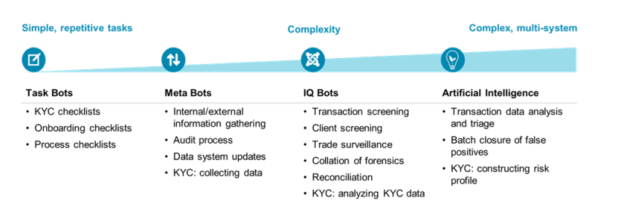
Consider All factors before Automate..

Slide 9
Limitations and factors affecting in implementing RPA at the enterprise level
Limitations of RPA:
○ Lack of Cognitive Abilities:
RPA handles rule-based processes but struggles with judgment-based tasks. Integrating AI/ML can help overcome this.
○ Dependence on Structured Data:
RPA requires structured data, limiting its application in processing unstructured inputs like emails and handwritten documents. Preprocessing tools can mitigate this issue

Slide 10
. ○ Partial Automation:
RPA automates specific tasks but often falls short of end-to-end process automation.
Integration with BPM and ITPA platforms enhances effectiveness.
○ Legacy System Dependency:
RPA often bypasses outdated systems
lacks deeper integration capabilities
serving as a short-term solution.

Slide 11
Governance and Security Concerns:
Challenges in credential management, cross-departmental access, and data security require robust governance frameworks.
○ Scalability Issues:
Expanding RPA across an enterprise is complex and requires strategic planning.

Slide 12
Factors Influencing RPA :
○ Process Selection: Focusing on repetitive, high-volume processes ensures better ROI.
○ Data Quality: Clean, structured data is essential for effective automation.
○ Cost and ROI: High initial costs necessitate realistic ROI projections and phased implementations.
○ System Integration: Effective middleware and API usage ensure smooth RPA deployment in diverse IT ecosystems.

Slide 13
○ Team Readiness: Training and change management are critical to overcoming resistance and skill gaps.
○ Compliance Requirements: Keep to regulatory standards is vital for secure and auditable workflows.
○ Vendor Selection: Choosing scalable and compatible RPA tools ensures long-term success.

Slide 14
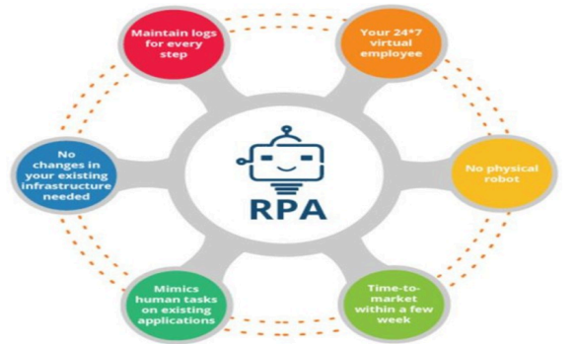
Environment setup for RPA Implementation

Slide 15
Key considerations for a successful RPA environment setup
Licensing: Ensure that the necessary licenses for the RPA tool cover all environments (Dev, Test, and Prod) and comply with vendor terms.
Virtual and Cloud Support: Evaluate the RPA tool’s compatibility with virtual machines (VM) or cloud setups, as most organizations are adopting these technologies.
Application Access: Test application compatibility with server setups, particularly for VMs
Security Policies: Address security differences between desktops and VMs to prevent interference with RPA functionality..

Slide 16
5. Software Updates: Collaborate with the infrastructure team to test software updates in lower environments before applying them to production, avoiding disruption to RPA automations.
6. Access Restrictions: Implement controlled access to higher-level environments based on business needs and security policies.
7. Supporting Tools: Ensure that auxiliary tools like OCR, Microsoft Office, and email systems are integrated into the infrastructure according to RPA guidelines.

Slide 17
8. Application Server Versions: Ensure compatibility between desktop and server versions of applications to prevent conflicts in virtual environments.
9. Active Directory Groups: Control Active Directory groups for efficient access management, assigning permissions based on specific user roles and organizational requirements

Slide 18
RPA Infrastructure Setup- 1. Environment Setup
○ Separate Dev, Test, and Prod environments with unique names and access controls.
Each environment must include:
■ A dedicated database connected to its Blue Prism/UI Path Studio Application Server.
■ Dev: Developer desktops, 1+ runtime resource, and 1+ interactive control.
■ Test: 1+ runtime resource (more for multi-bot tests), 1+ interactive control, no developer access.
■ Prod: Resources based on use case, 1+ runtime resource, and 1+ interactive control

Slide 19
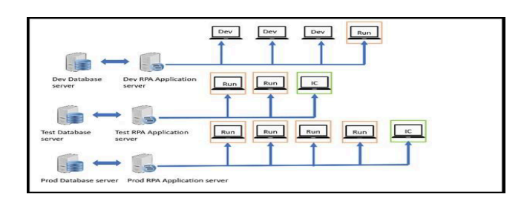

Slide 20
2. Best Practices
○ Plan Early: Begin setup during the POC phase to account for SLAs and approvals.
○ Distinct Environments: Use separate environments to reduce risks and enable efficient deployment.
○ Runtime Resource Consistency: Match production setup across all environments to avoid testing issues.
○ Code Promotion: Promote code from Dev → Test → Prod without direct changes in Test/Prod.
○ Monitoring: Regularly monitor Prod, schedule downtimes, and maintain checklists for maintenance tasks.

Slide 21
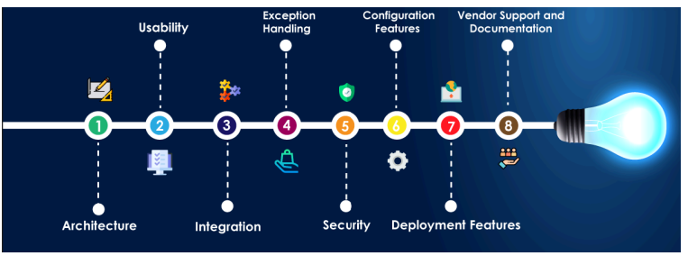
Benefits
○ Accelerates deployment, reduces errors, minimizes risks, and ensures system reliability.

Slide 22
Infra types to implement RPA
Considerations:
The choice of infrastructure depends on budget, security, scalability, existing IT systems, and organizational needs.
Carefully evaluate each option’s pros and cons to align with business goals.

Slide 23
RPA Infrastructure Types: Summary
Hosted within the organization’s premises with full control over data, security, and system integration.
Pros: High security, continuous integration.
Cons: High upfront costs, ongoing maintenance, limited scalability.

Slide 24
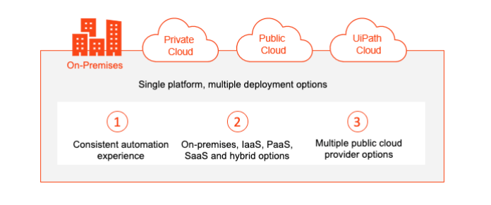
. On-Premises Infrastructure

Slide 25
Cloud Infrastructure
○ Hosted on cloud platforms like AWS, Azure, or Google Cloud.
○ Pros: Flexible, scalable, pay-as-you-go model, no hardware investment.
○ Cons: Potential connectivity issues, data security, and compliance concerns.

Slide 26
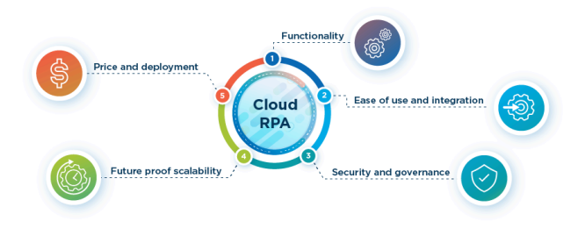

Slide 27
Hybrid Infrastructure
Combines on-premises and cloud components.
Pros: Balances security and scalability, cost-efficient.
Cons: Complex integration and planning required.

Slide 28
Managed Service Providers (MSPs)
○ Outsourced RPA setup and management by specialized providers.
○ Pros: Reduces operational burden, leverages expertise.
○ Cons: Relies on provider reliability, data privacy concerns, requires SLAs.

Slide 29
Virtual Desktop Infrastructure (VDI)
○ Centralized RPA software accessed through virtual desktops.
○ Pros: Centralized management, improved security, remote access, simplified updates.
○ Cons: Requires adequate infrastructure, network bandwidth, and planning for user experience

Slide 30
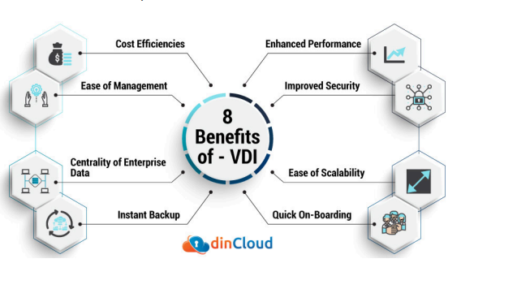

Slide 31
Automation Life Cycle in detail:
The Automation Life Cycle outlines the stages involved in
Planning, implementing, and managing automation initiatives like Robotic Process Automation (RPA).

Slide 32
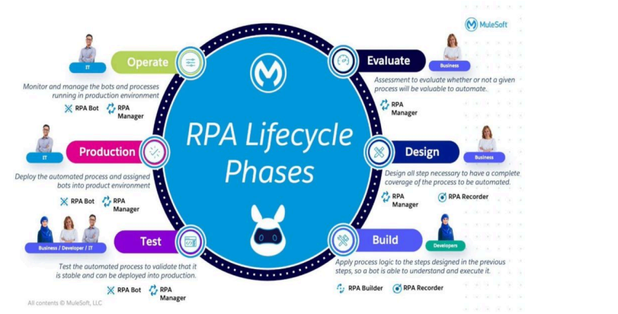

Slide 33
Discovery and Assessment
. ● Identify and Prioritize Processes: Assess processes based on criteria like volume, complexity, rules-based nature, and potential ROI.
● Conduct Process Walkthroughs: Understand the process steps, inputs, outputs, and dependencies to evaluate automation feasibility.
● Business Case Analysis: Analyze costs, benefits, ROI, and alignment with organizational strategy to justify automation.

Slide 34
Design and Development
● Define Automation Objectives: Clearly define goals and expected outcomes.
● Map Process Workflows: Create detailed flow diagrams to visualize process steps and identify automation opportunities.
● Develop Automation Scripts: Use RPA tools or programming languages to replicate manual tasks.
● Configure Automation Rules: Define decision logic and exception handling rules in the automation scripts.
● Test and Validate: Perform thorough testing to ensure the automation works as intended, handles exceptions, and meets quality standards.

Slide 35
Deployment
● Prepare the Environment: Set up infrastructure, resources, and permissions for production.
● Deploy Automation Scripts: Transfer validated scripts to production and configure schedules or triggers.
● Integrate with Systems: Ensure seamless data exchange, security, and compatibility with existing systems.
● User Training: Train users and stakeholders on the functionality and management of the automation.

Slide 36
Operations and Monitoring
● Monitor Performance: Track success rates, cycle times, error rates, and resource utilization.
● Handle Exceptions and Errors: Set up processes for error logging, notifications, and resolutions.
● Maintain and Update: Regularly update scripts to adapt to process changes, system updates, or optimizations.
● Governance and Control: Implement access controls, version management, and change management processes to ensure compliance and reliability.

Slide 37
Continuous Improvement
● Collect Feedback and Insights: Engage stakeholders and monitor systems to identify improvement opportunities.
● Analyze Automation Data: Use analytics to identify bottlenecks and optimize workflows.
● Iteratively Enhance: Implement and validate improvements to enhance performance.
● Scale and Expand: Identify additional processes for automation and repeat the life cycle to broaden automation efforts.

Slide 38
RPA Feasibility Analysis:
RPA feasibility analysis assesses whether processes are suitable for automation and the potential benefits of implementation. It consists of two stages

Slide 39
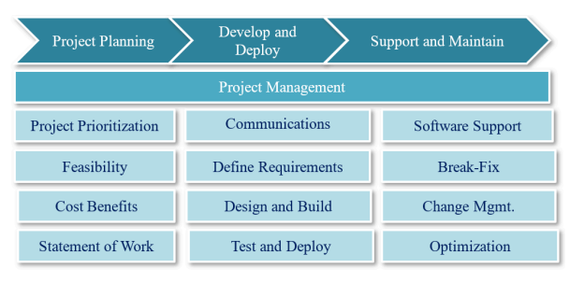

Slide 40
Process Examination
● Detailed Process Mapping: Document each step, including keystrokes and mouse clicks.
● Rule-Based Assessment: Identify rule-based tasks and additional decision-making needs.
● Data Validation: Confirm input types (structured/unstructured) and create templates.
● Scenarios and Timelines: Define scenarios, track request times, and identify automation opportunities.

Slide 41
Technical Feasibility
● Logic Validation: Confirm defined rules, input/output data, and manual intervention needs.
● Complexity Analysis: Assess transaction volume, system compatibility, and data flows.
● Process Re-engineering: Standardize or re-engineer processes as necessary.

Slide 42
Components for Feasibility Study
Process Level:
○ Create process documentation and error-handling workflows.
○ Highlight common errors and escalation processes.
2. Metrics:
○ Define schedules, transaction volumes, error counts, and resolution times.
3. Applications & Data:
○ Detail applications, triggers, inputs, outputs, and test environment access.
4. Support:
○ Provide resource availability, SLA details, and support for User Acceptance Testing (UAT).

Slide 43
Considerations
1. Process Suitability:
○ Focus on repetitive, rules-based, high-volume processes with low complexity.
2. Potential Benefits:
○ Evaluate cost savings, productivity gains, improved accuracy, scalability, and streamlined processes.
3. Technological Factors:
○ Ensure system compatibility, data security, IT infrastructure readiness, and tool availability.
4. Organizational Factors:
○ Assess change management, stakeholder alignment, and ROI.
5. Risk Assessment:
○ Identify risks (security, compliance, job displacement) and develop mitigation strategies

Slide 44
The feasibility analysis provides a foundation for RPA implementation, helping organizations:
● Evaluate the suitability of processes.
● Estimate benefits and ROI.
● Address risks and technical challenges.
● Build a business case for successful automation adoption

Slide 45
Process Definition Document (PDD) and Solution Design Document (SDD):
Both documents ensure clear communication, alignment, and efficient automation implementation.
Process Definition Document (PDD)
The PDD serves as a blueprint for documenting an existing process before automation.
It provides developers and stakeholders with a detailed understanding of the process to ensure successful automation implementation.

Slide 46
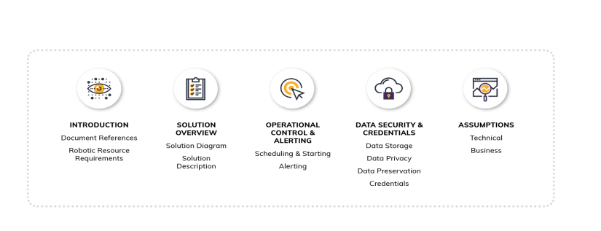

Slide 47
Key Sections of PDD:
Introduction
As-Is Process
To-Be Process Description
Reporting
Additional References

Slide 48
Introduction
○ Purpose: Explains the document's importance and utility for automation.
○ Objectives: Highlights business goals, e.g., reducing execution time. ○ Key Contacts: Lists stakeholders responsible for process clarifications.
○ Prerequisites: Details necessary tools, permissions, test data, and client environment setup.

Slide 49
As-Is Process
○ Overview: Describes the current process, including manual execution time.
○ Applications Used: Lists applications involved in the existing process.
○ Process Steps: Provides a step-by-step description of the current process.

Slide 50
To-Be Process Description
Process Map: Shows the revised process flow (e.g., diagrams).
○ Process Steps: Documents the bot's automation flow and execution steps.
○ Scope: Differentiates between activities within and outside the bot's capabilities.
○ Exception Handling: Defines known business and application exceptions.

Slide 51
○ Reporting
Specifies who receives execution and exception reports.
Additional References
Lists videos or documents used during PDD creation.

Slide 52
Solution Design Document (SDD)
The SDD is prepared by developers or senior developers to detail the technical solution for automating a selected process.
It complements the PDD by focusing on how the bot will perform automation tasks.
Key Sections of SDD
1. Introduction
2. To-Be Process Description
3. Applications Interaction
4. Runtime Details
5. Approval

Slide 53
Solution Design Document (SDD)
○ Introduction
Purpose: Outlines the solution's objectives and key components.
○ Process Details: Highlights key elements, version, and approval details.
To-Be Process Description
Process Flow: Describes workflows and logic diagrams, including bot interactions (e.g., screen clicks, dropdowns).
○ Exception Handling: Details mechanisms for handling errors during runtime

Slide 54
. Solution Design Document (SDD)
Applications Interaction
○ Shows how the bot integrates with various applications.
Runtime Details
○ Includes screenshots, logic flow, and execution details.
Approval
SDD is sent for client approval.
Once approved, the process is ready for development.

Slide 55
Industries Best Suited for RPA Implementation
Robotic Process Automation (RPA) is transforming industries by automating repetitive, rule-based processes.
Below are some industries where RPA is particularly impactful, along with examples of how RPA improves efficiency and reduces costs.
Manufacturing
Healthcare
Banking and Finance
Retail
Insurance

Slide 56
1. Manufacturing
RPA has revolutionized production and operational workflows in the manufacturing sector.
● Streamlining Assembly Line Processes: Automates material handling, quality checks, and packaging, improving production efficiency and reducing human error.
● Improving Quality Control: Monitors production lines, detects defects in real-time, and ensures consistency in manufacturing standards.
● Reducing Production Time and Costs: Optimizes assembly line operations and supply chain management, cutting costs and improving productivity.

Slide 57
2. Healthcare
Healthcare organizations leverage RPA to enhance operations and patient care.
● Automating Administrative Tasks: Handles data entry, appointment scheduling, medical coding, and billing to reduce human errors.
● Enhancing Patient Care Through Telemedicine: Supports telemedicine services by automating virtual appointment scheduling and reminders.
● Improving Accuracy in Medical Diagnosis: Automates data analysis and report generation, enabling quicker and more precise diagnoses.

Slide 58
3. Banking and Finance
Financial institutions use RPA to ensure compliance, improve efficiency, and enhance customer service.
● Automating Data Entry and Processing: Simplifies account management, loan processing, and data reconciliation.
● Improving Fraud Detection and Prevention: Identifies suspicious patterns in transactions using real-time data monitoring.
● Enhancing Customer Service Through Chatbots: Provides 24/7 assistance for customer inquiries, improving user satisfaction

Slide 59
4. Retail
RPA is a critical tool for improving retail operations and customer experience.
● Automating Inventory Management: Tracks inventory levels, triggers stock replenishment, and ensures optimal stock levels.
● Improving Supply Chain Management: Streamlines order processing and delivery tracking, reducing lead times.
● Enhancing Customer Experience Through Personalized Recommendations: Uses customer data to generate personalized offers and suggestions, boosting sales and loyalty.

Slide 60
5. Insurance
Insurance companies use RPA to automate core processes and improve service quality.
● Automating Claims Processing: Expedites the claims lifecycle from data collection to verification, reducing errors and turnaround time.
● Improving Risk Assessment and Underwriting: Automates underwriting tasks, ensuring accurate and consistent policy decisions. ● Enhancing Customer Service Through Chatbots: Handles policy inquiries and claims updates in real-time, improving customer satisfaction.

Slide 61
Benefits of RPA Across Industries
● Efficiency Gains: Automates repetitive processes, allowing employees to focus on higher-value tasks.
● Cost Savings: Reduces manual labor costs by automating workflows. ● Improved Accuracy: Minimizes human errors in data processing and analysis.
● Scalability: Quickly scales processes to meet increased demand without hiring additional staff.
RPA is a versatile tool that adapts to industry-specific needs, making it a valuable investment for businesses aiming to streamline their operations and stay competitive in a digital world

Slide 62
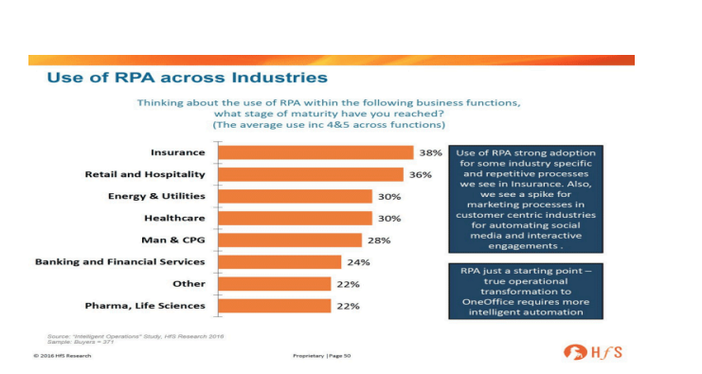

Slide 63
Risks and Challenges with RPA
RPA Strategy Risks
RPA has the potential to drive innovation, enhance customer service, and improve competitiveness.
Setting incorrect goals or misusing RPA for isolated tasks can prevent organizations from realizing its full value.
Key risks include:
● Missed Value: Focusing on cost-cutting rather than innovation.
● Lack of Strategic Intent: Absence of clear objectives.
● No End-Point Design: Undefined end goals.
● One-Off Goals: Isolated implementation without broader integration.
● Under-Resourcing: Inadequate allocation of resources.
● Damaged Reputation: Negative workforce sentiment and external perceptions

Slide 64
RPA Sourcing Risks
Incorrect sourcing models can result in excessive costs and inefficiencies.
Examples include:
● Lack of Internal Skills: Insufficient expertise for in-house solutions.
● Wrong Consulting Partner: Selecting ineffective advisors.
● Late External Advisors: Engaging expertise too late in the process.
● Cloud/Data Compliance Risks: Security and regulatory challenges

Slide 65
Tool Selection Risks
Market hype around RPA tools can lead to suboptimal choices.
Risks include:
● Wrong Tool Selection: Choosing tools that do not meet requirements.
● "RPA Washing": Misleading claims about capabilities.
● Overcrowded Market: Confusion due to numerous vendors.

Slide 66
Stakeholder Buy-In Risks
Successful RPA implementation requires collaboration across multiple stakeholders.
Key risks include:
● Employee Pushback: Fear of job loss.
● Non-Cooperative IT: Resistance from IT teams.
● Union Backlash: Labor disputes.
● Lack of Visible Progress: Delayed results reducing confidence.

Slide 67
Launch/Project Risks
Launching RPA projects without proper planning can lead to failure.
Examples include:
● Wrong Use Cases: Poorly chosen automation opportunities.
● Unrealistic Expectations: Overpromising results.
● Excessive Automation: Trying to automate everything at once.
● Bad Shortcuts: Skipping crucial steps like testing and documentation.

Slide 68
Operational/Execution Risks
Poor operational models can lead to inefficiencies when bots are deployed.
Risks include:
● Robot Failures: Bots malfunctioning or stopping unexpectedly.
● Insufficient Bot Force: Not enough bots to handle the workload.
● High Maintenance Costs: Expensive to sustain operations.

Slide 69
Change Management Risks
Change management is crucial for successful RPA adoption.
Risks include:
● No Change Management Strategy: Lack of planning for transitions. ● Misaligned HR Messaging: Inconsistent communication with employees.
● Blurred Roles: Undefined responsibilities post-automation.
● Lack of Expertise: Insufficient knowledge to manage changes.
● Poor Communication Plans: Ineffective information dissemination

Slide 70
Maturity Risks
Expanding RPA initiatives across business units introduces sustainability risks, such as:
● Momentum Stalls: Loss of progress after initial deployment.
● Underutilization of Bots: Bots not being fully utilized.
● Duplicated Efforts: Redundant automation across teams.
● Skills Shortage: Lack of qualified personnel for advanced automation.
● Integration Challenges: Failure to integrate with other technologies.

Slide 71
Challenges in RPA Implementation
Shortage of Skilled Resources
The RPA market faces a talent shortage, with experienced professionals demanding high salaries, creating resource constraints.
End-to-end use Case Automation
Some processes require integration with machine learning or OCR, increasing costs and complexity.

Slide 72
Lack of Business Support
Inefficient collaboration during process documentation and testing leads to suboptimal results.
Poor Team Structure
Undefined roles and shared resources across projects can delay milestones.
Vague Business Continuity Plans
Organizations often underestimate the maintenance required for bots, leading to disruptions during failures

Slide 73
Culture Shock
Employee resistance and fear of job loss hinder RPA adoption.
Incorrect Use Case Identification
Poorly chosen use cases result in low ROI and missed efficiency improvements.
Ignoring Best Practices
Failure to follow best practices complicates debugging, transitions, and upgrades

Slide 74
Insufficient Vendor Support
Limited support from RPA vendors can delay or hinder implementation.
Post-Implementation Adoption
Organizations fail to address pushbacks and operational challenges post-deployment.

Slide 75
Conclusion
RPA is a disrupting innovation that offers immense benefits but comes with its own set of risks and challenges.
Preparing for these risks through proper planning, stakeholder alignment, and strategic intent can help organizations maximize RPA’s potential and achieve long-term success.

Slide 76
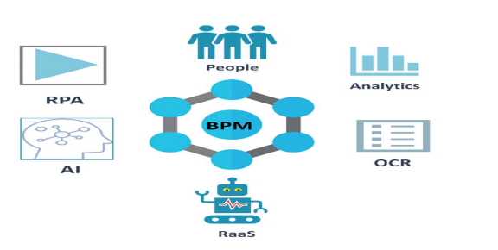
RPA and an emerging ecosystem:
This ecosystem boosts RPA’s scope, efficiency, and potential for driving digital transformation
RPA is evolving within a broader ecosystem of technologies and practices that enhance its capabilities, including

Slide 77
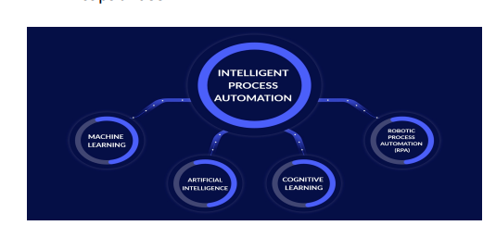
Intelligent Automation: Integration with AI, ML, NLP, and Computer Vision for cognitive capabilities.

Slide 78
Process Mining & Analytics:
Identifying inefficiencies and optimizing automation with data insights.
● Low-Code/No-Code Platforms:
Simplifying RPA development for non-technical users.
● Hyper Automation:
End-to-end process automation using multiple technologies.
● Automation Marketplaces:
Access to pre-built components and templates for faster deployment

Slide 79
. ● Governance Tools:
Ensuring compliance, control, and auditability.
● Digital Workforce Management:
Efficiently managing and monitoring software robots.
● Collaboration Platforms:
Seamless integration with enterprise systems for improved interoperability.

Slide 80
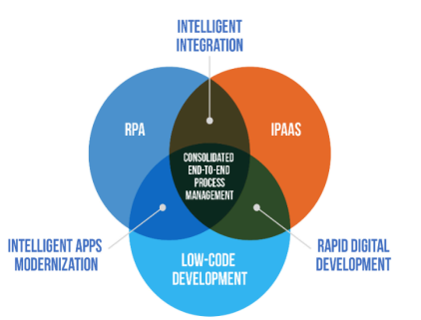

Slide 81
Leaders in RPA
Leaders are recognized for their market presence, capabilities, and customer base, with each catering to different organizational needs.
Several companies are leading the RPA market, each offering unique features and capabilities:
● UiPath: A comprehensive RPA platform known for its ease of use, robust automation, and strong developer community.
● Automation Anywhere: Offers intelligent automation, cognitive capabilities, and scalable architecture with excellent customer support.
● Blue Prism: Enterprise-grade RPA platform with AI integration and centralized control, popular across multiple sectors.

Slide 82
● Microsoft Power Automate: Part of Microsoft’s ecosystem, providing low-code RPA integration with other Microsoft products
Pega Systems: Combines RPA, case management, and AI, focusing on intelligent automation and complex process handling.
● Kofax: Provides intelligent automation with RPA, cognitive capture, and process orchestration, strong in banking and healthcare.
● NICE: Offers RPA, workforce optimization, and customer experience management, excelling in customer service and contact center automation

Slide 83
Future of RPA
The future of RPA highlights the growing importance and potential of RPA in transforming businesses
1.Increased Automation Investment:
Over 80% of organizations plan to increase automation spending, focusing on RPA, AI, DPA, and IDP to drive performance, revenue, and innovation.
2. RPA as the "Soul" of Automation:
RPA will be central to automation efforts, integrating with AI to streamline workflows and enhance processes.

Slide 84
3. Intelligent Automation Support:
AI and Machine Learning will expand RPA's capabilities to handle more complex, human-like tasks like decision-making and customer interaction.
4. Out-of-the-Box Software:
New software robots will simplify RPA implementation, using semantic understanding to automate tasks without detailed instructions.
5. Automation Assistants and Virtual Assembly Lines:
Digital assistants will automate repetitive tasks across multiple applications, increasing efficiency in workplaces.

Slide 85
6. Robot Workers:
Service industries will invest in robot workers to handle physically demanding tasks, addressing worker shortages and improving productivity.
7. Automated Process Discovery:
Tools like Discover will help businesses identify automation opportunities and optimize processes through intelligent discovery.
8. Continued Automation Growth:
Automation will expand into new areas, such as autonomous vehicles and healthcare robots, driving innovation across industries.

Slide 86
COs | Upon completion of course the students will be able to | PO2 | PO3 | PO6 | PO12 | PSO1
CO1 | outline the basics of RPA | 3 | 3 | 3 | 3 | 3
CO2 | implement RPA | 3 | 3 | 3 | 3 | 3
CO3 | demonstrate RPA tools and automation techniques | 2 | 2 | 3 | 3 | 3
CO4 | adapt RPA BOT Models | 3 | 3 | 3 | 3 | 3
CO5 | execute Orchestrator | 3 | 3 | 3 | 3 | 3

