Slide 1
Expert Systems in Artificial Intelligence
Overview, Roles, Architecture, Knowledge Acquisition & Case Studies (MYCIN, DART, XOON)

Slide 2
Introduction to Expert Systems
What is an Expert System?
- A computer system that emulates decision-making abilities of a human expert. - Operates through a set of rules derived from domain-specific knowledge. - Early branch of AI used for solving complex problems within specific domains (e.g., medicine, engineering).

Slide 3
Roles of Expert Systems
- Decision Support
- Knowledge Automation
- Problem-Solving
- Advisory Systems

Slide 4

Architecture of Expert Systems
Core Components:
- Knowledge Base: Repository of facts, rules, and heuristics.
- Inference Engine: Processes rules and applies them to data.
- User Interface: Interaction between users and system.
- Explanation Facility: Explains reasoning behind decisions.
- Knowledge Acquisition Module: Adds, refines, or updates knowledge.

Slide 5
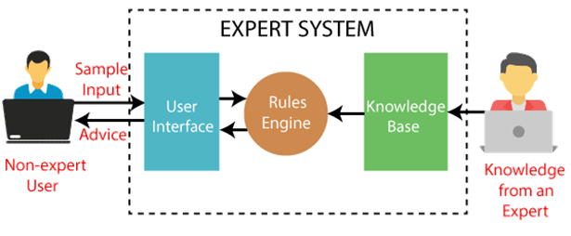
Architecture of Expert Systems

Slide 6
COMPONENTS OF EXPERT SYSTEM
1) USER INTERFACE
2) INFERENCE ENGINE
3) KNOWLEDGE BASE

Slide 7


USER INTERFACE
With the help of a user interface, the expert system interacts with the user, takes queries as an input in a readable format, and passes it to the inference engine. After getting the response from the inference engine, it displays the output to the user. In other words, it is an interface that helps a non-expert user to communicate with the expert system to find a solution

Slide 8
INFERENCE ENGINE(RULES OF ENGINE)
The inference engine is known as the brain of the expert system as it is the main processing unit of the system.
There are two types of inference engine:
Deterministic Inference engine: The conclusions drawn from this type of inference engine are assumed to be true. It is based on facts and rules.
Probabilistic Inference engine: This type of inference engine contains uncertainty in conclusions, and based on the probability.

Slide 9
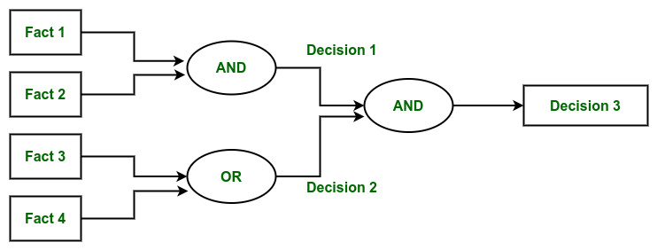
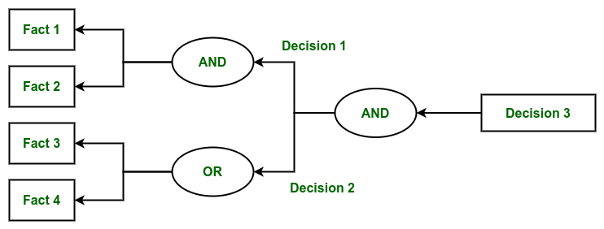
Reasoning Strategies used by Inference Engine

Slide 10
KNOWLEDGE BASE
The knowledgebase is a type of storage that stores knowledge acquired from the different experts of the particular domain. It is considered as big storage of knowledge. The more the knowledge base, the more precise will be the Expert System.
Components of Knowledge Base
Factual Knowledge: The knowledge which is based on facts and accepted by knowledge engineers comes under factual knowledge.
Heuristic Knowledge: This knowledge is based on practice, the ability to guess, evaluation, and experiences.

Slide 11
Knowledge Representation: It is used to formalize the knowledge stored in the knowledge base using the If-else rules.
Knowledge Acquisitions: It is the process of extracting, organizing, and structuring the domain knowledge, specifying the rules to acquire the knowledge from various experts, and store that knowledge into the knowledge base
Explanation System:
Knowledge Acquisition Module:
Working Memory:

Slide 12
Knowledge Acquisition
Knowledge acquisition process of gathering, structuring, and encoding domain-specific knowledge into the system’s knowledge base
Knowledge Acquisition Process:
The knowledge acquisition process typically involves the following steps:
Identify the Domain: Determine the specific area in which the expert system will operate (e.g., medical diagnosis, financial planning).
Engage Experts: Collaborate with domain experts to extract relevant knowledge. Knowledge engineers work closely with experts through interviews, observations, and discussions to gather insights.
Extract Knowledge: Collect detailed information, including facts, rules, heuristics, and procedures used by experts.
Encode Knowledge: Translate the extracted knowledge into a formal representation that the expert system can process (e.g., production rules, decision trees).
Validate Knowledge: Check the encoded knowledge for accuracy, completeness, and consistency. Often, experts review the knowledge base to ensure it reflects real-world expertise.
Implement and Test: Integrate the knowledge into the expert system and test it using real-world scenarios to evaluate its performance.
Refinement and Updating: Based on feedback and new information, refine and update the knowledge base to improve the system's accuracy and effectiveness.

Slide 13
META KNOWLEDGE
Meta-knowledge in expert systems within artificial intelligence (AI) refers to "knowledge about knowledge." It encompasses information about how the system’s knowledge should be used, organized, and controlled to enhance its reasoning processes.

Slide 14
Importance of Meta-Knowledge in Expert Systems:
Improved Decision-Making: Meta-knowledge helps the system decide which rules to apply and in what order. This enables the system to choose the best path when making decisions or solving problems.
Control of Reasoning: It allows the system to control its reasoning process by managing how it searches for solutions, handles uncertainty, or decides between multiple potential actions.
Enhancing Flexibility: With meta-knowledge, expert systems can adapt their strategies to varying contexts, making them more flexible in dealing with complex and dynamic situations.

Slide 15
Types of Meta Knowledge
Control Knowledge
Heuristic Knowledge
Knowledge about Uncertainty
Knowledge Organization

Slide 16
HEURISTICS
Heuristics in expert systems refer to strategies or rules of thumb that guide the system’s problem-solving processes. These are not strictly algorithmic but are based on practical, experience-driven knowledge to simplify decision-making and improve the efficiency of proble
Role of Heuristics in Expert Systems:
Simplify Decision-Making.
Improve Efficiency
Manage Uncertainty
Speed Up Processing

Slide 17
Knowledge Acquisition
Knowledge acquisition process of gathering, structuring, and encoding domain-specific knowledge into the system’s knowledge base. This knowledge allows the system to make informed decisions or solve problems like a human expert.
Here’s a detailed explanation of each point in the knowledge acquisition process with examples:
Knowledge Acquisition Process:
The knowledge acquisition process typically involves the following steps:
Identify the Domain: Determine the specific area in which the expert system will operate (e.g., medical diagnosis, financial planning).
Engage Experts: Collaborate with domain experts to extract relevant knowledge. Knowledge engineers work closely with experts through interviews, observations, and discussions to gather insights.
Extract Knowledge: Collect detailed information, including facts, rules, heuristics, and procedures used by experts.
Encode Knowledge: Translate the extracted knowledge into a formal representation that the expert system can process (e.g., production rules, decision trees).
Validate Knowledge: Check the encoded knowledge for accuracy, completeness, and consistency. Often, experts review the knowledge base to ensure it reflects real-world expertise.
Implement and Test: Integrate the knowledge into the expert system and test it using real-world scenarios to evaluate its performance.
Refinement and Updating: Based on feedback and new information, refine and update the knowledge base to improve the system's accuracy and effectiveness.

Slide 18
Meta Knowledge
Meta-knowledge in expert systems within artificial intelligence (AI) refers to "knowledge about knowledge." It encompasses information about how the system’s knowledge should be used, organized, and controlled to enhance its reasoning processes. While the core knowledge base in an expert system contains facts, rules, and heuristics specific to a particular domain, meta-knowledge guides the system on how to use this domain knowledge effectively.
Importance of Meta-Knowledge in Expert Systems:
Improved Decision-Making: Meta-knowledge helps the system decide which rules to apply and in what order. This enables the system to choose the best path when making decisions or solving problems.
Control of Reasoning: It allows the system to control its reasoning process by managing how it searches for solutions, handles uncertainty, or decides between multiple potential actions.
Enhancing Flexibility: With meta-knowledge, expert systems can adapt their strategies to varying contexts, making them more flexible in dealing with complex and dynamic situations.

Slide 19
Types of Heuristics in Expert Systems:
Rule-Based Heuristics
Description: Simple if-then rules derived from expert knowledge or common practices.
Example: In a medical diagnosis system, a heuristic might be: “If the patient has a high fever and a rash, then check for possible viral infections first.” This rule simplifies the diagnostic process by prioritizing certain conditions based on common symptom patterns.
Similarity-Based Heuristics
Description: Using past cases or examples that are similar to the current problem to guide decision-making.
Example: In a legal expert system, a heuristic might be: “If the current case resembles a previously resolved case with a similar contract clause, use the same interpretation as in the previous case.”
Experience-Based Heuristics
Description: Heuristics derived from the accumulated experience of experts in the field.
Example: In financial planning, a heuristic might be: “For clients nearing retirement, prioritize low-risk investments to preserve capital,” based on experienced advisors’ observations about client behavior and market trends.
Pattern Recognition Heuristics
Description: Identifying and applying patterns observed in historical data.
Example: In fraud detection systems, a heuristic might be: “Flag transactions that are significantly higher than the user’s typical spending patterns,” based on observed patterns of fraudulent activity.
Constraint-Based Heuristics
Description: Applying constraints or limitations to reduce the search space for solutions.
Example: In a scheduling system, a heuristic might be: “Assign tasks to available time slots that do not exceed the capacity of the resource,” to ensure that scheduling is feasible given resource constraints.
Greedy Heuristics
Description: Making locally optimal choices at each step with the hope of finding a globally optimal solution.
Example: In route planning, a heuristic might be: “Always choose the shortest available path to the destination,” which simplifies the routing process by focusing on local optimizations

Slide 20
Heuristics
Heuristics in expert systems refer to strategies or rules of thumb that guide the system’s problem-solving processes. These are not strictly algorithmic but are based on practical, experience-driven knowledge to simplify decision-making and improve the efficiency of problem-solving. Heuristics help expert systems make reasonable decisions in complex or uncertain situations by applying general principles that have proven effective in similar scenarios.
Role of Heuristics in Expert Systems:
Simplify Decision-Making: Heuristics provide simplified rules or strategies to handle complex problems that might otherwise require exhaustive computations.
Improve Efficiency: They help the system quickly narrow down possible solutions by focusing on the most promising options.
Manage Uncertainty: Heuristics allow the system to make reasonable guesses or decisions even when information is incomplete or ambiguous.
Speed Up Processing: By using practical shortcuts, heuristics reduce the computational effort and time required for problem-solving.

Slide 22
MYCIN Expert System (Case Study)
Overview:
- Developed for diagnosing bacterial infections and recommending antibiotics.
- Rule-based system with 600+ rules.
Key Features:
- High Accuracy, matching human experts.
- Backward chaining inference engine.

Slide 23
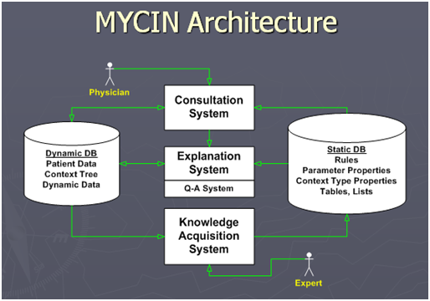

Slide 24
DART Expert System (Case Study)
Overview:
- Deployed during Gulf War for managing military logistics.
Key Features:
- Real-time decision making for logistics and supply management.
- Scalability for handling large data.

Slide 25
DART(DYNAMIC ANALYSIS AND REPLANNING TOOL)
Key Features of DART in Expert Systems
Dynamic Analysis:
DART continuously monitors the environment and the performance of the system.
It analyzes changes and unexpected events, adjusting strategies accordingly.
Replanning Capabilities:
When anomalies are detected or when predefined goals are not met, DART can initiate a replanning process.
This involves assessing alternative courses of action based on current conditions.
Decision Support:
DART aids human experts by providing insights and recommendations, making the decision-making process more efficient.
It utilizes heuristics and algorithms to predict outcomes of different actions.
Feedback Loop:
The tool often incorporates feedback mechanisms to learn from previous decisions, improving future performance.
This adaptability is crucial in environments where conditions frequently change.
Integration with Expert Systems:
DART can be integrated into larger expert systems, enhancing their capabilities by adding a dynamic planning layer.
It works alongside knowledge bases and inference engines to provide real-time solutions.
Applications:
DART is useful in various fields, including robotics, logistics, healthcare, and finance, where real-time data and adaptability are essential.

Slide 26
XOON Expert System (Case Study)
Overview:
- A modern hybrid system managing uncertain or incomplete data.
Key Features:
- Combines rule-based reasoning with fuzzy logic.
- Used in medical diagnosis, financial forecasting.

Slide 27
Advantages and Limitations of Expert Systems
Advantages:
- Consistent decision-making, reduced human error.
- Availability and scalability (24/7).
- Knowledge preservation.
Limitations:
- Limited to specific domains.
- Difficulty handling novel situations.
- Knowledge acquisition bottlenecks.

Slide 28
Future Trends in Expert Systems
- Evolution towards hybrid systems (integration of ML, fuzzy logic).
- Scalability with Big Data and integration with AI models.
- Expanded use in healthcare, finance, cybersecurity.

Slide 29
Conclusion
Expert systems remain a key aspect of AI for decision-making in specialized domains.
Their role is evolving with hybrid systems and advanced technologies.

